Slide 1

NSRIC Inc. (Nature Science Research and Innovation Centre)
Ontario (ON), Canada
Online Education (OE) Division
Consumer Behavior
Instructor: Kathy Chen
Marketing Program, OE Division
NSRIC Inc.
London, ON, Canada
E-mail: kathyjchen18@gmail.com
https://www.nsric.ca

Slide 2
Week 4: Information Processing
Content included in this week:
2.3 Conditioning
2.4 Mere exposure effects
2.5 Cognitive fluency

Slide 3
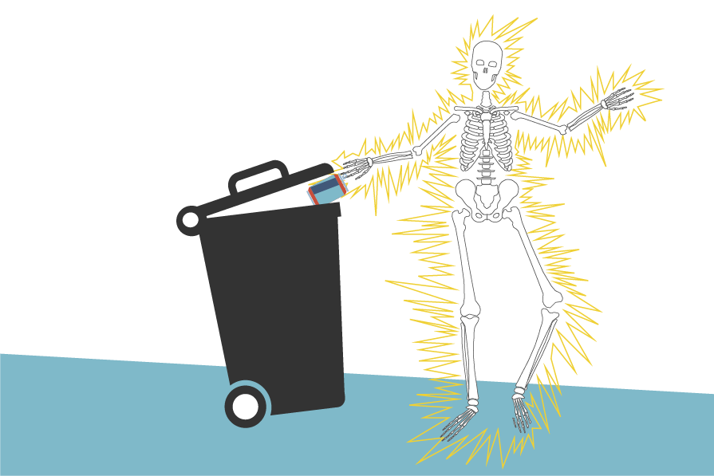
Week 4: Information Processing
2.3 Conditioning
1. How do we create new nodes, new links or change existing links?
How do we explain the creation of new nodes or links or changing existing associations?
We rely on Behavioral Learning Theory. This is not interested in how individuals process or store information, but rather, focuses on how individuals react.
For example, a man is trying to dispose of an
aluminum soda can. He throws the aluminum
can in the garbage bin instead of the recycling one, and receives an electric shock. He will definitely remember that,
so it is very likely that the next time that he drinks a soda or thinks about throwing an aluminum can in the garbage, he will
immediately remember that situation and recycle that can.

Slide 4
Week 4: Information Processing
2.3 Conditioning
1. How do we create new nodes, new links or change existing links?
Behavioral learning theory states that individuals learn from their experiences and either repeat them, if they receive positive outcomes, or avoid them, if they receive negative outcomes. These conditioned experiences either strengthen or weaken the associations or links between activated nodes that might not have naturally been connected.
So, before that man tried to throw away that aluminum can in the cafe’s garbage bin, he probably never thought that disposing of a can would lead to an electric shock. But by doing it once, or maybe even by doing it twice, the link between disposing of aluminum cans in the garbage bin and electric shocks becomes extremely strong. It is now easy and quick to process that association, which changes his behavior in the future as he wants to avoid electric shocks.

Slide 5
Week 4: Information Processing
2.3 Conditioning
Two types of conditioning: classical and operant
Classical conditioning
Classical conditioning describes the creation of associations or links between a conditioned stimulus and an unconditioned stimulus by the anticipation of an outcome. At school, you were conditioned to raise your hand if you wanted to ask a question or had some comment, otherwise you were either ignored or told to raise your hand.
Operant conditioning
Operant conditioning occurs when desirable behavior is either encouraged or discouraged by the consequences (i.e., rewards or punishments) that result from that behavior. For example, if you are late to work, your manager might let you know that your behavior is not appropriate. If you are late too often, you might receive a warning, and maybe even be threatened with dismissal. So, if you are a person who is often late for appointments, over time you learn that you need to be on time for work.

Slide 6
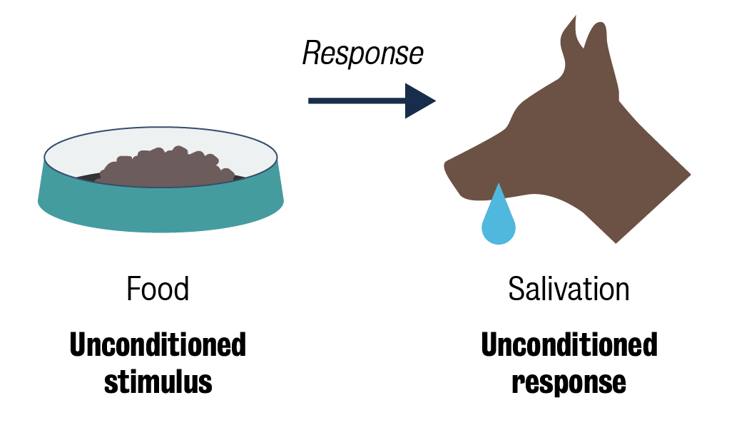
Week 4: Information Processing
2.3 Conditioning
2. Contributions from the field of psychology
Classical conditioning
The Russian physiologist Ivan Pavlov conducted some early experiments with dogs to understand how unconditioned stimuli can be conditioned.
Before conditioning
Pavlov used dog food as the unconditioned stimulus that resulted in the dogs salivating, which is
the unconditioned response.
There is a natural, biological
link between food and
salivation to aid digestion
in both dogs and humans.

Slide 7
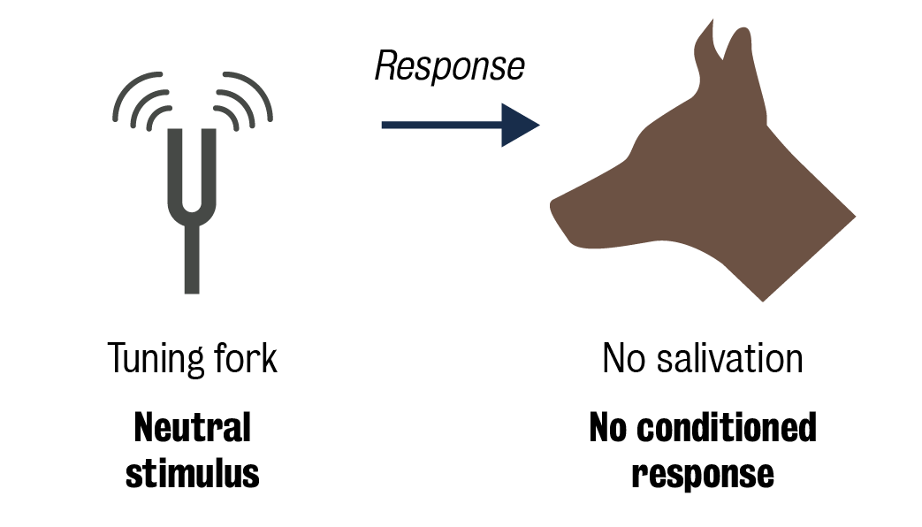
Week 4: Information Processing
2.3 Conditioning
2. Contributions from the field of psychology
Pavlov then made a loud sound, for example using a tuning fork, and the dogs did not respond to it because they had never experienced that sound before. In other words, that sound meant nothing to those dogs – there were no links from that sound node.

Slide 8
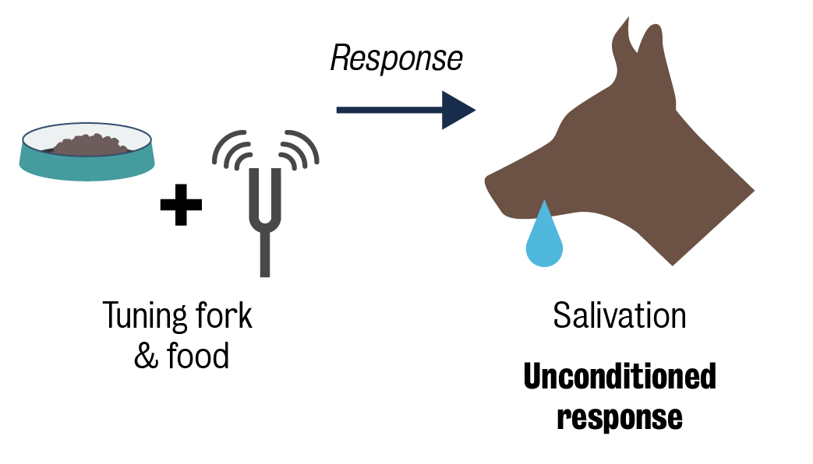
Week 4: Information Processing
2.3 Conditioning
2. Contributions from the field of psychology
During conditioning
Following that, Pavlov presented the dogs with their food and the loud sound. The natural, biological link between food and salivation occurred but also in the presence of the loud sound. This resulted in links being formed between food, salivation and the loud sound.

Slide 9
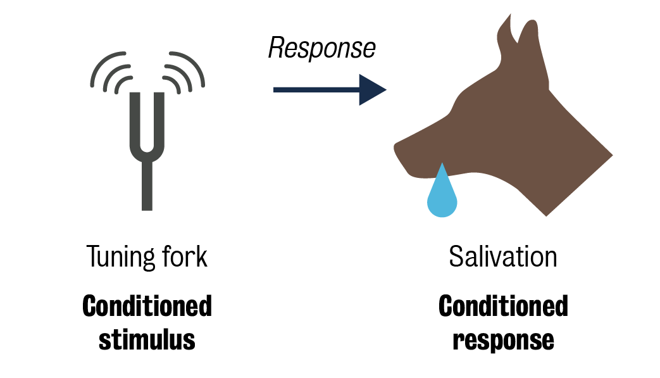
Week 4: Information Processing
2.3 Conditioning
2. Contributions from the field of psychology
After conditioning
Finally, Pavlov made the loud sound and the dogs salivated; thus the dogs have been conditioned to expect food by hearing the loud sound and therefore started salivating.
True learning comes from the information that really sticks with you, or creates and links nodes in your memory.

Slide 10
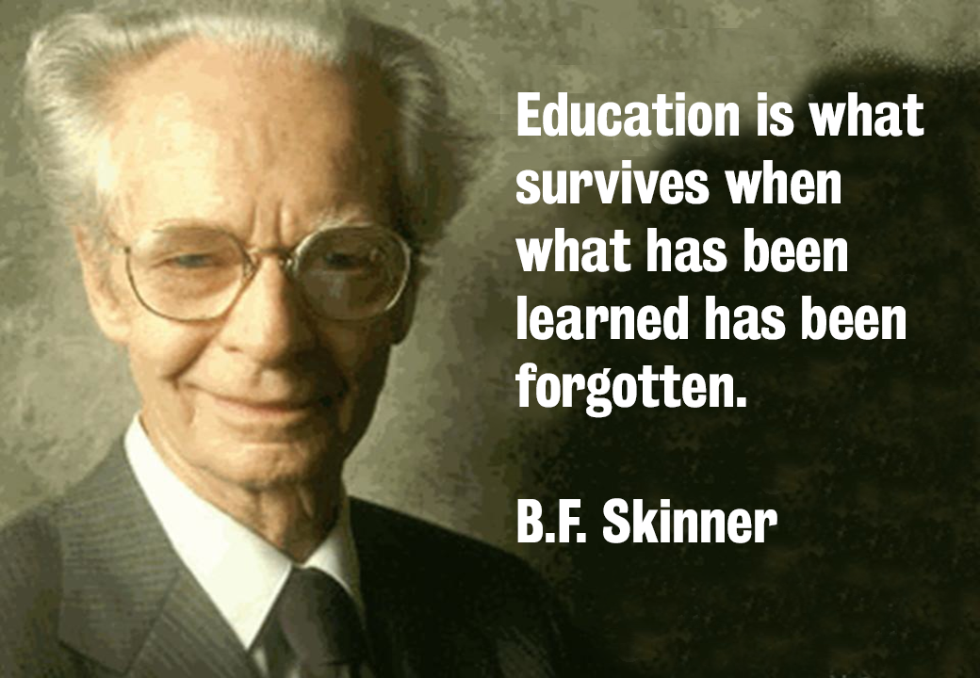
Week 4: Information Processing
2.3 Conditioning
2. Contributions from the field of psychology
Another notable psychologist, B. F. Skinner, said, ‘education is what survives when what has been learned has been forgotten’. Just think about that for a second. What does it mean? Education is not what you remember for a test or an assignment. It is what stays with us, that is, concepts that are embedded in our long-term memories or in our mental representation framework.
In other words, the peripheral information that you have learned during your life is interesting to know, but the
true learning comes from the information
that really stays with you, that creates
and links nodes in your memory. This is
the process that can help you in your
future life and represents the real value of
education.

Slide 11
Week 4: Information Processing
2.3 Conditioning
This question will be discussed in the seminar:
What is the key difference between classical and operant conditioning?
Operant is all about the consequences, so reward or punishment are just not forgotten, whereas with classical, the response is automatic by building associations between elements that shouldn’t naturally be associated.

Slide 12
Week 4: Information Processing
2.4 Mere exposure effects
1. Psychological primes and brands
On a daily basis, we are exposed, in our environment, to factors that may influence our emotions, thoughts and eventually our behaviours. This lesson presents a research study to explain the effects of exposure to certain brands. You will also complete a short activity to observe the effects by yourself.
Priming occurs through non-conscious processing of environmental information that includes activating nodes and their links to other nodes. In other words:
Primes are something in the environment that are processed using system 1 and can have emotional and cognitive effects that result from mere exposure.

Slide 13

Week 4: Information Processing
2.4 Mere exposure effects
For example, think about the image of a skull:
For some people, a skull can be very scary and associated with death or Halloween. However, for Mexicans, skulls are about history, ancestors, and they celebrate the dead at the beginning of November each year. For Mexicans, this is a time for reflection and for family and community to gather. If you are a motorcyclist or a biker,
such as Harley enthusiasts, skulls represent
equality. All human beings' skulls look similar
despite their skin color, gender or age.
Thus, the same symbol, the skull, can
activate several different non-conscious
processes with different emotional and
cognitive reactions depending who you are and
what kind of experiences you have had that led
to associations with that symbol.

Slide 14

Week 4: Information Processing
2.4 Mere exposure effects
There is evidence that primes do not only impact the way someone feels or thinks, but also how they act.
If you see a big bear walking down the street towards you, you will likely be scared and run away. This happens automatically through our system 1 and not through system 2, as system 1 is faster and functions to protect the self above all.
Fitzsimons et al. (2008) found brands can
have automatic effects on individuals'
behavior and concluded that ‘consumer
brands can also serve as sources of
non-conscious construct activation in the same
way as that other stimuli’.
Brands can have automatic affective, cognitive, behavioral effects on our lives and on how we interact with the world.

Slide 15

Week 4: Information Processing
2.4 Mere exposure effects
2. Are you creative?
This will be discussed in the seminar: in 15 seconds, write down as many creative uses for this object as possible:

Slide 16
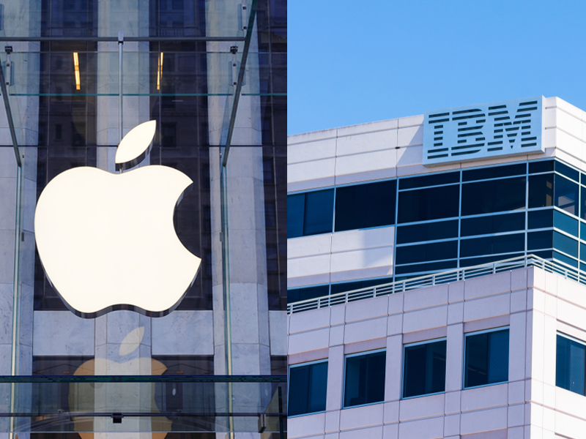
Week 4: Information Processing
2.4 Mere exposure effects
3. Research on psychological primes and brands
You just did the task that Fitzsimons and colleagues used in their research. Fitzsimons et al. (2008) illustrated automatic behavioral effects of brands with two experiments:
Experiment 1: Apple and IBM
In the first one, respondents were primed with either the Apple logo or the IBM logo, before they did the brick creativity test. In randomized trials, where the logos were presented so briefly
that respondents didn’t consciously see them,
those exposed to the Apple logo were
significantly more creative than those exposed
to the IBM logo.

Slide 17

Week 4: Information Processing
2.4 Mere exposure effects
Experiment 2: Walt Disney and the E! channel
A similar, second experiment was conducted with Walt Disney and the E! channel logo.
Disney is often associated with innocence, childhood, and fun trips to one of the theme parks. The E! Channel is an American TV network that broadcast low quality TV programs about celebrities and all the wonderful and horrible things that they might be doing.
Respondents were exposed to either the Walt Disney or the E! channel logo, and then took tests on truthfulness and
honesty. In randomized trials, the results indicate that respondents
exposed to the Walt Disney logo were
significantly more honest than those exposed to
the E! Channel logo.

Slide 18
Week 4: Information Processing
2.4 Mere exposure effects
In practice, through marketing communications and brand management, we, as marketers, have to understand not only the conscious effects that brands have on consumers but also, the non-conscious effects that include the affective, cognitive and behavioral ones. Marketers need to understand whether or not their brands have non-intended effects on consumer behavior as well as intended effects.
In cases where there are negative effects, marketers might want to rethink what their brand means, and why people are having certain automatic reactions to this. Only then can marketers hope to change this through reconditioning consumers with a new brand meaning and image.

Slide 19
Week 4: Information Processing
2.5 Cognitive fluency
1. What is cognitive fluency?
Cognitive fluency refers to the feeling of either ease or difficulty that people experience when completing a task. Because of this experience, cognitive fluency affects the decision-making process. In this lesson, you will learn in-depth about this concept, the difference between conceptual fluency and perceptual fluency and its relationship with the mere exposure effects.
What is fluency in general?
Most people say that fluency means you can speak a language very smoothly. However, that is actually a specific kind of fluency, called ‘linguistic fluency’. Fluency, in general, means the ease of doing something.

Slide 20
Week 4: Information Processing
2.5 Cognitive fluency
1. What is cognitive fluency?
Cognitive fluency is defined as the ease by which an individual can process a stimulus’ information or its attributes (eg, size, shape, colour, smell, meaning, feeling, etc).
The ‘truth effect’
In other words, fluency is connected to familiarity. A stimulus is familiar if a node already exists and its links are very strong; this means that it is easy to process the stimulus’ information. If that stimulus is a familiar brand, the consumer understands the meaning of that brand and its outcomes. Additionally, if a brand is familiar to consumers, as the Shapiro (1999) study discusses, they trust it more and it is more likely to be part of the consideration set.

Slide 21
Week 4: Information Processing
2.5 Cognitive fluency
The ease of information retrieval using both system 1 and system 2 from the mental representation of the brand encourages consumers to consider the brand as an option and also select it. Why? To preserve our cognitive resources. Shapiro (1999) calls this the ‘truth effect’.
The ‘truth effect’ states that if a brand and its meaning are easy to process, any information consumers see or hear will be perceived as true and this will shape future purchase behavior.
This is essentially the foundations of habitual and reinforcement purchases because the brand seems familiar to consumers due to past purchases, or an advertising campaign with many exposures across different media.

Slide 22
Week 4: Information Processing
2.5 Cognitive fluency
2. Conceptual fluency and perceptual fluency
Exploring cognitive fluency further, there are two other kinds of cognitive fluency that are important to marketers: perceptual fluency and conceptual fluency.
Let’s imagine a boat. You might have imagined a toy boat that a child plays with while taking a bath. Or, you might have imagined a sailboat, maybe a big yacht, an ocean-going freighter, or a tug boat.
Conceptual fluency
Conceptual fluency is when exposure leads to a memory trace for the semantic (meaning or connotation) information.
Perceptual fluency
Perceptual fluency is when exposure leads to a memory trace for the perceptual features (e.g., shape, brightness, etc.) of the stimulus.

Slide 23
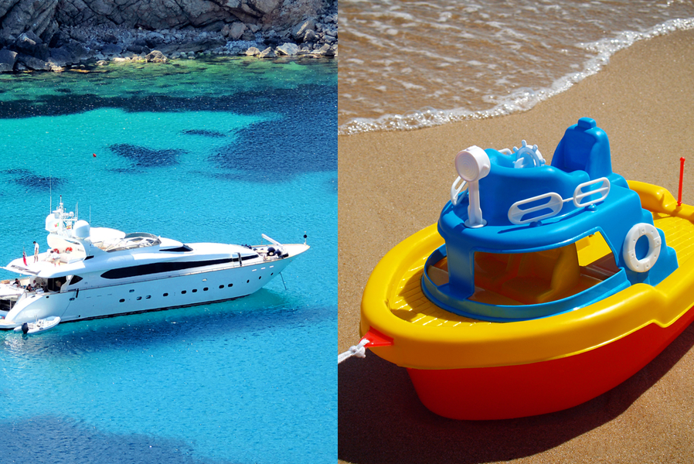
Week 4: Information Processing
2.5 Cognitive fluency
2. Conceptual fluency and perceptual fluency
Regardless of your perceptual associations, the conceptual fluency of the word ‘boat’ is probably strong, as you have had many experiences of boats in the past. You know the basic concept of ‘boat’ means something that floats on water and that it is used to transport something (eg, people, animals, products, etc) on water.
Perceptual fluency is when recognition is easy performed just from sensory information (ie, smell, sound, touch, sight, taste). The different types of boats have very different
further meanings driven by individuals’
perception (ie, sensory information) that can
distinguish between a toy boat and a yacht.

Slide 24

Week 4: Information Processing
2.5 Cognitive fluency
3. Cognitive fluency and mere exposure
Mere exposure to a brand, or an advert for a brand, results in a feature analysis that adds to our perceptual fluency by strengthening the links between the brand node and the feature node. The semantic analysis adds to the conceptual fluency, as it establishes or creates a thicker link between the brand node and nodes that give meaning by association.
If a product has strong perceptual
and conceptual fluency, it becomes
familiar. Because of the truth effect,
familiarity leads to its inclusion in the
consideration set. Then, since the
brand is so fluent and familiar,
consumers likely evaluate it quite
highly, and this results in a purchase.
This is all with just mere exposure to
the brand.

Slide 25

Week 4: Information Processing
2.5 Cognitive fluency
3. Cognitive fluency and mere exposure
We have learned that the mere exposure of brands has emotional, cognitive and behavioral outcomes for consumer behavior.
By advertising and making brands
more familiar to consumers,
marketers can shape not only how
consumers think and feel towards a
brand, but also induce them to
purchase. That is the power of
marketing.

Slide 26
Week 4: Information Processing
2.5 Cognitive fluency
3. Cognitive fluency and mere exposure
Application to branding
Marketing is shaping how customers think about brands: educating consumers, not only to recognise and recall brands, but also to understand the benefits and meaning that those brands deliver to them. Information processing is more complex than the rational mind. Consumers make decisions using a combination of conscious (system 2) and non-conscious (system 1) processes that dictate how they think, feel and behave.
Markers can influence how brands are associated with perceptual and conceptual attributes through either conditioning or mere exposure to marketing communications. The thickness of links between brands and their associations can develop into highly cognitive fluent processing that can lead directly to (at least) consideration, and possibly even to purchase decisions.

