Slide 1

NSRIC Inc. (Nature Science Research and Innovation Centre)
Ontario (ON), Canada
Online Education (OE) Division
Consumer Behavior
Instructor: Kathy Chen
Marketing Program, OE Division
NSRIC Inc.
London, ON, Canada
E-mail: kathyjchen18@gmail.com
https://www.nsric.ca

Slide 2
Week 3: Information Processing
Content covered in this week:
2.1 Dual process theory
2.2 Mental model representation

Slide 3

Week 3: Information Processing
2.1 Dual process theory
1. Introduction: powerful logos
There are many theories about how the mind works. This lesson will focus on a very prominent one by Daniel Kahneman that explains how our brain works consciously and non-consciously.
Read through the following examples. What is so important about the logos presented?
Example 1: FedEx
Consider the FedEx logo. What is so important about this logo? Why did it win critical acclaim when it was created?

Slide 4



Week 3: Information Processing
2.1 Dual process theory
1. Introduction: powerful logos
Example 1: FedEx
The secret to this logo is the arrow between the E and the X. Think about what an arrow means to you? What does it signify to you?
Arrows indicate movement, direction, forward motion, speed, the future, and other similar concepts. All these ideas are very important drivers of customer value for a courier company like FedEx.
this even translates into other languages. Here the arrow is facing the other way around, because in this culture people read from right to left.

Slide 5


Week 3: Information Processing
2.1 Dual process theory
1. Introduction: powerful logos
Example 2: Heineken and Amazon
Now look at this Heineken logo very carefully. What is essential to this logo and the brand value that it is communicating before you drink the contents? What is the symbolic message here?
The Heineken logo is tied, in a certain sense, to the Amazon logo. Can you see how?

Slide 6
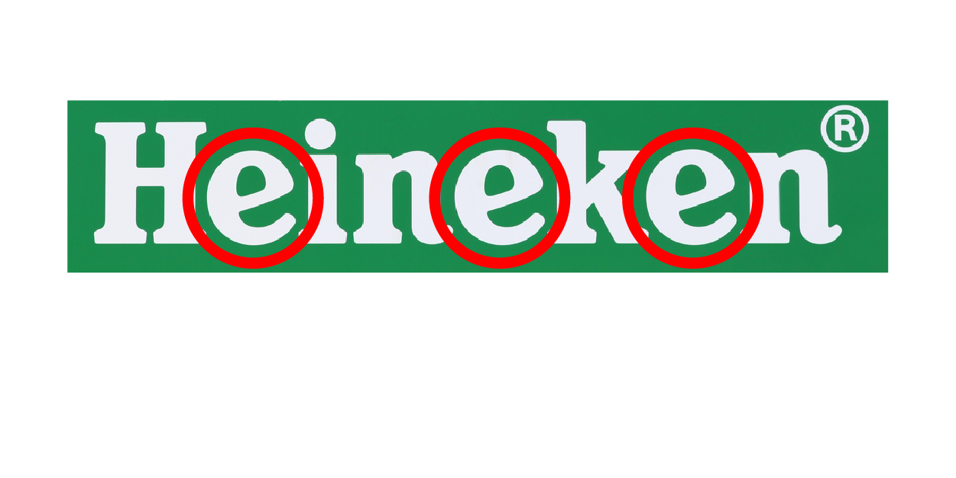

Week 3: Information Processing
2.1 Dual process theory
1. Introduction: powerful logos
Example 2: Heineken and Amazon
You may not have noticed this before, but it is the smiles. Heineken is associated with good times, and the e’s can be seen as smiling, or even giggling; having a good time and just enjoying life.
Amazon smile runs from A to Z indicating they sell just about everything under the sun. Furthermore, this smile is also an arrow. As with FedEx this might indicate satisfaction with the delivery service and its speed.

Slide 7
Week 3: Information Processing
2.1 Dual process theory
Why those logos are powerful?
Because of the two systems in which our brains work!
2. How does the brain work?
There are many theories about how the mind works, but we will focus on a very prominent one by Daniel Kahneman. He is a Nobel Prize winner and you should have read about his theory of dual processing this week.
This simple theory explains how our brains work consciously and non-consciously. We say non-consciously because if we were to say unconsciously, it would mean that we would be asleep. Let's start first with system 2.

Slide 8
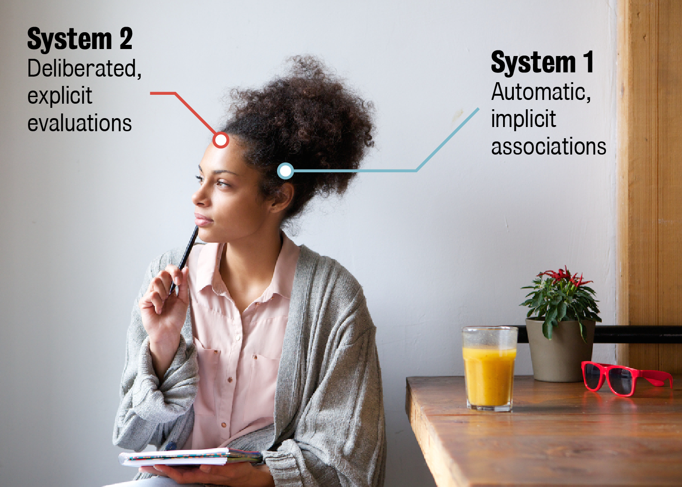
Week 3: Information Processing
2.1 Dual process theory
2. How does the brain work?
System 2
System 2 is how most people think their mind works. It is responsible for our rational thinking, including problem-solving or complex decisions, such as figuring out math equations or the change that is due when you give a £20 note to a cashier at a store.
Because it can process these complex problems and make decisions, system 2 is a lot slower and requires a lot more effort to function.

Slide 9
Week 3: Information Processing
2.1 Dual process theory
System 1
Our minds have a short-cut to save cognitive resources and speed up decision-making, and that short-cut is system 1.
System 1 is always on. It is very fast and processes non-consciously. The non-conscious processing is important, as system 1 protects you even when you are asleep or unconscious by constant monitoring of the environment around you. Even when you are conscious or awake, system 1 influences many aspects of perceptions, decisions and thought processes.

Slide 10
Week 3: Information Processing
2.1 Dual process theory
System 1
System 1 is also the basis for intuition and humans developed this way during our evolution to, basically, keep us alive. It is constantly on the lookout for elements like loud sounds, strange shady people, animals or other potential dangers to us. It wakes us up if the room is too cold or too hot, or if a burglar in the house makes a sound.

Slide 11
Week 3: Information Processing
2.1 Dual process theory
2. How does the brain work?
System 1 and system 2 are labelled as such based on their characteristics. System 1 is always first, since it is so fast and instinctual. System 2 needs to consider much more about the environment, other information and the facts around it, to make rational decisions. System 1 reactions are often called ‘automatic’ and system 2 decisions are often called ‘considered’.

Slide 12
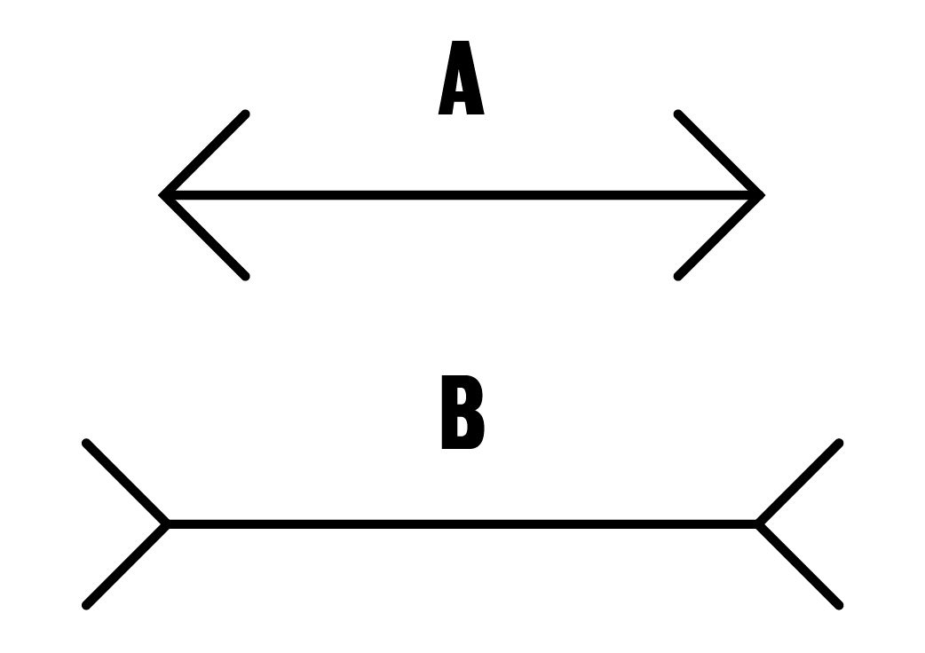
Week 3: Information Processing
2.1 Dual process theory
3. How does the brain work: which line looks longer?
This is a simple example that you have surely seen before. If not, you need to read chapter 1 of Daniel Kahneman's book.
Of course, B looks longer. No matter how much evidence you have (ie, like measuring them), even though you know that A and B are the same length, B still looks longer. So, the only difference is that A has lines on the side that make it seem smaller, and B has lines on the outside that make it seem a little bit bigger.

Slide 13
Week 3: Information Processing
2.1 Dual process theory
3. How does the brain work: which line looks longer?
So, system 1 seems to think that B is longer than A. System 2 knows that they are the same, based on the evidence, but your system 1 keeps telling you that B is longer. So system 1 can make some mistakes. This means that your intuition can be wrong, especially with regard to our perceptions.
Our perception of the environment and the stimuli in it are largely guided by automatic reactions processed in system 1.

Slide 14
Week 3: Information Processing
2.2 Mental model representation
1. Introduction: The importance of perception
Understanding the way we process information and think about the information presented to us is essential to understand consumer behavior models. This lesson presents the mental model theory that explains how we store and organize information, and how our perception plays a fundamental role in this process.
You may try a little experiment at home: Use two bottles in different shapes (one is taller and the other is wider) but have same volume. When you pour liquid to the bottles, do you think the taller is bigger and holds more liquid?
Our mind relies on system 1 to judge volume perceptions, and even when we have evidence that these two glasses are the exact same in terms of volume, our mind still makes volume perception errors.
This happens in our daily life, such as the beverage packaging, beer cups used at the pubs.

Slide 15
Week 3: Information Processing
2.2 Mental model representation
2. The concepts of nodes and meaning
The mental representation model describes how we store what we learn and our life experiences, as well as how we access those through the process of thinking.
The mental representation model is essentially a big map of everything you know and can remember. It is multi-dimensional and, therefore, not something you can actually draw in 3D space: consider it as a very complex diagram that has millions of dimensions. It is a massive associative network of interlinked nodes that make up our memory.
Memory is an associative network of interlinked nodes in which each node is a concept (eg, elephant, pink, heavy, etc).

Slide 16

Week 3: Information Processing
2.2 Mental model representation
2. The concepts of nodes and meaning
Nodes and semantic meaning
What is a node? A node is a specific concept, noun, idea, action, etc that is important in our lives or environment. Nodes are something that we have learned to attribute some sort of meaning. Even by reading this text, you are activating a huge amount of different nodes that are giving meaning to the characters in front of you.
For example, if somebody writes the word ‘pink’, your mind is quickly processing what those visual characters mean. In other words, you are thinking of what pink means: how vibrant it is and what that
color means to you, or your friends or even to society.

Slide 17
Week 3: Information Processing
2.2 Mental model representation
2. The concepts of nodes and meaning
Meaning is shaped by personal experiences
In addition, somebody else’s conception of ‘pink’ would be slightly different than yours, or your friends’ ones, or some random person in a far off country that maybe does not understand English. But with more information, we can all be thinking of something similar.
The first thing that may come to mind might be ‘Barbie pink’, and now (having said that) everyone has the same idea. In fact, now you are considering all that the word Barbie means, what it is, who likes it, what society thinks of it, and other associated ideas.

Slide 18

Week 3: Information Processing
2.2 Mental model representation
2. The concepts of nodes and meaning
Meaning is shaped by personal experiences
Or instead, you might have been thinking about a salmon-color ‘pink’. So, now, your mind is thinking of that color that is a light pink, and that might be because you bought a salmon-colored T-shirt or today you saw someone wearing one in that color.
Our conception of even basic things, such as
color, is shaped by our experiences.

Slide 19

Week 3: Information Processing
2.2 Mental model representation
2. The concepts of nodes and meaning
What is semantic meaning?
The semantic meaning of a node is given by the links to the other nodes around it. Node links can either be weakened or strengthened by experience and other information.
For example, consider the word ‘elephant’. Some
people might think that an elephant is a living,
breathing animal that lives in Africa or India whilst
others may think first of a child’s stuffed
elephant toy. Without further information,
individuals jump to conclusions shaped by their strong links to nodes surrounding the original node ‘elephant’. If the only
source of information is the word ‘elephant’, you
might be led to different kinds of conclusions.

Slide 20
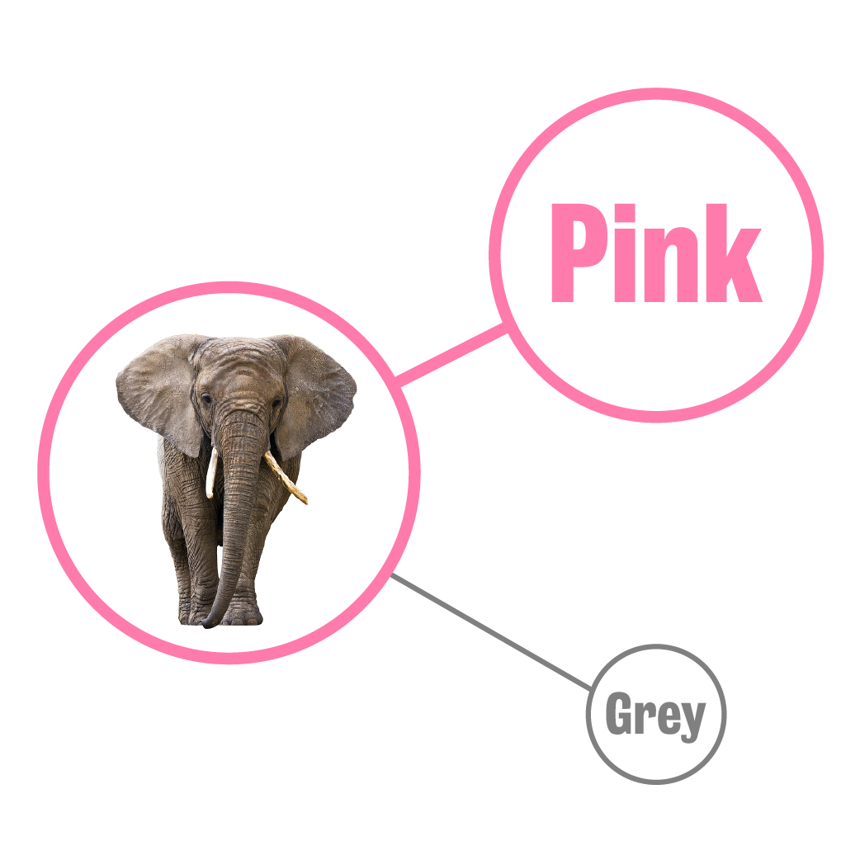
Week 3: Information Processing
2.2 Mental model representation
2. The concepts of nodes and meaning
Perception and thinking strengthen and/or weaken links between nodes
Perception of the environment activates nodes in your memory that correspond to the object that you perceive. Thinking occurs when nodes in your memory are activated, and those nodes are
linked to other nodes.
As the examples of ‘pink’ and ‘elephant’ show:

Slide 21
Week 3: Information Processing
2.2 Mental model representation
2. The concepts of nodes and meaning
Perception and thinking strengthen and/or weaken links between nodes
Pink and elephant are seemingly unrelated to most people, but a link could be created over time by frequent activation of these two nodes together. For example, let’s say there is a new
disease that does not kill the elephants but
changes their color from grey to Barbie pink. Whereas before the disease, the elephant node was associated
with grey, through constant activation of elephant
and pink, the link between grey and elephant starts
to weaken and the link between elephant and pink
begins to strengthen.

Slide 22
Week 3: Information Processing
2.2 Mental model representation
Stronger concepts relating to more frequently activated nodes are more easily retrieved.
We will talk about this later in terms of fluency but, now, let's think about it in terms of very simple concepts. For example, if you think about bedtime, you might think about your usual routine that could include brushing your teeth, changing into pyjamas, reading a book, or charging your phone. If you think about coffee, you might think about mornings, energy boost or stress relief. There are strong links between the stimulus node (eg, bedtime or coffee) and the associated nodes (eg, brushing teeth or energy boost).

Slide 23

Week 3: Information Processing
2.2 Mental model representation
Stronger concepts relating to more frequently activated nodes are more easily retrieved.
Nodes and links are also valenced: there is either a positive, negative or neutral feeling behind them. For example, when thinking of ‘mushrooms’, somebody might immediately think of the mushroom soup that they despise, associating mushrooms and mushroom soup a negative valence. These valenced
associations provide the basis for
attitudes, or how we think, feel and
intend to act towards something.

Slide 24
Week 3: Information Processing
2.2 Mental model representation
Memory can be described as short-term and long-term. Long-term memory contains all the nodes and links in your mind – so it is the massive, multi-dimensional associative structure that contains everything you know and all your experiences – whereas the short-term memory is the currently or recently activated part.
Our mind is an extraordinary organ that allows us to think about numerous things at the same time. So, while you might not notice it, our minds are actually constantly using our system 1 and system 2 to perceive our environment, enabling us to evaluate and respond to different stimuli in our local environment. In other words, individuals can process information about their environment and also consider complex problems in parallel. Simultaneous activations of nodes and links occur and most of these activations are processed by system 1 while system 2 focuses on one complex task.

