Slide 1

NSRIC Inc. (Nature Science Research and Innovation Centre)
Ontario (ON), Canada
Online Education (OE) Division
Consumer Behavior
Instructor: Kathy Chen
Marketing Program, OE Division
NSRIC Inc.
London, ON, Canada
E-mail: kathyjchen18@gmail.com
https://www.nsric.ca

Slide 2
Week 8: Nudging, Satisfaction, WoM
Content covered in this week:
4.5 Service quality: the SERVQUAL model
4.6 Scenario activity: customer service manager
4.7 Dose satisfaction leads to profit?
4.8 Word-of-Mouth

Slide 3
Week 8: Nudging, Satisfaction, WoM
4.5 Service quality: the SERVQUAL model
Satisfaction research is about quantifying the attitude towards a product or service, whereas service quality research is about finding out why a product is high or low quality so that the customer’s satisfaction can be improved.
Before introducing the next topic, let's see what 'service quality' and 'service failure' are.
Service quality and service failure
Service quality is a customer’s assessment of the level of service delivered in its context.
A service failure happens when a firm's performance is below (or well below) the customer's expectations.

Slide 4
Week 8: Nudging, Satisfaction, WoM
4.5 Service quality: the SERVQUAL model
Work on service quality measures what should happen, while satisfaction studies measure what did or will happen. Why?
Service quality research focuses on exploring why a product is high or low quality, or perceived as high or low quality, so that satisfaction and service quality perceptions can be improved. Satisfaction research tries to quantify attitudes towards a product or service, and understand how expectations about what the product is expected to deliver are formed.

Slide 5
Week 8: Nudging, Satisfaction, WoM
4.5 Service quality: the SERVQUAL model
SERVQUAL
The most famous and influential model for service quality is called SERVQUAL (Parasuraman, Zeithaml & Berry, 1988) and it has five dimensions: responsiveness, assurance, tangibles, empathy and reliability (note that the first letter of each word of the five dimensions creates the word ‘RATER’).
Let’s explore what the five dimensions involve.
Responsiveness
Responsiveness involves timely and prompt service. Thus, for example, if a representative delays the promised response, or does not follow up or call, or even forgets to place an order, customer satisfaction suffers.

Slide 6
Week 8: Nudging, Satisfaction, WoM
4.5 Service quality: the SERVQUAL model
Assurance
Assurance involves the employees' knowledge about the service they are providing, and how courteous they are in delivering that service.
Tangibles
Tangibles are the physical evidence of the service. For example, a well prepared and generally clean facility, like a restaurant or a bank, increases customer satisfaction, and thus, perceptions of service quality.
Empathy
Empathy is about how both the employee and the firm provide individualized caring service. This shows that the firm is flexible and understands the needs of the customers. For instance, vegetarian options when flying and flexible building dates for small businesses are important dimensions of this service quality.

Slide 7
Week 8: Nudging, Satisfaction, WoM
4.5 Service quality: the SERVQUAL model
Reliability
Reliability is about how dependable and accurate the service is (ie, the service is correct the first time, every time). If the consistency of the service is inadequate or variable, the organization is presenting a problem with service quality, and this will affect the customer’s satisfaction.

Slide 8
Week 8: Nudging, Satisfaction, WoM
4.6 Scenario activity: customer service manager
Customer’s experience: fabulous!
The guest is thrilled with the upgraded room and how you handled the potential service failure, in addition to the personalized tips on the local area. The hotel guest left.
Within a week, the general manager of the hotel calls you into her office to show you a review that was left on TripAdvisor. The five-star review was glowing and stated that you were the reason for the guest’s enjoyment and really made their trip special. The guest even wrote a letter explaining how with your help it transformed their experience with the hotel. You get invited to a training program called ‘Big Jump’ for a fast track to executive management.

Slide 9
Week 8: Nudging, Satisfaction, WoM
4.7 Does satisfaction lead to profit?
The relationship between customer satisfaction and profit
If you ask a customer if they would like to have a better service, the answer most likely will be positive. Customers want better service, and service quality is improving across the board. It is how companies like FedEx, Nordstrom, and WestJet differentiate themselves from their competition.
However, before a company makes an investment in service quality, they need to consider three key questions that relate service quality with profit.
Can the company make it pay?
Can the company, through the improvement of the service quality, achieve more significant market share, or additional profits, making this a worthwhile endeavor?

Slide 10
Week 8: Nudging, Satisfaction, WoM
4.7 Does satisfaction lead to profit?
Who is receiving better service?
This brings us to the second question: is every customer receiving better service? Will there be equality in the service provision? Or will the company stratify its offerings? An example is what cable internet and mobile phone providers do: do the customers that are heavier users want quick services or, maybe, more selections, while paying more?
Can the company sustain the improved service?
Can the company sustain the improvements in the long term or will the service reverse back after a certain time? As we have seen, an improved service can increase expectations, but if there is a sudden decreasing to a lower standard, dissatisfaction can result. The consequences of this might be the spread of negative word-of-mouth and the dissatisfied customer switching to other providers.

Slide 11
Week 8: Nudging, Satisfaction, WoM
4.7 Does satisfaction lead to profit?
What is the relationship between satisfaction and profits?
You might think that the relationship is positive: a highly satisfied customer, most likely, will buy more and refer other people to the business. It is actually more complicated.
Let’s try to explore this by looking at the diagram. Thanks to increased customer satisfaction, a company can acquire more customers. This can happen through customers' retention or acquisition (referrals and/or advertising). More customers lead to an increase in profit.

Slide 12
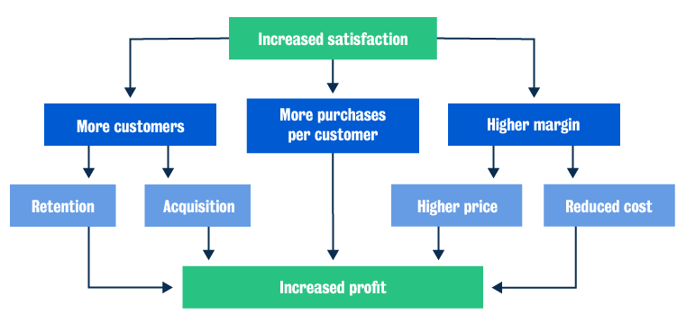
Week 8: Nudging, Satisfaction, WoM
4.7 Does satisfaction lead to profit?

Slide 13
Week 8: Nudging, Satisfaction, WoM
4.7 Does satisfaction lead to profit?
Another case can be the one where the amount of purchase per single customers increases. This equally leads to an increased gain.
Third, the company has higher margins due to a reduction of the costs, or by charging a price premium. This leads again to an increase in profit.
However, with more customers, and even higher paying customers, the client population can grow much further than the original target and the product or service can start to mismatch the needs of some of those new customers.
This means the satisfaction and market share actually have a slightly negative correlation: when satisfaction increases, it attracts more customers that aren't looking for the same features and the company’s product or service might not be able to satisfy them to that same extent.

Slide 14
Week 8: Nudging, Satisfaction, WoM
4.8 Word-of-mouth (WOM)
Why is customer satisfaction so important now?
"Customers now interact with firms through myriad touch points in multiple channels and media and the customer, and customer experiences are more social in nature."
Lemon & Verhoef, 2016
The customer's satisfaction is now significantly linked to digital technologies: customers are able to communicate and have a two way or multilateral conversation about the products and services that a company offers.

Slide 15
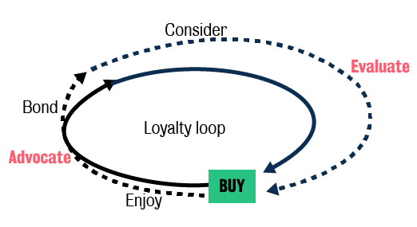
Week 8: Nudging, Satisfaction, WoM
4.8 Word-of-mouth (WOM)
The Loyalty Loop model
Let’s have a look at the Loyalty Loop model (Edelman, 2010): it explains the different stages customers experience and shows similarities with the cognitive and the habitual models introduced in the first week.
In ‘consider’, the customer is considering
the basket of brands that they know,
trust, have relationships with, or
even are curious about.
In ‘evaluate’, the customer is
seeking input from the brand’s
advertising, competitors, and retailers,
but also peers and online reviews.

Slide 16
Week 8: Nudging, Satisfaction, WoM
4.8 Word-of-mouth (WOM)
In ‘buy’, the customer increasingly postpones the purchase until they are in the store (chance for in-store promotion or discounts), but we are also talking about the retail channel – whether physical, digital, or both, in some cases.
Finally, the last three stages, ‘enjoy’, ‘advocate’ and ‘bond’ show the real benefit of digital technologies: consumers
are never really alone in their consumptions.
For example, someone might enjoy a
meal, take pictures of that meal
and post it on Instagram. They might
even rate them on a site, or join
the restaurant’s loyalty program.
This creates a loyalty loop where
a customer doesn’t continue considering or evaluating the purchase, but just keeps buying and, then, enjoying, advocating and bonding.

Slide 17
Week 8: Nudging, Satisfaction, WoM
4.8 Word-of-mouth (WOM)
In what stages can a company influence a customer purchase?
Most marketing budgets are spent in two areas: ‘consider’ and ‘buy’.
From the company perspective, ‘consider’ focuses mainly on advertising and, specifically, in creating awareness of the product or services benefits (or innovations) to the consumers. The company is trying to communicate the value propositions of the product or service they are trying to sell.
In ‘buy’, it is about ‘closing the deal’: through discounts, in-store promotions, both digital and online signage, the company encourages the customer to make the purchase.

Slide 18
Week 8: Nudging, Satisfaction, WoM
4.8 Word-of-mouth (WOM)
In what stages can a company influence a customer purchase?
It is important to highlight that ‘evaluate’ and ‘advocate’ are actually considered potential extra avenues for investment because they are strongly linked with digital technologies. In ‘advocate’, consumers are producing content that describes their experiences and that content is used in the ‘evaluate’ stage by other consumers to inform their own purchase decisions.
Therefore, companies can create value and ensure customer satisfaction by understanding the value the ‘advocate’ stage can deliver for a product or service and by encouraging and being part of the online conversation. They can also ensure they are tailoring that consumer information about their brand in a way that will be favorable when consumers are evaluating their products and their services.

Slide 19
Week 8: Nudging, Satisfaction, WoM
4.8 Word-of-mouth (WOM)
Read the questions below. First, think of your answer, then we will discuss them in the seminar.
What are the points of the journey where consumers are best influenced?
Why? How can brands influence consumers during the ‘evaluate’ and ‘enjoy-advocate-bond’ stages?

