Slide 1

NSRIC Inc. (Nature Science Research and Innovation Centre)
Ontario (ON), Canada
Online Education (OE) Division
Consumer Behavior
Instructor: Kathy Chen
Marketing Program, OE Division
NSRIC Inc.
London, ON, Canada
E-mail: kathyjchen18@gmail.com
https://www.nsric.ca

Slide 2
Week 6: Attitudes and Behaviors (Cont.)
Content covered in this week:
3.4 The links between attitudes and behaviors
3.5 Persuasion and attitude change

Slide 3
Week 6: Attitudes and Behaviors (Cont.)
3.4 The link between attitudes and behaviors
Now that you have learned about attitudes, we will look at why they matter. In particular, we will be examining a question that has driven a lot of research in psychology, that is: what is the relationship between attitudes and behaviors?
The traditional view of attitudes involves only beliefs and feelings. However, this definition of attitude poorly predicted actual behavior. In fact, an influential review by Wicker, in 1969, found that studies that measured attitude were poorly related to actual behavior. He concluded, 'It is considerably more likely that attitudes will be unrelated or only slightly related to overt behaviors than that attitudes will be closely related to actions'.

Slide 4
Week 6: Attitudes and Behaviors (Cont.)
3.4 The link between attitudes and behaviors
Thus, he called for the abandonment of the psychological concept of attitude. For example, you plan to study all Saturday night to get caught up for the upcoming test but, perhaps, you are overcome by the amount of work and fall asleep early on Saturday without studying very much. Or, perhaps, you give in to social pressure and go partying with your friends. While your thoughts and feeling support studying all night on Saturday, you actually acted differently. This example indicates that there are more factors at play in planning our future behaviors beyond feelings and beliefs.
This is why Ajzen, in 1975, proposed the Theory of Reasoned Action which changed the definition of attitudes; that is attitude should involve behavioral intentions in addition to beliefs and feelings. In his re-analysis of past findings, this new definition resulted in a better predictive ability of actual behavior.

Slide 5
Week 6: Attitudes and Behaviors (Cont.)
3.4 The link between attitudes and behaviors
However, there are still other factors that are not represented in the Theory of Reasoned Action. Considered the influence of social pressures and cognitive overload in our previous example where actual behavior was impacted. Here is another example of how attitude is changed, and yet actual behavior did not change very much: the Surgeon General's 1964 report in the United States that confirmed the link between smoking behavior and lung cancer. However, this report only helped decrease smoking behavior slightly. Many people continue smoking despite compelling evidence linking smoking behavior to increased rates of cancer, heart disease and emphysema, as well as negative effects on children and the general anti-social effect.

Slide 6
Week 6: Attitudes and Behaviors (Cont.)
3.4 The link between attitudes and behaviors
Can you come up with factors that are preventing people from quitting smoking? Perhaps, you thought there are physiological factors at play where smoker's bodies need a dose of nicotine because they are addicted. Or, perhaps, you thought of the social factors involved in the 1960s – and somewhere still prevalent today – where people are expected to smoke, such as on breaks from work, in bars and in nightclubs.
These additional factors let Ajzen, in 1985, to extend the Theory of Reasoned Action into the Theory of Planned Behavior, by proposing two new variables: subjective norms and perceived controls. The addition of these two new variables resulted in more accurate predictions of actual behavior from the measurement of attitudes, by including subjective norms and perceived control.

Slide 7
Week 6: Attitudes and Behaviors (Cont.)
3.4 The link between attitudes and behaviors
Subjective norms are behaviors that 'important others' think that an individual should do. So, these 'important others' could be parents, friends or other influential people that the individual sees as role models, inspirational figures or people that can impact their lives in both positive and negative ways. Perceived controls involve the perceived ease to which an individual can take an action. This could depend on personal capabilities, resources, environmental conditions or other factors that affect an individual's notion of control over their actions. In the case of smoking behavior, individuals’ bodies might actually be controlling their behavior due to physiological addiction.
What other variable might be important to include to improve the accuracy of actual behavior predictions?

Slide 8
Week 6: Attitudes and Behaviors (Cont.)
3.4 The link between attitudes and behaviors
The Theory of Planned Behavior has been extended to include past behavior – as we know, purchase behavior is strongly influenced by habits. Thus, the inclusion of past behaviors, social norms and perceived controls significantly increases the predictive value to marketers of attitude measurements. Marketers can and do use the Theory of Planned Behavior to reliably predict purchase behavior of their company's products and services.
As we have seen, attitudes can predict actual behavior but as marketers, perhaps, the attitude towards a product or a service is not as favorable as we'd like. The next section talks about attitude change through persuasive techniques.

Slide 9

Week 6: Attitudes and Behaviors (Cont.)
3.5 Persuasion and attitude change
1. Introduction to the principles of persuasion
Individuals’ attitudes can be changed through persuasive communication techniques.
Persuasion
Persuasion is the process of attempting to influence the beliefs, feelings, intended behaviors, motivations or actual behaviors of other people.
This picture of a woman threatening a child in
order for them to eat their vegetables is not a
form of persuasion. It is a form of coercion that
will not be explored in this section. Instead, we
will be talking about Cialdini’s principles of
persuasion.

Slide 10
Week 6: Attitudes and Behaviors (Cont.)
3.5 Persuasion and attitude change
Cialdini’s principles of persuasion
By applying these principles, Cialdini utilizes persuasive communication techniques to direct attitudes in favorable ways. These principles include liking, reciprocity, social proof, commitment and consistency, authority, and scarcity.

Slide 11

Week 6: Attitudes and Behaviors (Cont.)
3.5 Persuasion and attitude change
2. Principles of liking and reciprocity
Principle of liking
The principle is based on the liking between the individual being persuaded and the influencer. It could include similar social status or similar physical/psychological characteristics between the individual and the influencer, or it could be that
the influencer’s characteristics
are desirable for that individual.
This video here illustrates the
principle of liking.

Slide 12
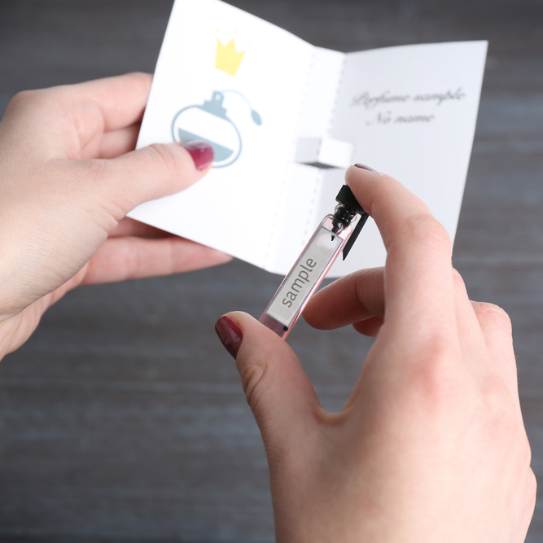
Week 6: Attitudes and Behaviors (Cont.)
3.5 Persuasion and attitude change
2. Principles of liking and reciprocity
Principle of reciprocity
Reciprocity involves returning a favor after receiving one. For example, a free sample or advice in a store could
influence an individual to purchase
additional products and services, or
donation rates increase when the charity
first gives a small gift in a direct mail
campaign.

Slide 13

Week 6: Attitudes and Behaviors (Cont.)
3.5 Persuasion and attitude change
3. Principles of social proof and commitment and consistency
Principle of social proof
Social proof, sometimes called peer pressure, comes from other individuals’ acceptances, reassurances or other opinions that signal social risk inherent in purchases. For example, consider two consumers entering a shoe shop. One consumer tries on a
pair of shoes. The shop staff that is helping that
consumer should immediately ask the other
consumer how they can help or, if that consumer
is alone, then another member of staff should
rapidly assist that customer as well to create
social proof, that is a reduction in the social risk
of purchase.

Slide 14
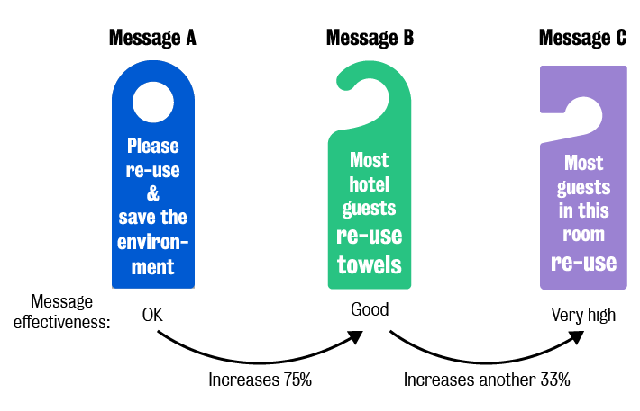
Week 6: Attitudes and Behaviors (Cont.)
3.5 Persuasion and attitude change
3. Principles of social proof and commitment and consistency
Another example is about the signs used in hotels to increase the change in guests attitudes towards reusing towels. Message A is effective to influence the guests’
attitudes to reuse the
towel but, in comparison,
message B increases it
of 75 per cent. However,
the effectiveness of message
C generates an additional
increase of 33 per cent.
Why do you think this is?

Slide 15

Week 6: Attitudes and Behaviors (Cont.)
3.5 Persuasion and attitude change
4. Principles of authority and scarcity
Principle of authority
Authority can be persuasive by showing expertise in a domain. For example, individuals
respect dentists’
expertise regarding
their dental hygiene
and health. Thus,
dentists play an
authoritative role in
persuading consumers
to improve their dental
health. This
video illustrates this
example.

Slide 16

Week 6: Attitudes and Behaviors (Cont.)
3.5 Persuasion and attitude change
4. Principles of authority and scarcity
Principle of scarcity
Scarcity can be very influential in
changing attitudes by limiting the
number of products and services.
For example, Apple has been extremely
successful in limiting the number of its
new iPhones in the past which has
resulted in increased demand through
media portrayals of massive queues
outside their stores.

Slide 17

Week 6: Attitudes and Behaviors (Cont.)
3.5 Persuasion and attitude change
5. Observe the principles in action
Observe the persuasion principles in action
The following video shows several different examples of the principles of persuasion. The video is from nightly footballs 2010 campaign around the World Cup. While watching this video, identify the persuasion principles and think about how they are persuasive to a general or specific audience.

Slide 18
Week 6: Attitudes and Behaviors (Cont.)
3.5 Persuasion and attitude change
Find two examples of persuasion ad. or scenarios that you have identified in your city using your smartphone camera. They could be in any context or language. You can share the examples in the seminar and discuss the following questions:
What elements of persuasion are evident in the examples?
Are they different? Why or why not?
How effective are they?
How could they be improved?

