Slide 1

NSRIC Inc. (Nature Science Research and Innovation Centre)
Ontario (ON), Canada
Online Education (OE) Division
Essentials of Marketing
Instructor: Kathy Chen
Marketing Program, OE Division
NSRIC Inc.
London, ON, Canada
E-mail: kathyjchen18@gmail.com
https://www.nsric.ca

Slide 2
Week 10: Promotion and 6Ms
Content covered in this week:
6.4 Message
6.5 Media
6.6 Money
6.7 Measurement

Slide 3
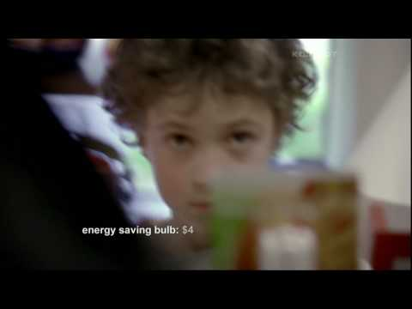
Week 10: Promotion and 6Ms
6.4 Message
1. What is our message?
Watch this MasterCard advertisement. As you watch, think about the message this ad is conveying.

Slide 4
Week 10: Promotion and 6Ms
6.4 Message
Creating advertising messages
Brands need a message strategy to help them decide on the general message that customers should be given. The three parts to a message strategy are:
Developing a position or personality which focuses on the customer benefits of the brand.
Creating the concept or the ‘big idea’ with visualisations, phrase combination or both.
The advertising appeal itself, which should be meaningful, believable and distinctive.
Now, let’s explore this messaging strategy, using MasterCard as an example.

Slide 5
Week 10: Promotion and 6Ms
6.4 Message
2. MasterCard’s message strategy
Developing a position and personality
In order to develop their position, MasterCard asked consumers the following:
What comes to mind when you hear the word MasterCard?
If MasterCard were a human being, what would they be like?
If you had to write an obituary for MasterCard, what would it say?
Below you can see some of the responses that came out of this.
Inventory: what comes to mind when you hear the word MasterCard?
‘credit card’
‘red and yellow’
‘basic’
‘second or third choice’
'nothing exciting’.

Slide 6
Week 10: Promotion and 6Ms
6.4 Message
Personification: if MasterCard were a human being, what would they be like?
‘male or female in their 40s’
‘conservative’
‘quiet’
‘humble’
‘friendly’
‘honest’
‘family-orientated’
‘predictable’.
Obituary: if you had to write an obituary for MasterCard, what would it say?
‘died of old age in his sleep’
‘will be missed by the few that were close to him’
‘lived a modest life with his family’.

Slide 7
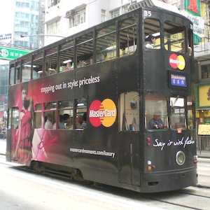
Week 10: Promotion and 6Ms
6.4 Message
From this feedback, MasterCard saw that they were seen as practical and boring, yet they could also see that their brand came across as modest and friendly, and that it had the potential to tug at the public’s heartstrings.
Creating the concept
The creative concept was assumed to be that life
experiences are ‘priceless’, and that’s what
MasterCard wanted to bring out through it’s
advertisement. ‘It’s priceless’ has been their tagline
for a long time, and you will have noticed this in the
video that you watched on the previous page.
Creating advertising appeals
Under the advertising appeal part of the strategy, we are looking at the actual execution of the big idea. For example, whether MasterCard wants to use humour or emotion. This is where creative agencies come in and build the appeal up. MasterCard’s ‘it’s priceless’ campaign has been very successful in positioning and communicating.

Slide 8
Week 10: Promotion and 6Ms
6.5 Media
1. Where, when and how often should we communicate the message?
Under media, there are two main issues:
Where do we want our promotions to be ‘seen’?
When (eg what time of day?) and how often (eg how many times a day?) do we want the advertisement to run?
Where do we want our promotions to be seen?
The ‘where’ is based on a couple of basic issues: efficiency and fit.
Efficiency
The first issue is the efficiency of the advertisement/promotion. Two features and terms associated with efficiency are:
Cost
This is the cost of doing the promotions. It is often referred to as ‘cost per thousand or ‘cost per mille’, meaning the cost of a promotion reaching 1000 people. This can be shortened to CPM.

Slide 9
Week 10: Promotion and 6Ms
6.5 Media
Reach
An example of reach could be the following: there is a program running on TV and the universe that we are targeting is, say, 100 people. In reality, about 30 of those hundred people might actually see the program during which our advertisement runs. In this case, we would say the reach was 30 per cent. ‘TV ratings’ and ‘gross rating points’ (GRP - the gross rating points of TV advertising ratio) are how many times the advertisement was watched by the relevant target group. Needless to say, the higher the target rating points (TRP), which was developed based on ads viewed on TV, or gross rating points, the more successful the campaign.

Slide 10
Week 10: Promotion and 6Ms
6.5 Media
Fit
The next issue that helps us decide on which medium or media to use is the fit. If we are thinking about a television advertisement, then TV would be the main showcase for the advertisement, but there would also be similar outputs made for social media, streaming videos, or even print media as part of an integrated marketing communication approach. This means that the same brand with similar campaigns could have different creative outputs based on the context in which the advertisement will run.
When and how often do we want our advertisement to run?
On the scheduling front, the first thing to note is that advertisements are repeated, especially on TV. This is called ‘duplication’. Remember that every time an ad is run on a spot on TV, it costs the firm money, and therefore how much duplication is appropriate is something that the firm needs to consider carefully. Duplication is required to act as a reminder to viewers of the product or brand.

Slide 11
Week 10: Promotion and 6Ms
6.5 Media
What are the pros and cons of duplication?
Once brand awareness has been created, duplication of the advertisement will keep the product or the brand in the consumer’s mind and make it salient enough for them to consider the product at the point of purchase. Repeating ads has a positive effect, but only up to a certain point. After a while, the effect of the ad wears out – this is called ‘ad wear-out’ – and continuing to run the ad begins to have a net negative effect whereby it costs money without significantly increasing sales.
In terms of how often we should schedule (for example, do you want your ad to be shown only once a week, or do you want it to be shown every day, and if so how many times a day), do keep in mind that all of this costs money. There are three different types of scheduling:

Slide 12



Week 10: Promotion and 6Ms
6.5 Media
Continuous
This is where an ad is shown every week, or every day, at the same time, or in the same spot, in the same television program.
Flighting
This is where the advertisement is shown for a certain number of weeks, then it stops, and then it is resumed again.
Pulse
This is where the ad is run on a continuous schedule, then extra ads are run at certain times of the year. For example, in the West, these extra ads might run during Christmas, or in other countries, it might happen at other times. After the special occasion is over, the frequency will likely return to continuous scheduling. Please refer to the textbook for even more details.

Slide 13
Week 10: Promotion and 6Ms
6.5 Media
2. Online advertising
Having discussed television and print advertising, now let’s look at online advertising.
Social media
We would like our brand to be on social media or get lots of Facebook likes, but it is unclear how effective these platforms are. For example, in a Guardian report(opens in a new tab) on Facebook’s targeted advertising, it was shown that for beauty products and gaming apps, mouse clicks were 40 per cent higher in the presence of ads, and sales rose by as much as 50 per cent, yet Forbes stated(opens in a new tab) that the picture was not as positive as seen in the previous example. Firms are spending money on social media, but the benefits of this are still unclear.

Slide 14
Week 10: Promotion and 6Ms
6.5 Media
2. Online advertising
Website banner advertisements
Online banner ads can be used, but where should we put the ad so that it captures people’s attention? Have a look at this a snapshot of a heat map(opens in a new tab), which is shared on a French website called 'Internet et opinion'. Heat maps show where page viewers' focus is concentrated when looking at a web page. The darker/more intense areas of colour show where the viewer spends more time looking at the page. In the linked example, the web page contains a banner ad from Volkswagen and the heat map colours show that page viewers do view the Volkswagen banner more than some other areas of the page, although it is not the most-viewed area of the page.

Slide 15
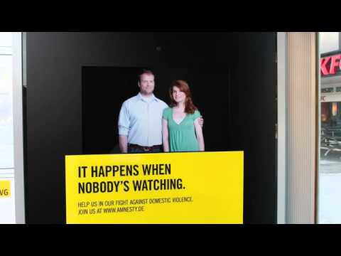
Week 10: Promotion and 6Ms
6.5 Media
3. Innovative examples of media
Have a look at the following videos.
Amnesty International campaign
In this example, the advertisement reacts to the gaze of the viewer, in order to reinforce the message within it.

Slide 16
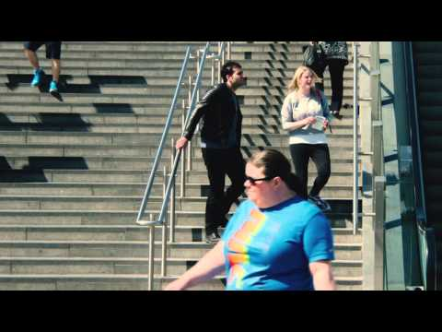
Week 10: Promotion and 6Ms
6.5 Media
3. Innovative examples of media
Have a look at the following videos.
Battersea Dogs’ and Cats’ Home campaign
In this second campaign, the advertisement is triggered only when a particular person is passing by, because the advertiser wanted it to target dog-lovers specifically.

Slide 17
Week 10: Promotion and 6Ms
6.5 Media
4. Product placement
Product placements are products that are used in TV and film in the following ways:
By the cast
The cast of the show uses the product, for example in a cooking show the chef may use the brand to make the food or as an ingredient. This is the simplest and most direct form of placement.
Integrated into the plot
Some shows build a plotline around a particular product or company, with marketers acting as consultants on scripts.
Associated with a character
Some marketers seek to have their product reflected in the values or aspirations of a character.

Slide 18
Week 10: Promotion and 6Ms
6.5 Media
Sometimes product placements are so well done, we don’t even realize that products have been placed in a show. However, there has been some backlash from consumers against blatant placements, and therefore, more subtle integration would be a better way to go about this.
Product placement is not very good for brand recall, thus the utility of product placement is somewhat limited. There are also parts of the world where product placement is not allowed. Product placement has only been allowed in the UK since 2011, but it is now a legitimate way of promoting a brand.
Where have you come across product placement on TV or in films? Think about the use of BMW in James Bond movies, for example. Feel free to share any examples in the week 10 seminar

Slide 19
Week 10: Promotion and 6Ms
6.5 Media
5. Summary
In summary, we can use traditional forms of promotion, such as email (direct mail), outdoor advertising banners and in-store marketing, but there is now increased usage of some non-traditional forms, such as product placement and interactive TV shows where the consumer can change the dialogue, the plot and so on. Additionally, we have insight videos, viral marketing, such as YouTube’s Buzz marketing, online social networks and virtual reality. These are just some examples of what is happening in the marketing world today.

Slide 20
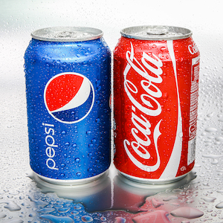
Week 10: Promotion and 6Ms
6.5 Money
1. Introduction
A key question a firm needs to ask itself is how much can it really afford in terms of budgets for campaigns? Another consideration is, if sales are what the metrics are about, then what percentage of the advertisement cost will actually bring in sales? Are we achieving competitive parity?
Think about the classic example of Coke and Pepsi. Between them, the two firms dominate the lion’s share of the cola beverage market, yet they both continue to pay for advertising because they want to get the consumers’ share of voice.

Slide 21
Week 10: Promotion and 6Ms
6.5 Money
2. Deciding what to spend
One technique to help with understanding whether money is worth spending is experimentation. You also saw experimentation demonstrated when we looked at new product development. In that topic, we simulated test markets in order to trial campaigns for a new product. These tests are done for all products with new campaigns and this testing phase is where the new advertising creatives/copy are actually tested out. Advertising data from the campaigns are analyzed through quantitative modelling, such as regression and other econometric approaches, to draw inferences. If the experiments are successful in meeting the objectives set by the firm, then the campaigns are launched and monitored accordingly.
Look at the following graph:

Slide 22
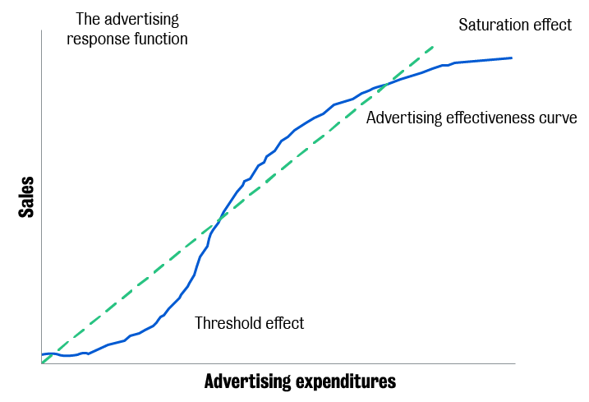
Week 10: Promotion and 6Ms
6.5 Money

Slide 23
Week 10: Promotion and 6Ms
6.5 Money
What does the graph tell you about how much money to spend on advertising?
The graph suggests that simply spending lots of money is not a good idea. It has been found that as advertising expenditure increases, sales don’t go up immediately. It is only after the threshold has been reached that sales (one of the advertising response functions) start picking up. Sales keep going up as advertising expenditure increases, up to a certain point at which there is saturation and spending more money on those ads will not increase sales. This is not a linear function. This graph varies by category, and each brand within a category has to work out where these threshold and saturation points are and budget accordingly.

Slide 24
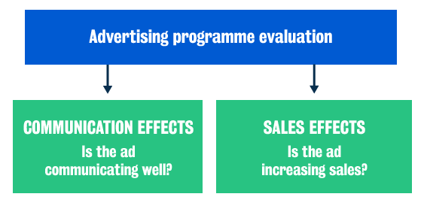
Week 10: Promotion and 6Ms
6.6 Measurement
1. Campaign evaluation
Evaluating a campaign is about working out whether an advertisement is communicating well and increasing sales.

Slide 25
Week 10: Promotion and 6Ms
6.6 Measurement
2. Current issues in promotion
The following two graphs show some of the issues that promotion is facing at the moment.
The rising price of attention
This first graph shows the rising price of attention. Look at how costly it has become to advertise. Over time (between 1960 to 2010), the cost has risen.

Slide 26
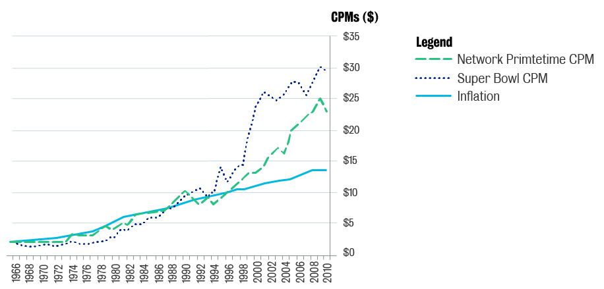
Week 10: Promotion and 6Ms
6.6 Measurement

Slide 27
Week 10: Promotion and 6Ms
6.6 Measurement
Decreasing attention to TV ads
The second graph shows how much attention is being paid to TV advertising. This has been steeply decreasing since the 2000s and was almost flat between 2000 and 2012. The graph shows that the percentage of ads which are viewed completely and receive high attention has declined dramatically, from 97% at the beginning of the 1990s to less than 20% today (note: time is not strictly ordered as studies overlap in the times of their data collection or publication). This finding matches with other market research showing that people are giving less attention to TV ads, either switching channels, binge-watching with a DVR, or just mentally escaping by multitasking while watching.

Slide 28
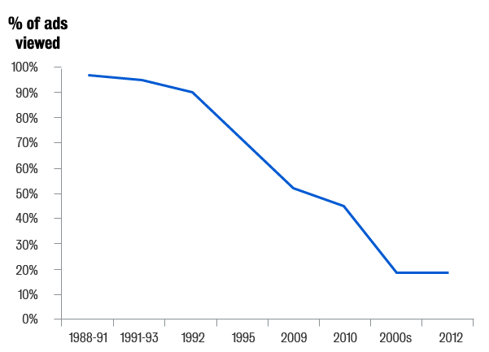
Week 10: Promotion and 6Ms
6.6 Measurement

Slide 29
Week 10: Promotion and 6Ms
6.6 Measurement
What we can see from these graphs is that, on the one hand, the cost of these ads is going up, whilst on the other hand people are not paying attention to them. This indicates a double problem.
What can firms do about this? A paper in the Harvard Business Review(opens in a new tab) discusses optimising video advertising for the audience’s attention level. What the paper suggests is that in a cinema the audience gives its full attention to whatever is on the screen, and therefore, a good strategy might be to focus on persuasion using mainly information ads. With television, however, there is only partial attention to the ad screen because people are now multitasking across different digital devices. More attention is paid to what is on the so-called ‘second screen’: the mobile device. This creates competition between the two screens for attention. The suggestion in this case is to balance entertainment and information.

Slide 30
Week 10: Promotion and 6Ms
6.6 Measurement
An interesting strategy might be to entertain with one ad on one screen and inform with another ad on the other screen. So, the same brand would advertise on two screens: one would be a more entertaining creative and the other would be a more informative creative. With peer to peer ads, what the research finds is lack of attention, and here it is gaining attention which is the critical element, and the suggestion is to entertain to grab attention from a few people and then eventually inform over time.
Finally, let’s look at the effectiveness of promotions across different countries. Look at the following graph, which is adapted from:
Gedenk K., Neslin S.A., Ailawadi K.L. (2006). Sales Promotion. In: Krafft M., Mantrala M.K. (eds) Retailing in the 21st Century. Springer, Berlin, Heidelberg.

Slide 31
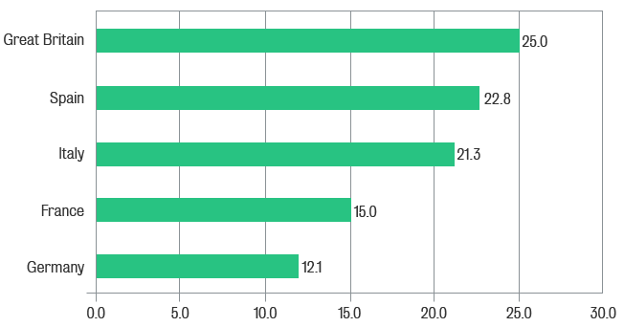
Week 10: Promotion and 6Ms
6.6 Measurement

Slide 32
Week 10: Promotion and 6Ms
6.6 Measurement
What does this graph tell you about returns on money spent on promotion in different countries?
What we find is that promotions don’t give us a similar return on money spent similarly across different countries. The graph is a snapshot of some countries in Europe. When the data was collated, Great Britain had the largest percentage of sales (25 per cent) made on promotion, in contrast to Germany, where it was only 12.5 per cent. Thus, how much money is being spent and how effective it is at meeting targets, whether the required outcome is brand awareness or sales, will vary by the part of the world in which the decision is being made.

