Slide 1

NSRIC Inc. (Nature Science Research and Innovation Centre)
Ontario (ON), Canada
Online Education (OE) Division
Essentials of Marketing
Instructor: Kathy Chen
Marketing Program, OE Division
NSRIC Inc.
London, ON, Canada
E-mail: kathyjchen18@gmail.com
https://www.nsric.ca

Slide 2
Week 8: Place/Distribution
Content covered in this week:
5.1 Introduction to channels in marketing
5.2 Channel length
5.3 Channel breadth
5.4 Channel modification
5.5 Channel conflict

Slide 3
Week 8: Place/Distribution
5.1 Introduction to channels in marketing
1. Channel structure
This lessons introduce the different marketing channels available. The following lessons then outline some of the key considerations relating to marketing channels and discuss the different decisions which marketers need to make in relation to their use of channels.
What are channels and how do they work? This is a generic diagram of channels, indicating the multiple types of possible pathways through which the manufacturer’s product may reach the final consumer.

Slide 4
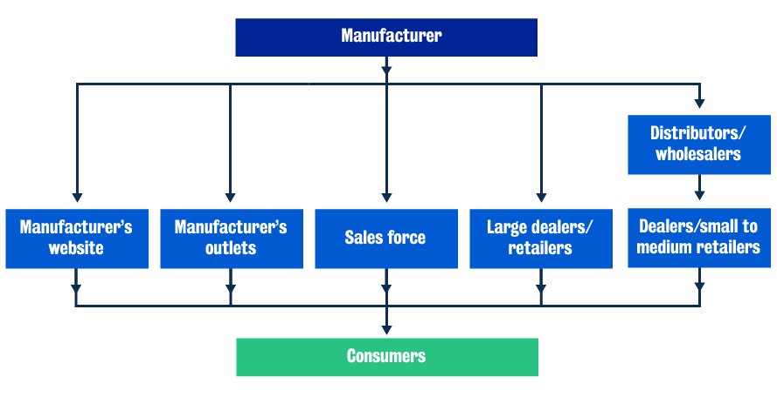
Week 8: Place/Distribution
5.1 Introduction to channels in marketing
1. Channel structure

Slide 5
Week 8: Place/Distribution
5.1 Introduction to channels in marketing
At the top, we have the manufacturer, which can have:
its own online website
its own outlets
its own sales force to sell the product to different consumers
large dealers and retailers
distributors and wholesalers who sell the product to dealers and small retailers.
Finally, all of these channels reach the ultimate consumer.

Slide 6
Week 8: Place/Distribution
2. The importance of channels in marketing
Why are channels in marketing essential? Channels create value for customers, as well as increase profits for companies. This is why they are not only a stand-alone function, but they affect everything in our four Ps.
Product
It is via channels that we get a product to the customer.
Place
Channels influence the decision to use wholesalers or distributors, etc.
Promotion
Channels affect the kind of promotion we want to do.
Price
Finally, channels affect the sort of pricing we want to use.
The distribution channel is a reseller function. Remember that unlike in a very old barter system where the actual producer (the farmer) sells their product to the final consumer, in most modern economies we have somebody else in the middle (wholesalers, distributors and retailers). This reseller function is an important one, which leads to the following benefits:
adding value for customers
increasing profits for companies.

Slide 7
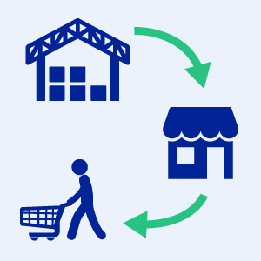
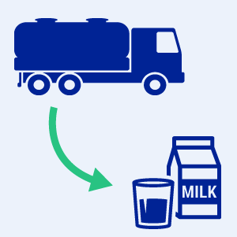
Week 8: Place/Distribution
5.1 Introduction to channels in marketing
3. Delivering value
How do distribution channels deliver value to customers?
Distribution channels help to get products from the
manufacturer’s warehouse to the final consumer. This
model satisfies the buyer’s needs and wants while
minimizing their costs with regards to travel,
transportation, searching, etc.
Resellers reduce larger quantities to smaller quantities.
Think about the multiple sizes of milk cartons that you
can buy, all at different price points. As you can see,
retailers are channel members who will ‘break’ large
sizes into smaller SKUs (stock keeping units) for the
final consumer to purchase.

Slide 8

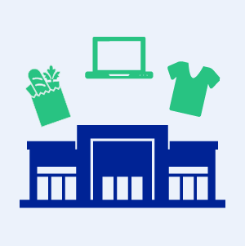
Week 8: Place/Distribution
5.1 Introduction to channels in marketing
3. Delivering value
Retailers in channels also provide assistance to consumers
who need information about the performance of certain
products, for example, home improvement products.
Resellers offer a large variety of product categories in one location. Thinking about grocery or department stores, they contain many SKUs of products, across multiple categories, all under the same roof. Department stores have everything from home furnishings, to apparel, to food. Therefore, they offer assortment across categories, as well as assortment within categories. They sell multiple brands, at multiple sizes
and price points, catering to the diverse tastes and
preferences of a variety of consumers.

Slide 9

Week 8: Place/Distribution
5.1 Introduction to channels in marketing
3. Delivering value
Retailers/resellers add value to the final consumer by offering installation services, for example by carrying out installation of audio-visual and other technology systems into cars. They may also offer installation in the B2B sense. Think about the Barco case you explored earlier in the module. In that case, a lot of the projectors made by Barco required the distributor to actually install them at the final users’ locations. In a B2B situation, resellers help with services to the consumer, and
all of this plays a very important marketing role.
It is critical that we understand distribution in
the modern context.

Slide 10
Week 8: Place/Distribution
5.1 Introduction to channels in marketing
4. Generating profits
How do distribution channels help manufacturers achieve better profits?
Manufacturers are good at making the product, but not necessarily at running retail sales locations or dealerships. By having other agencies look after dealerships, manufacturers save on costs and are able to focus on their core competency.

Slide 11
Week 8: Place/Distribution
5.1 Introduction to channels in marketing
4. Generating profits
Channel partners help with inventory management. You may have heard of inventory management systems such as ‘Dunnhumby’, ‘Aimia’, or Walmart and Tesco’s own inventory management system. In today’s online world, these systems are extremely advanced in terms of technology. The moment you pick up an item, go through the till and pay for it, the inventory is automatically updated. When stock reaches a certain level at a certain location, the manufacturers are informed that a certain number of new items are required at a particular store and those items are delivered. Thus, inventory management systems are very important, and they save the manufacturer the cost of overstocking or out-of-stock losses, as well as optimizing delivery costs. When a manufacturer’s inventory management is tied in with the retailer’s inventory management and it works smoothly, it can help reduce costs for the retailer and boost profits for the retailer and manufacturer.

Slide 12
Week 8: Place/Distribution
5.1 Introduction to channels in marketing
Channel partners help promote and advertise the manufacturer’s product. This is extremely useful for smaller manufacturers who cannot afford large advertising budgets.
Finally, the retailer also collects data on behalf of the manufacturer and shares it with them to help improve their existing products and to develop new ones. Remember, the new product development process starts with ideas and those ideas might indeed come from the retailer or channel partner.

Slide 13
Week 8: Place/Distribution
5.1 Introduction to channels in marketing
5. Channel considerations
There are four different considerations which firms need to take into account when making decisions about channels:
Channel length
Channel length relates to the number of intermediaries between the manufacturer and the consumer.
Channel breadth
Channel breadth is the number of outlets in any geographical area.
Channel modification
Channel modification is adding intermediaries to or removing intermediaries from an existing channel structure.
Channel conflict
Channel conflict describes the tensions that the manufacturer, the retailer and possibly the consumers may face and how that might play out in practice.

Slide 14
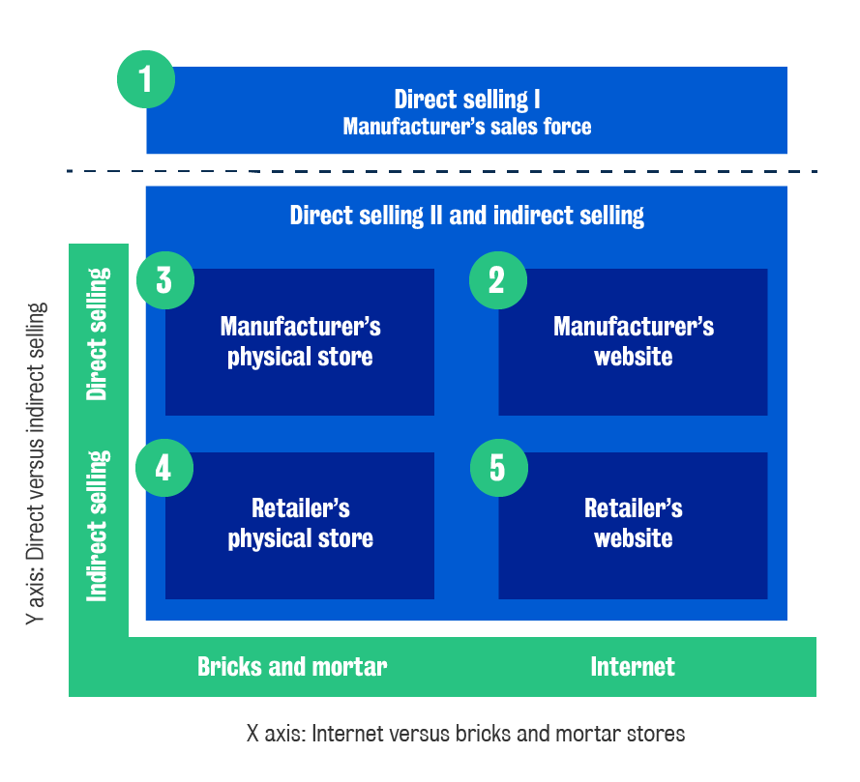
Week 8: Place/Distribution
5.2 Channel length
1. Introduction
Channel length
concerns the number
of intermediaries
between the
manufacturer and
the consumer.
What are the
options relating to
channel length?
There are five
options for
channels:

Slide 15
Week 8: Place/Distribution
5.2 Channel length
Let’s now look at these five options in turn.
Direct selling I
Option 1: Manufacturer's sales force
This is where the manufacturer’s sales force visits the consumer to sell the product. Firm representatives negotiate directly with the final user. For example, King’s College London has a relationship with Dell and has a dedicated set of people who deal with them. Another B2B example of this option is medical reps from a pharmaceutical manufacturer selling to doctors and hospitals.

Slide 16
Week 8: Place/Distribution
5.2 Channel length
Let’s now look at these five options in turn.
Direct selling II
There are two different options here:
Option 2: Manufacturer's website
This is where the internet site is owned by the manufacturer. Examples of this are sites such as Dyson.co.uk, Sony.com and Dell.com, where consumers buy products directly from the manufacturer’s own website.
Option 3: Manufacturer's physical store
This option relates to the manufacturer’s bricks and mortar/physical outlets. Here, an example is the Apple Store, where Apple sells directly to customers through physical shops which are exclusive to Apple, the manufacturer.

Slide 17
Week 8: Place/Distribution
5.2 Channel length
Let’s now look at these five options in turn.
Indirect selling
Under indirect selling, again we have two options:
Option 4: Retailer's physical store
This is the conventional system, whereby products are sold through retailers’ or wholesalers’ physical bricks and mortar stores. Examples of these are standard department stores like John Lewis, Debenhams, Target, Macy’s, etc.
Option 5: Retailer's website
Option 5 relates to internet sites owned by the retailer, such as Amazon, eBay and Alibaba, which have multiple manufacturers selling on the same online website. There are other examples, depending on which part of the world you are located in.
The rest of this lesson will explore some of the key criteria we use when deciding between these different options.

Slide 18
Week 8: Place/Distribution
5.2 Channel length
2. Manufacturer’s sales force versus manufacturer’s other outlets
What are the key criteria that manufacturers use to decide between using their own sales force and other outlets, assuming that the manufacturer has its own website or bricks and mortar outlet? Note that when we are talking about a manufacturer’s other outlets, the buyer chooses to go to the store or the online website, whereas in the sales force situation the manufacturer goes to the buyer. Having made that distinction, some of the key criteria are as follows:
Is the consumer-base geographically concentrated?
If the consumers are all located within a manageable area, it might be easier for the manufacturer to simply visit all the customers or people that they will be dealing with.
What is the complexity of the product?
If the product is complex and requires extensive demonstration, then it makes sense for the manufacturer’s sales representatives to visit the consumer to install or maintain the product.

Slide 19
Week 8: Place/Distribution
Does selling the product require complex B2B negotiations?
Remember that there are multiple steps in the B2B purchase process and if negotiations are required (for example, regarding price, how the product will be bought, when it will be installed, what the guarantee and warranty systems will be and how repair and maintenance issues will be dealt with), it is easier for its own sales force to visit the buyer rather than just have a store or a website.
Example: hospital machinery
Philips manufactures large equipment for hospitals. It might choose to send its sales representatives to hospitals instead of using other outlets. This allows Philips to make decisions on behalf of a chain of hospitals. So, if the consumer-base or the decision-making is concentrated, it makes sense to use the sales force.
Another reason for Philips to use its sales force over other outlets might be to manage the installation and repairs of these complex hospital machines or to demonstrate how to use them. In terms of demonstration, it may be simpler and cheaper for Philips to send its reps to these locations, rather than have a large number of hospital technicians from various hospitals come to the manufacturer’s location.

Slide 20
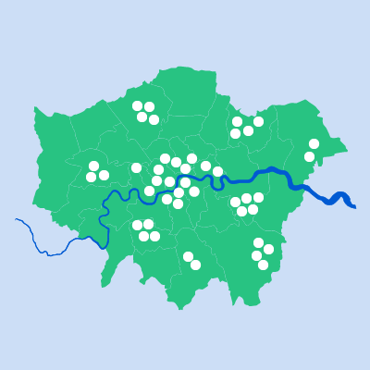
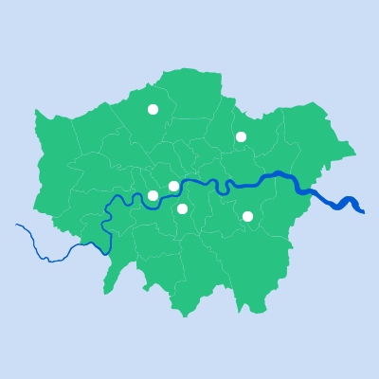
Week 8: Place/Distribution
5.3 Channel breadth
1. Introduction
Now let’s explore the second major topic, channel breadth. There are two main options in channel breadth:
Intensive distribution
Intensive distribution involves a large number of outlets in a given geographical area.
Selective distribution
Selective distribution is where there are just a small number of outlets in a geographical area.

Slide 21

Week 8: Place/Distribution
5.3 Channel breadth
2. Criteria for making channel breadth decisions
Frequency of purchase
The first criterion in deciding between intensive or selective distribution is the frequency of purchase of the product.
Imagine you want to sell coffee. Would you choose intensive distribution (many outlets in a geographical location) or selective distribution (a few outlets in an area)?
Price
The second criterion is price.
Imagine you are setting up an exclusive restaurant. Would you choose intensive distribution (many outlets in a geographical location) or selective distribution (a few outlets in an area)?
Listen your instructor to summarize the channel breath

Slide 22
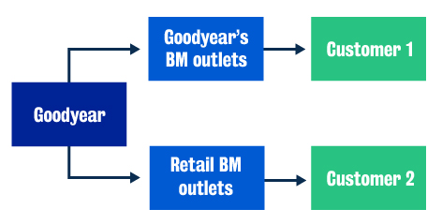
Week 8: Place/Distribution
5.4 Channel modification
1. Goodyear tires
In this section, we will look at three different examples of channel modification. The first is Goodyear, a multinational manufacturer of tires for cars. Goodyear used to have bricks and mortar outlets serving one type of customer. Then, the firm decided that it wanted to reach other types of customers. Goodyear’s decision was to allow its tires to be sold through other retailers’ bricks and mortar stores.
Listen the audio for the explanation.

Slide 23
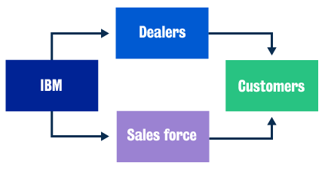
Week 8: Place/Distribution
5.4 Channel modification
2. IBM
Another example of a firm using different kinds of channels is IBM. Traditionally, IBM used its own sales force to reach customers (mainly big corporations). It then decided, additionally, to use dealers to reach those customers who did not need so much service or complex negotiations to be undertaken.
IBM did this to reach more customers
and, more importantly, to reach a
different set of customers to the
ones it had targeted previously.
It made sense for it to modify its
channels, so it decided to use not only
its own sales force, but also to add dealers.
Using dealers is a different way of dealing
with channels. Unlike using a sales force, it is not usually tied exclusively to the manufacturing firm.

Slide 24
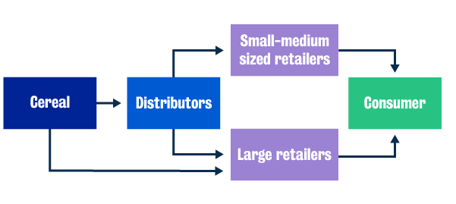
Week 8: Place/Distribution
5.4 Channel modification
3. Cereal manufacturer
A final example of channel modification is where a competitor starts selling through a different set of retailers and the manufacturer is forced to also try and sell to them. This occurs because consumers buy through those retailers, so without going through those different retailers, the manufacturer would never manage to reach that set of consumers.

Slide 25
Week 8: Place/Distribution
5.4 Channel modification
3. Cereal manufacturer
A final example of channel modification is where a competitor starts selling through a different set of retailers and the manufacturer is forced to also try and sell to them. This occurs because consumers buy through those retailers, so without going through those different retailers, the manufacturer would never manage to reach that set of consumers.
Listen to your instructor for the summary of three examples about channel modification:

Slide 26
Week 8: Place/Distribution
5.5 Channel conflict
1. What is channel conflict?
Channel conflict is the bargaining power of the manufacturer versus that of other channel members, especially the retailer. This will dictate how much conflict there is in the channel and how it is dealt with. To motivate this, let’s turn our attention to an example where Levi’s jeans decided to go online. This was at a time when online selling was not very common.
Levi’s jeans had decided to start an online store, and retailers, such as department stores in the United States, were not happy with the decision. They were unhappy because if customers bought online, they, the retailers, would lose out on the margins from selling Levi’s jeans in their stores. The power of the department stores was at that point very high, and they decided not to stock Levi’s jeans. This forced Levi’s to step back from that decision for a while and renegotiate with the retailers on margins, sales help, stocking etc.

Slide 27
Week 8: Place/Distribution
5.5 Channel conflict
1. What is channel conflict?
Some key points to consider:
If there is intense competition between retailers, then the manufacturer has more power in the channel.
If the competition between manufacturers is strong, retailers have more power.
Listen to your instructor to discuss Levi's example further:

Slide 28
Week 8: Place/Distribution
5.5 Channel conflict
2. Managing channel conflict
What are some suggestions/tactics for managing a channel conflict if the manufacturer’s bargaining power is somewhere in the middle?
If one is adding new channels, remember the Levis’ story as an example. If Levi’s had said that the online jeans would be a little higher priced than the jeans being made available to the department stores at that point, it might have done a lot better. Note that in the department store, a person would help you try the jeans on, reorder out-of-stock products and process your payment at the till. If Levi’s had charged a slightly higher price online, the retailers would not have seen such a reduction in customer visits to buy jeans in-store, and that might have been an effective way for Levi’s to manage the channel conflict.
Secondly, if retailers had indeed started losing traffic to the Levi’s jeans section, Levi’s could have helped them with advertising expenditure or offered other ways to make up for that loss, e.g through discounts.

Slide 29
Week 8: Place/Distribution
5.5 Channel conflict
2. Managing channel conflict
What are some suggestions/tactics for managing a channel conflict if the manufacturer’s bargaining power is somewhere in the middle?
If one is adding new channels, remember the Levis’ story as an example. If Levi’s had said that the online jeans would be a little higher priced than the jeans being made available to the department stores at that point, it might have done a lot better. Note that in the department store, a person would help you try the jeans on, reorder out-of-stock products and process your payment at the till. If Levi’s had charged a slightly higher price online, the retailers would not have seen such a reduction in customer visits to buy jeans in-store, and that might have been an effective way for Levi’s to manage the channel conflict.
Secondly, if retailers had indeed started losing traffic to the Levi’s jeans section, Levi’s could have helped them with advertising expenditure or offered other ways to make up for that loss, e.g through discounts.

