Slide 1

NSRIC Inc. (Nature Science Research and Innovation Centre)
Ontario (ON), Canada
Online Education (OE) Division
Essentials of Marketing
Instructor: Kathy Chen
Marketing Program, OE Division
NSRIC Inc.
London, ON, Canada
E-mail: kathyjchen18@gmail.com
https://www.nsric.ca

Slide 2
Week 7: Pricing
Content covered in this week:
4.1 Economic-based pricing
4.2 Economic value analysis
4.3 Behavioral pricing
4.4 Reference pricing

Slide 3
Week 7: Pricing
4.1 Economic-based pricing
1. Economic pricing
In this lesson, you will learn how to analyze pricing from an economic perspective. This includes an understanding of the conventional way of setting prices and the notion of price elasticity, as well as identifying when prices of a product are elastic and what this implies for its demand.
How are prices set?
Let's start by taking a look at the conventional view of economics in terms of how prices are set.
Essentially in economics, price is where the demand and supply curves intersect. We can see this on the graph below, where demand is indicated by a curvy line and supply is indicated by a step function. Demand and supply don’t always have to look like this; this is simply an illustration to highlight the intersection between the two.

Slide 4
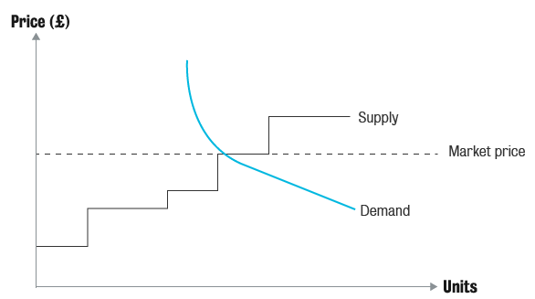
Week 7: Pricing
4.1 Economic-based pricing
This is the standard form, but suppose there is brand differentiation and heterogeneity among consumers, etc. These are not captured in this basic view of demand and supply.

Slide 5
Week 7: Pricing
4.1 Economic-based pricing
Identifying when prices are elastic
You may remember that when we covered customer decision-making and competition, we discussed price elasticities. We will now look at this topic again, but this time from a pricing angle.
What you see in the figure below is essentially the two different methods of pricing: for niche markets and for mass markets. A niche pricing strategy implies that a firm sells to only a certain group of people, and/or a certain small target segment, and this can command a higher price. A mass-market pricing strategy involves selling to a large group of people, and/or a large target segment, and prices are generally lower.

Slide 6
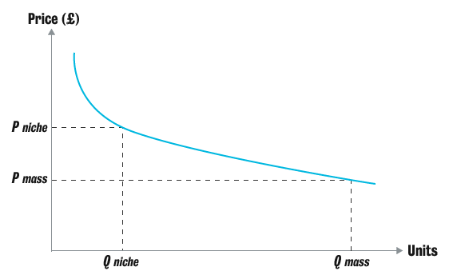
Week 7: Pricing
4.1 Economic-based pricing
Identifying when prices are elastic
If you think back to the Barco Projection Systems case, Barco was a niche product, and therefore had a high price in the market, while Sony, in that particular case, was a mass product, able to charge a lower price. So, to summarise, a niche product is about high margins to fewer people, while a mass-market product is about low margins to many people.

Slide 7
Week 7: Pricing
4.1 Economic-based pricing
2. Price elasticity
Price elasticity (E) is defined as the percentage change in quantity demanded divided by the percentage change in price:
𝐸= % change in quantity demanded / % change in price
To give you an example of what the different values of E mean, look at the following:
|E | > 1
If the absolute value of E is greater than one, it means that there is an elastic demand. This suggests that a small change in price will produce a large change in demand: the demand flexes according to the price.
For instance, if somebody changed the price of a Coke or Pepsi by a few pence, say an increase of 10 pence, it would produce a drop in demand. Sales would go down.

Slide 8
Week 7: Pricing
4.1 Economic-based pricing
2. Price elasticity
|E | < 1
Where the absolute value of E is less than one, there is an inelastic demand. This suggests that a small change in price will produce an even smaller change in demand. Inelastic demand implies that even if you changed the price, the demand would not change very much.
|E | = 1
If the absolute value of E is equal to one, we call this a unitary elastic demand. This is where one unit change in price produces the equivalent unit change in demand. This rarely happens in real life.
For example, let's say we are selling 1000 units of a product with a price of $100, and we change the price to $101. Under unitary elastic demand, sales would drop to 990 units. That's a change of exactly one per cent in both.

Slide 9
Week 7: Pricing
4.1 Economic-based pricing
3. Identifying when prices are elastic
Can you think of a category or product where even if you started raising the price, the demand would not go down?
What happens when prices are lowered in the case of fast-moving consumer goods (FMCG)?
It has been found that, in general, consumers respond to lower prices in two ways: 25 per cent of consumers respond by expanding the category (also known as primary demand), ie, people who would never have bought that type of product usually will buy it. On the other hand, 75 per cent of consumers respond by switching brands (also known as selective demand).
For example, let’s consider carbonated cola beverages. If Pepsi dropped its price, for example, only 75 per cent of that extra demand would come from switching away from Coke. The other 25 per cent of extra demand would come from people who never used to drink cola beverages and who had actually started buying Pepsi.

Slide 10
Week 7: Pricing
Please note that a brand that has a very high market share may drop their prices, but it is unlikely to gain much more demand. Thus for such a brand, price may not be the best marketing tool to gain more market share.
If a brand has greater loyalty, as mentioned before, it is not very elastic. The brand may charge a high price because it is a good brand, but there is not much leeway to play with prices. If there are fewer competitors, like in a very strong control oligopoly market, a firm may have a lot of pricing power, but there is not much it can do in terms of increasing its prices to make more money.
If you have a category of products which is not storable – for instance, fresh coffee – pricing is very tricky. For a fast-moving consumer good that is storable, for example, toilet paper, if there is a price cut consumers will buy a lot at the cheaper price and store it. For that time period, the brand whose price was lowered will have gained market share. On the other hand, for a good that is not storable, for example, coffee, a price drop will increase sales but not by a whole lot compared to the storable category (toilet paper). Thus, dropping price will increase market share for the non-storable (coffee) brand but less than it would for the storable item.

Slide 11
Week 7: Pricing
4.1 Economic-based pricing
4. Price discrimination
Price discrimination implies different groups or individuals may be offered a different price based on certain criteria. Some examples of price discrimination are explained below.
University financial aid
Quantity discount
Bundling
Coupons
Airline flight schedules
Senior/student ticket prices

Slide 12
Week 7: Pricing
4.1 Economic-based pricing
University financial aid
When applying to or enrolling at a university or college, sometimes certain students are unable to pay the fees in full. These students are therefore given a different price (e.g. through financial aid or a studentship) for a particular course or program, and the university makes it cheaper for this group. This means that even though the students are enrolling at the same time, for the same degree, they see a different pricing pattern.
Quantity discount
Let’s think about an example from B2B pricing: if a buyer orders a large number of items of the same kind, then the seller may offer them a better price. For example, if King’s College London ordered 3000 tables and chairs for our students, King’s College might see a cheaper price than if you or I were to buy one table and one chair. This is called a quantity discount, and it is extremely common in the B2B setting.

Slide 13
Week 7: Pricing
Bundling
If you have ever visited a fast-food restaurant, for example, McDonald’s, you may have noticed that you tend to get the hamburger and fries, the combination, at a cheaper price than if you bought the hamburger and the fries separately. This is an example of bundling.
Bundling works very well when the willingness to pay for two items together is stronger than the willingness to pay for one of the items. If you want to read more about how bundling works, see p.344 of Kotler and Keller’s
Marketing Management.
Coupons
Next, we have coupons. These are what nowadays we often receive online and allow us to get a little bit of money off the usual price. Customers are usually targeted for coupons based on their previous purchases, and then they redeem the coupon at the point of purchase. Thus, they are based on the customer’s willingness or ability to buy a certain product. Somebody who is more price-sensitive may not buy the product if they don’t get a lower price and so, by using vouchers/coupons, firms can also make it more likely that price-sensitive customers will buy the product, because of the lower price.

Slide 14
Week 7: Pricing
Airline flight schedules
Let’s now turn our attention to airlines and flight schedules. People who value their time more highly are likely to pay higher prices for an airline ticket which would mean less time in the air, fewer layovers and fewer changes, so there is a clear indication of willingness to pay. Based on these consumer characteristics, people are shown different ticket prices in line with how many changes they will have to make, how much time the total journey will take, etc. We, as customers, pick the one which suits us and this is inherently based on our willingness to pay: what we can we afford in terms of trading off time and money. To summarize, the airlines will let us self-discriminate – and here we do not mean discrimination based on anything social, merely our willingness to pay – by posting a different set of prices for the different options.

Slide 15
Week 7: Pricing
Senior/student ticket prices
Finally, we have senior and student ticket prices. We would like students and senior citizens to be able to watch a film, for example, but a lot of the time people who have retired or who are studying don’t have much of an income, and therefore their ability to pay is lower. In the case of the film, if we want to make more revenue, we need more people to watch it. In order to do that, we do not reduce the ticket prices of the standard ticket, but we allow students and senior citizens to watch the film at a lower rate, perhaps at a different time of day. Doing that gives us greater profit without having to lower the price for everybody.

Slide 16
Week 7: Pricing
4.2 Economic value analysis
1. Economic value to the customer (EVC)
It is essential for marketing managers to learn how to analyze prices from the customer’s perspective. This lesson focuses on explaining what the economic value to the customer (EVC) is, how to measure it and the benefits and limitations of this value. Once you have understood this concept and the examples, try to solve the problem proposed independently.
Introduction
Economic value analysis means that you need to analyze each transaction and compare two products within the same category based on the total life-cycle of products. The components to be taken into account will be the price, the cost to use and maintain the product, and so on.
The economic value to a customer is what we will be able to charge the customer based on their willingness to pay. It is the maximum that we should be able to charge them. It is based on the total life-cycle cost of the product, and we can make a comparison to an existing or a competitive product using economic value.

Slide 17
Week 7: Pricing
4.2 Economic value analysis
How do we measure EVC?
Step 1 Work out the total life-cycle of the focal product that we want to price.
Step 2 Know what the product’s cost elements to the consumer will be.
Step 3 Identify the costs that the customer will undertake or will have to pay out over the life-cycle of that product. Please note that when we say ‘cost’ here, it is not the cost of manufacturing. It is what the customer will have to pay to purchase, maintain and use the product over the life-cycle of the product.
Step 4 If you want to make a comparison with a similar product, do the exact same steps (1-3) for a competing product or a new product that you want to showcase.
You can perform this process for multiple products. Hopefully, the product that you as the manager want to sell is able to provide the best economic value, and therefore, you are able to charge the customer just a penny less than their maximum willingness to pay. Thereby, the customer is given the best economic value and the company receives the best possible amount of profit.

Slide 18

Week 7: Pricing
4.2 Economic value analysis
2. Calculating EVC: benefits and problems
Example of the EVC calculation
The following table illustrates a real example of how to calculate economic value. Listen to the audio from your instructor for a detailed explanation.
(Based on 10,000 hours of usage)
One 18-watt fluorescent bulb | Ten ordinary 75-watt bulbs
Purchase price | $8* | $8 (10 x $0.80)
Electricity cost for 10,000 hours (at 14.7 cents per kilowatt-hour) | $26 | $110
Total cost | $34 | $118
Over the life of the compact fluorescent bulb, you could save $84 | Total savings: $84
*Price with Con Edison discount

Slide 19
Week 7: Pricing
4.2 Economic value analysis
Benefits of calculating EVC
Price expectation
Price expectation is what a consumer would assume the price of an item is. If we can demonstrate to consumers that they will be better off due to positive economic value from a product, we can change what they may want to pay for such products ie, their expectations. In the previous example, if a customer only knows the price of the old bulb and would expect to pay around $0.80 for bulbs in general, they are less likely to consider the new bulb. However, once we have shown them that they are better off with the new one, they might be willing to pay $8.00, ie they will have adjusted their price expectations about bulbs. This is important for pricing, as it allows us to charge different prices to different customers and maximize profit.

Slide 20
Week 7: Pricing
4.2 Economic value analysis
Benefits of calculating EVC
Segmentation
If we know that there are people who are more price-sensitive, and we know the economic value, maybe we could give them different coupons and vouchers to make it easier to pay for bulbs across the whole house.
New product introduction
If we have a new product, just like in the example above, and we want to show that while our product may be more expensive at the beginning, it will be better economic value for the customer in the long run, we can use EVC for pricing decisions on a new product.

Slide 21
Week 7: Pricing
4.2 Economic value analysis
Problems when using EVC
Some of the issues or problems that come up with economic value to the customer include the following:
EVC is based on the life-cycle cost, and this is difficult to work out, especially if it’s a totally new product. In that situation, we truly don’t know how long things will last. For example, when cars which were not based on petroleum came out, we were not very sure of how long they would last. We know that on average a petrol-based car’s life-cycle time is 12,000 miles, but when hybrid cars and electric cars became available it was difficult to know upfront what the lifecycle mileage would be. Market research may help alleviate this problem, and over time and usage by consumers, managers get good estimates of life-cycles.
You need to know your customers’ differences really well to know how to convince them. For example, you may have two kinds of customers: on the one hand, you may have customers who are myopic, such that they will just pay what they can now without caring about the future; on the other hand, you may have customers who just don’t care about saving money.

Slide 22
Week 7: Pricing
4.2 Economic value analysis
Problems when using EVC
Having two different types of customer might be a problem in trying to use economic value pricing, and it’s also very difficult for people to foresee psychological benefits for the future versus the functional benefits at the moment. Some people just really like the old type of bulb. When there are two segments, one which can afford a higher-priced item and one which cannot, despite the calculation, one group may still not buy it due to the unaffordable price. Furthermore, imagine that one group will not use the product for the life-cycle: the EV may not fully accrue to them and thus they may not be interested in buying that product. For example, a tenant may not be willing to spend $8.00 on a bulb because they will not be using it over the life-cycle.

Slide 23
Week 7: Pricing
4.3 Behavioral Pricing
1. Introduction to behavioral pricing
One of the key limitations of EVC estimation is that it ignores the functional and psychological factors influencing the perceived value of a product. This last lesson focuses on exploring these factors and explains the notion of reference prices, how these are formed, the role of fairness and typical strategies that marketers can apply to move customers’ reference prices and influence what they purchase.
Kahneman and Tversky’s prospect theory
The following graphic acts as a reminder of how we look at value, losses and gains. It is adapted from Kahneman and Tversky’s prospect theory (to recap this, you can revisit the materials covered in 1.2.3, Customer decision-making). Observe that the losses curve is steeper than the gains curve, therefore, we are pained by losing a pound more than we are happy about gaining a pound.

Slide 24
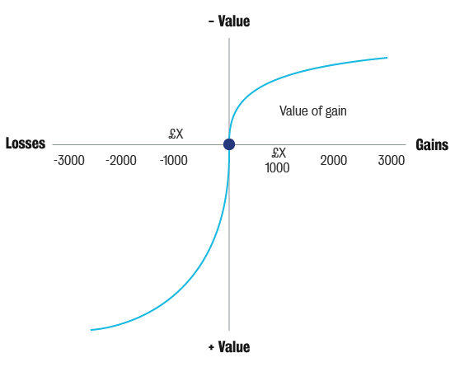
Week 7: Pricing
4.3 Behavioral Pricing

Slide 25
Week 7: Pricing
4.3 Behavioral Pricing
Thaler’s theory: mental accounting
Richard Thaler suggested that money isn’t just money; people have separate mental accounts for each product or service category. For example, we have an account for rent, an account for entertainment, an account for education, etc. Although the money itself might be the same each time, in our minds, we do not put all of it into one basket. Instead, we use mental accounting to make judgements on what to buy, when to buy it, etc. Thaler also suggested that we may segregate gains and aggregate losses: in other words, we prefer to make gains in separate chunks and to suffer losses all in one go.
Thaler’s theory on mental accounting is an extension of prospect theory.
Here is an example of how we tend to segregate gains: a person wins $50 through a single lottery ticket, while somebody else wins two separate lotteries on the same day, one of $25 and then another of $25. According to Thaler, the person who receives the separate wins is actually happier, thus, we prefer segregated gains.

Slide 26
Week 7: Pricing
4.3 Behavioral Pricing
Thaler’s theory: mental accounting
Here is an example of how we tend to aggregate losses: someone receives a letter from the tax authorities telling them that there has been some kind of mistake and they owe the government $100, and then another letter comes through from another authority saying that they owe that authority $50 too. Another person receives one letter saying that they owe $150 in total. Who is more unhappy: the person who gets two letters ($100 + $50) or the person who gets just one asking for $150 at once? According to Thaler, the person who gets the two letters is more unhappy. As customers, people prefer to aggregate their losses.
Thaler suggests that consumers are hard-wired to perceive gains and losses, as detailed in prospect theory. Consumers make decisions based on transactions, in a two-step process. In step one, they make a judgement to evaluate a potential transaction and in step two they decide on approving or disapproving a potential transaction.

Slide 27
Week 7: Pricing
4.3 Behavioral Pricing
2. The implications of mental accounting on pricing
These are some actions that firms can take, based on how customers, or people in general, use mental accounting and prospect theory:
Separate out customers’ gains
As a marketing manager, you can separate out customers’ gains when they buy your product. For example, if your firm is going to sell a product and it can be split into two parts, it could be profitable to present that product as two separate items, one which the customer pays for and the other which they receive for free or for a cheaper price. The firm still sells the same item, but by making it look like two purchases, the customer perceives it as better value.
Combine customers’ losses
It might be better to combine losses. For example, if someone is buying a car or house, you could combine the cost of the car or house with insurance and present it to the customer as one package. That might feel like a better deal for the customer because the combined loss will pinch less than if they paid for the car or house first and then again separately for the insurance.

Slide 28
Week 7: Pricing
4.3 Behavioral Pricing
2. The implications of mental accounting on pricing
Combine smaller losses with larger gains
Let’s consider taxes as an example. When we earn a salary, we have a large gain, but a small amount is taken away as taxes. Another example might be paying for life insurance when being paid a salary. The small loss is palatable to the customer because of the large gain.
Separate out small gains from larger losses
Finally, we have separating out small gains from larger losses. Think about buying a car. Cars cost a lot of money but some car retailers give buyers a rebate – an amount of money that they will get back later – if they purchase the car. While this might only be a small saving compared to the total price, the buyer will feel like they are getting something back.
This is what is called the silver lining principle. Essentially, this is giving people a little gain when they are purchasing a big-ticket item.

Slide 29
Week 7: Pricing
Example of the silver lining principle
Imagine a customer is about to buy an $8000 car. You can offer them a $500 discount upfront or you can offer them a $500 rebate. While the $500 discount is immediate, the rebate is delayed gains. In both situations the customer will end up paying $7500, but what do you think they will be happier with, a rebate or a discount? It turns out that, due to prospect theory and mental accounting, the customer is generally happier with a rebate.
Psychology
Unlike traditional economics, behavioral economics uses psychology. As shown in the graphic below, Thaler proposed that the utility of a product, or whatever customers gain from buying a product, has two components:
One is acquisition utility, which is how we compare benefits from a product and how much we are willing to pay. The second is called transaction utility. This is where Thaler said that customers tend to compare the price that the seller has proposed with a reference price. This reference price is something that is part of our mental accounting, ie, it is in our heads. This, in turn, has associations with fairness, framing etc.
Utility = acquisition utility (perceived value and price) + transaction utility (price and reference price)

Slide 30
Week 7: Pricing
4.4 Reference Pricing
1. Introduction to reference pricing
Reference prices are not a pricing technique but a price that people use to compare to the current price when they are buying something. The attractiveness of a product depends, in part, on how its current price compares to the buyer’s reference price:
Buyers develop and maintain a reference point for prices that they expect to encounter when they pay for products and services. The buyers’ reference prices depend on the product’s current price, the reference prices available and how those reference prices are formed.
A reference price depends on the buyer’s past experiences, the list of prices they are aware of and their sense of a fair price. The reference price gets updated according to how frequently the product is purchased by the customer. It is thus the standard of comparison against which an observed price is compared.

Slide 31
Week 7: Pricing
4.4 Reference Pricing
How are buyers’ reference prices formed?
Internal
This is something that the customer controls (eg past experience with a product, information about prices, expectations about prices, etc.)
External
This can be managed or manipulated by the marketer because it is context-dependent.

Slide 32
Week 7: Pricing
4.4 Reference Pricing
2. Reference prices: example
This example is taken from an experiment which was conducted by Richard Thaler. It illustrates how marketers can influence customers’ reference prices:
The experiment had two groups of people, whose response was compared. Each group saw a slightly different narration about the type of shop.
Scenario presented to group 1
You're lying on the beach on a hot day. All you have to drink is iced water and for the last hour you have been thinking about how much you would enjoy an ice-cold bottle of your favorite brand of beer. A companion gets up to make a phone call and offers to bring back beer from the only nearby place where beer is sold – a fancy resort hotel. He says the beer might be expensive and asks how much you are willing to pay for it. He says he will buy the beer if it costs less than the price you state, otherwise, he will not. You trust your friend, and there is no possibility for bargaining with the hotel bartender.

Slide 33
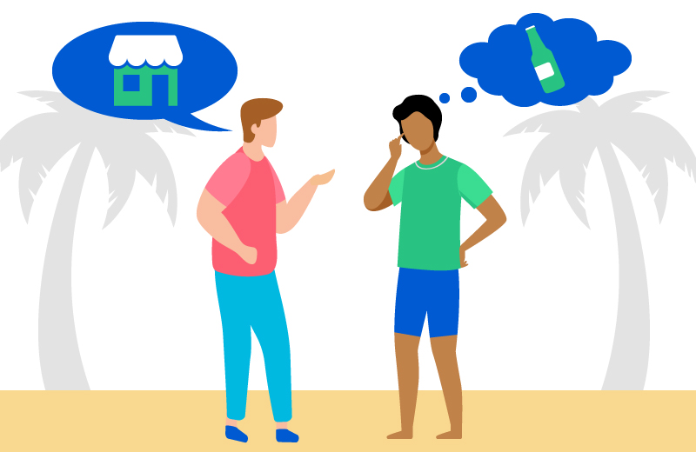
Week 7: Pricing
4.4 Reference Pricing
2. Reference prices: example
Scenario presented to group 2
You're lying on the beach on a hot day. All you have to drink is iced water and for the last hour you have been thinking about how much you would enjoy an ice-cold bottle of your favorite brand of beer. A companion gets up to make a phone call and offers to bring back beer from the only nearby place where beer is sold – a small, run-down grocery store. He says the beer might be expensive and asks how much you are willing to pay for it. He says he will buy the beer if it costs less than the price you state, otherwise, he will not. You trust your friend, and there is no possibility for bargaining with the store owner.

Slide 34
Week 7: Pricing
4.4 Reference Pricing
Consistently, the willingness to pay for the same brand of beer was higher simply due to reading the words ‘fancy resort’ versus ‘small, run-down grocery store’ ($2.65 in the fancy resort hotel scenario, versus $1.50 in the run-down grocery store scenario). This is a very nice example of how simply changing the context can change a person’s reference point or reference price.
If by mere words one can change the reference price that somebody is willing to compare against the real price, you can well imagine what you can do as a manager with a fancier ad!
Think of the brand you usually buy: you form the reference price based on your knowledge. For example, if you are looking on the market for a particular laptop and you have an idea of what the market prices are, you base the reference price on this.
Alternatively, you can find out what the average prices of similar products are in order to form price expectations. For example, if there is inflation in the market, you will probably be willing to pay higher prices. For instance, if the price of cheese has gone up recently and you are aware of that, it is very likely that you will be willing to adjust your reference price upwards for a pizza.

Slide 35
Week 7: Pricing
4.4 Reference Pricing
3. The role of fairness in pricing
Our idea of fairness also influences the way we form reference prices. To illustrate this, think of the following questions:
Is it fair to charge a certain high price for medicines because they have patents, or for software because they have technological licenses?
Is what you are willing to pay based on the cost of a particular product? For example, if the price of manufacturing has gone up, would you adjust your reference price higher to take into account those additional costs for the manufacturer?
If there is high demand, do you think it is fair to give a film ticket with limited availability a higher price?
Maybe your answer to these questions is ‘Yes!’ and therefore you will form your reference price accordingly.

Slide 36
Week 7: Pricing
4.4 Reference Pricing
3. The role of fairness in pricing
Is it fair to charge a different price when demand has suddenly increased?
For example, imagine a ticket to see your favorite football team is priced at $10 for a game, and then suddenly this team seems to be doing really well and is expected to win the series. Because of its good performance, the league starts charging $50 per game for the rest of the team’s matches.
Do you think this is fair? Whichever way you think, it will form your reference price.
Is it fair to price more highly when supply is restricted?
As an example, let’s look at a pharmaceutical company which makes two drugs: one is priced at $2000 per shot, and the other costs only $40. Both drugs treat the same condition, however, one is approved for that condition and the other is not. Now, consider the following questions.
Is this differential pricing?
If you were aware of the two different prices available, how would you feel about it?

Slide 37
Week 7: Pricing
4.4 Reference Pricing
3. The role of fairness in pricing
In terms of economics, it is absolutely fine to price differentially – this is not a legal problem. Prices are set according to the customer’s willingness to pay, and we want to extract the best profits based on this. However, when we consider the behavioral or psychological angle, fairness also comes into play, and therefore, we may have to be more careful when setting prices for goods that are inelastic (e.g. in the case of the life-saving drugs).

Slide 38
Week 7: Pricing
4. Moving reference points: Decoys
Reference points can be moved using decoys.
A decoy is an asymmetrically dominant alternative (Huber, Payne and Puto, 1982). Simply put, it is an offering that is closest to the target offering but of lesser ‘value’ and possibly higher price.
Let’s explore the example of a travel agency which sends out information about packages to people enquiring about travel products. The product is a trip to Disney World, as shown below:
Tour #1 ($805)
Includes:
Roundtrip airfare from St. Louis to Orlando on nonstop service.
Five nights’ accommodation at the Caribbean Beach Hotel located on the grounds of Walt Disney World.
Hotel taxes are not included.
Use of compact car for five 24-hour periods. Taxes are not included.
Four-day passport providing use of the three main Disney theme parks - Disney World, Epcot, and Disney MGM Studios.
Magic Morning breakfast feature

Slide 39
Week 7: Pricing
4. Moving reference points: Decoys
Tour #2 ($1,073)
Includes:
Roundtrip airfare from St. Louis to Orlando on nonstop service.
Five nights’ accommodation at the Grand Floridian Hotel (water view) located on the grounds of Walt Disney World.
Five-day SUPERPASS providing unlimited use of all Disney theme parks as well as Pleasure Island, Typhoon Lagoon, River Country, and Discovery Island.
Magic Morning breakfast feature.
Some consumers were given only those two choices, where no decoy was present. Another group of consumers were given those choices, plus an additional third choice, shown next page. Tour #3 acted as a decoy.

Slide 40
Week 7: Pricing
4.4 Reference Pricing
4. Moving reference points: Decoys
Tour #3 ($1,273)
Includes:
Roundtrip airfare from St. Louis to Orlando on US Air via Charlotte.
Five nights at the Holiday Inn Main gate located close to Walt Disney World.
Two-room suite accommodation.
Hotel taxes are not included.
One-day admission to your choice of the Magic Kingdom, Epcot Center, or MGM Studios.
Steve Birnbaum guide to Walt Disney World.
Use of intermediate car for three 24-hour periods.

Slide 41
Week 7: Pricing
4.4 Reference Pricing
4. Moving reference points: Decoys
When a decoy is present, more people choose the option the firm would like them to pick as the target choice. In this case, the firm would ideally like people to choose the $1073 option, not the cheaper $805 option. When the decoy option is offered, more people choose the $1073 option than when no decoy is present.
By using a decoy, which in this scenario is the $1273 option, the travel agency is trying to influence some people who would otherwise not have done so into buying the target package. By showing them something a little more expensive, people think they are getting a better deal by going for the option between the cheapest offer and the more expensive decoy.
Indeed, the following graphic illustrates the results obtained by the travel agency using a decoy: the dark, blue lines on the graph show that the target option is chosen only around 55 per cent of the time when there is no decoy, but when the decoy is present, notice how the takeup of the thousand-dollar target option increases dramatically. Thus, through the simple addition of a decoy, the firm ends up making more money.

Slide 42
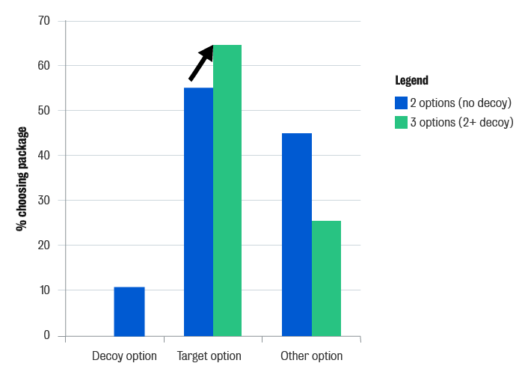
Week 7: Pricing
4.4 Reference Pricing
So what is the decoy effect? There is research that suggests that something happens in our brains when we are in the presence of a decoy. Different areas of the brain play a larger or smaller role in the presence of the decoy than when it is not present.
One of the findings is that
the amygdala, the part of the
brain associated with
negative emotions, has
decreased activation,
while another area of the
brain, associated with
decision-making, has
increased activity. If you
want to learn more about
this, we recommend you
read the work of Hedgcock
and Rao (2009).

Slide 43
Week 7: Pricing
4.4 Reference Pricing
5. Moving reference points: The anchoring effect
People tend to anchor on a number that is salient or which has been given to them at the moment of purchase/decision-making.
In an experiment, students were asked to think about the last two digits of their student ID before being shown a picture of a bottle of wine. Everyone was then asked to indicate the price that they would pay for this particular bottle of wine.
Interestingly, the students who had higher numbers at the end of their IDs tended to come up with higher prices for the bottle of wine. By simply anchoring their minds psychologically to those two digits, students were willing to pay a higher price.
Marketers can use the anchoring effect intelligently in pricing their products. For example, if they tell people that a product was X price and then drop the price a little, people anchor to that higher price and are more willing to pay the slightly lower price. Consumers think they are getting a better deal, and therefore they tend to buy the product.

