Slide 1

NSRIC Inc. (Nature Science Research and Innovation Centre)
Ontario (ON), Canada
Online Education (OE) Division
Project Operation Environment
Dr. Ali AbouAbbas, MPM, DBA
Professor & Founder of Canadian Development Center.
E-Mail: ally.a.abou@gmail.com
https://www.nsric.ca

Slide 2
Course Content
Project Management Structure.
Project Management Office (PMO).
Project Charter?
Stakeholders Management.
Matrix organization.
Project Management Process.
Planning Process.
Execution Process.

Slide 3
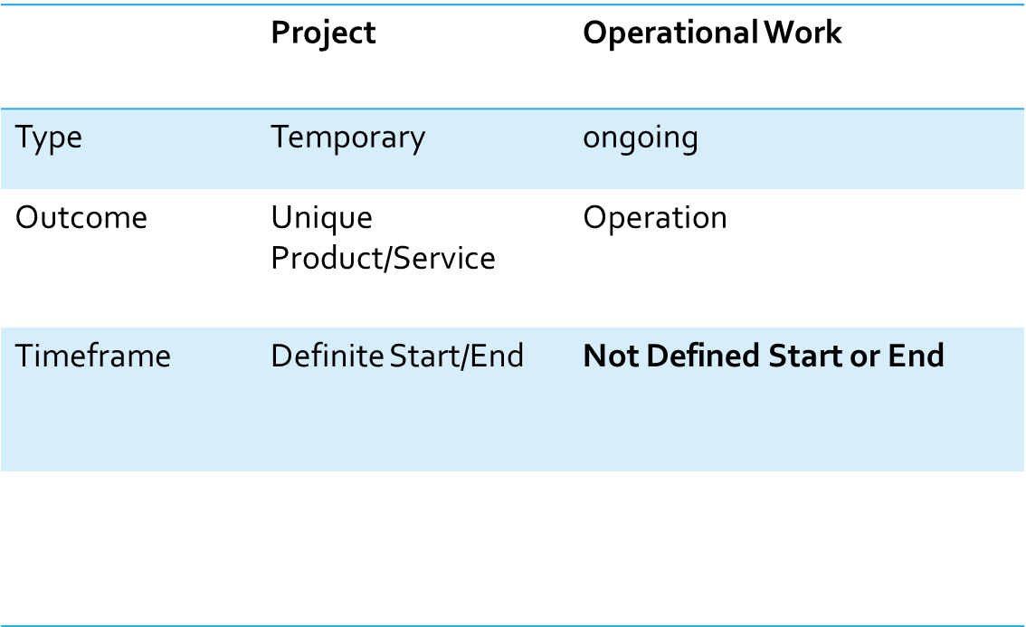
WHAT IS PROJECT MANAGEMENT?

Slide 4
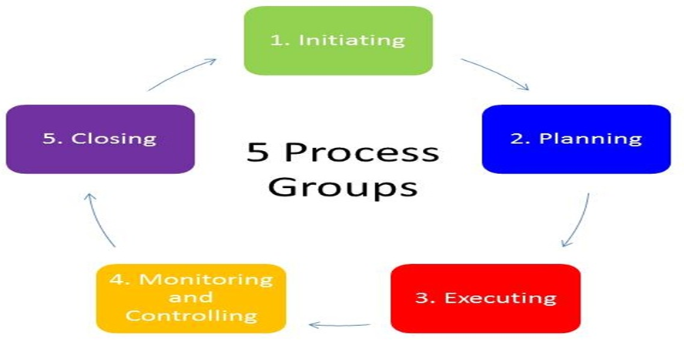
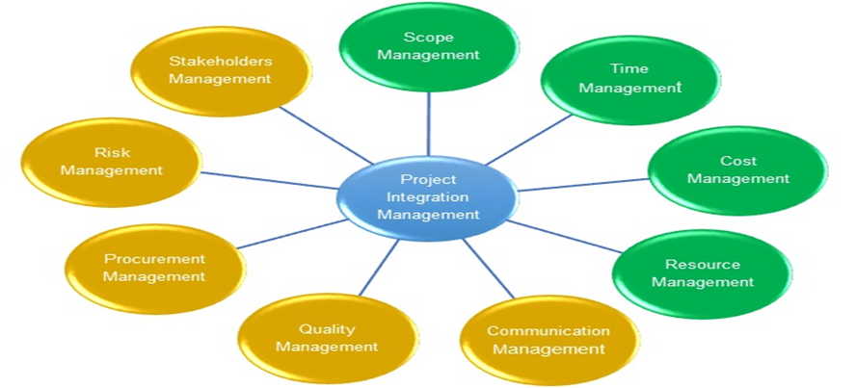
Project Management Structure.
Process Groups
Knowledge Areas

Slide 5
Review Question
After the first phase of the project is complete, which process group of the second phase should follow?
a) Initiation
b) Planning
c) Executing
d) Closing

Slide 6
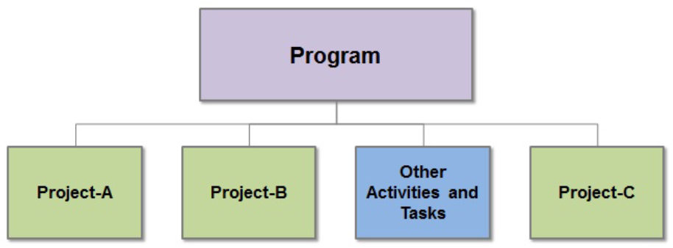
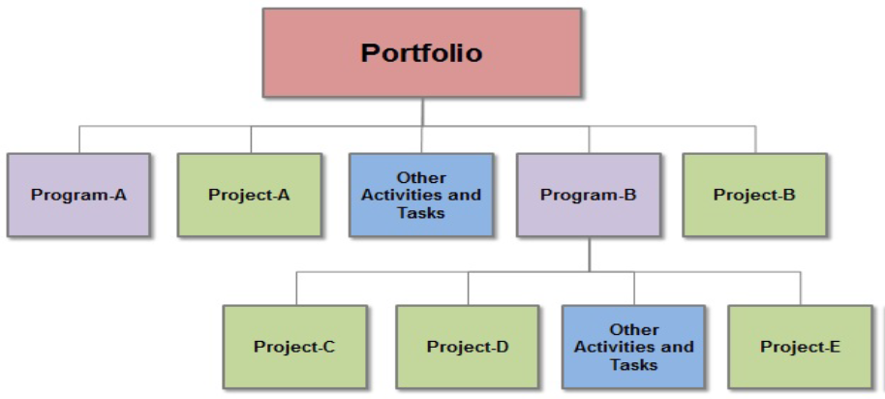
Programs Vs. Portfolio
A group of projects is termed as a Program
A portfolio includes a group of programs and
individual projects

Slide 7
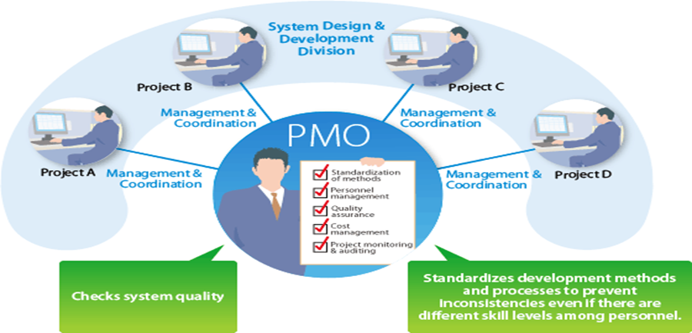
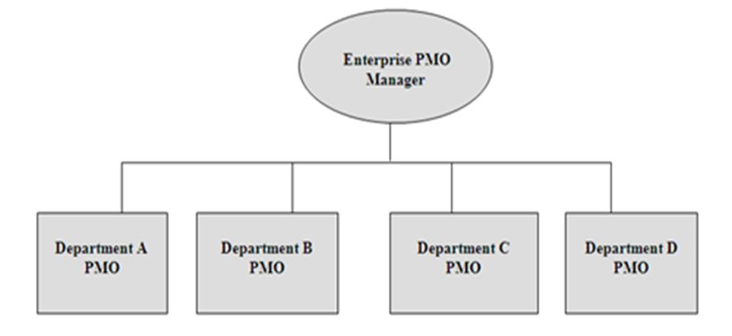
PROJECT MANAGEMENT OFFICE (PMO).
PMO is a centralized
department that manages projects.
Enterprise PMO can manage more than one PMO

Slide 8
Review Question
Which of the following BEST describes the program manager's role as an integrator?
a) Helps project managers become familiar with the program
b) Track all the projects under one program and help the project managers whenever required
c) Put all the pieces of a project into a program
d) Get all team members together into a cohesive whole

Slide 9
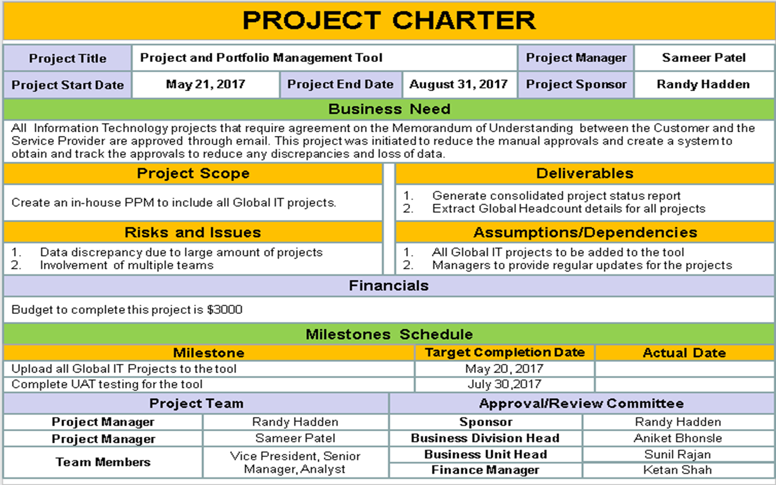
PROJECT INITIATION→PROJECT CHARTER

Slide 10
Review Question
In which of the following project management process groups are the most time and money typically spent?
a) Initiation
b) Planning
c) Executing
d) Closing

Slide 11
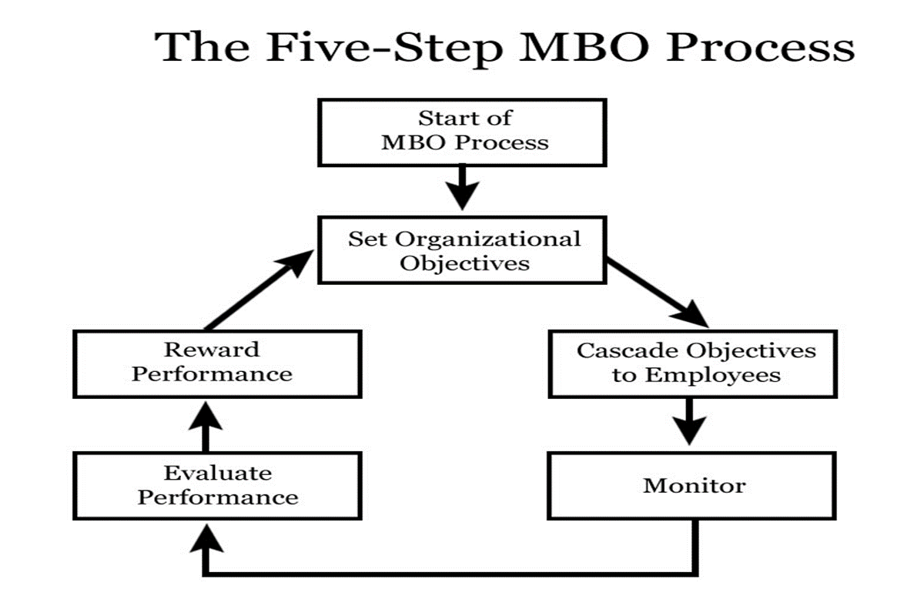
Management by Objectives (MBO)

Slide 12
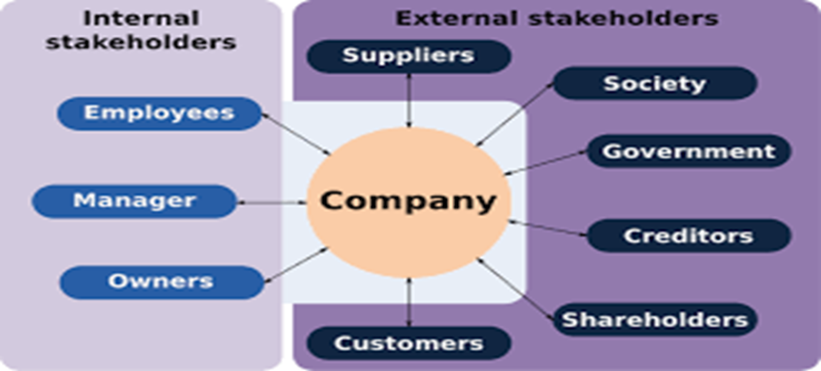
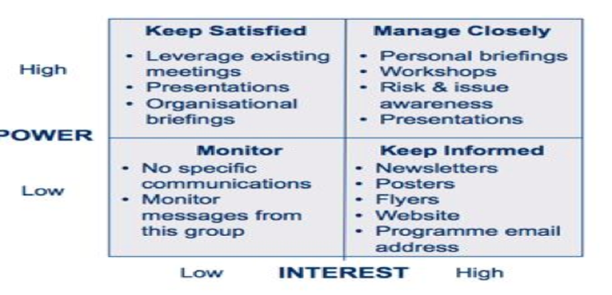
Stakeholder Management.
Stakeholder Types
Stakeholder Groups

Slide 13
Review Question
Which of these is not one of the constraints of a project?
a) Scope
b) Resources
c) Team
d) Budget

Slide 14
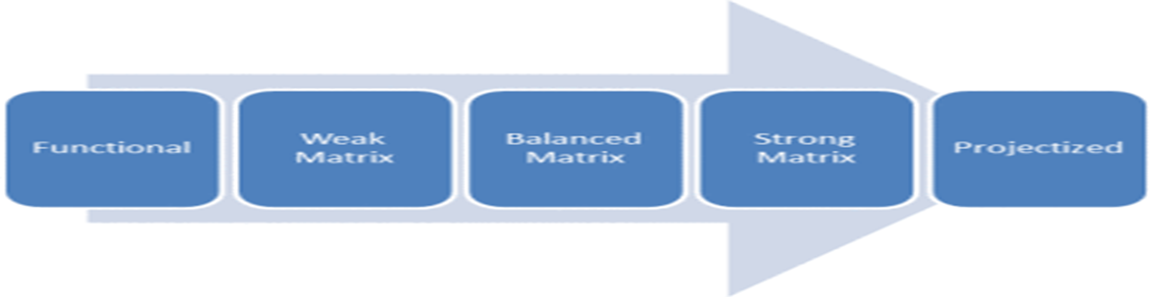
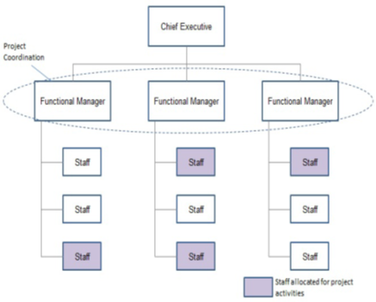
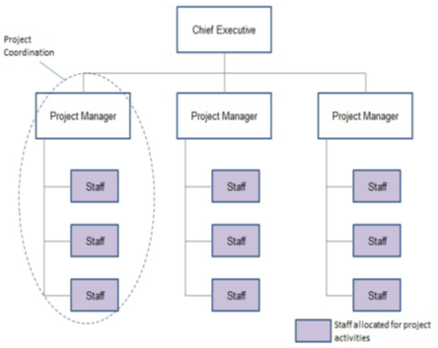
ORGANIZATIONAL INFLUENCES AND PROJECT LIFECYCLE

Slide 15
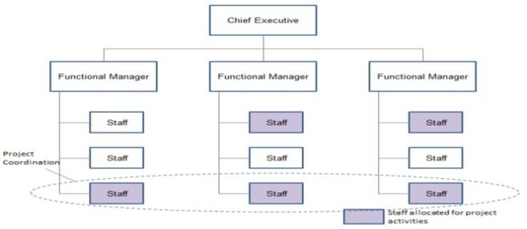
Matrix Organization
Weak matrix organization, the power remains with the functional manager. The project manager is a coordinator or an escalator.

Slide 16
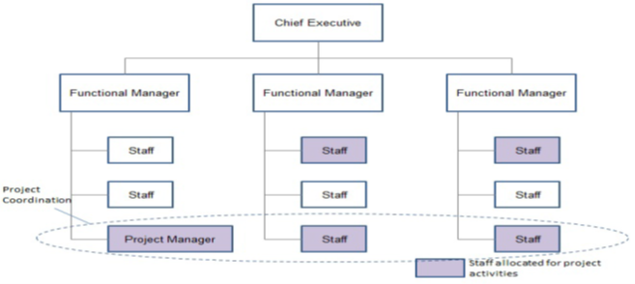
Matrix Organization
Balanced matrix, the power is equally balanced between the project manager and the functional manager.

Slide 17
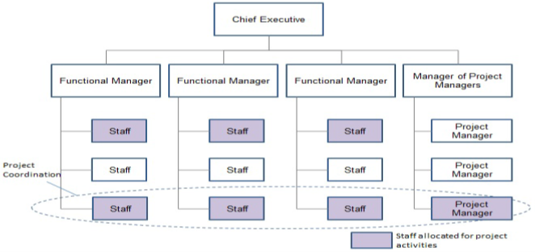
Matrix Organization
Strong matrix organization, the power remains with the project manager.

Slide 18
Review Question
You are the Project Managers of XYZ consultants. The Project team members are from Finance and HR departments. The team members report to Finance and HR Managers respectively, and you have limited control over them. What type of organizational hierarchy does XYZ consultants follow?
a) Matrix organization b) Projectized organization c) Functional organization d) None of these.

Slide 19
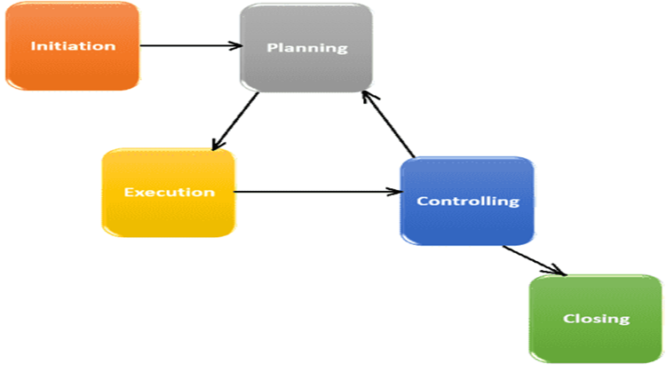
Cycle Types.
PROJECT LIFE CYCLE A project life cycle is required to be executed to produce the deliverables of the project. The life cycle of a project can span from initiation phase to its closure phase

Slide 20
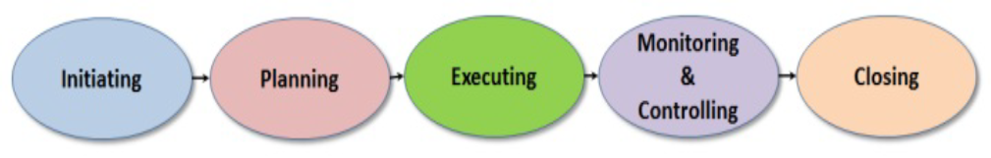
PROJECT MANAGEMENT PROCESSES.
Input
*Business case
*Product description
*Linkage of company’s strategy with the project
*Likely stakeholders
*Contracts
*Current Industry Standards
*Change Control System
*Defined processes and procedures
*Templates from past projects
*Historical Work Breakdown Structures (WBS)
*Historical Estimates
*Understanding company’s culture
*Possible team members
Output
*Project Charter
*Identified Stakeholders
*Stakeholder Management
Initiation Phase
The project manager is assigned during the Initiating phase in the project
High Level Planning

Slide 21
Planning Process
- Blueprint of the Project
- Getting the project organized before work execution
- A detailed analysis of whether the project team can achieve the project objectives
Input
Output
• Creating a Project Management Plan
• Identifying Stakeholders and their needs
• Collecting Requirements
• Defining Scope
• Creating WBS
• Defining Work packages and Activities
• Sequencing Activities
• Estimating Activity Resources
• Estimating Activity Durations
• Developing Schedule
• Estimating Costs
• Determining Budget
• Planning Quality
• Developing Human Resource Planning
• Planning Communication
• Planning Risk Management
• Identifying Risks
*Project Charter
*Identified Stakeholders
*Stakeholder Management
Planning Phase

Slide 22
Executing Process
- Completing the work as defined in the project management plan
- Meeting the project objectives
Input
Output
•Project Management Plan
• Stakeholders needs
• Project Scope
• Project WBS
• Work packages and Activities
• Activity Schedule
• Project Cost Estimate
• Budget
• Quality Plan
• Human Resource Plan
• Communication Plan
• Risk Management Plan
Executing Phase
Project Deliverables
• Direct and Manage Project Execution
• Perform Quality Assurance
• Resource Acquisition & Management
• Distribute Information
• Manage Stakeholder Expectations
• Conduct Procurements

Slide 23
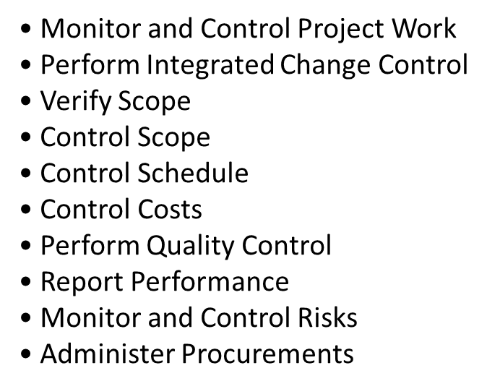
MONITORING AND CONTROLLING PROCESS
Measuring the performance of the project with the project management plan
Approving change requests
Monitoring and controlling all project areas, tasks, and activities in iterative mode

Slide 24
CLOSING PROCESS
Project is completed only when the project closure is completed. The actions required for Closing Process are:
• Close Project or Phase
(formal sign-off that the product of the project is acceptable by stakeholder(s)
• Close Procurements

Slide 25
Review Question
Which of the following is not a project?
a) Running an election campaign for a political candidate. b) Building a bridge over a river. c) Pilot aircraft for a United flight. d) Writing a book on Project Management.

