Slide 1
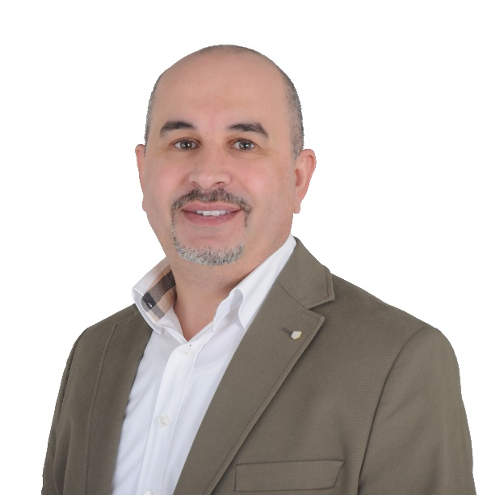
NSRIC Inc. (Nature Science Research and Innovation Centre)
Ontario (ON), Canada
Online Education (OE) Division
Culture Awareness in Project Management
Dr. Ali AbouAbbas, MPM, DBA
Professor & Founder of Canadian Development Center.
E-Mail: ally.a.abou@gmail.com
https://www.nsric.ca

Slide 2
Course Content
Scope Management.
Define Project Scope.
Expert Judgement Technique.
work breakdown structure (WBS).
Time Management.
Estimation Types.
Schedule Network Analysis

Slide 3
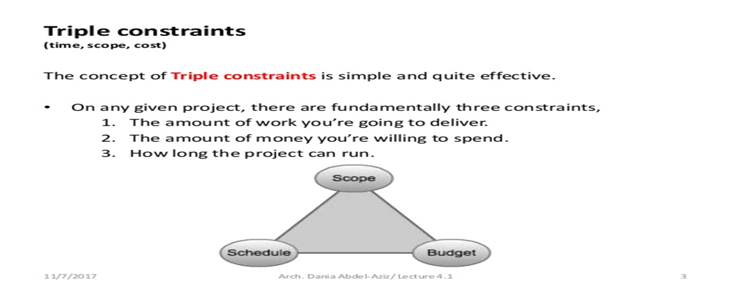
SCOPE MANAGEMENT.
Scope management plan is the process of defining:
What IS INCLUDED in the project (Planning Stage)
What IS NOT INCLUDED in the project (Planning Stage)
Scope and Change validations (Monitoring & Controlling)
Why Projects need Scope Management Plan?
To prevent Gold-Plating (Not Allowed EXTRA Tasks) to the project
Scope Management Plan is part of the Project Management Plan

Slide 4
Review Question
Project Scope is:
a) The work that must be done in order to deliver a product with the specified features and functions.
b) The features and functions that are to be included in a product or service.
c) A narrative description of work to be performed under contract.
d) A & B

Slide 5
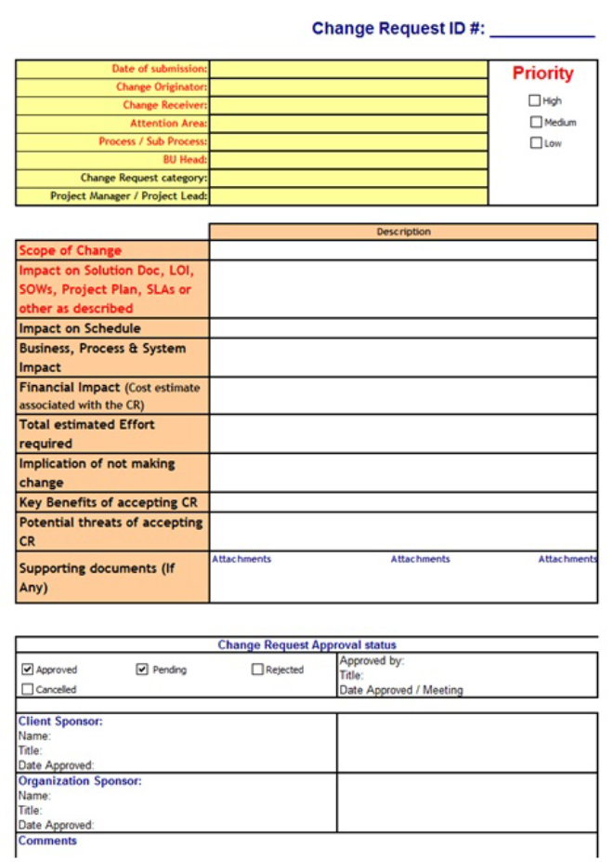

Change Request Information Section
Impact on Scope, Schedule, and Cost Section

Slide 6
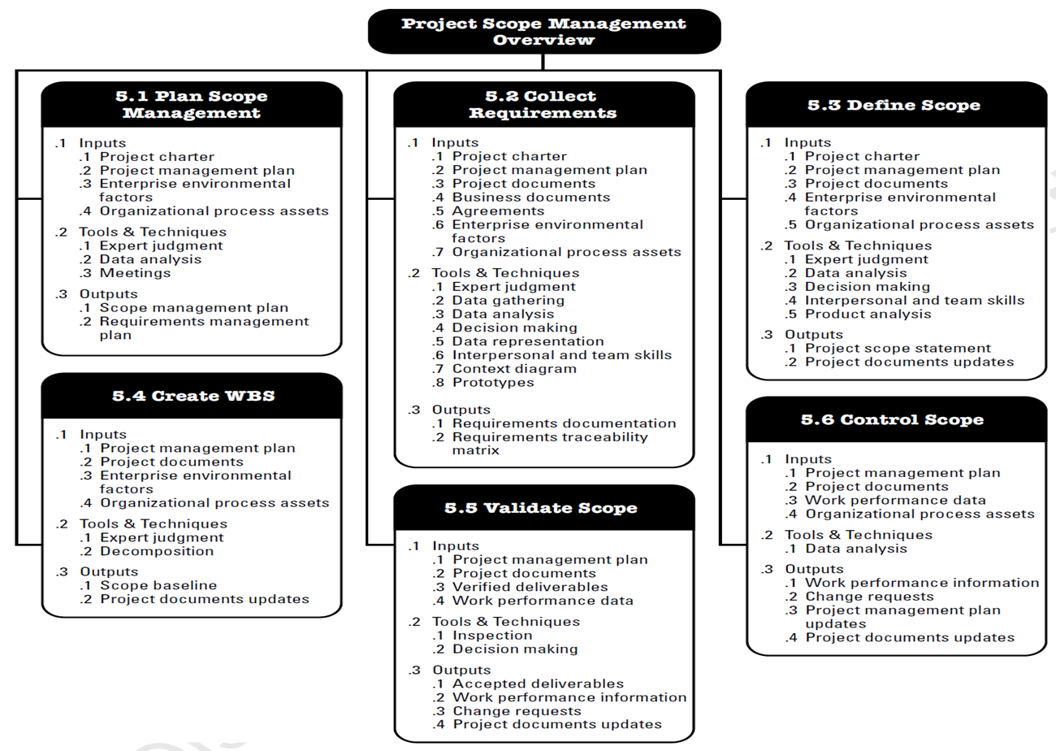
Scope Management Overview.

Slide 7
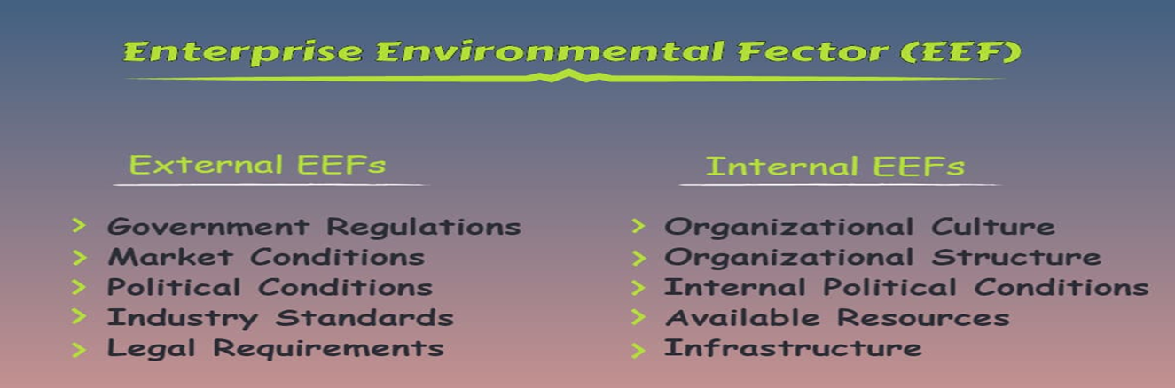
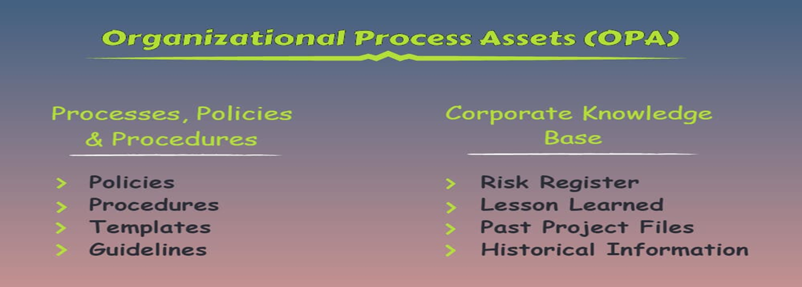
Scope Management Overview.

Slide 8
Expert Judgement Technique.
Meetings Technique
Focus Group: Decided group with a stakeholder or certain Requirement using moderator
Facilitated Workshop: Group of Stakeholders with moderator/facilitator
Brainstorming (Group-Think): helps to produce large number of ideas in a short period of time.
Delphi-Technique:
- No need for physical meetings – anonymous identity
- Responses are compiled, and the results are sent back for further review until a final consensus is reached.

Slide 9
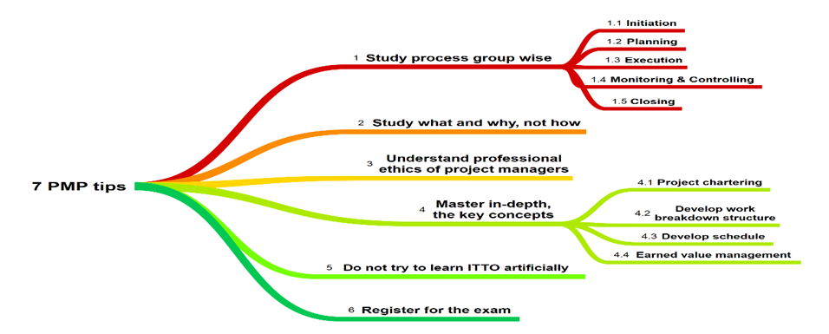
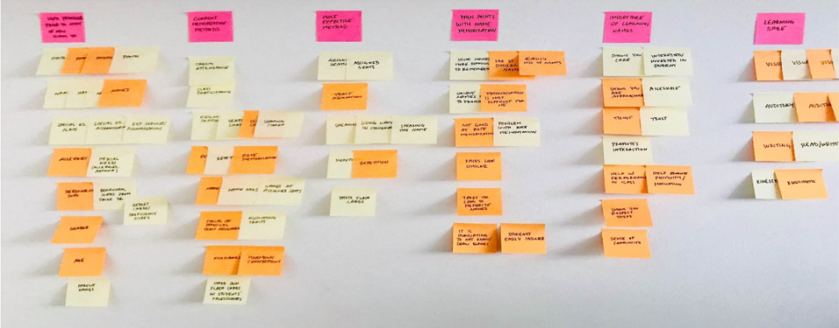
MIND MAP Technique:
AFFINITY DIAGRAM Technique:

Slide 10
PROTOTYPE TECHNIQUE: A model of the proposed product is a prototype.
REQUIREMENTS DOCUMENTATION: Should be clear, unambiguous, and approved with ALL the stakeholders of the project.
BALANCING STAKEHOLDER REQUIREMENTS (PM Role)
Prerequisite:
Clear Project Objectives (from Project Charter)
Identify and prioritize ALL the requirements from ALL of the stakeholders during Collect Requirements Process
Identify any requirement conflict and adjust it as per scope, cost, time, project charter, and its impact on the project.

Slide 11
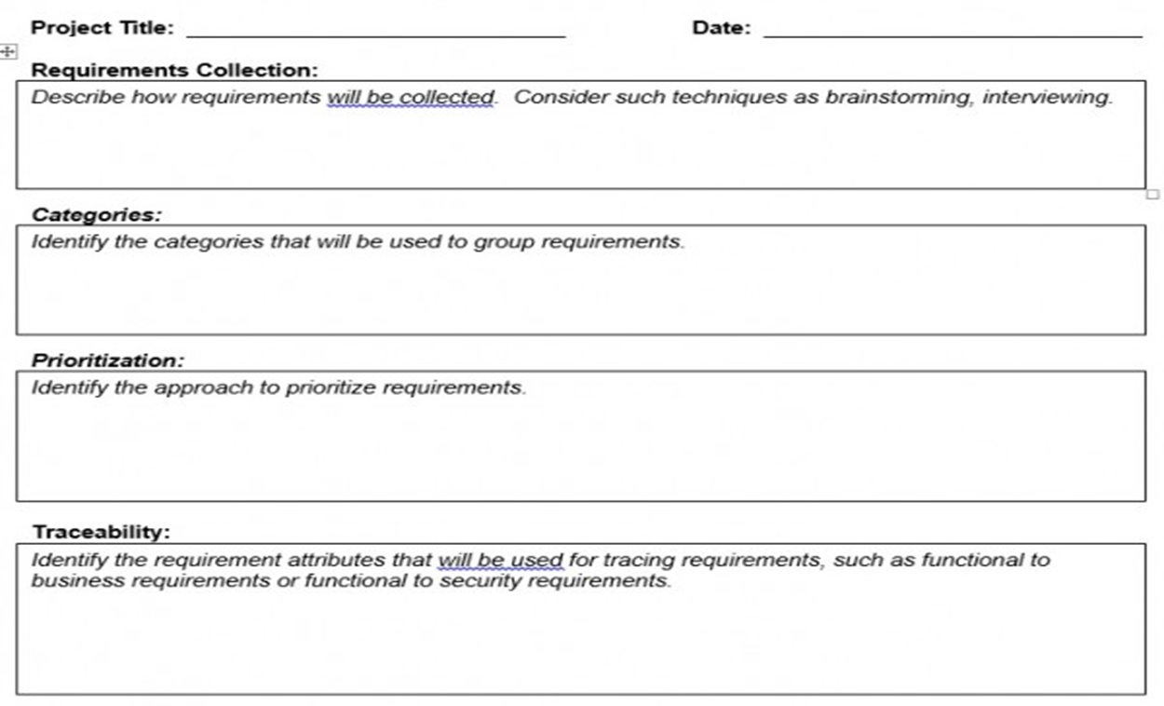
Requirements Management Plan

Slide 12
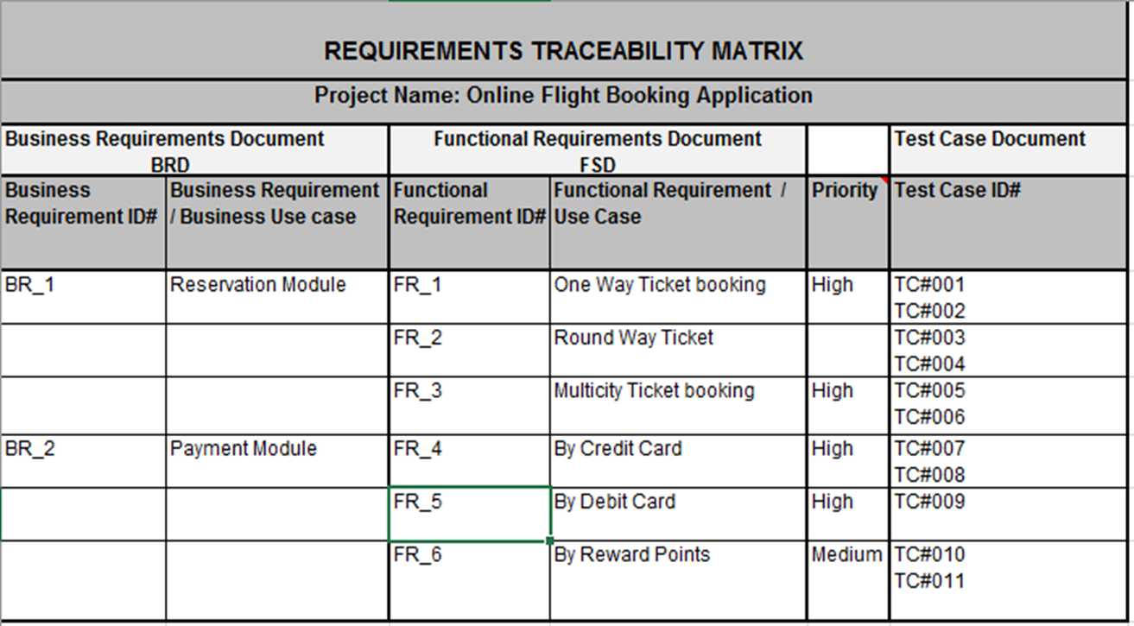
Requirements Traceability Matrix (RTM)

Slide 13
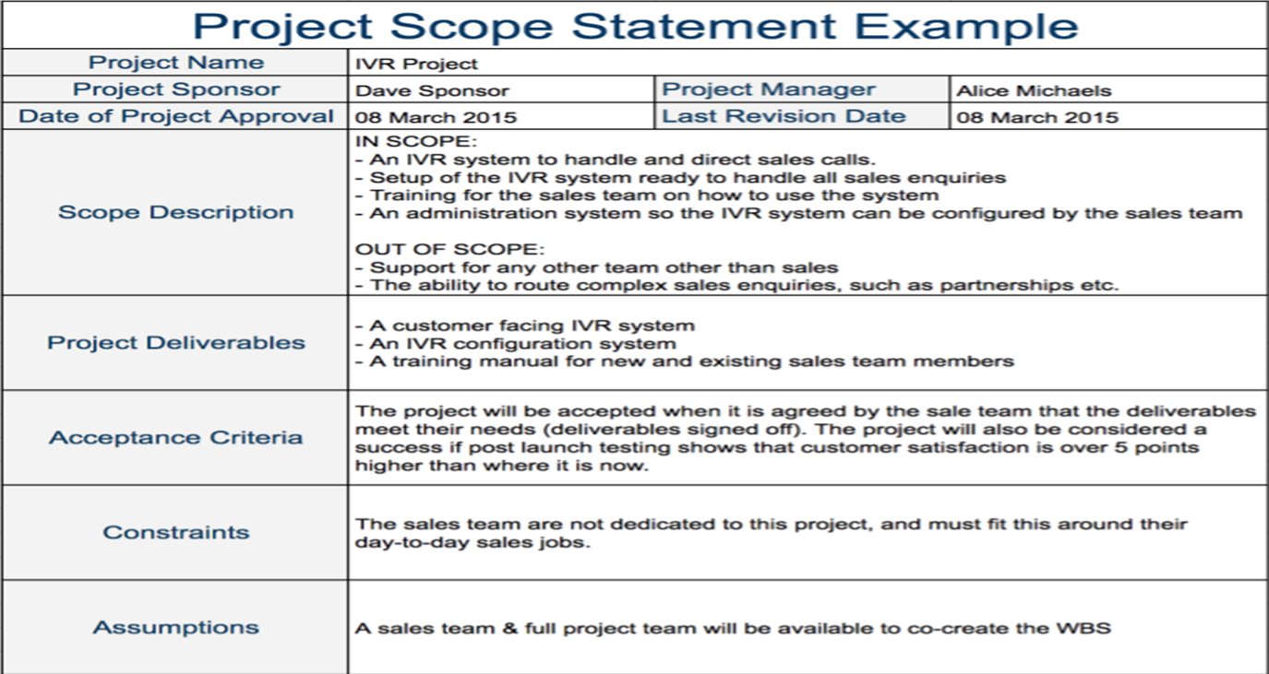
Define Scope.
The product and project scope is determined using inputs from the requirements document (created in Collect Requirements Process)
The output of product analysis is identification of tangible deliverables.
PM should NOT include SCOPE CREEP in the Scope Statement

Slide 14
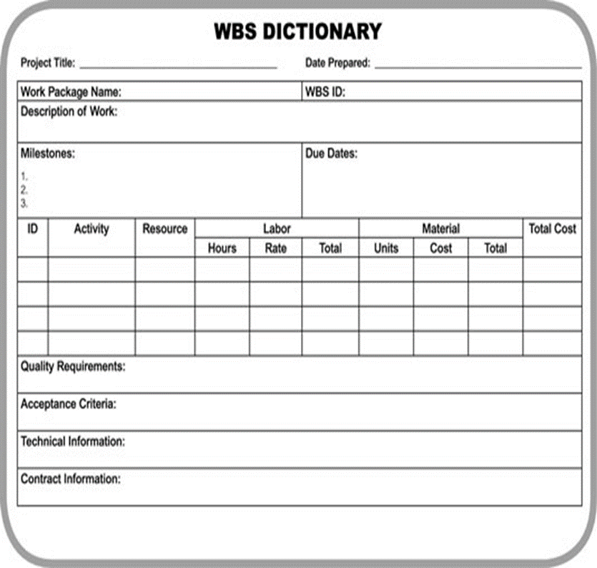
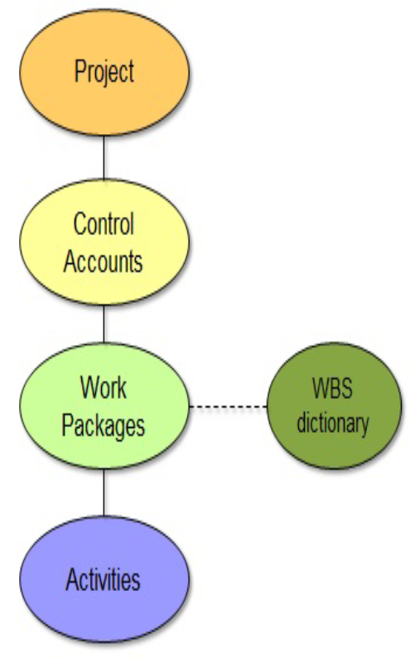
Define Scope.
The project has a hierarchy and WBS is a graphical picture of that hierarchy.
WBS and WBS Dictionary

Slide 15
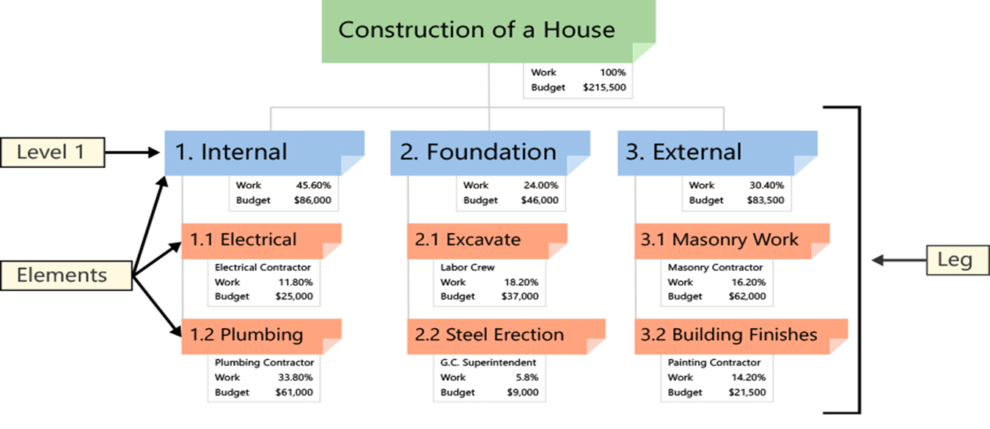
Define Scope.
Scope Baselines include WBS, WBS Dictionary, and Scope Statement
Any deviation from the baseline, a change request is needed

Slide 16
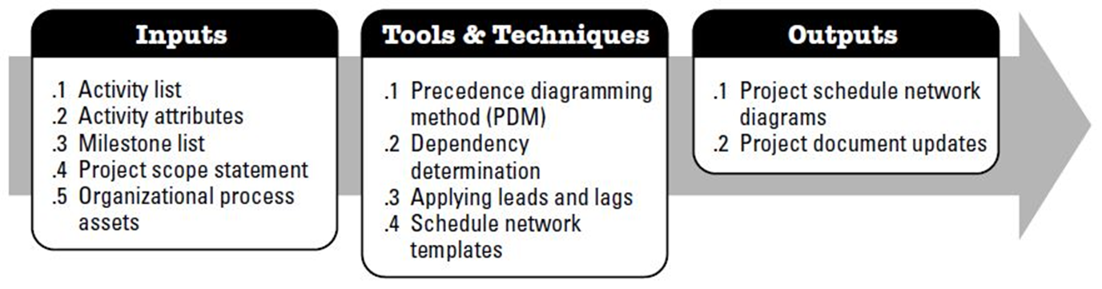
TIME MANAGEMENT.

Slide 17
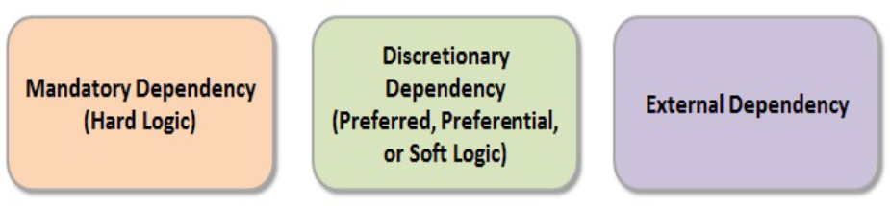
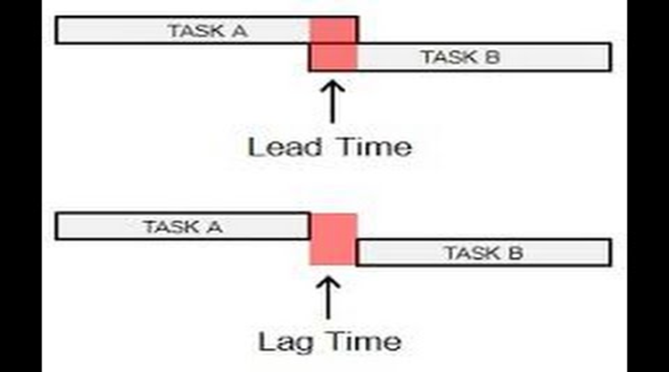
TYPES OF DEPENDENCIES
Leads and Lags
A resource could be an equipment, materials or people
The type and quantity of needed resources are determined after the activities are sequenced
Estimate Activity Resources

Slide 18
Estimation Types
one estimate is made per activity
Contingency Reserve – Based on time
Management Reserve – Fund Reserve
uses a similar past project to estimate the duration or cost of your current project
estimators give an Optimistic (O), Pessimistic (P), and
most likely (M) estimate for each activity using Pert Estimate = (Optimistic + (4 X Most Likely) + Pessimistic)/6
uses the relationship between variables to calculate the cost or duration
Approximation estimation (80/20 Rule)

Slide 19
Review Question
A Project with a total funding of $100,000 finished with a BAC value of $95,000. What term can BEST describe the difference of $5,000?
a) Cost Variance
b) Management Overhead
c) Management Contingency Reserve
d) Schedule Variance

Slide 20
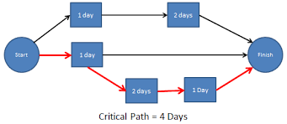
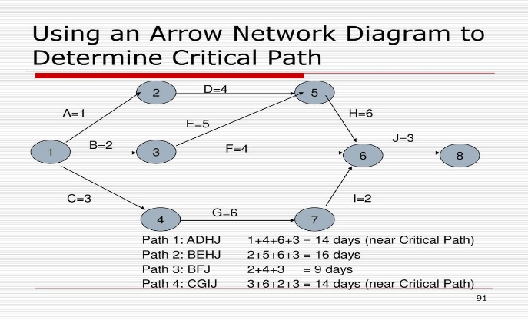
Schedule Network Analysis
CRITICAL PATH METHOD:
Longest Path in the Network Diagram
NEAR-CRITICAL PATH:
Path(s) that are near in duration to the CPM

Slide 21
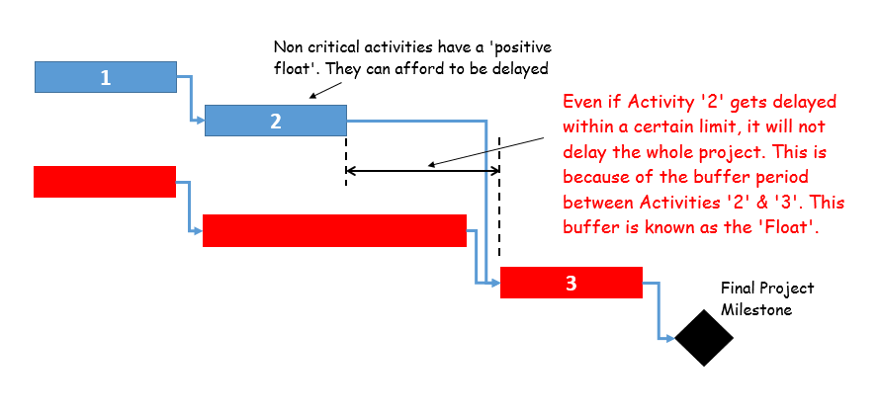
Float (Slack)
Total Float (slack): The amount of time the activity can be delayed without delaying the project end date
Free Float (slack): The amount of time the activity can be delayed without delaying the early start date of the successor(s).
Project Float (slack): The amount of time the activity can be delayed without delaying the externally imposed project completion date required by the management or by the customer.

Slide 22
Techniques to Solve Scheduling Problems
SCHEDULE COMPRESSION:
If the project has deviated considerably from the baseline, the project schedule requires compression.
The objective is to compress the schedule without changing the scope of the project.
CRASHING: This technique involves making cost and schedule trade-offs to determine how to compress the schedule the most for the least cost.
WHAT-IF SCENARIO ANALYSIS: What if a particular factor changed on the
project? Would that produce a shorter schedule?
MONTE CARLO ANALYSIS: Computer-based simulation program based on three-point estimating technique for each activity or each network diagram. Provides scenarios that could be an input for What-if analysis.
Monte Carlo analysis is used as a risk management tool to quantitatively analyze risks.

