Slide 1

NSRIC Inc. (Nature Science Research and Innovation Centre)
Ontario (ON), Canada
Online Education (OE) Division
Project Manager key Roles and skills
Dr. Ali AbouAbbas, MPM, DBA
Professor & Founder of Canadian Development Center.
E-Mail: ally.a.abou@gmail.com
https://www.nsric.ca

Slide 2
Course Content
What are the new roles and responsibilities for PM.
Skills that every good project manager needs.
What are the types of communications?
Organizational skills.
What are the main key elements of budgeting for every project.
Problem-Solving skills as a key element for daily operation.
Negotiation Skills in PM.
Cultural Intelligence Awareness.

Slide 3

Q1: What are the Roles and Responsibilities for a PM?

Slide 4

Project Manager key Roles and skills
Guaranty Project Objectives.
Recruit & Motivate People.
Sets Project Strategies & Plan.
Control Project Execution.
Detect & Resolve Problems.
Ensure Quality.
Identify & Mitigate Risk.

Slide 5
Project Manager key Roles and skills
Guaranty Project Objectives.
SCOPE
TIME
COST

Slide 6


Slide 7

Project Manager key Roles and skills
Recruit & Motivate People.
Recruit talented people.
Getting everyone committed.
Motivate people.

Slide 8

Project Manager key Roles and skills
Sets Project Strategies & Plan.

Slide 9

Project Manager key Roles and skills
Control Project Execution.

Slide 10

Project Manager key Roles and skills
Detect & Resolve Problems.
Identify issues before anyone.
Key to protect success.
Manage by waking around and listen intently.
Interact with team members.

Slide 11

Project Manager key Roles and skills
Ensure Quality.
Identify the standard.
Monitor and control quality.
Frequent evaluation.

Slide 12

Project Manager key Roles and skills
Identify & Mitigate Risk.
To reduce plan gaps.
Risk can dictate how you control project execution and monitor quality.
Reduce possibility to reach objective.

Slide 13


Slide 14
Project Manager key Roles and skills
A Study:
Conducted by Barry & Posner from Sana Clara University.
287 PM (189 men and 98 women), age ( 22 to 60 years).
Q1: What factors or variables are most likely to cause you problems in managing a project?
Q2: what personal characteristics, traits, or skills, make for “above average” project manager?

Slide 15


Slide 16
Project Manager key Roles and skills
Communication Skills.
Organizational Skills.
Budgeting Skills.
Problem-Solving Skills.
Negotiation Skills.
Leadership Skills.
Team-Building and Human Resources Skills

Slide 17
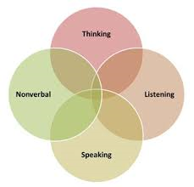
Project Manager key Roles and skills
Communication Skills.

Slide 18


Slide 19
Project Manager key Roles and skills
Organizational Skills.
A project manager organizes documents, meetings, teams, and media releases (if applicable) among other things.
Documents such as: project plan, project reports, memos, contracts, and so on.
A project manager should be able to produce any of those documents on moments notice.

Slide 20


Project Manager key Roles and skills
Budgeting Skills.
Finance
Accounting
Manage cost Estimation
PM
Manage Spending
Reading & Understanding vendor quotes | Preparing & overseeing purchase orders. | Reconciling invoices for purchase orders.

Slide 21


Slide 22

Project Manager key Roles and skills
Problem-Solving Skills.
Four basic steps in solving a problem:
Defining the problem.
Generating alternatives.
Evaluating and selecting alternatives.
Implementing solutions.
There are many strategies in conflict situation:
Forcing, accommodating, avoiding, compromising, and collaborating.

Slide 23


Project Manager key Roles and skills
Negotiation Skills.
Negotiation Process: The power of nice.
Prepare
Probe
Propose
Alternative.
Interest.
Deadline.
Weaknesses & Strengths.
Why?
What? Questions.
Answers
Let other side Go first.
Don’s accept their offer quickly.
Aim high.

Slide 24
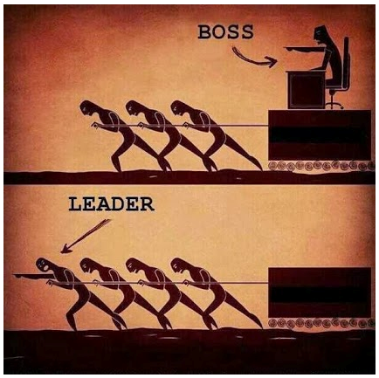
Project Manager key Roles and skills
Leadership Skills.
Tolerant.
Problem solving.
Flexible.
Effective communicator.
Credible.

Slide 25


Slide 26

Project Manager key Roles and skills
Team-Building and Human Resources Skills.
Plan human resource management.
Acquire project team.
Develop project team.
Manage project team.

Slide 27

Project Manager key Roles and skills
Program Manager Role.
• Managing related projects to achieve results not obtainable by managing each project separately
• Ensuring selected projects support the strategic goals of the organization
• Providing oversight to adjust projects for the program’s benefit
• Guiding and supporting individual project manager’s efforts

Slide 28
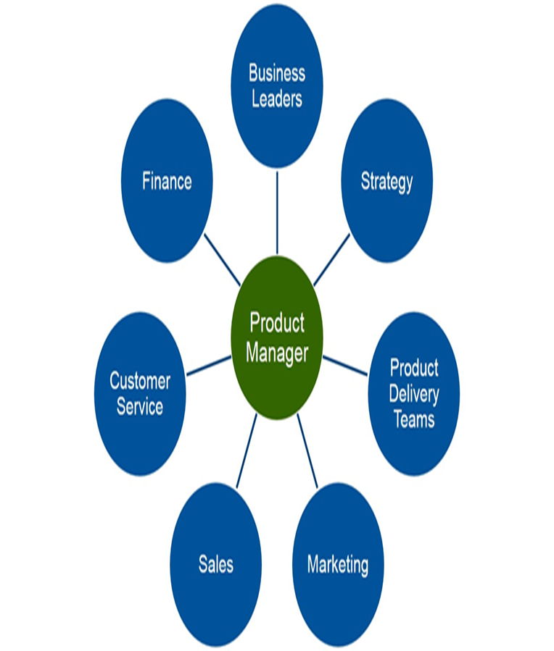
Project Manager key Roles and skills
Product Manager Role.
able to study the market needs
able to explore the opportunities and minimize the threats to make the organization successful
able to monitor the performance of the products in the market and keep a close check on competitors’ products
able to play an important role in launching a new product
able to be a sounding board for his operational team to stop production of any of its non-performing products
able to be responsible to manage product’s performance in the market

Slide 29
Project Manager key Roles and skills
Service Manager Role.
• Monitor the overall performance of his service area
• Identify metrics for performance and tracking them
• Continue relationships with project teams
• Responsible to manage team’s performance in the service area

Slide 30
Project Manager key Roles and skills
Product Quality Manager Role.
• identify the critical parameters/metrics that could fail the product when in use
• identify and implement audit mechanisms for these products
• identification and selection of quality auditors
• create a mechanism to track and monitor quality performance of the product

Slide 31
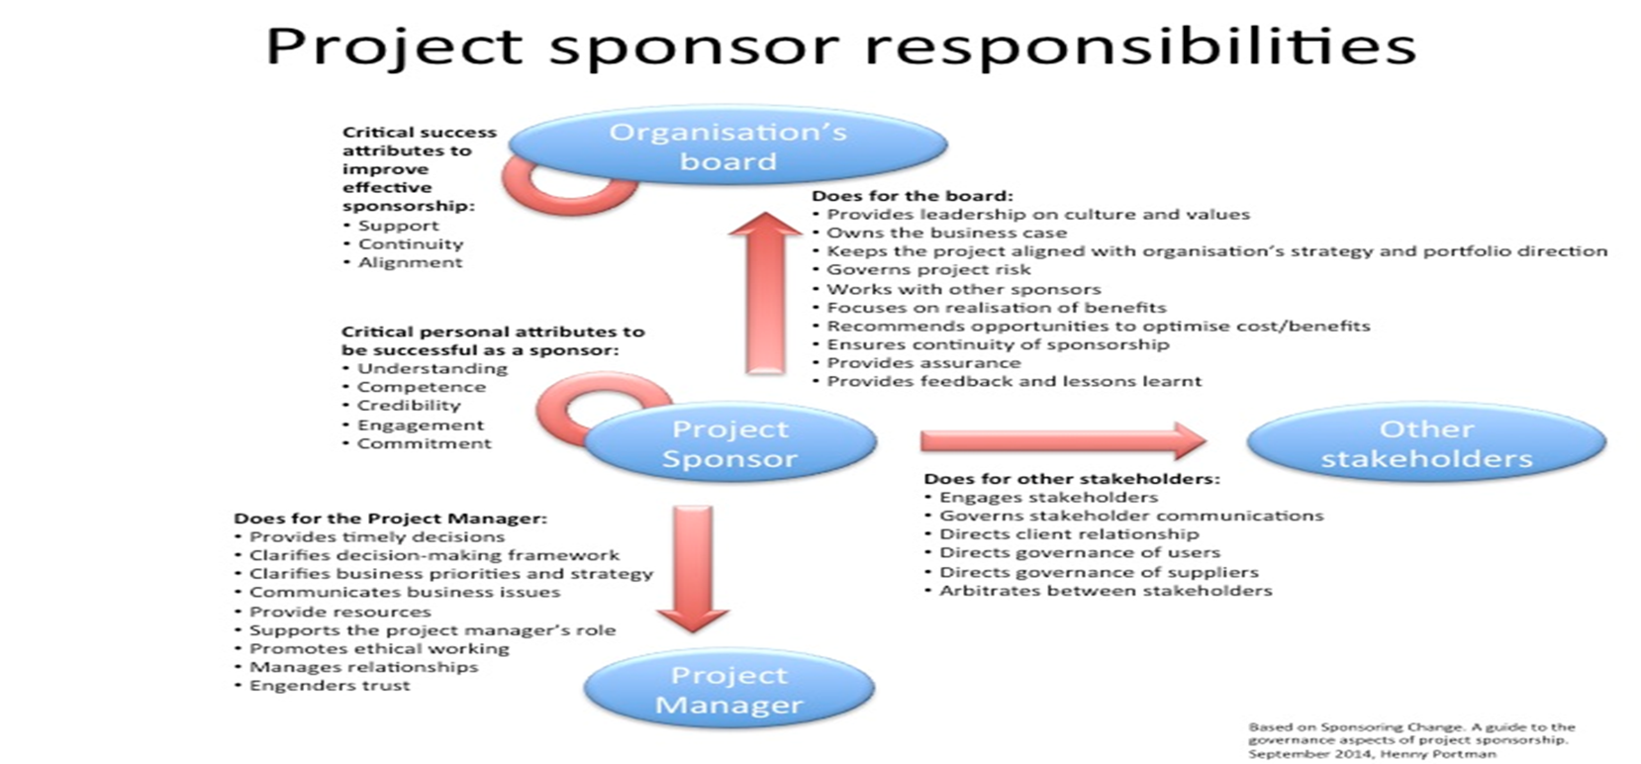
Project Manager key Roles and skills
Sponsor Role.

Slide 32
Cultural Awareness
Cultural Intelligence (CQ) :
Cognitive CQ,
Metacognitive CQ,
Motivational CQ,
Behavioral CQ.

Slide 33

Final Exam (30Mins)

