Slide 1

NSRIC Inc. (Nature Science Research and Innovation Centre)
Ontario (ON), Canada
Online Education (OE) Division
NSRICURA13_1 – Practical Procedures in Testing Software Project(s)
Rasham Majachani
Instructor
NSRIC Inc.
London, ON, Canada
E-mail: rmajachani@gmail.com
Insert Your Picture in the Box
https://www.nsric.ca

Slide 2
Testing Throughout the Software Development Lifecycle Chapter 2
Keywords
Acceptance testing, alpha testing, beta testing, change-related testing, commercial off-the-shelf (COTS), component integration testing, component testing, confirmation testing, contractual acceptance testing, functional testing, impact analysis, integration testing, maintenance testing, non-functional testing, operational acceptance testing, regression testing, regulatory acceptance testing, sequential development model, system integration testing, system testing, test basis, test case, test environment, test level, test object, test objective, test type, user acceptance testing, white-box testing

Slide 3
Software Development Lifecycle Models
A software development lifecycle model describes the types of activity performed at each stage in a software development project, and how the activities relate to one another logically and chronologically

Slide 4
Software Development and Software Testing
It is an important part of a tester's role to be familiar with the common software development lifecycle models so that appropriate test activities can take place.
In any software development lifecycle model, there are several characteristics of good testing:
For every development activity, there is a corresponding test activity
Each test level has test objectives specific to that level

Slide 5
And…
Test analysis and design for a given test level begin during the corresponding development activity
Testers participate in discussions to define and refine requirements and design and are involved in reviewing work products (e.g., requirements, design, user stories, etc.) as soon as drafts are available

Slide 6
Common software development lifecycle models are as follows:
Sequential development models
Iterative and incremental development models

Slide 7
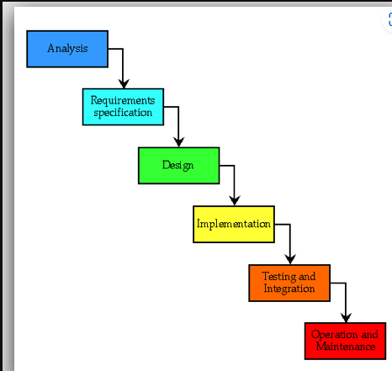
Sequential development models
The model describes the software development process as a linear, sequential flow of activities

Slide 8
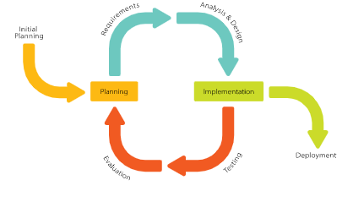
Iterative and incremental development models
Incremental development involves establishing requirements, designing, building, and testing a system in pieces, which means that the software’s features grow incrementally

Slide 9
Software development lifecycle models
Software development lifecycle models must be selected and adapted to the context of project and product characteristics

Slide 10
Reasons, why software development models must be adapted to the context of project and product characteristics, can be:
Difference in product risks of systems (complex or simple project)
Many business units can be part of a project or program (a combination of sequential and agile development)
Short time to deliver a product to the market (merge of test levels and/or integration of test types in test levels)

Slide 11
Test Levels
The test levels used in typical projects are:
Component testing
Integration testing
System testing
Acceptance testing

Slide 12
Test levels are characterized by the following attributes:
Specific objectives
Test object (i.e., what is being tested)
Typical defects and failures
Specific approaches and responsibilities

Slide 13
Component/Unit Testing as a Test Level
Component testing (also known as unit or module testing) focuses on components that are separately testable.
Objectives of component testing include:
Reducing risk
Verifying whether the functional and non-functional behaviors of the component are as designed and specified

Slide 14
Objectives of component testing also include:
Building confidence in the component’s quality
Finding defects in the component
Preventing defects from escaping to higher test levels

Slide 15
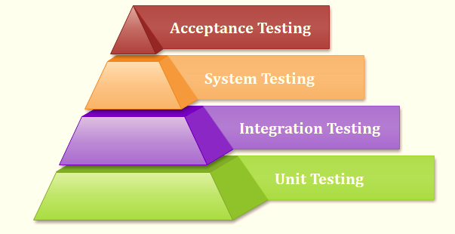
Test basis / information needed in order to start the test analysis and create our Test Cases
Examples of work products that can be used as a test basis for component testing include:
Detailed design
Code
Data model
Component specifications

Slide 16
Test objects
Typical test objects for component testing include:
Components, units, or module
Code and data structures
Database modules

Slide 17
Typical defects and failures
Examples of typical defects and failures for component testing include:
Incorrect functionality (e.g., not as described in design specifications)
Data flow problems
Incorrect code and logic

Slide 18
Integration Testing as a Test Level
Integration testing focuses on interactions between components or systems.
Objectives of integration testing include:
Reducing risk
Verifying whether the functional and non-functional behaviors of the interfaces are as designed and specified

Slide 19
Objectives of integration testing also include:
Building confidence in the quality of the interfaces
Finding defects (which may be in the interfaces themselves or within the components or systems)
Preventing defects from escaping to higher test levels

Slide 20
Test basis
Examples of work products that can be used as a test basis for integration testing include:
Software and system design
Sequence diagrams
Interface and communication protocol specifications
Use cases
Architecture at the component or system level
Workflows
External interface

Slide 21
Test objects
Typical test objects for integration testing include:
Subsystems
Databases
Infrastructure
Interfaces

Slide 22
Typical defects and failures
Examples of typical defects and failures for component integration testing include:
Incorrect data or missing data
Incorrect sequencing or timing of interface calls
Interface mismatch

Slide 23
Examples of typical defects and failures for component integration testing also include:
Failures in communication between components
Unhandled or improperly handled communication failures between components

Slide 24
Examples of typical defects and failures for system integration testing also include:
Inconsistent message structures between systems
Incorrect data, missing data, or incorrect data encoding
Interface mismatch

Slide 25
Examples of typical defects and failures for system integration testing also include:
Failures in communication between systems
Unhandled or improperly handled communication failures between systems

Slide 26
System Testing - as a Test Level
System testing focuses on the behavior and capabilities of a whole system or product, often considering the end-to-end tasks the system can perform and the non-functional behaviors it exhibits while performing those tasks

Slide 27
Objectives of system testing include:
Reducing risk
Verifying whether the functional and non-functional behaviors of the system are as designed and specified
Validating that the system is complete and will work as expected

Slide 28
Objectives of system testing also include:
Building confidence in the quality of the system as a whole
Finding defects
Preventing defects from escaping to higher test levels or production

Slide 29
Test basis
Examples of work products that can be used as a test basis for system testing include:
System and software requirement specifications (functional and non-functional)
Risk analysis reports
Use cases (how service/ software could potentially be used)

Slide 30
Examples of work products that can be used as a test basis for system testing also include:
Epics and user stories
Models of system behavior
State diagrams
System and user manuals

Slide 31
Test objects
Typical test objects for system testing include:
Applications
Hardware/software systems

Slide 32
Test objects also include:
Operating systems
The system under test (SUT)
System configuration and configuration data

Slide 33
Typical defects and failures
Examples of typical defects and failures for system testing include:
Incorrect calculations
Incorrect or unexpected system functional or non-functional behavior
Incorrect control and/or data flows within the system

Slide 34
Examples of typical defects and failures for system testing also include:
Failure to properly and completely carry out end-to-end functional tasks
Failure of the system to work properly in the system environment(s)
Failure of the system to work as described in the system and user manuals

Slide 35
Acceptance Testing as a Test Level
Acceptance testing, like system testing, typically focuses on the behavior and capabilities of a whole system or product
Objectives of acceptance testing include:
Establishing confidence in the quality of the system as a whole

Slide 36
Objectives of acceptance testing also include:
Validating that the system is complete and will work as expected
Verifying those functional and non-functional behaviors of the system are as specified

Slide 37
Common forms of acceptance testing include the following:
User acceptance testing
Operational acceptance testing
Contractual and regulatory acceptance testing
Alpha (testing performed to identify bugs before releasing the software product to the real users or public) and beta testing (limited number of end-users of the product to obtain feedback on the product quality)

Slide 38
Test basis
Examples of work products that can be used as a test basis for any form of acceptance testing include:
Business processes
User or business requirements
Regulations, legal contracts
Use cases, and/or user stories
System requirements
System documentation
Installation procedures
Risk analysis reports

Slide 39
In addition, as a test basis for deriving test cases for operational acceptance testing, one or more of the following work products can be used:
Backup and restore procedures
Disaster recovery procedures
Non-functional requirements
Operations documentation

Slide 40
Also in addition, as a test basis for deriving test cases for operational acceptance testing, one or more of the following work products can be used:
Deployment and installation instructions
Performance targets
Database packages
Security standards or regulations

Slide 41
Typical test objects
Typical test objects for any form of acceptance testing include:
System under test
System configuration and configuration data
Business processes for a fully integrated system
Recovery systems and hot sites (for business continuity and disaster recovery testing)

Slide 42
Typical test objects for any form of acceptance testing also include:
Operational and maintenance processes
Forms
Reports
Existing and converted production data

Slide 43
Typical defects and failures
Examples of typical defects for any form of acceptance testing include:
System workflows do not meet business or user requirements
Non-functional failures such as security vulnerabilities, inadequate performance efficiency under high loads, or improper operation on a supported platform

Slide 44
Examples of typical defects for any form of acceptance testing also include:
The system does not satisfy contractual or regulatory requirements
Business rules are not implemented correctly
The system does not satisfy contractual or regulatory requirements

Slide 45
Specific approaches and responsibilities
Acceptance testing is often the responsibility of the customers, business users, product owners, or operators of a system, and other stakeholders may be involved as well.

Slide 46
Test Types
A test type is a group of test activities aimed at testing specific characteristics of a software system or a part of a system
Objectives may include:
Evaluating functional quality characteristics, such as completeness, correctness, and appropriateness
Evaluating non-functional quality characteristics, such as reliability, performance efficiency, security, compatibility, and usability

Slide 47
Objectives also include:
Evaluating whether the structure or architecture of the component or system is correct, complete, and as specified
Evaluating the effects of changes, such as confirming that defects have been fixed (confirmation testing) and looking for unintended changes in behavior resulting from software or environment changes (regression testing)

Slide 48
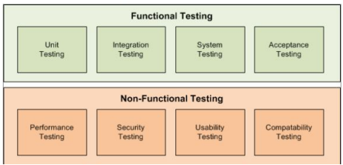
Functional Testing as a Test Type
Functional testing of a system involves tests that evaluate functions that the system should perform

Slide 49
Non-functional Testing as Test Type
Non-functional testing of a system evaluates characteristics of systems and software such as usability, performance efficiency, or security

Slide 50
White-box Testing as Test Type
White-box testing derives tests based on the system’s internal structure or implementation

Slide 51
Change-related Testing as Test Type
When changes are made to a system, either to correct a defect or because of new or changing functionality, testing should be done to confirm that the changes have corrected the defect or implemented the functionality correctly, and have not caused any unforeseen adverse consequences

Slide 52
Test Types and Test Levels
It is possible to perform any of the test types mentioned above at any test level.

Slide 53
Maintenance Testing as Test Type
Once deployed to production environments, software and systems need to be maintained

Slide 54
A maintenance release may require maintenance testing at multiple test levels, using various test types, based on its scope.
The scope of maintenance testing depends on:
The degree of risk of the change, for example, the degree to which the changed area of software communicates with other components or systems
The size of the existing system
The size of the change

Slide 55
Triggers for Maintenance
There are several reasons why software maintenance, and thus maintenance testing, takes place, both for planned and unplanned changes.

Slide 56
Impact Analysis for Maintenance
Impact analysis evaluates the changes that were made for a maintenance release to identify the intended consequences as well as expected and possible side effects of a change, and to identify the areas in the system that will be affected by the change.

Slide 57
Quiz

