Slide 1
Nature Science Research and Innovation Centre
Ontario (ON), Canada
Online Education (OE) Division
Recipe Development and Menu Planning
Lesson 20
Ms Wonda Grobbelaar (MBA)
Professor of Practice – OE Division
NSRIC Inc.
London, ON, Canada
E-mail: wonda.grobbelaar@gmail.com
https://www.nsric.ca

Slide 2
Learning Outcomes
The student will understand the steps that will be required to launch a menu or a new food item.
The student will have knowledge about the importance of social media when launching a menu or food item.
The student will be able to create a timeline to launch successfully.
The student will know the importance of training staff on, especially allergens.

Slide 3
The Final Steps

Slide 4
Ask the Following Question
Are we ready to launch the new menu?

Slide 5
Final Questions
A wrong menu design can shave millions in profits. It is possible to add revenue without changing menu prices or unit costs.
Customers are looking for foods higher in nutritional quality.
Does the menu communicate a sense of place and sense of season?
Does the menu properly highlight signature dishes or the company’s culinary point-of-view for example fine dining?
Does the menu consider the emergence of new diets, styles of eating, or the rise of food allergies?

Slide 6
Vision & Long-term Thinking
Is every functional area of the business aware of the launching of the menu? (Operation, Supply Chain and Distribution, Marketing team and the culinary team )?
Does the new menu match up with consumer trends and the company’s own culinary vision?
Does the new menu resonate with customers?
Does the serving staff feel a sense of pride in the changes?
Are the serving staff excited about the launch?
Have the cost, distribution, marketing and production been considered?
Will the menu prices be different in certain regions?

Slide 7
Pilot Studies
A pilot study can be conducted to confirm that the newly created menu is feasible before it will be rolled out to all the restaurants in the chain.
A menu can be tested without a large investment, yet ensuring the capabilities are viable.
Decide how long will you run the test.
Set clear goals what you are trying to establish.
Monitor the progress and take notes of any changes.

Slide 8
The profit is in the detail
Include clear indication on a menu what food can be ordered for different allergens.
Allergen symbols, abbreviations, or a clear description can be used to indicate the allergen.
If sales tax is excluded, clearly indicate it on the menu.
If tourism tax, staff tip or any other additional fee is excluded, it should be clearly mentioned.

Slide 9
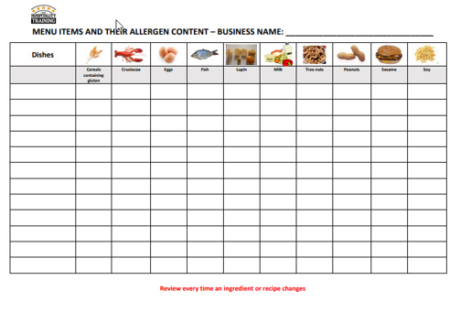
Allergen Matrix Chart

Slide 10
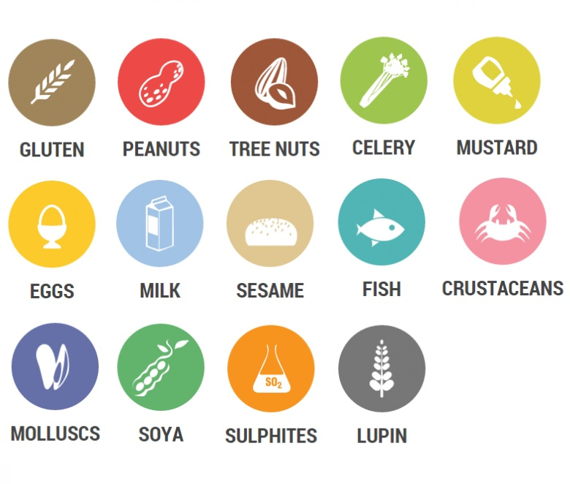
Allergen Symbols

Slide 11
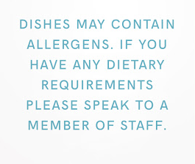
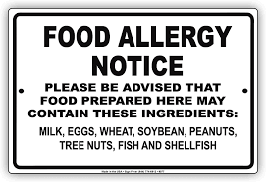
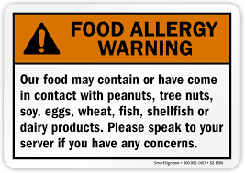
Allergen Disclaimers

Slide 12
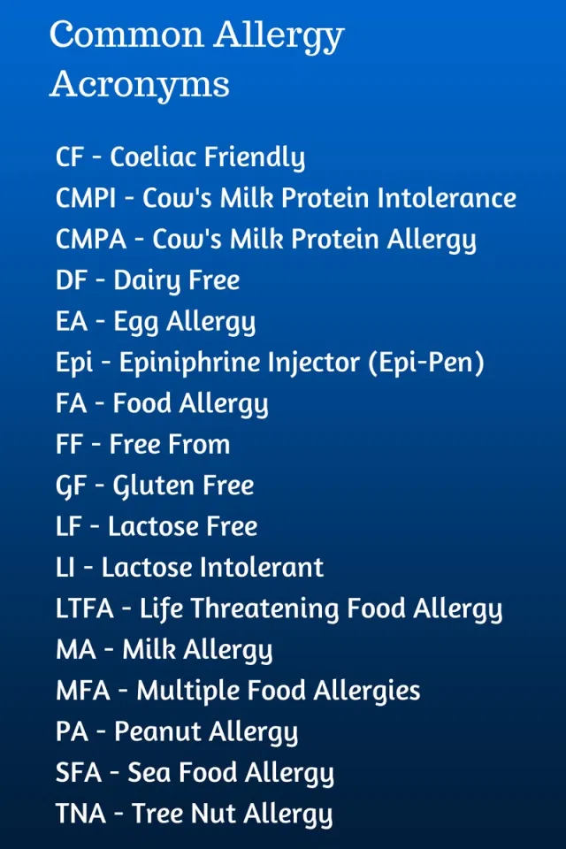
Common Allergy Acronyms

Slide 13
Quality Check
Once the menu is approved by a tasting panel and the stakeholders involved, a quality check must be conducted:
Check the adjectives used to describe menu items. Are they descriptive or exaggerated?
Are the words written in the menu true? For example: “wild caught”, “sustainable”, “free-range” or “organic”?

Slide 14
Quality Check (Continued)
Are all menu items easily pronounceable?
Will people feel comfortable ordering them?
Should you conduct a pilot study?
How will this menu affect packaging for delivery, self-ordering, drive thru or online ordering?
Check spelling and grammar.
Confirm the layout of the menu.

Slide 15
Check List
Prepare the final Standard recipes without costing suitable to use in a food production facility.
Conduct a final quality check.
Organize for menu printing.
Organize for food photography.
Start advertising on social media or speak to the marketing team.

Slide 16
Check List (Continued)
Evaluate the packaging options.
Make sure that the POS system is updated with the latest food items and pricing.
Organize for training sessions with chefs and include all food handlers.
Inform the purchasing department of new ingredients.
On the day of the launch make sure all the above steps were completed.

Slide 17
Food Photography
It is recommended to take a short course in food photography. Another option is to hire a professional photographer.
If you are going to take the photo’s, remember the following:
Always try to shoot food photos in natural lighting.
Be mindful of shadows, however it can be used as an advantage.
Backgrounds should be simple, and not filled with items that can take attention away from the main item.
Shoot from different angles to find the best possible photo.
Decorate your scene, for example if it was a Strawberry Tart, maybe you can place a fresh strawberry in the back.
Remember, less is more.
You can add a human element for example a laptop or eyeglasses.

Slide 18
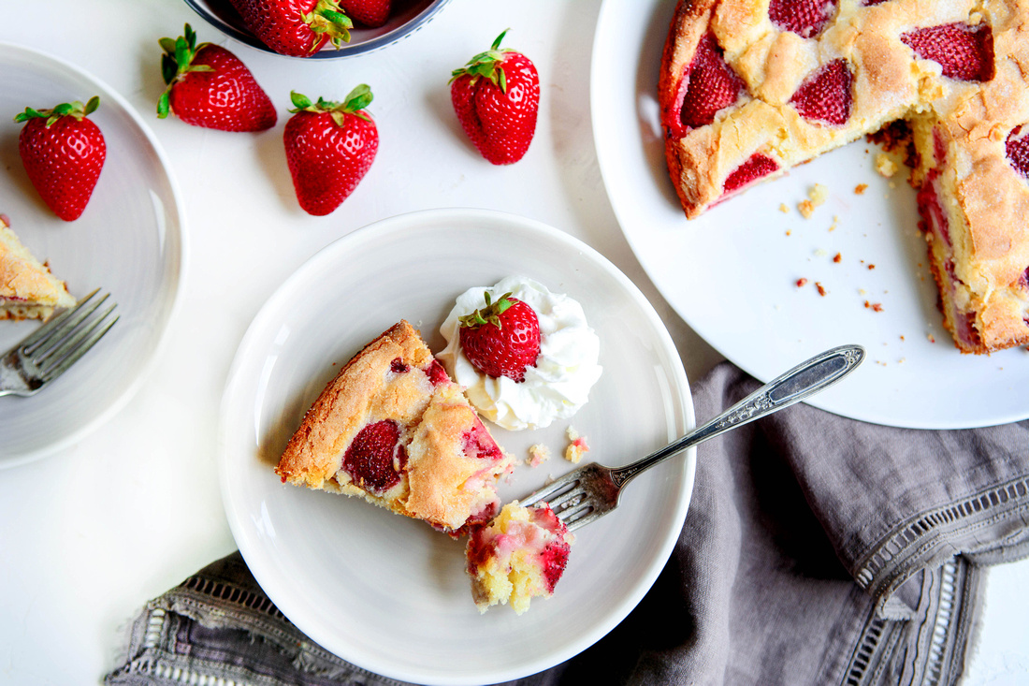
Food Photography (Continued)

Slide 19
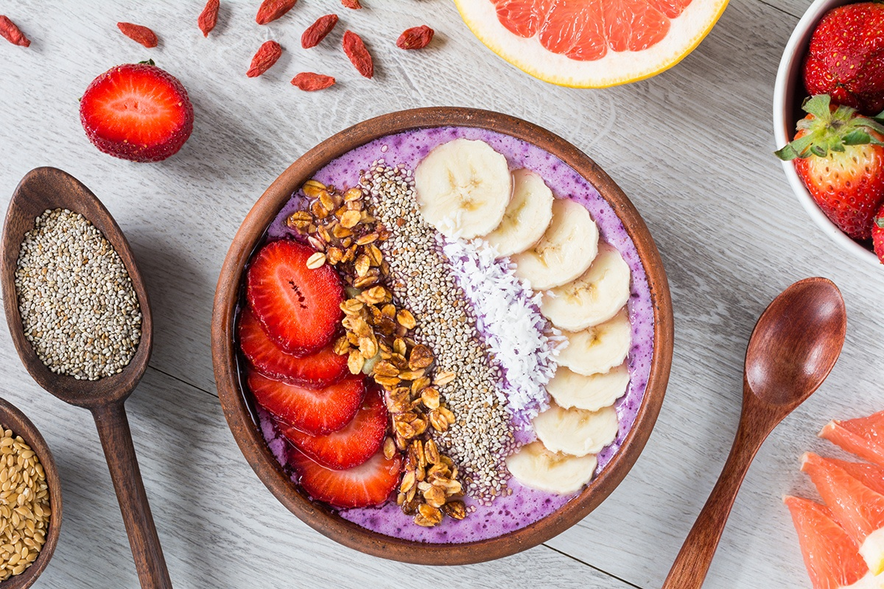
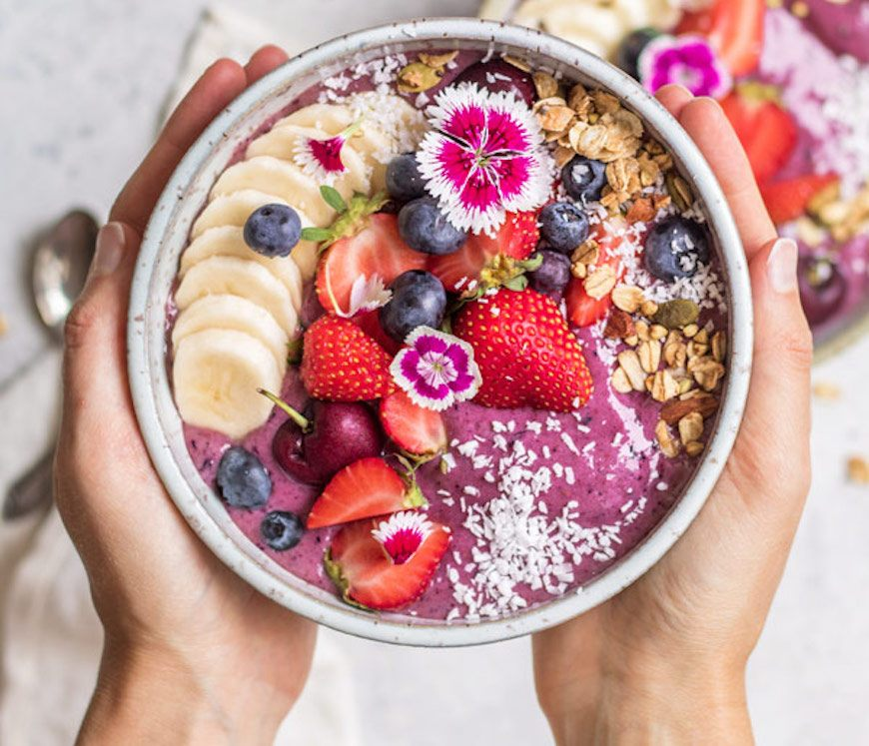
Food Photography (Continued)

Slide 20
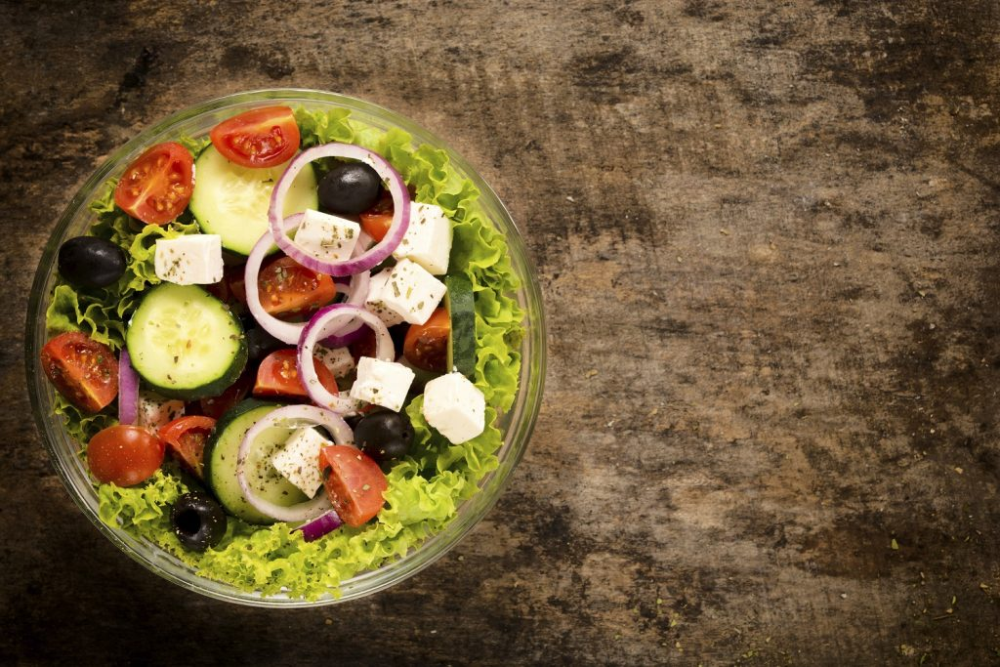
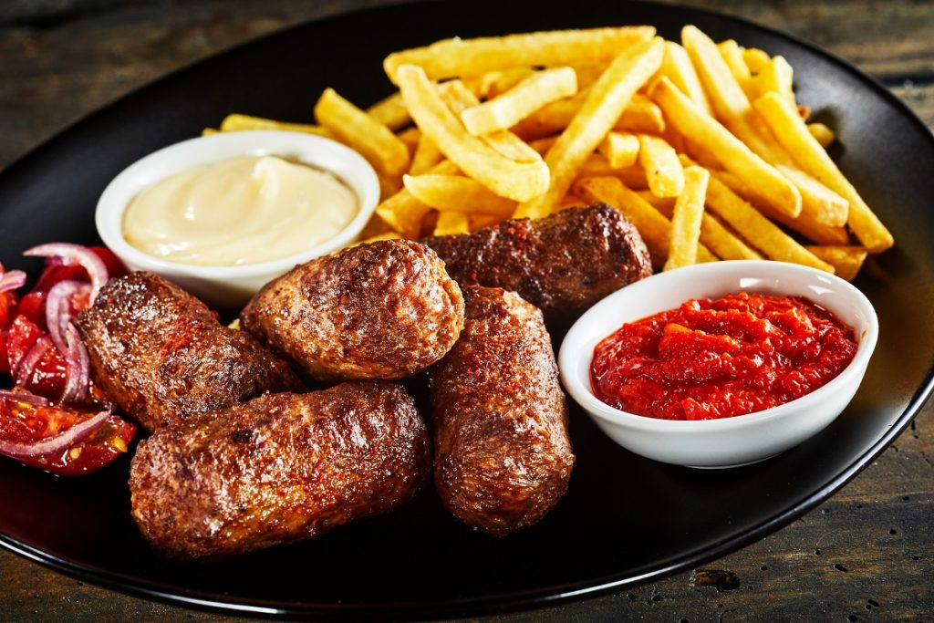
Food Photography (Continued)

Slide 21
Marketing
Start to advertise on social media at least two weeks before the launch of your new menu.
Create teasers of new menu items that you can promote on social media.
Do a short research to establish what social media platform will work best in your country to launch a new menu, however it doesn’t mean that you will exclude the other platforms.
Create incentives for customers if they will try a new menu item.
Visibly promote a new menu in your restaurant.
Alert Your email List about the launching of the new menu or food items.

Slide 22
Supply Chain
Give an ingredient list for new items well in advanced to the purchasing officer.
Sometimes it takes time to find the best supplier of a specific ingredient.
An audit must be conducted on a supplier, before they can be added to an established supplier list of a company.
The ingredient request should be very clearly written (Size, brand, color, flavor).
If there is more than one option, ask for samples, so that the new food item can be confirmed.

Slide 23
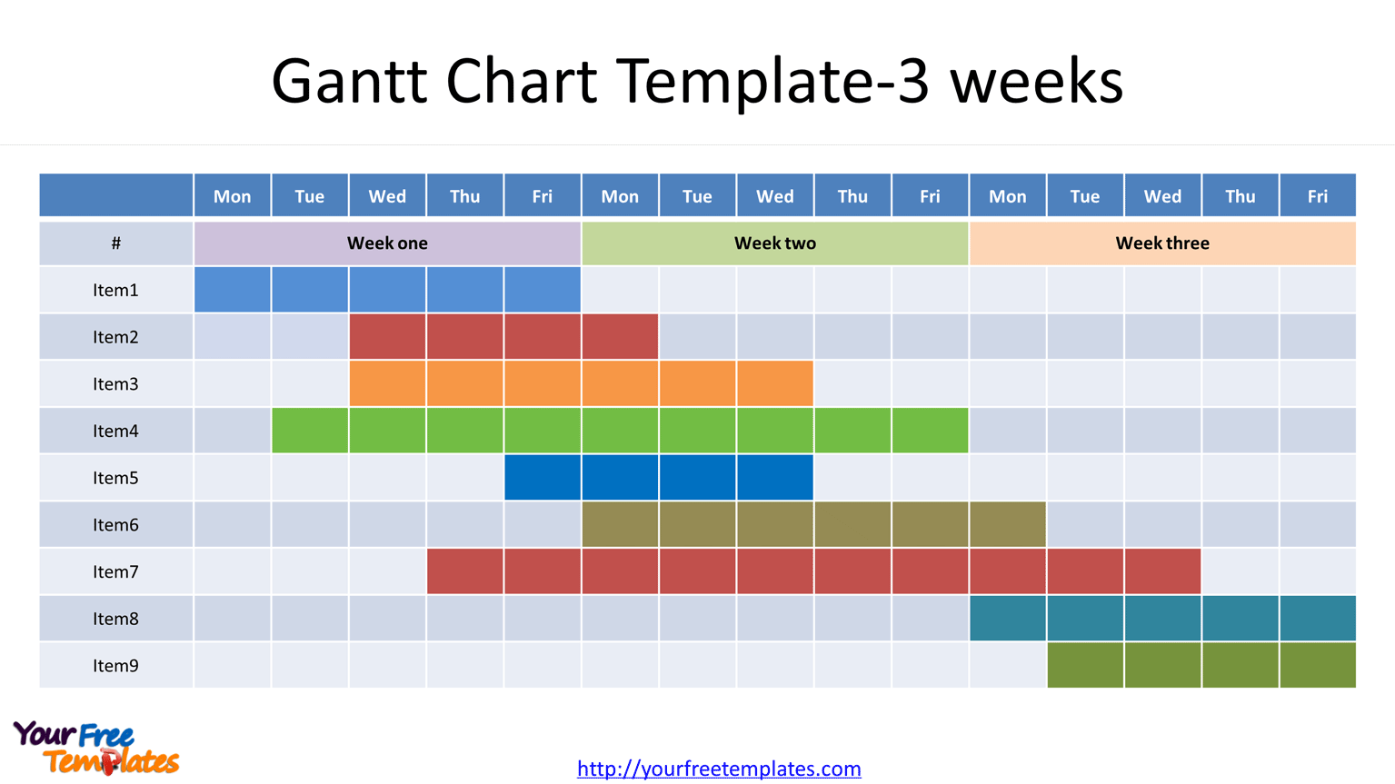
Menu Launching Timelines

Slide 24
Sampling
Research has proven that sampling of food items work.
According to research, 73% of consumers said they were likely to buy a product after trying it.
Reciprocity is a very, very strong instinct. If somebody does something for you, you really feel a rather surprisingly strong obligation to do something back for them.
According to a study conducted by Cornell University assistant professor Miguel Gomez, tastings can turn a “satisfied customer” into a “highly satisfied customer.”
The difference here, according to the study, is “she (or he) is likely to spend an additional $10 buying an extra bottle of wine (with a probability of 93 percent), and to re-purchase wine in the future (92 percent probability).”

Slide 25
Final Assignment
A new restaurant is hiring you to create their menu.
Their theme is Traditional Emirati Food.
You must create the menu from scratch. (Starters, Main Courses, Desserts and Drinks)
The owner is not clued up with restaurant food prices but insist that the prices will be suitable for the average tourist.
You need to think about how many food items, food items that will represent Emirati food, (Food fusions can be used, but the theme must be clearly identified when looking at the menu) cost, the design of the menu and what menu type will be most suitable for this restaurant.

Slide 26
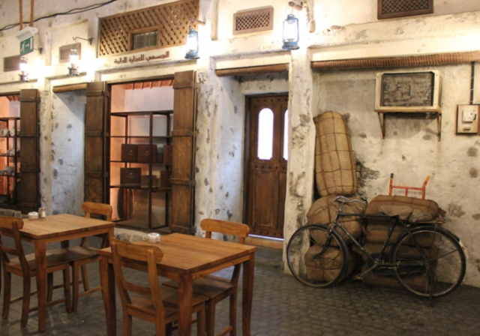
Final Assignment

Slide 27
Conclusion
You have a completed the Recipe Development and Menu Planning Course.
You should be able to develop a menu from scratch, choose the best ingredients and create food items for any occasion.
You will also know how to develop a profitable menu from scratch and know how to apply menu engineering on existing menus.
The most important is to keep practicing. Keep looking for opportunities where you can practice your skills.
Thank you for choosing this course!

Slide 28
Assessment
TEST 30 MINUTES
Test will count 30% and the Final Assignment 70%.

