Slide 1
Nature Science Research and Innovation Centre
Ontario (ON), Canada
Online Education (OE) Division
Recipe Development and Menu Planning
Lesson 19
Ms Wonda Grobbelaar (MBA)
Professor of Practice – OE Division
NSRIC Inc.
London, ON, Canada
E-mail: wonda.grobbelaar@gmail.com
https://www.nsric.ca

Slide 2
Learning Outcomes
The student will understand the meaning of menu engineering.
The student will learn about the importance of menu engineering.
The student will be able to do a contribution margin costing.
The student will be able to use a Menu Engineering Matrix.

Slide 3
Construction of a Menu (Part 3)

Slide 4
What is Menu Engineering?
Menu engineering is the study of the profitability and popularity of menu items.
The influence of these two factors determine the placement of items on a menu.
Menus normally have items with varying levels of profitability and popularity and with menu engineering it can increase your profits.
Menu engineering is a way to evaluate a restaurant’s menu pricing by using sales data and food costs to guide which dishes to feature and their menu price.
Equipped with that data, menu engineering involves categorizing menu items based on their popularity (sales volume) and profitability.

Slide 5
Menu Engineering
Menu Engineering is a phrase used in context with restaurants, hotels, catering businesses, coffee shops, and pubs.
It can be applied to any business that makes and sells food or beverage.
The main aim with menu engineering is to maximize a business’s profitability by subconsciously encouraging customers to buy what the company wants them to buy, specifically the higher profit dishes on a menu and the ones that have the best margin (%).
A Gallop poll found that the average customer spends only 109 seconds studying a menu. During that time, they scan the menu, read descriptions and check prices before making a decision.

Slide 6
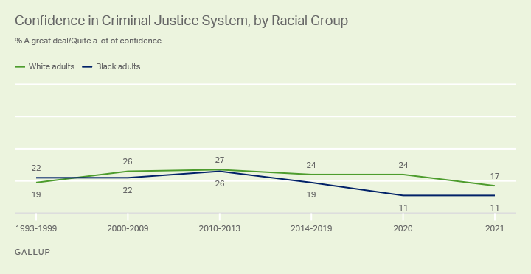
Gallop Poll
The Gallop Poll is an assessment of public opinion by the questioning of a representative sample.
It is an opinion poll (a study in which people are asked their opinions) produced by the Gallup organization.

Slide 7
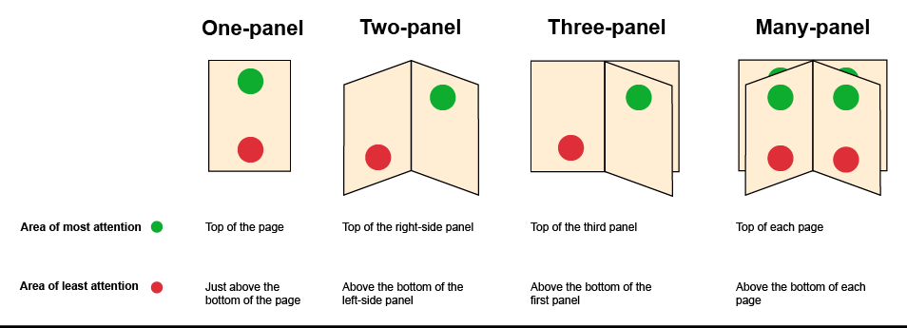
Redesign Your Menu (Reminder)

Slide 8
Categorising a Menu
The major groups will include Food, Liquor, Beer & Wine.
Family groups will include Appetizers, Salad, Dessert and Entrée.
Categories can be further split into sub sections for example Hot & Cold Appetizers.

Slide 9
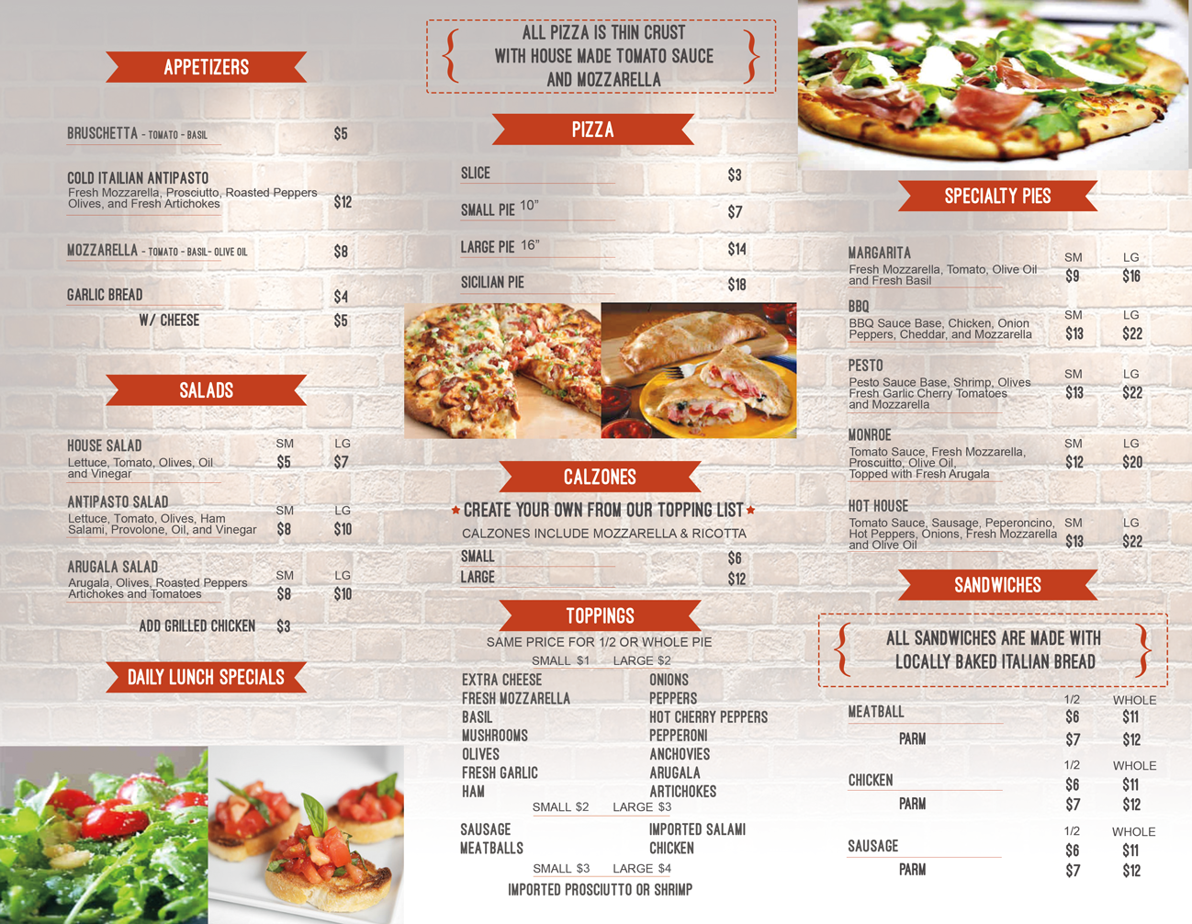
Categorising a Menu

Slide 10
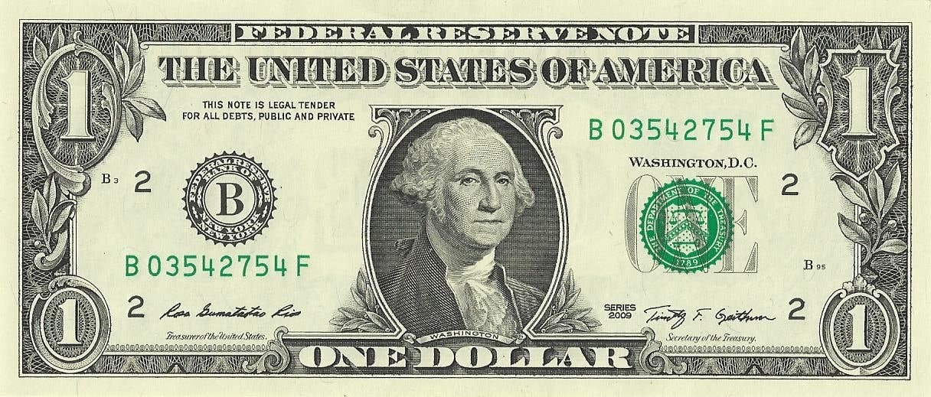
The 3 Main Areas
How many of each dish do you sell in comparison to the rest of the dishes.
What Food Cost / GP% each dish achieves.
How much money you make each time you sell each dish.

Slide 11
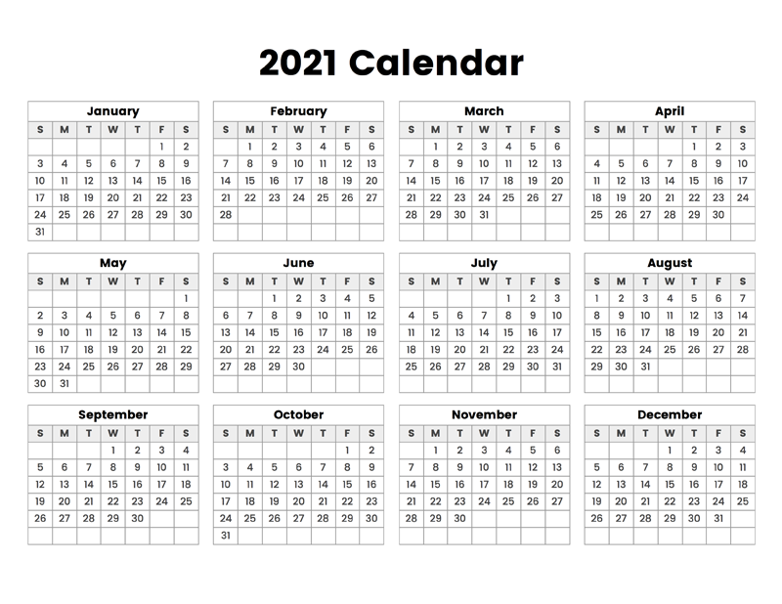
Time Period
First thing’s first, you need to select a time period to analyze.
It can be one month, over a season, or even over a year.
This will depend on how often the menu is changed.

Slide 12
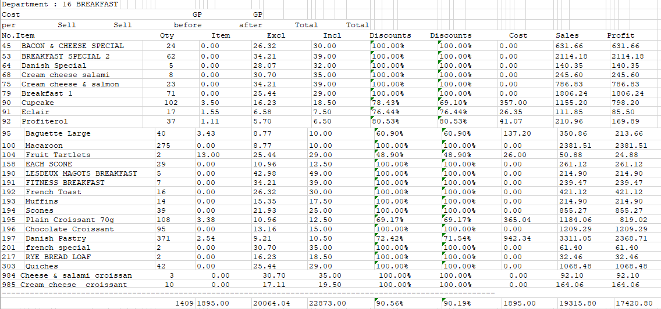
Sales / Daily Sales / Monthly Sales Report

Slide 13
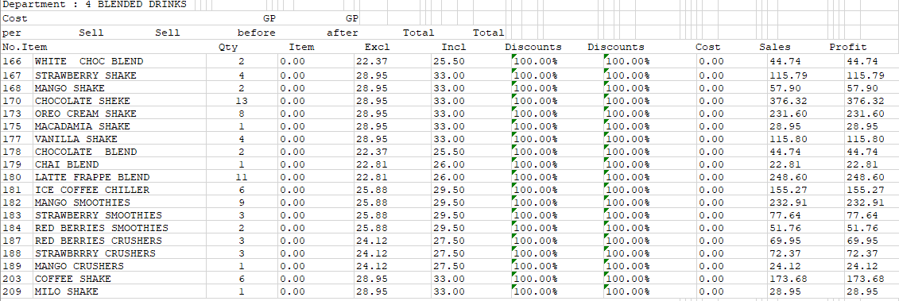
Sales / Daily Sales / Monthly Sales Report

Slide 14
Cost your Menu
The important metrics that you need to measure menu item profitability are food cost percentage and contribution margin.
That information should be readily available in your restaurant POS system, but if it isn’t, you can calculate them manually using these formulas:
Food cost per serving (Work out the cost price of a recipe and divide this between the amount of portions)
Contribution Margin (To be explained in the next slide)
Categorize menu items based on profit and popularity.

Slide 15
Contribution Margin
It allows a company to determine the profitability of individual products by measuring how sales affects profits.
Revenue is how much money the company is making from selling items.
Variable cost is that expense that varies depending on the companies’ production volume.
A business owner will use contribution margin to establish what prices should be reduced, or which prices should be increased.

Slide 16
Contribution Margin (Continued)
Contribution Margin = Sales Revenue − Variable Costs
The above formula is also used as a ratio, to arrive at an answer in percentage terms, as follows:
Contribution Margin Ratio = Sales Revenue − Variable Costs​
Sales Revenue

Slide 17
Decisions Based On Contribution Margin
If the profit is too low, the business might drop the item.
It could mean that he will no longer order this item from the supplier.
It could mean a change in the cost price, by changing ingredients, brands, quantity of a food item.
It could mean that if you add one or two products together that the profit margin will be met based on what you have expected for the company.

Slide 18
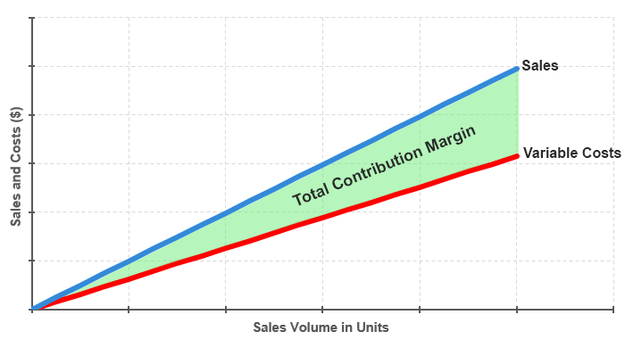
Contribution Margin

Slide 19
Item Popularity
Most POS systems have reports that show how much you sold of a menu item over a period.
Along with concrete data, sit down with waiters, servers and bartenders and hear from them.
Are there certain dishes that they sell often?
They’re on the front line talking with customers every shift and can give valuable insight.
You can also include a quick survey when your customer is paying the bill. Include a question like ”What would you like to see on the menu in future”? What is your favorite item?

Slide 20
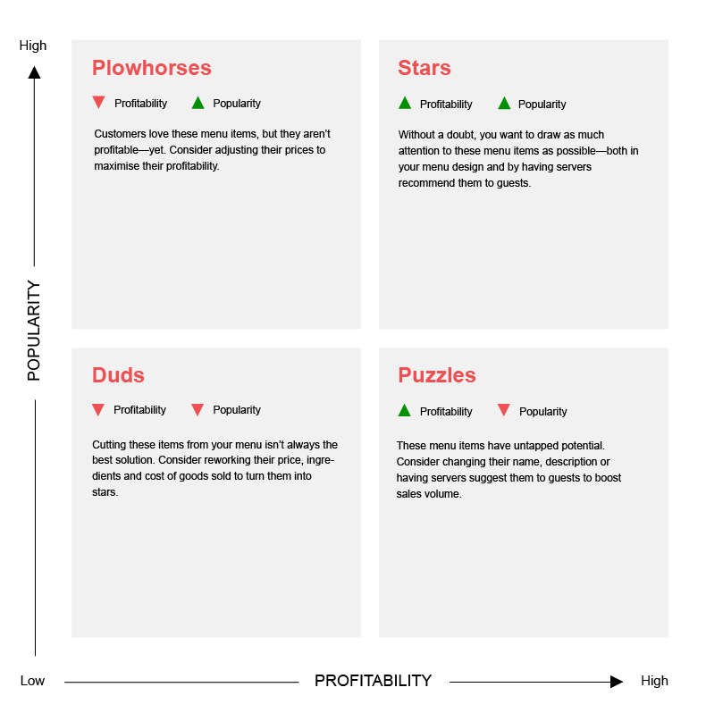
Planning a good menu

Slide 21
Plow Horses or Cows
Plow horses or cows are popular menu items.
Normally the food cost is higher.
The objective with these menu items that fall into this category is to make them more profitable.
Profitability can be increased by raising its menu price, lowering food costs, reworking the recipe with different ingredients or pairing it with high-profit sides or drinks.
It is also important to pay attention to the portion size of plow horses. If you observe that customers rarely finish their plate, it may be wise to serve slightly smaller portions, reducing food waste and food cost per serving in the process.

Slide 22
Stars
High profitability, high popularity food items.
Stars are a menu’s most popular, profitable items.
Inexpensive to make and very popular with your guests.
Leave these items alone and promote them in any way you can.

Slide 23
Duds or Dogs
These are low profitability, low popularity food items.
Normally these menu items are expensive to make and aren’t popular.
They take up valuable space on a restaurant menu.
They also distract guests from your stars and puzzles.
You can also rework them and create something new.
You can give them a different price, however if sales and contribution margin remain low, consider removing it from the menu altogether.

Slide 24
Puzzles
These food items are high profitability, low popularity.
Puzzles are menu items that are profitable, but not a popular choice.
Try to find out why they are not selling.
They could be hidden on your menu.
The menu description could not be inviting and therefore nobody orders the item.
The price might be too high.

Slide 25
Mistakes to avoid
It is important to have a look at your menu pricing occasionally.
Food costs fluctuate and your menu prices need to reflect that.
If your food costs grow while your menu price stays the same, your gross profit margin shrinks, and you make less money on the sale.

Slide 26
Final Assignment- A Reminder
A new restaurant is hiring you to create their menu.
Their theme is Traditional Emirati Food.
You must create the menu from scratch. (Starters, Main Courses, Desserts and Drinks)
The owner is not clued up with restaurant food prices but insist that the prices will be suitable for the average tourist.
You need to think about how many food items, food items that will represent Emirati food, (Food fusions can be used, but the theme must be clearly identified when looking at the menu) cost, the design of the menu and what menu type will be most suitable for this restaurant.

Slide 27
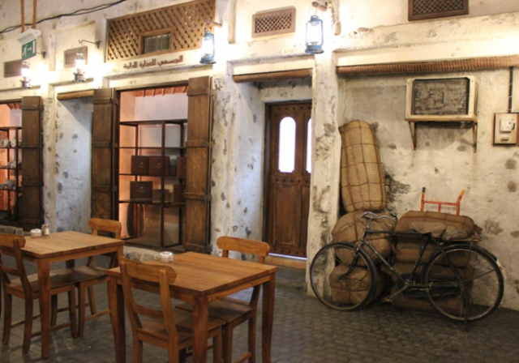
Final Assignment

Slide 28
Conclusion
Have a look at your menu prices on a regular basis.
A Menu Engineering Matrix can assist with the evaluation of a menu.
In the next session, the student will learn about how to launching a menu what steps should be followed to maximize opportunity?
Thank you for attending the session!

