Slide 1
Nature Science Research and Innovation Centre
Ontario (ON), Canada
Online Education (OE) Division
Recipe Development and Menu Planning
Lesson 18
Ms Wonda Grobbelaar (MBA)
Professor of Practice – OE Division
NSRIC Inc.
London, ON, Canada
E-mail: wonda.grobbelaar@gmail.com
https://www.nsric.ca

Slide 2
Learning Outcomes
The student will have guidelines how to develop a menu.
The student will have knowledge how to write descriptions that will sell the products.
The student will understand the industry tricks that can be applied to motivate customers to increase sales ticket.

Slide 3
Construction of a Menu (Part 2)

Slide 4
Guidelines for Menu Planning
The ideal restaurant menu offers a balance of unique dishes and old favorites.
  Consider the Hummus.
  You can offer it in classic form—plain, or you can add different flavors.
  You can also offer a unique version, one that fits with your restaurant theme, such as a Ginger Beetroot Hummus.
  But how you present your dishes in print can be just as important as what your server delivers to your customers' tables.
  They must find that great dish on your menu before they can enjoy it.
  A great restaurants menu isn't just a list of dishes you offer. It should be a sales tool.

Slide 5
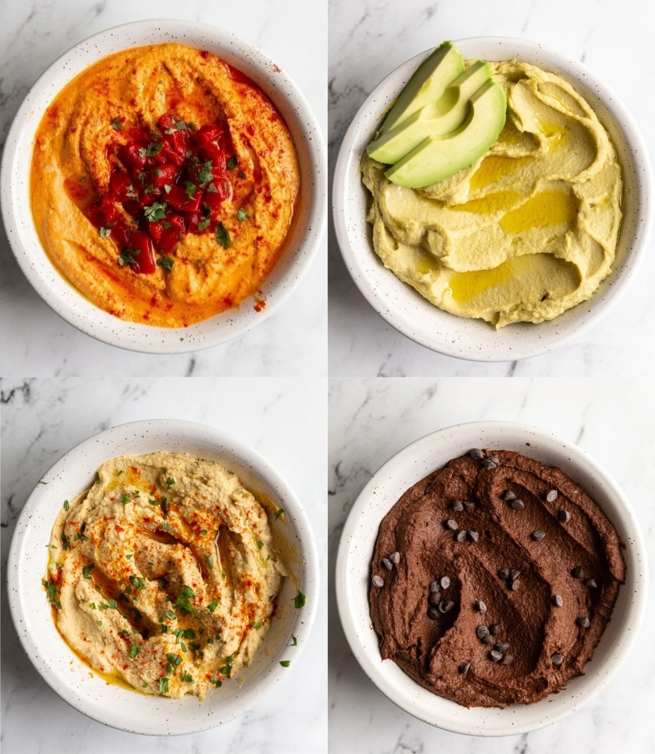
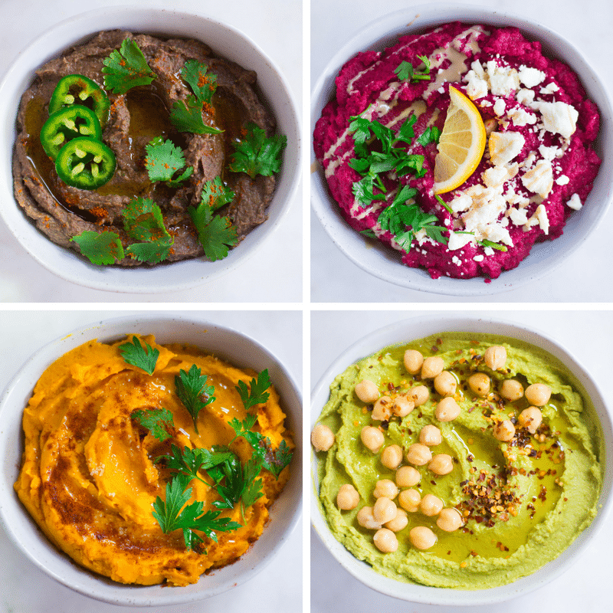
Planning a good menu

Slide 6
The Importance of a Menu
A menu is a vital marketing tool (Cousins et al., 2011).
An advertisement for a restaurant (Gillespie, 2001).
A major factor in influencing a customer’s first impressions of a restaurant and raising his or her expectations about its F&B offer(Antun and Gustafson, 2005).
A menu refers to the way in which a restaurant communicates its offerings to customers and menu design should facilitate this communication (Ozdemir and Caliskan, 2015).
A menu reflects the restaurants personality (Hence et al. 2016).

Slide 7
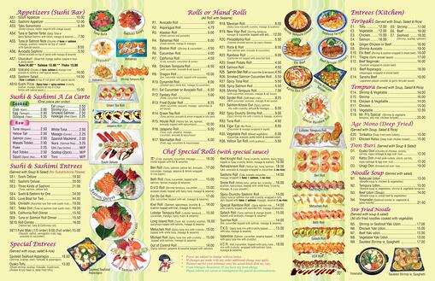
Menu Mistakes

Slide 8
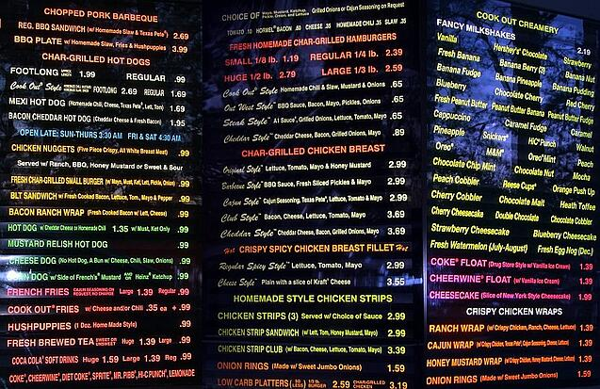
Menu Mistakes

Slide 9


Menu Mistakes

Slide 10
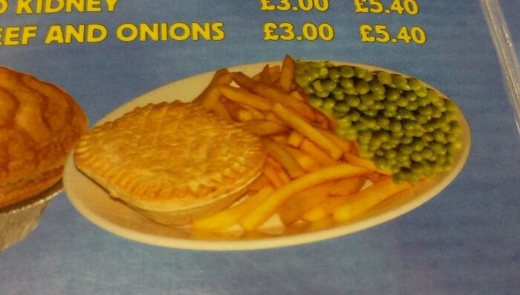
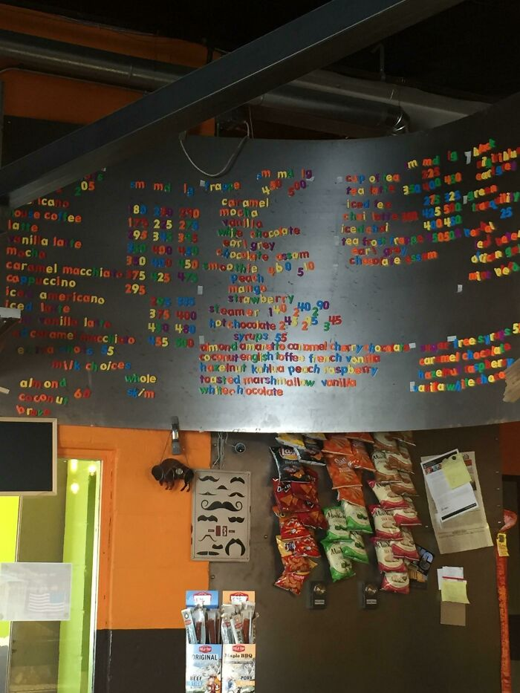
Menu Mistakes

Slide 11
Check out the Competition
Depending on the size of the city or town you're situated in, a customer's choice can come down to your place at one corner of the block and another establishment just two blocks over.
Eight out of 10 customers choose a restaurant within 10 minutes from home, so a good rule of thumb is to know what other restaurants within 10 minutes from your door are doing.
Take a little time to find out what other restaurants are up to with their menus.
You want customers to come through your door, not one of the others. Assess prices, themes, and cuisine. Find out when they typically offer to-die-for specials. Consider offering something other restaurants don’t.

Slide 12
Menu Should be a Manageable Size
Avoid the temptation to offer a huge selection of items.
Consider what the restaurant kitchen can produce.
Are there enough stations to offer grilled items, sautéed dishes, salads, soups, and baked goods?
Manageability also means not overwhelming your customers with choices.
Too many options can confuse people, or worse, it might even subconsciously stress them a little.
Try to keep your dishes to seven or eight in each category or section.

Slide 13
Menu Descriptions
A menu description should be vivid and enticing, enough to make a guest’s mouth water.
Mouth-watering restaurant menu descriptions can make customers crave offerings and will let them return many times.
The menu can be seen as “a map that encourages easy navigation between hunger and satisfaction”.
Well written food descriptions can benefit a restaurant tremendously and could increase sales.

Slide 14
Menu Descriptions (Continued)
Menus are not only a food list but can make a huge difference.
Even researchers were curious if people spend more when the menu descriptions are appetizing.
A study from 2019 shows that the menu description triggers 45 % of the buying decision for a specific dish.

Slide 15
Important Factors (Menu Descriptions)
Identifying the food as local, indicating it belongs to this region.
Giving proof that the recipe is made with organic ingredients.
Create food items that promote a sense of place(personal experience, social interaction).
Explaining the ingredients in the local language.
Using sensory words (describe how we experience the world).
Including sentimental references (an opinion).

Slide 16
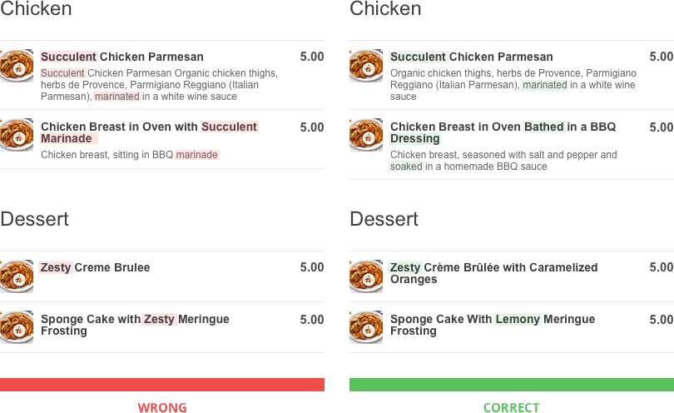
Menu Descriptions

Slide 17
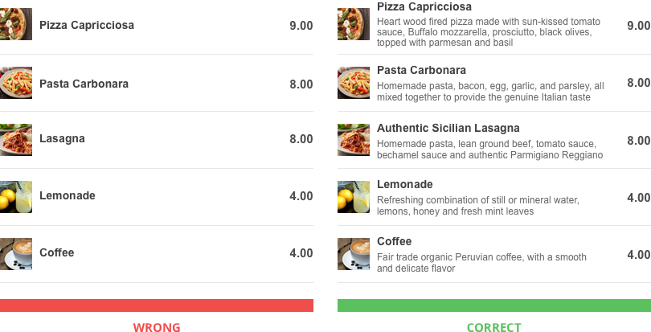
Menu Descriptions

Slide 18
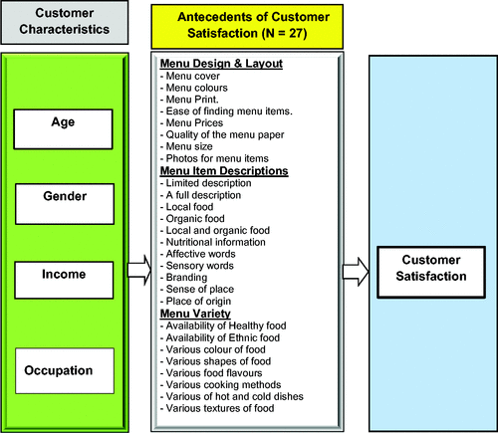
Menu Satisfaction

Slide 19
Signature Dish
A signature dish is a recipe that identifies an individual chef or restaurant.
A signature dish can help to give the restaurant a certain identity.
It converts people into loyal customers.
When developing a menu, create a signature dish.
The name should reflect the restaurant’s brand.
It could be named after the restaurant’s name.

Slide 20
Designing the menu
The menu should offer balance of classic dishes and fresh food trends, while balancing the right food cost to maintain and increase profits.
Make Your Menu Versatile.
Any menu ingredient should exist in at least 3 menu items.
By having it in more than one menu item you ensure that it gets ordered so that it rotates out and will always be fresh, but you’re also minimizing the number of ingredients you must carry reducing your food cost.
Meal/Time Period – such as breakfast, lunch, happy hour, or dinner.

Slide 21
Designing the menu
Start with a menu pattern that fits your operation.
If you must design all the timings, start with breakfast, then lunch, then dinner.
If you are planning a lunch menu, will you have soups, salads, sandwiches, full platters, sides, desserts, and beverages?
How many selections will you offer in each of your chosen menu categories?
Will you have daily specials?
Are there any other special options you might want to offer your customers?

Slide 22
Designing the menu (Continued)
Once you establish your menu categories, it is recommended to plan the main course first.
After the main course, plan the sides that go with the main course.
Other courses, salads are planned next.
This is followed by soups, appetizers, additional sides, and any planned daily specials.
Desserts and beverages finish off the categories.
This sequence of working through the menu categories helps make sure the most expensive dishes are chosen first so the lower-priced items can better fit in the plan and complement the choices offered.

Slide 23
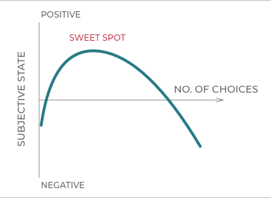
Designing the menu (Continued)
Seven options per food category is a good choice.
The best menus account for the psychological theory known as the “paradox of choice,” which says that the more options we have, the more anxiety we feel.
https://neurofied.com/paradox-of-choice-why-less-more

Slide 24
Kids Sections on Menus
Extra-large portions served at restaurants put kids at risk of overweight and obesity.
Developing standards for portion sizes for kids' menus could reduce the risk that children will be served more food than they need for normal growth and wastage will be reduced.
Most restaurants offer kids' menu items which exceed the calorie counts recommended by nutrition experts.
According to research, the menu item that most often exceeded the calorie guidelines was fried potatoes.
The study found that the average calorie count for the popular side dish was 287, nearly triple the recommended amount.
Most kids will eat what they are served.
(Kids’ Menu Items Often Include Excess Calories; Experts Say Changes May Help to Curb Childhood Obesity by Dr. Lenard I. Lesser of UC San Francisco, Cameron Wright of RAND, Mary Story of Duke University, and Christina D. Economos of Tufts University)

Slide 25
Manipulative Prices
Make price tags as inconspicuous as possible.
Currency signs will remind people that they as spending money.
Many food establishments have adopted prices without any currency signs for example 15.00 or only the number.
Some research has proven that if you write out the amount in words, that your customers will spend more money.
Some prices are more acceptable than others. For example, 9.95 is a friendlier price than 10.00.

Slide 26
Expensive Decoys
Perspective is everything on menus.
Include an incredibly expensive item near the top of the menu.
This will make everything else seem reasonably priced.
It is never expected that a customer will order the AED 319.00 lobster, but it sure makes the AED95 steak looks affordable?
Slightly more expensive items, but make sure that it still falls within the boundaries of what the customer is willing to pay, suggest the food is of higher quality.
This pricing structure can literally make customers feel more satisfied when they leave. For example, one study gave participants an AED 189 buffet or an AED 59 buffet. While the food was the same, the AED 189 buffet was rated as tastier.

Slide 27
Things to Avoid When Writing a Menu
Clip Art
Clipart makes a menu look like it was done on a home computer. It lacks the polish of professional photographs or graphic designs featuring your restaurant’s logo. A graphic designer can help you design something that will make your restaurant menu stand out.
Too Much Technical Jargon
Consider your audience. A few well-placed terms like sauté or mole (pronounced MOL-lay), will add just enough flavor to your menu, without frustrating customers.
Itemized Menus
Avoid saying exactly how many pieces of food come in a dish. If you must cut back customers will notice and will feel cheated.

Slide 28
Menu Disclaimers
Most menus will have a disclaimer or two in fine print on the bottom.
Common disclaimers include “gratuity will be added to parties of six or more” or “two for one special not available for take out” or “Kids menu available only for those 12 and under.”
Don’t add crazy with the disclaimers.
Don’t list all the things the restaurant won’t do for customers.

Slide 29
Final Assignment- A Reminder
A new restaurant is hiring you to create their menu.
Their theme is Traditional Emirati Food.
You must create the menu from scratch. (Starters, Main Courses, Desserts and Drinks)
The owner is not clued up with restaurant food prices but insist that the prices will be suitable for the average tourist.
You need to think about how many food items, food items that will represent Emirati food, (Food fusions can be used, but the theme must be clearly identified when looking at the menu) cost, the design of the menu and what menu type will be most suitable for this restaurant.

Slide 30
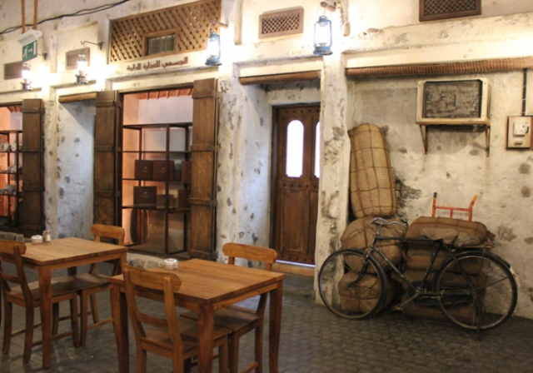
Final Assignment

Slide 31
Conclusion
The descriptions of food items should describe exactly what the customer will get to eat.
Learn the tricks of the trade to improve your restaurant sales.
In the next session, the student will learn about menu costing, price matrix and additional requirements in a menu.
Thank you for attending the session!

