Slide 1
Nature Science Research and Innovation Centre
Ontario (ON), Canada
Online Education (OE) Division
Recipe Development and Menu Planning
Lesson 17
Ms Wonda Grobbelaar (MBA)
Professor of Practice – OE Division
NSRIC Inc.
London, ON, Canada
E-mail: wonda.grobbelaar@gmail.com
https://www.nsric.ca

Slide 2
Learning Outcomes
The student will learn about the different types of menus.
The student will have knowledge about eye scanning patterns.
The student will be able to create the most effective layout for a menu.
The student will understand the importance of color and font when designing the menu.

Slide 3
Construction of a Menu (Part 1)

Slide 4
The Importance of a Menu
The menu dictates what will be made in the kitchen, and how your operation will be organized and managed, the extent to what the company will meet its goals.
The menu will dictate the way the interior and sometimes the exterior will be designed and constructed.
Without a menu the customer will not know what their options are for goods to purchase.
A properly designed menu serves as both a sales and marketing tool for the foodservice operation.

Slide 5
Planning a good menu
When planning a good menu, keep the following in mind:
Food cost and budget goals of the foodservice operation.
Production capability, including available equipment and personnel.
Type of service and food delivery system.
Availability of foods.
The philosophy of the business and foodservice operation.

Slide 6
Types of Menus
There are five types of menus that are mostly used:
A La Carte menus.
Static menus.
Plat Du Jour menus.
Cycle menus.
Fixed menus.

Slide 7
A La Carte Menu
An a la carte menu lists the prices for each food item separately.
While the prices tend to be higher, a la carte menus have more flexibility.
Customers can choose individual items and combine them any way they want.
It is a French phrase that translates literally as “by the card” and is not only related to food.
Phrases like “from the menu” and “individually priced” communicate that a menu or section of a menu is ‘a la carte’.

Slide 8
Static Menus
A static menu is a larger menu.
It is normally divided into categories that do not change very often.
It’s the most widely used menu today, and it’s what you likely think of when you think of menus.
Most restaurants utilize a static menu.
They provide the best customer experience because of the different options, consistency, and easy navigation.

Slide 9
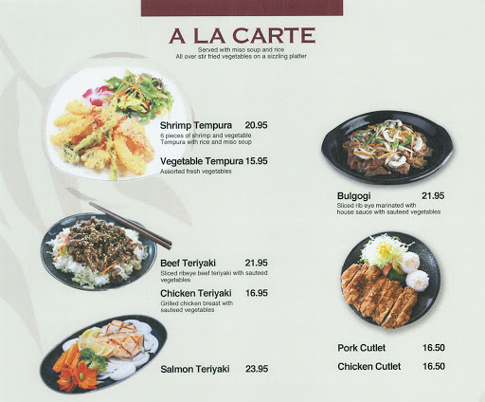
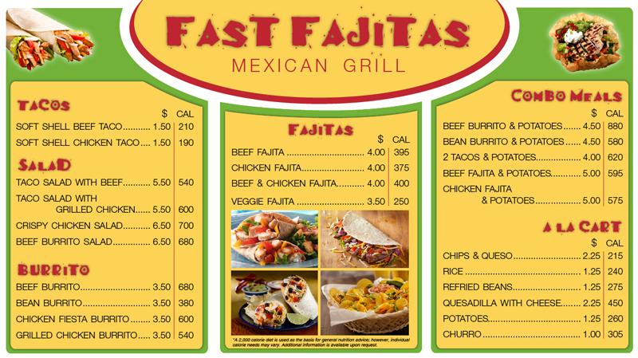
A La Carte & Static Menus

Slide 10
Plat Du Jour
Plat du Jour means “Daily Special”.
It means the menus change daily, depending on what’s available or what the chef prepared.
It can be written for example as “chicken du jour” means the chicken that’s available today or “soup du jour” that is the soup that’s available today.
Du jour is a French phrase that means “of the day.”

Slide 11
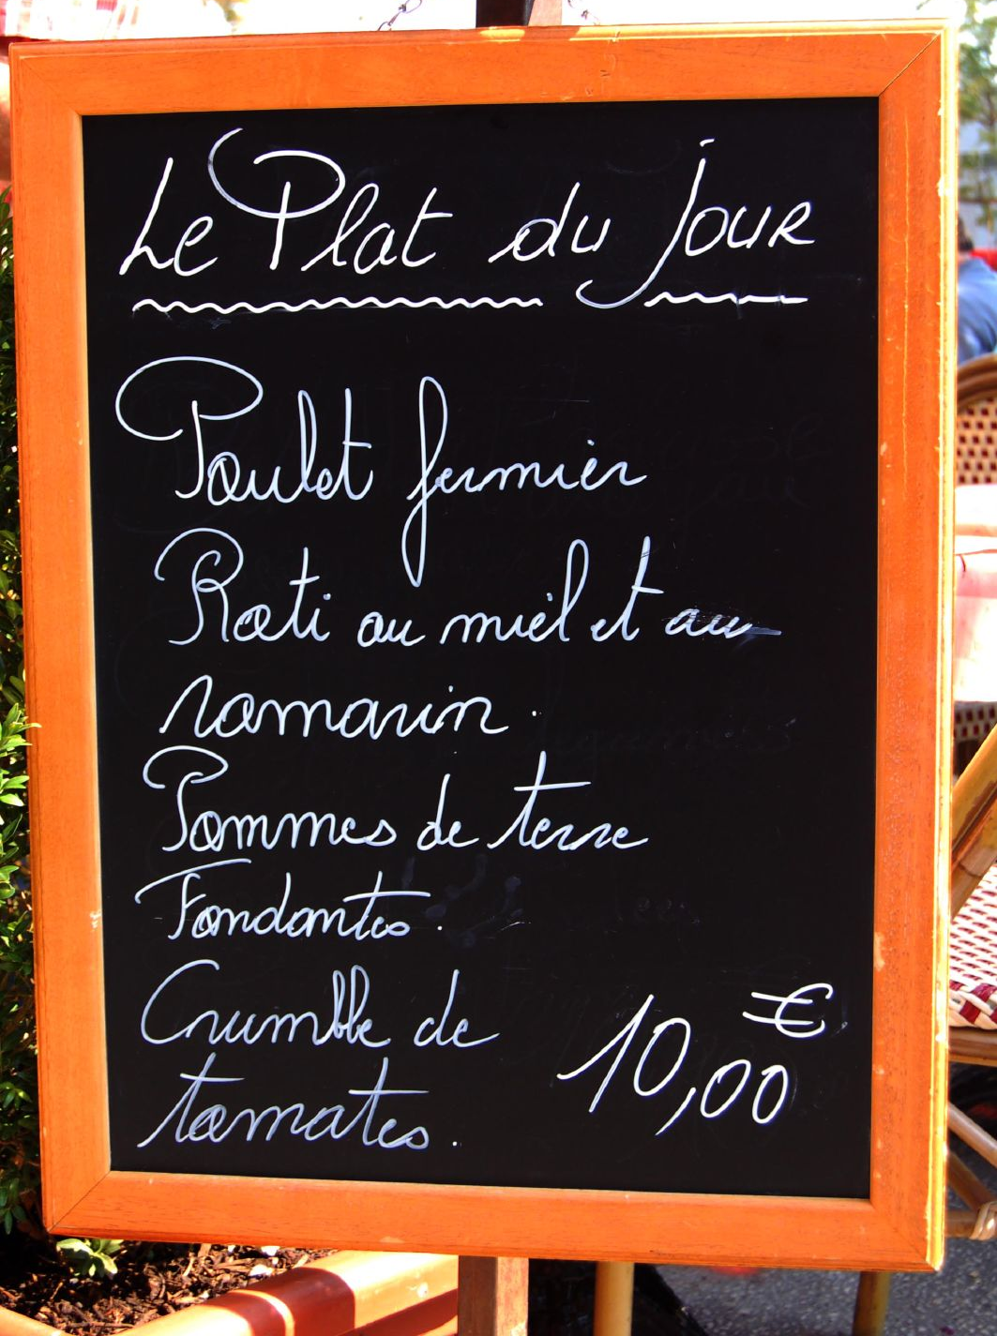
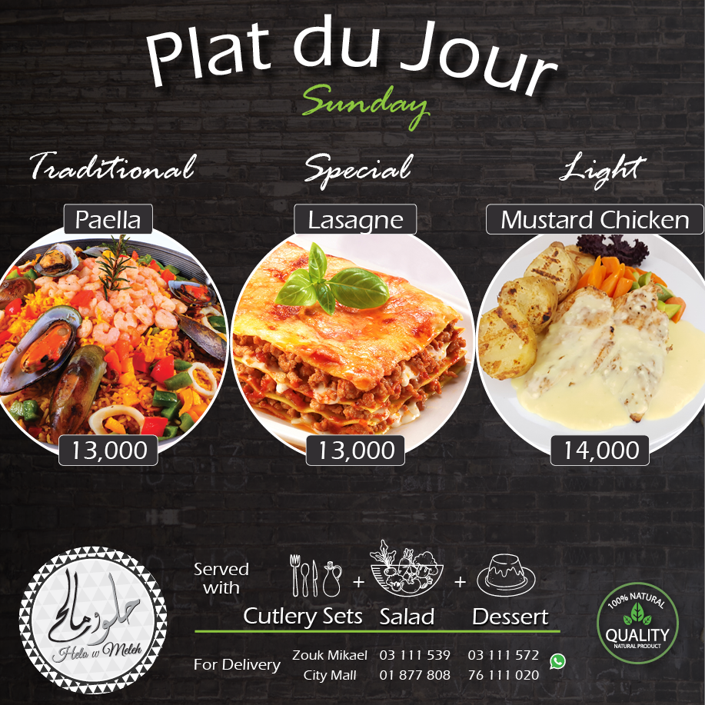
Plat Du Jour

Slide 12
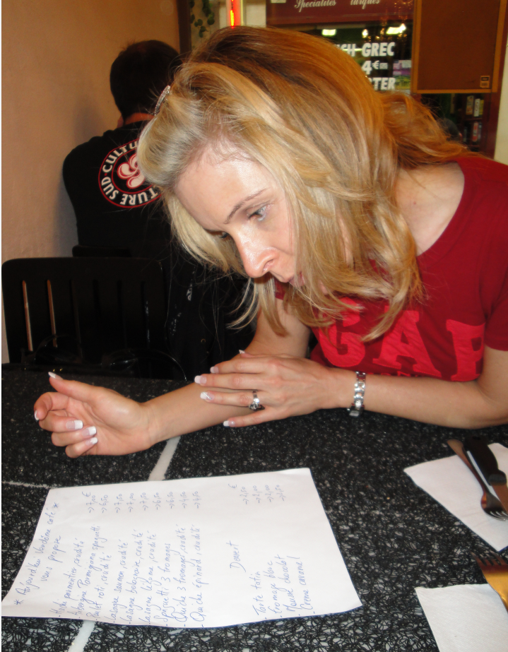
Plat Du Jour

Slide 13
Cycle Menus
A cycle menu is a menu or part of a menu that has repeated options over a specific time period.
An example will be a sandwich shop that offers a certain sandwich on Monday, then another sandwich on Tuesday.
If they stick to those sandwiches on those days and repeat that week after week, it’s a cycle menu.
Cycle menus are often used for two reasons:
  One is that the cooking operation is relatively small and doesn’t have the resources to cook-to-order items off a larger menu.
  The second is for daily specials, like a happy hour menu.

Slide 14
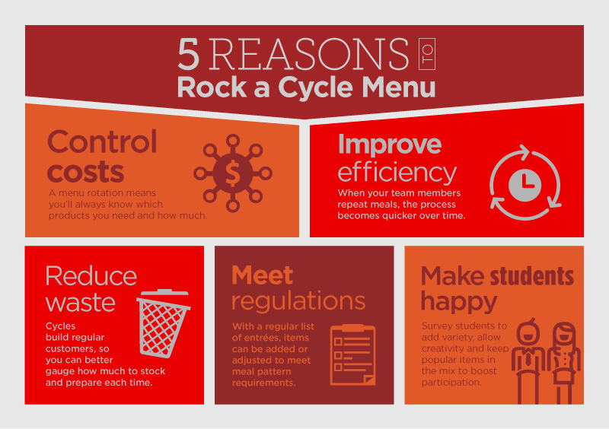
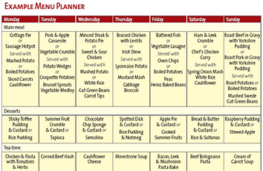
Cycle Menus (Continued)
A cycle menu can be great for the health of a school foodservice program.
It helps manage food-buying costs, improves staff efficiency and allows menu flexibility for creative meals students will enjoy.

Slide 15
Cycle Menu Lengths
There is no right or wrong answer as long as your menu meets the needs of the people the menu is designed for and can vary in cycle length from one to 8 weeks or more.
A menu for hospitals will have shorter cycle lengths due to the duration in which most patients spend in hospital and it is now common for a person to be in hospital for 1 to 2 days.
Aged Care Home’s menu cycles tend to be longer to meet the needs of residents who do not have access to an outside food supply.
Educational menus for a university or boarding school are based on the cycle.
It normally consist of more types of food selection and buffet dining where students would help themselves or even make up items such as salads and sandwiches.

Slide 16
Fixed Menus
A fixed menu is a menu with few options and a fixed total price.
A fixed menu is also commonly called a set menu, and there are two common types:
  The ‘table d’hote’ menu and the prix fixe menu.
  A ‘table d’hote’ menu offers a choice of appetizer, entree, and dessert all at a fixed total price, however the diner can choose normally from two options, and the price doesn’t change.
  The ‘Prix fixe’ menu is a fixed menu with little to no variability for a fixed total price. It includes an appetizer, an entree, and a dessert, only one option to choose from per course.

Slide 17
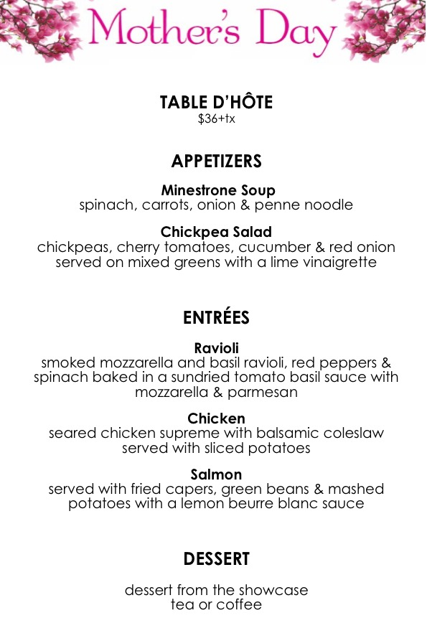
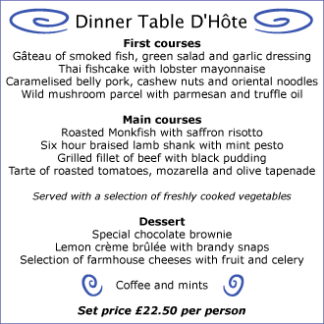
Fixed Menus

Slide 18
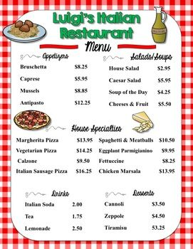
Essential Menu Design Tips
Be aware of eye scanning patterns.
Divide the menu into logical sections.
Use photos sparingly.
Consider using illustrations.
Don't emphasize currency signs on a menu.
Boxes to group food courses can be used.
Typography
Choose appropriate colors, as not all colors are suitable for menus.

Slide 19
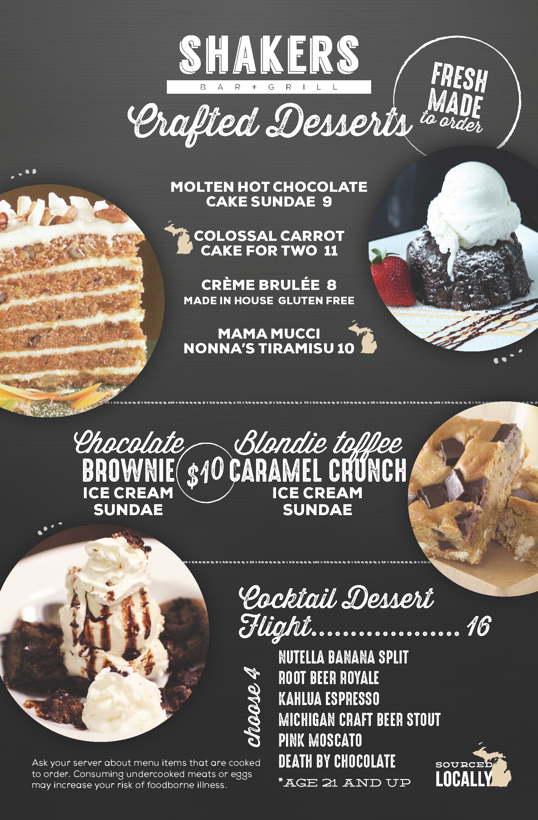
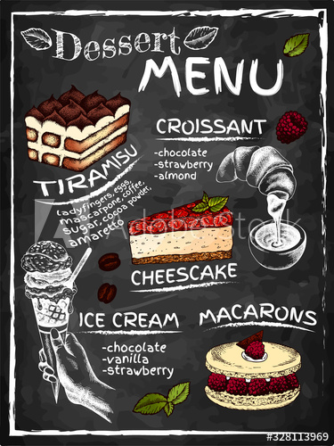
Menu Examples

Slide 20
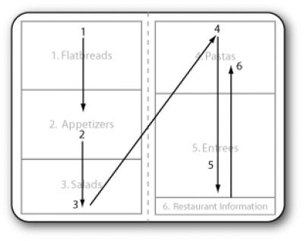
Eye Scanning Patterns - The Latest Study
Research found that customers tend to read a restaurant menu sequentially like a book.
These findings challenge years of conventional wisdom in the restaurant industry, which until now, proposed a more complex scan path with a "sweet spot" above the center of the righthand page -- an area where customers are thought to look the longest and gaze most frequently. Yang's results found no evidence of menu sweet spots. (Professor Sybil Yang. San Francisco State University)

Slide 21
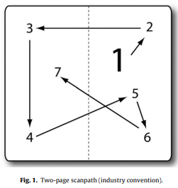
Eye Scanning Patterns (Continued)
Recommended items or items on promotion should be boxed or highlighted (Hopkins, 2005; Hug and Warfel, 1991; Hunt-Wesson Foodservice, 1999; Stoner, 1986).
They can also be placed at the top or bottom of a category list (Gallup, 1987; Hopkins 2005).
Previously it was believed that they can also be placed in sweet spots where guest scan paths pass through most frequently (Gallup, 1987).

Slide 22
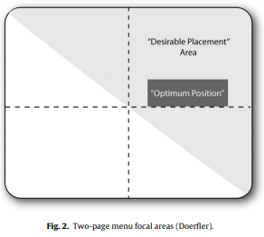
Eye Scanning Patterns (Continued)
One of the first academically published maps of customer focal points was espoused by a well-known menu and graphic designer of the time, William Doerfler.
He suggested that the consumer focus on a single-fold menu with two facing pages lies in the region above a diagonal line cutting across both facing pages (shaded region in Fig. 2).
Of this region, the most influential area lies just above the midpoint of the right page (Livingston, 1978).

Slide 23
What is a Good Menu Size?
Most menus are built to accommodate the standard paper sizes of 8.5” x 11”. (215mm x 280mm).
If your menu exceeds 12” x 18”,(305mm x 457mm) consider having separate menus for dessert, and kids in order to keep the size manageable.

Slide 24
Fonts
Restaurant menu fonts are incorporated into the larger brand image.
Choose a simple font that is easy to read.
Sometimes multiple fonts are used to reflect the nature of individual dishes while influencing buyer decisions.
A bold font is paired with bold flavors, while a mild, lower-case font reflects a simple and elegant dish.
Either choose a basic, universal font or go with something that brings out your image and brand on the menu.

Slide 25
Fonts & Emotion
Food and flavor is connected to emotion and physical response.
If you see or read the word hot pepper, your mouth may salivate as a response.
Fonts are used to connect specific dishes to the flavors they represent.
A spicy, bold dish can use bold, in-your-face type fonts to associate with the spiciness.
When looking at gourmet burgers, a font like Timberline is perfect to show quality without being over-the-top fancy.

Slide 26
Meaning of Color & Menus
Certain colors can be used to create the feelings you’re looking for to encourage and motivate specific behaviors from customers.
Limited use of red can call attention to high-margin items that the restaurant wants to move.
Orange stimulates the appetite.
Brown communicates nature and earthy vibes.
The color variation (lighter background) in a menu design calls attention to the high margin items for the category and attracts customers attention to them, which can lead to a significant shift in menu preference scores.

Slide 27
Final Assignment
A new restaurant is hiring you to create their menu.
Their theme is Traditional Emirati Food.
You must create the menu from scratch. (Starters, Main Courses, Desserts and Drinks)
The owner is not clued up with restaurant food prices but insists that the prices will be suitable for the average tourist.
You need to think about how many food items, food items that will represent Emirati food, (Food fusions can be used, but the theme must be clearly identified when looking at the menu) cost, the design of the menu and what menu type will be most suitable for this restaurant.

Slide 28
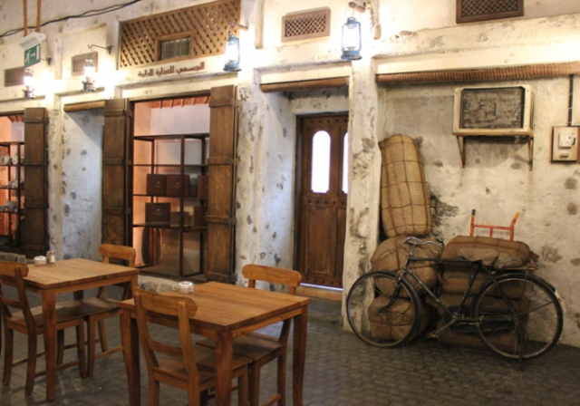
Final Assignment

Slide 29
Conclusion
There are different types of menus.
Color and font of menus play an important part in designing menus.
In the next session, the student will learn about part two of menu construction, for example what food items to choose. (Variety).
Thank you for attending the session!

Slide 30
References
Eye movements on restaurant menus: A revisitation on gaze motion and consumer scanpaths Sybil S. Yang∗ Cornell University, School of Hotel Administration, G80p Statler Hall, Cornell University, Ithaca, NY 14853, United States International Journal of Hospitality Management 31 (2012) 1021–1029

