Slide 1
Nature Science Research and Innovation Centre
Ontario (ON), Canada
Online Education (OE) Division
Recipe Development and Menu Planning
Lesson 16
Ms Wonda Grobbelaar (MBA)
Professor of Practice – OE Division
NSRIC Inc.
London, ON, Canada
E-mail: wonda.grobbelaar@gmail.com
https://www.nsric.ca

Slide 2
Learning Outcome
The student will understand what the definition of a menu is.
The student will understand the reason why menus exist.
The student will learn about the history of menus in general.
The student will have knowledge about the different styles over different periods.

Slide 3
What is Menu Planning in General?
Menu planning is the process of deciding what you will eat for each meal, including main dishes, side dishes, and desserts.
It also entails knowing how many meals to plan for and when to serve them.
Daily activities and scheduling variations may complicate the menu planning process.

Slide 4
What is Menu Planning?(Continued)
Menu is the statement of food and beverage items available or provided by food establishments primarily based on consumer demand and designed to achieve organizational objectives.
It represents the focal point around which components of food service systems are based.
The menu is designed carefully to show what the outlet wants caters for, keeping in mind the type of clientele.
The main advantage of a well-planned menu is that it leads to consumer satisfaction. It also helps to motivate the employees for a responsible and successful service.

Slide 5
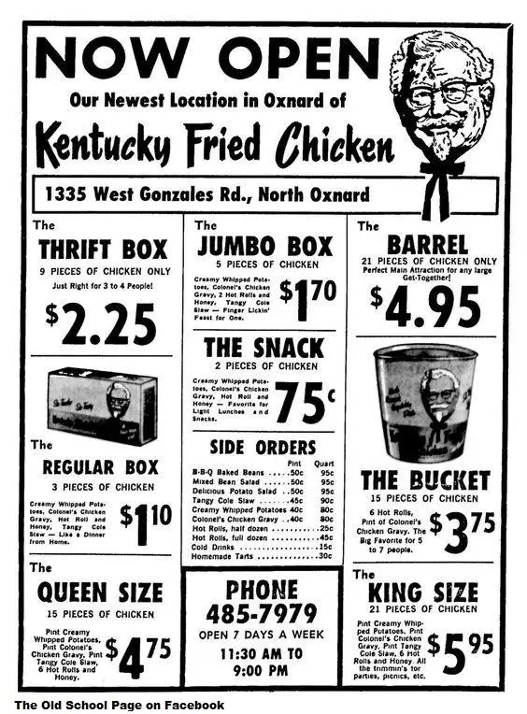
History of Menu Planning

Slide 6
History of Menu Planning (China)
Menus have been discovered from the Song Dynasty in China.
Trade was bustling between these northern and southern capitals of the 12th-century Song Dynasty.
Chinese tradesmen traveling outside their home city weren’t accustomed to the strange local foods.
“The original restaurants in those two cities were essentially southern cooking for people coming up from the south or northern cooking for people coming down from the north”.
The ”ethnic” restaurant’ was the first restaurant.

Slide 7
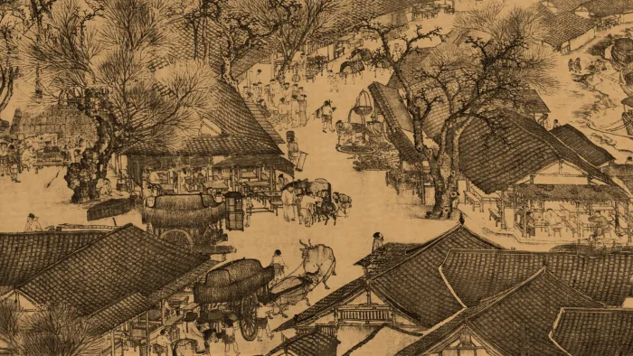
China
The dining experiences at the larger and fancier restaurants were very similar to today.
According to a Chinese manuscript from 1126 quoted in Dining Out, patrons of one popular restaurant were first greeted with a selection of pre-plated “demonstration” dishes representing hundreds of delectable options. Then came a well-trained and theatrical team of waiters.
“The waiter took their orders, then stood in line in front of the kitchen and, when his turn came, sang out his orders to those in the kitchen. Those who were in charge of the kitchen were called ‘pot masters’ or were called ‘controllers of the preparation tables.’ This came to an end in a matter of moments and the waiter—his left hand supporting three dishes and his right arm stacked from hand to shoulder with some twenty dishes, one on top of the other—distributed them in the exact order in which they had been ordered. Not the slightest error was allowed.”
A scene in what is thought to be the ancient capital of Kaifeng showing food stalls from a scroll titled 'Going Up the River at the Qingming Festival' by Zhang Zeduan, circa 1100.
Werner Forman/Universal Images Group/Getty Image

Slide 8
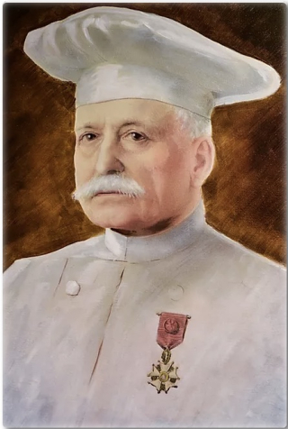
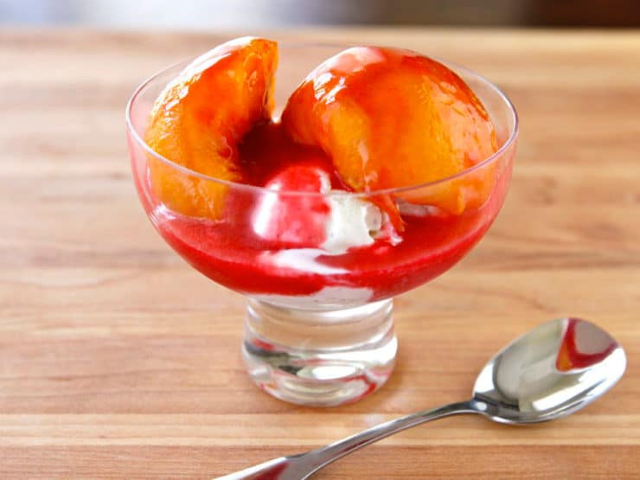
History of Menu Planning
In restaurants, the modern menu, with dishes in a set order of courses, was invented by the great French chef Escoffier.

Slide 9
How was the term “Menu” derived?
The Larousse de la Langue Francaise [Librarie Larousse:Paris] 1979 (p. 1140) confirms the word "menu" has Latin roots. The term has been used in the French language since the 1080.
The word "menu" as it relates to food dates in French print to 1718. The Oxford English Dictionary (2nd edition) confirms the English word "menu" was borrowed from the French. The French borrowed it from the Latin word "minutus," meaning detailed list.
According to the OED, the first instance of the word "menu," as it relates to food, in English dates to 1837.

Slide 10
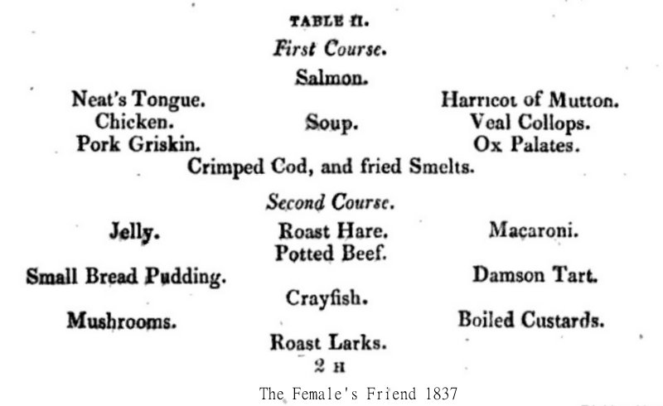
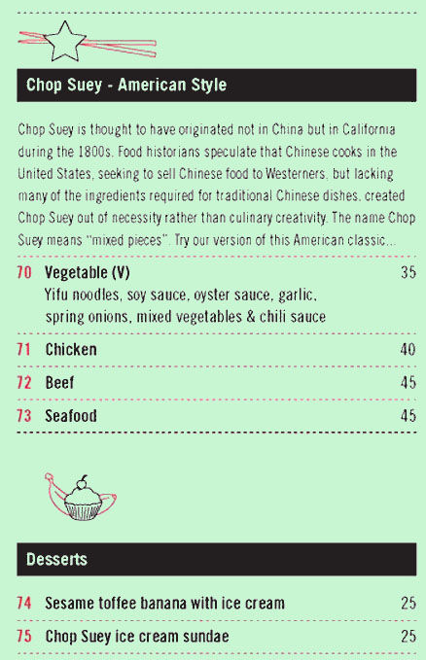
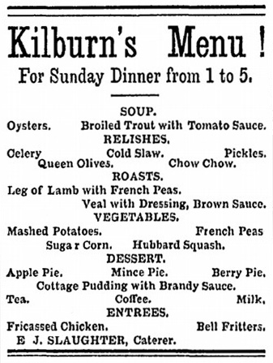
Old Menu’s

Slide 11
Children's Menu
The earliest references we find in print to children's menus in America surfaced in the early 20th century.
Domestic scientists promoted the new discovery that healthy, growing children required special nutrition and foods. They were not just tiny adults, as previously thought. It was acceptable for modern women to dine in public during without male accompaniment during the day. Savvy marketers capitalized on a brand-new market: selling to parents via their children.
Children's menus were were offered by department stores, fancy hotels, railroads, and catering companies. Colorfully decorated menus featuring games and nursery rhymes were developed by companies hoping to upsell wealthy people with small children.

Slide 12
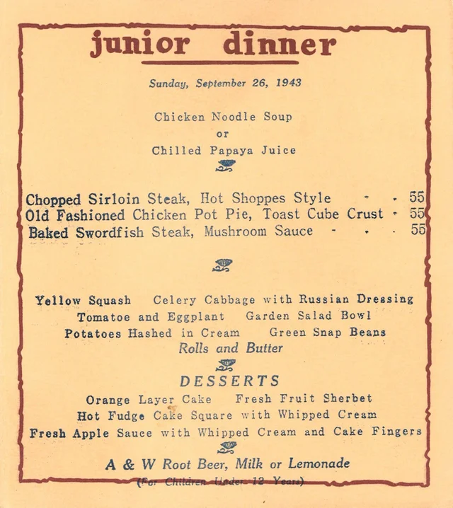
Children's Menu (Continued)

Slide 13
Children's Menu (Continued)
"When children rode the train, special efforts were made to add to their dining pleasure. It might begin with the steward, cookie jar in hand, passing through the train handing out complimentary between-meal snacks.
When he seated children in the dining car, he might hand each one a peppermint stick. The colorful children's menu, sometimes with a happy story or interesting facts included, often named the meal as to enhance the fantasy children experience when traveling by train.
Chicken soup, a broiled lamb chop, mashed potatoes, carrot sticks, and ice cream became the "Engineer's Special Dinner."
Children's mealtime favorites included spaghetti, a broiled hamburger with French Fried potatoes, and French toast...Every effort was made to ensure that all children ate and enjoyed their meals, and that memories of the experience lingered with them.
They were, after all, the next generation of riders." ---Dining by Rail, James D. Porterfield [St. Martin's Griffin:New York] 1993 (p. 311)
[1916]

Slide 14
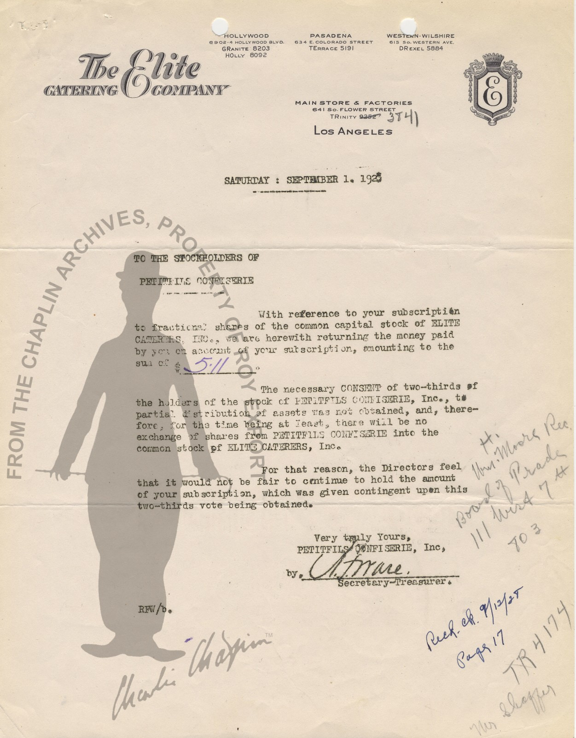
Children's Menu (Continued)
“The Elite Catering Company has been making a specialty of children's parties during the past few weeks including in that service animal candies, Jack Horner pies, merry-go-round cakes, animal molds and a special children's menu. They advise that the children's specialties and the menu are met with great favor by the children as well as by the grown-ups." ---"Children Parties Specialty,"
Los Angeles Times,
January 25, 1928 (p. A13)

Slide 15
Coffee House Menu’s of the Past
Food historians tell us food served in coffee houses were generally a ‘prix fix’ affair with a set menu established daily by the proprietor.
Like the bills of fare served at contemporary taverns, inns, and boarding houses.
The primary purpose of coffee houses was intellectual stimulation, sharing news, conducting business transactions and fostering social comradery.
Food was served, but it wasn't featured.
Some American coffee houses also proffered finer dining options.

Slide 16
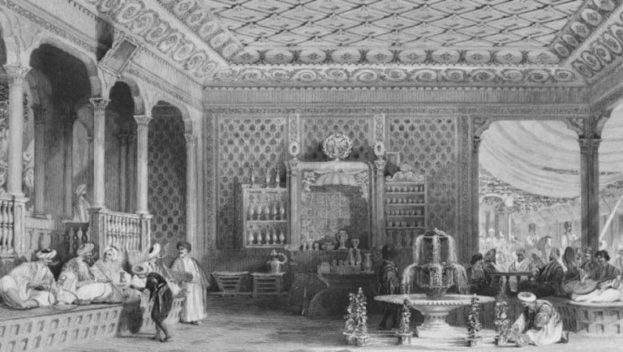
Coffee House Menu’s of the Past

Slide 17
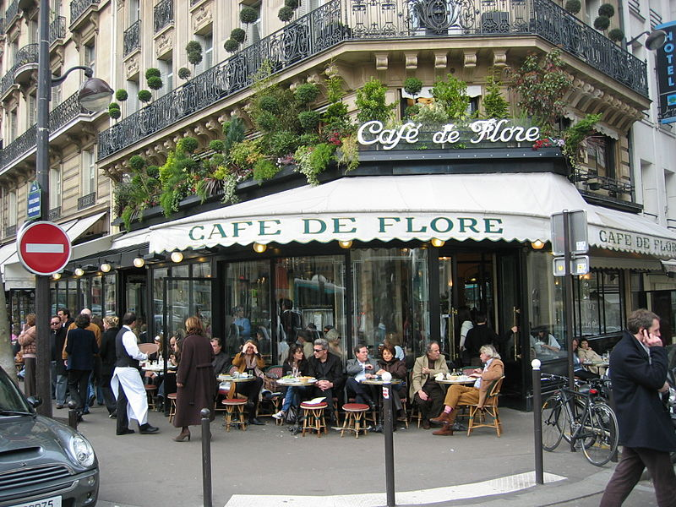
Coffee House Menu’s
A coffeehouse, coffee shop, or cafés serve alcoholic drinks. A coffeehouse may also serve some type of food, such as light snacks, sandwiches, muffins or other pastries. Coffeehouses range from owner-operated small businesses to large multinational corporations.

Slide 18
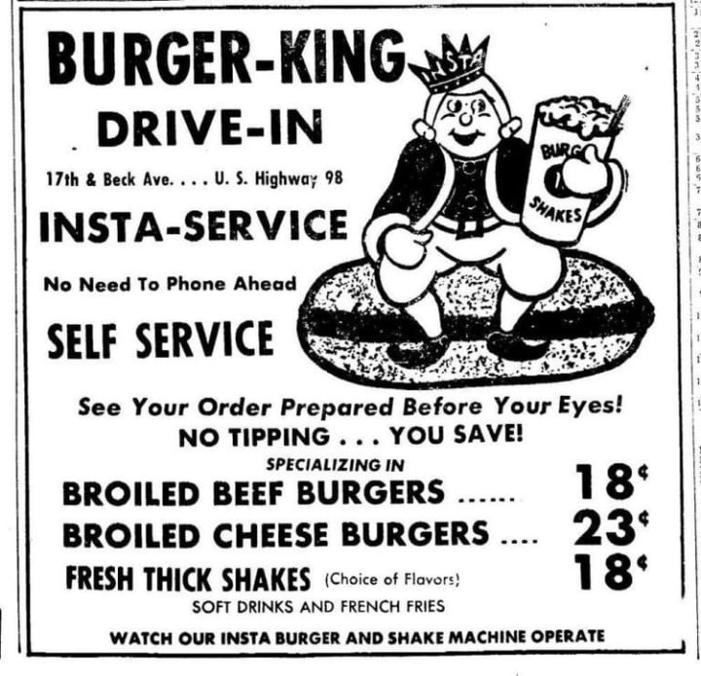
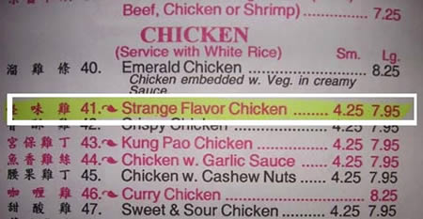
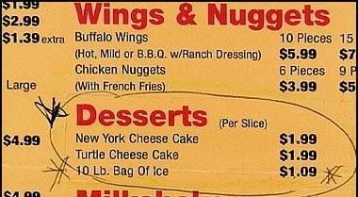
Failed Menu’s

Slide 19
The way we eat has changed
Tongue (corned, pressed, pickled, boiled) was omnipresent around the turn of the century.
From this 1910 Norddeutscher Lloyd Bremen menu comes an intriguing dish called “Dominos Of Tongue.”
Eel is another protein of yester year you won’t find today, except in Japanese restaurants.
Popular methods of preparation include stewing it, smoking it, chilling it with aspic, or adding it to scrambled eggs.
A 1900 menu from Boston Oyster House served a dish called burger eel in jelly.

Slide 20
The way we eat has changed
The restaurant diners of the late 19th century were also more open to different species of fowl and game birds.
This 1858 menu from Parker House in Boston (of Parker House roll fame) offers five varieties of duck, geese, partridge, and grouse.
Kidney was served at the finest restaurants at the beginning of the 20th century, but its popularity diminished greatly in recent decades.
A more popular offal was liver, but it, too, has fallen out of favor. Same with calf and lamb’s brain.
Turtle soup (and the cheaper, more popular mock turtle soup) all but disappeared from menus by 1987.

Slide 21
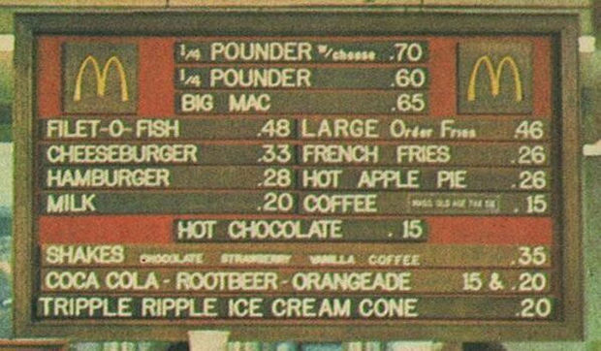
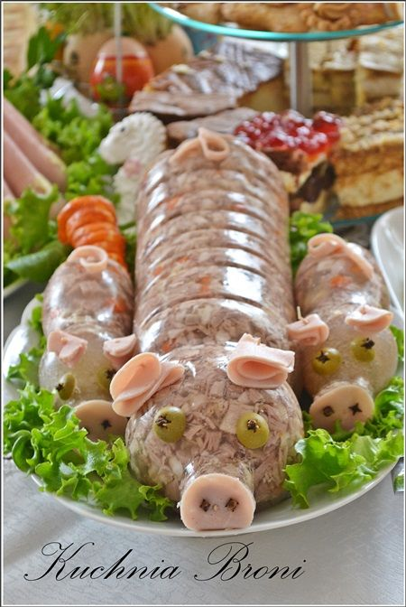
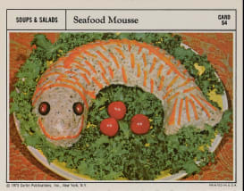
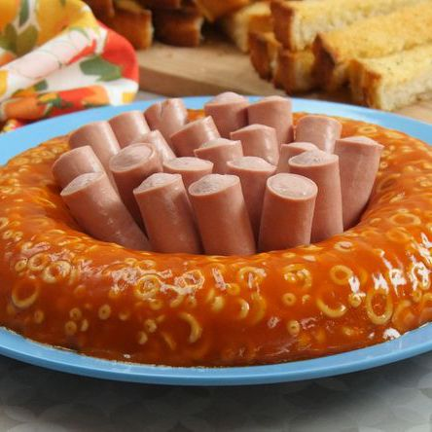
Menus of the 70’s

Slide 22
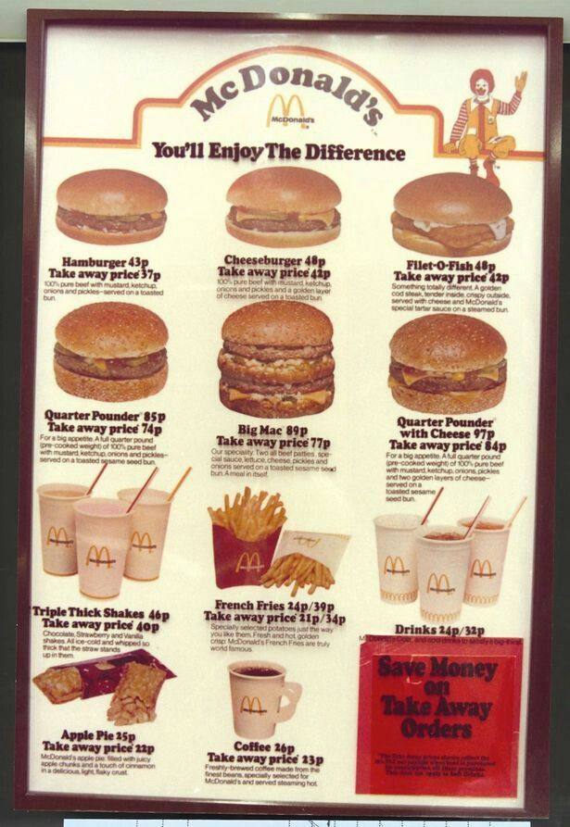

The 80’s & 90’s

Slide 23
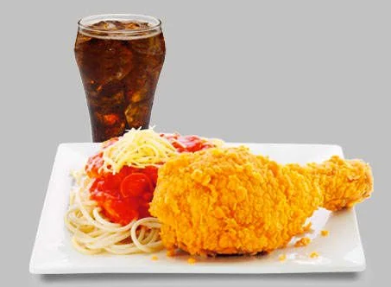
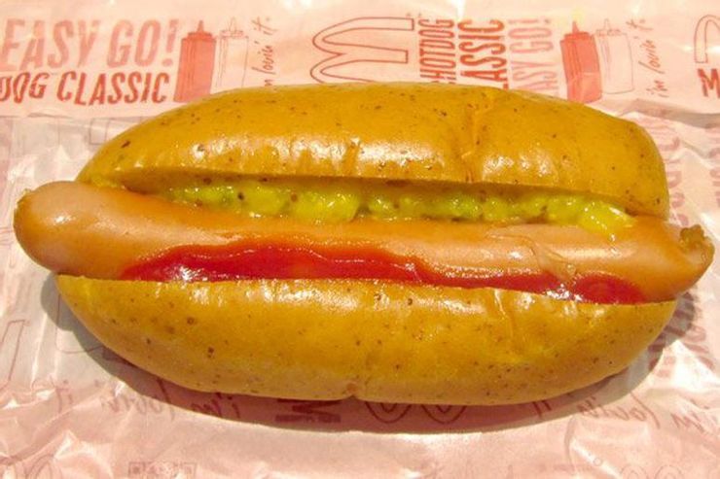
Weird McDonald Menu Items

Slide 24
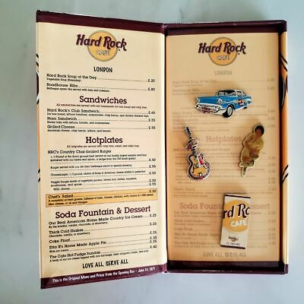
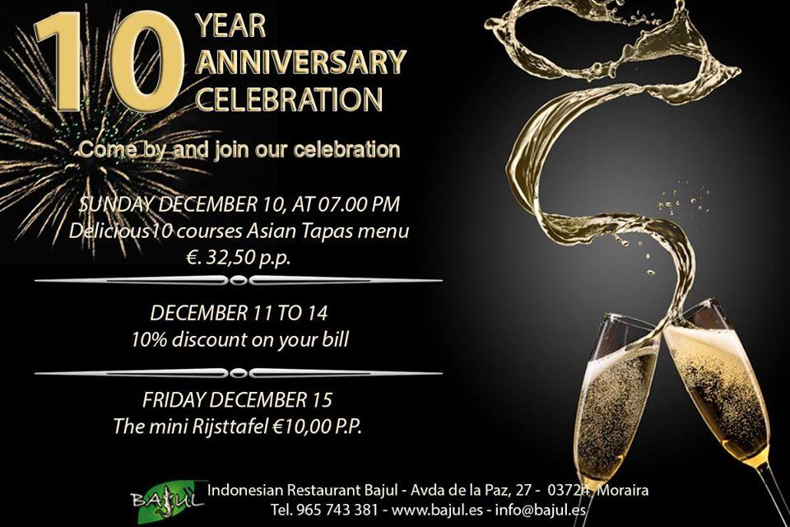
2000’s

Slide 25
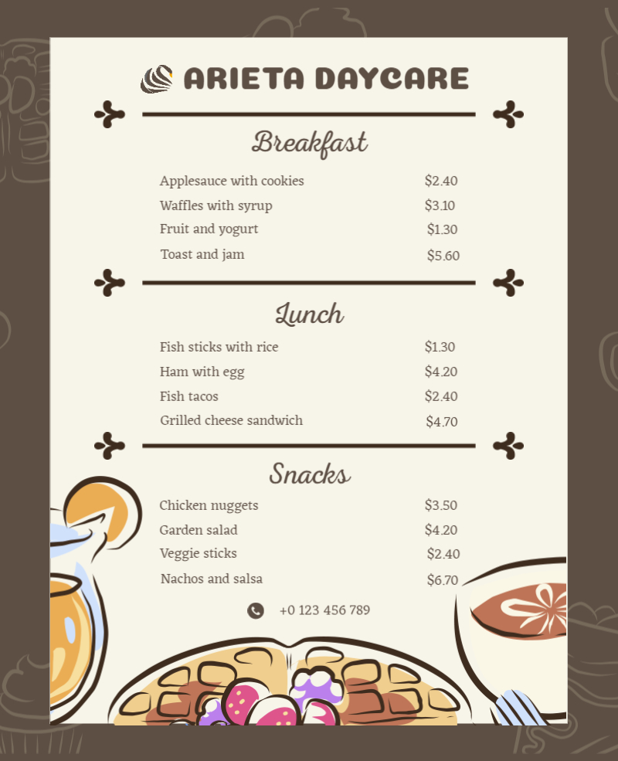
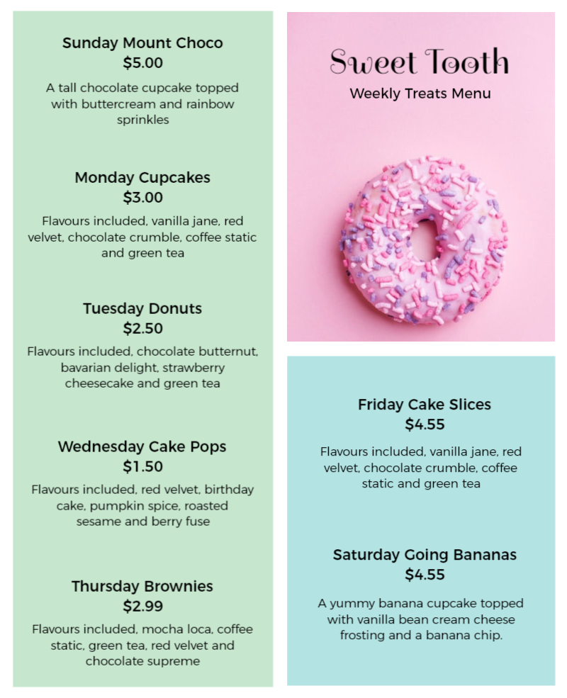
2021

Slide 26
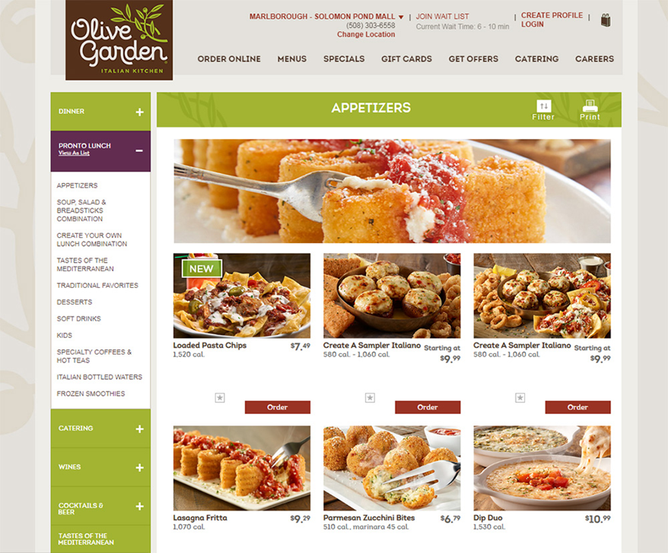
Assignment
Write an article of about 500 words suitable to publish in a local magazine. (You can include a high-quality picture)
What is the latest technology trends that can be used instead of a printed menu? (See picture for an example).
Do you think paper printed menu’s will be outdated soon?
Is there any consumer value in a printed menu?

Slide 27
Conclusions
Menu’s have been around for a very long time.
The first country according to history that used menus were China.
The outlay of menus over time has changed in many ways.
In the next session, you will learn about the construction of a menu.
Thank you for attending the session.

