Slide 1
Nature Science Research and Innovation Centre
Ontario (ON), Canada
Online Education (OE) Division
Recipe Development and Menu Planning
Lesson 15
Ms Wonda Grobbelaar (MBA)
Professor of Practice – OE Division
NSRIC Inc.
London, ON, Canada
E-mail: wonda.grobbelaar@gmail.com
https://www.nsric.ca

Slide 2
Learning Outcomes
The student will learn how to organize a professional tasting session.
The student will have knowledge on how to set up a tasting station.
The student will be able to design a food tasting form.
The student will be able to evaluate the food in a professional way.

Slide 3
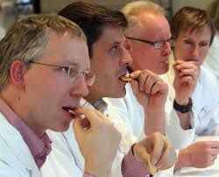
Professional Tasting

Slide 4
Creating an ideal tasting environment
The most important factor in the beginning stages of developing recipes will be the taste.
To make sure that nothing else influences the results of the professional tasters, the food tasting should happen in a quiet and odor free area.
Each food taster should be allocated to one cubicle or tasting station.
Choose the correct light during the food tasting.
The idea is that each food taster must make their own decision, not be influenced by the facial expressions of other food tasters, neither by the color of the food.
Try and have food tasting sessions in the morning as your taste and smell is sharpest in the morning before eating any other food.

Slide 5
The important role of a red light
As you already know, your taste buds play an important role in determining taste.
When you taste food, your taste buds send signals to your brain to interpret flavor.
Because we look at our food before eating it, our eyes send signals to our brain well before our taste buds get the chance.
This can predetermine how we will perceive the taste and flavor of what we’re about to eat.
Therefore, we eliminate any perceived tastes or flavors that can play a role in the taste evaluation of food.

Slide 6
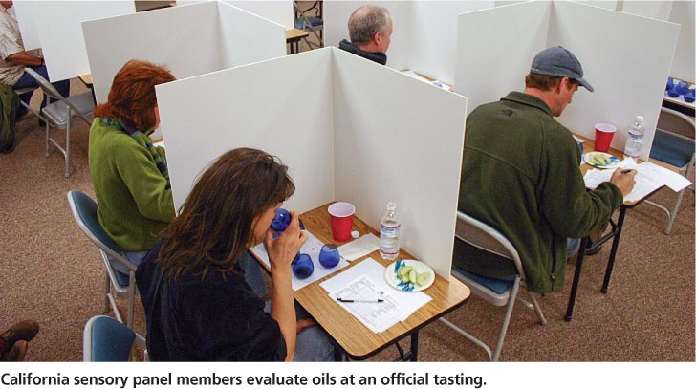
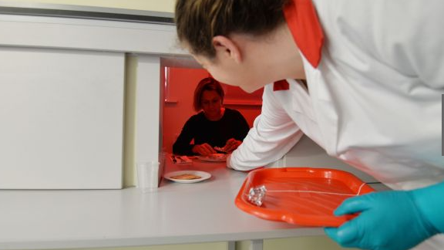
Creating an ideal tasting environment

Slide 7


How to prepare for a food tasting
No curries at least 24 hours before the time.
No morning coffee.
No strong deodorants or shower gels.
No aftershave.
No perfume, no lipstick.
No strong-tasting toothpaste.
No smoking.

Slide 8
How to prepare for a food tasting (Continued)
Not everyone is suitable to be a sensory tester, as many people have an inability, or reduced ability to distinguish the basic tastes.
Our tongues can only perceive five basic tastes – sweet, sour, salt, bitter and a savory taste called umami.
The flavor we perceive in food comes from our nose, through our sense of smell.
Hearing for example the sound of the crack of chocolate when you bite into a Magnum ice-cream is not part of the flavor, but certainly enhances the experience of eating it.

Slide 9
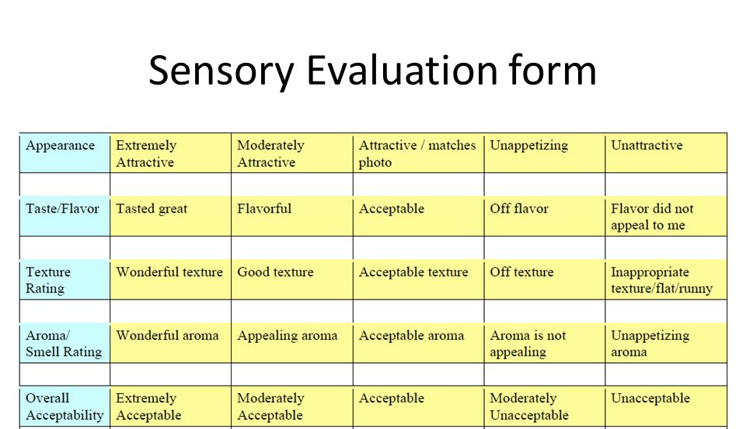
Sensory Analysis Form

Slide 10
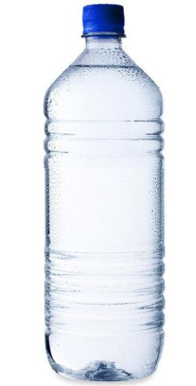
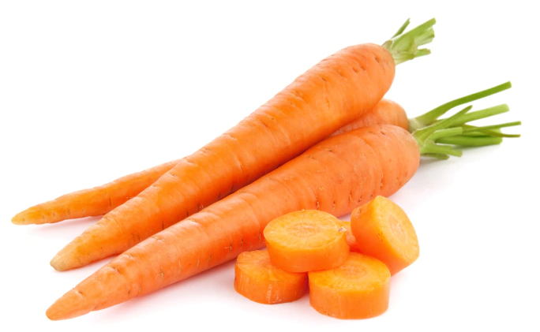
Creating an ideal tasting environment
Place water in every cubicle to cleanse the palate.
Drink a few sips between different foods to cleanse your palate.
If your food sample is oily, crunching on a cleansing food, such as raw carrots, before sipping water can cleanse your palate of some residual fats.

Slide 11
Triangle Testing
Triangle testing is used primarily for difference testing.
Participants are asked to taste three products, two of which are the same and one of which is different.
After tasting all three products, they are asked which one is the odd one out.
Triangle testing is a great way to measure the impact of minor recipe modifications on an existing product.
Ideal to evaluate the effect of minor recipe modifications.

Slide 12
How to Taste Like a Master Chef – Smell it
Did you know that 90% of taste is linked to smell?
The taste buds of the tongue identify taste, and the nerves in the nose identify smell.
Both sensations are communicated to the brain, which integrates the information so that flavors can be recognized and appreciated.
When you combine TASTE with the sense of SMELL it can recognize many other individual 'tastes’.

Slide 13
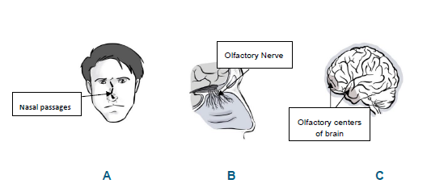
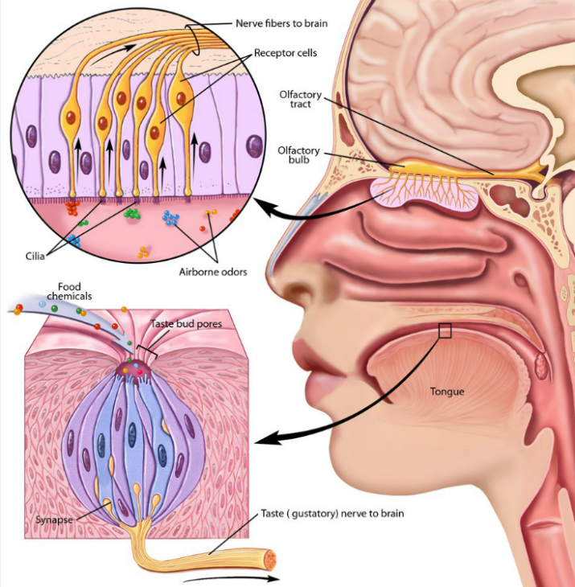
How do we smell?
The senses of smell and taste are directly related because they both use the same types of receptors. If one's sense of smell is not functional, then the sense of taste will also not function because of the relationship of the receptors.

Slide 14
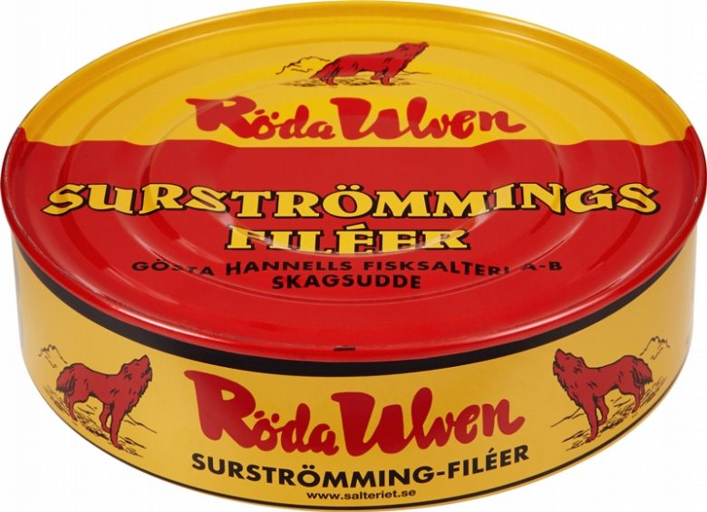
Smelly Food
Taste:
Roquefort cheese, vinegar and seafood all in one.
Serve it:
On an open-faced sandwich on crunchy flatbread with butter, sliced potatoes and chopped red onions.

Slide 15
Deconstruct what you are eating
To have a better understanding of the meals’ complexity, break it down.
By tasting each component, you will be able to understand what the individual flavors are and how they combine taste.
Try to isolate flavors with one bite.
The step will be to add something to this bite. What about a sauce?

Slide 16
Leverage non-tongue taste
Not all taste receptors are in the tongue.
There is also taste receptors at the roof of your mouth and at the back of your tongue.
Sometimes when you taste food it might taste great in the beginning and as the food works through your mouth to the back of your tongue, it becomes unfavorable.

Slide 17
Isolate the basic taste
Each dish has its own flavor profile.
Learn the different flavor profiles.
Know what the flavor profile is.
What is a flavor profile?

Slide 18
What is a flavor profile?
A flavor profile is a set of basic and common spices, seasonings, and aromatics that create a specific cuisine.
The key factor is BASIC.
If you know what spices to use for a Thai-inspired meal it will be easy to create a taste of Thai food.
The idea is to take inspiration from other cuisines and cultures to spice up your basic, go-to preps.

Slide 19
Combination of flavors
Understanding how to combine and balance flavors is an important cooking concept that will allow you to create flavorful dishes every time you cook.
Flavors can enhance each other.
Salt enhances sweet and vice versa for example, sea salt caramels or sea salt chocolate chip cookies.
That light addition of saltiness amplifies the sweetness of caramels and cookies.

Slide 20
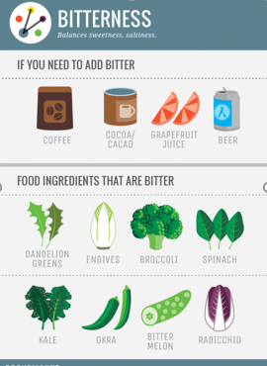
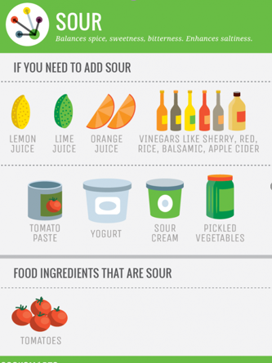
How to add flavor

Slide 21
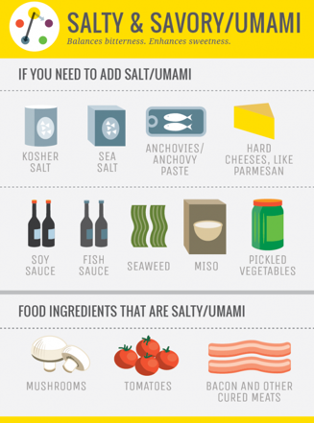
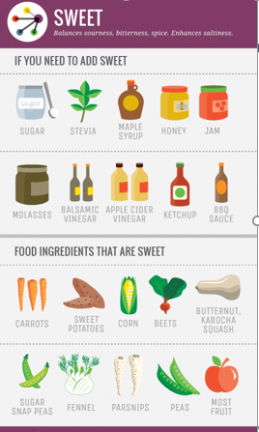
How to add flavor (Continued)

Slide 22
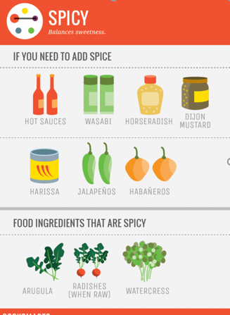
How to add flavor (Continued)

Slide 23
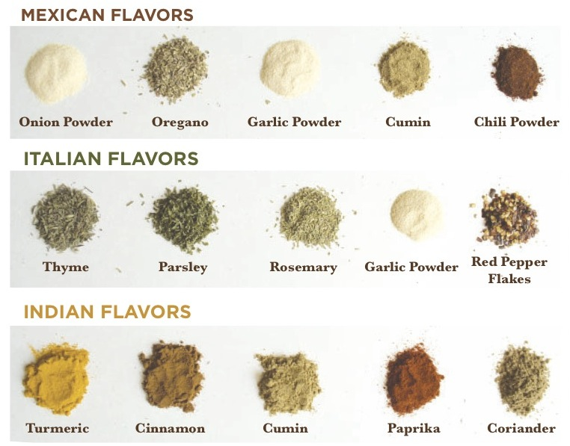
Global flavors

Slide 24
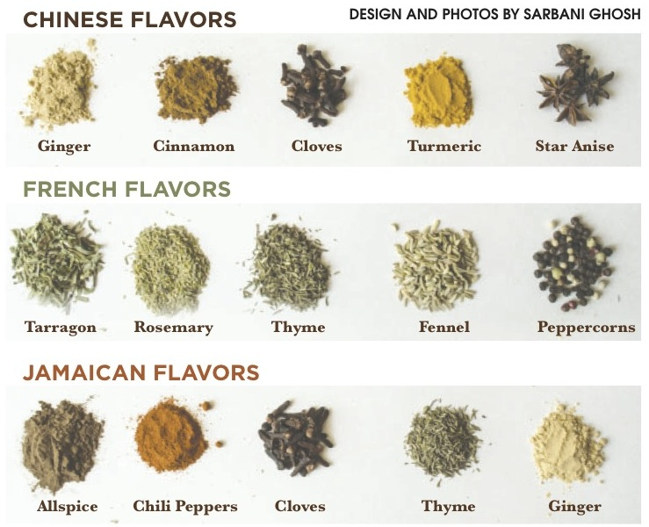
Global flavors (Continued)

Slide 25
Menu Tasting
When you’re attending a menu tasting, the reason is normally to create a menu.
A menu is developed using three main components: Taste, Texture and Presentation.
This will guide you when you put together a final menu for example an event.
All three combined provide the ultimate assessment of what works and what is not suitable.
Texture plays an important role in the mouth-feel of food and can eventually impact the enjoyment of what we are eating.
If something is too crunchy, it might hurt the roof of the mouth.

Slide 26
Conclusion
Not every person is a suitable food taster, as some people lack the ability to differentiate between different tastes.
It is important to understand how to combine and balance flavors in a cooking concept as that will allow you to create flavorful dishes every time!
In the next session, the student will learn about the importance and history of a menu.
Thank you for attending the session!

