Slide 1
Nature Science Research and Innovation Centre
Ontario (ON), Canada
Online Education (OE) Division
Recipe Development and Menu Planning
Lesson 14
Ms Wonda Grobbelaar (MBA)
Professor of Practice – OE Division
NSRIC Inc.
London, ON, Canada
E-mail: wonda.grobbelaar@gmail.com
https://www.nsric.ca

Slide 2
Learning Outcomes
The student will understand how to choose the correct packaging for food items for different occasions.
The student will know the basic rules of plating and what should be avoided.
The student will be able to choose the best option for food presentation in general.

Slide 3
Plating and Food Presentation

Slide 4
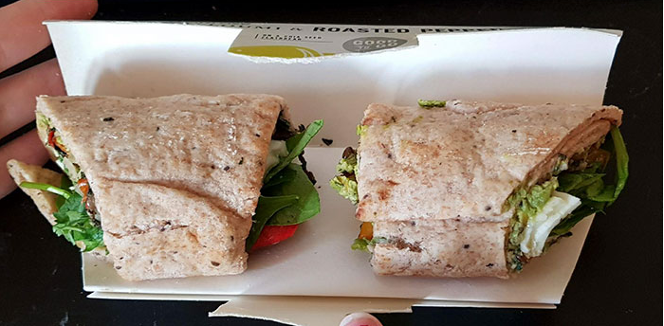
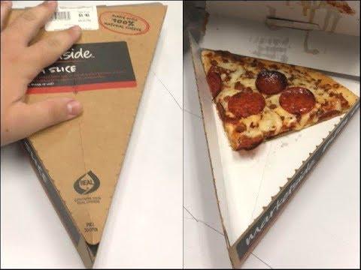
Food Packaging for Take Away Food
When catering for events, it is important to pay attention to the type of packaging that you will use to pack your food in when selling it to a customer.
But why?

Slide 5
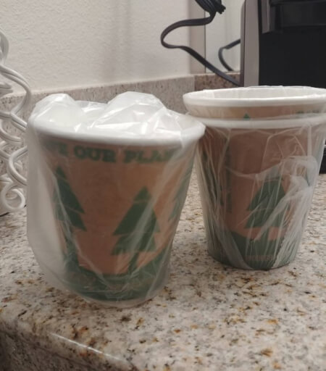
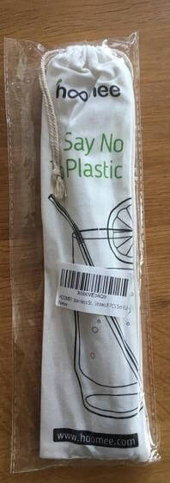
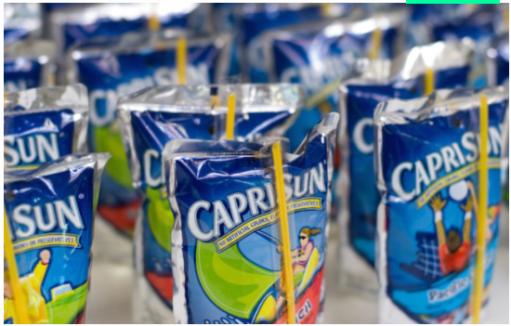
Make the right choice!
Recycled ‘save our planet’ cups in a plastic bag.

Slide 6
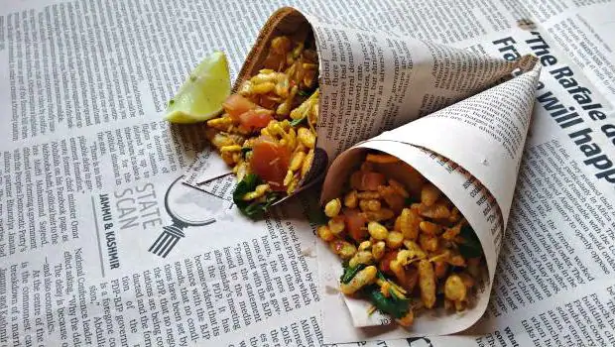
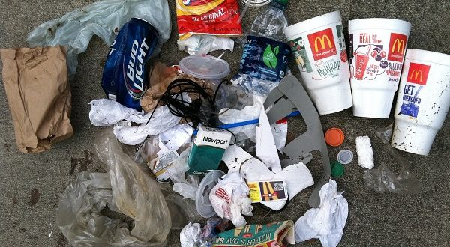
Make the right choice!
Decrease Wastage! Do we need all this packaging?
Newspaper Packaging is not a good idea!

Slide 7
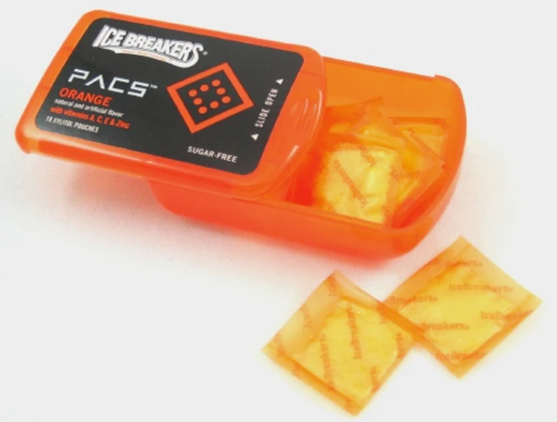
Food Packaging Issues – Case Study
“In so doing, the company hopes to end the controversy that has swirled around the product since its launch in November 2007. Hershey's found itself battling drug charges in the court of public opinion, not for manufacturing, distributing, or selling, but for simulating. Critics claimed that the packaging is too similar to the packaging for street drugs, such as cocaine, crack, and heroin.” (https://www.packworld.com/home/news/13343145/hersheys-packaging-controversy)

Slide 8
Food Packaging for Events
Food operators have many opportunities to sell at different events, namely sporting events and concerts.
Keep in mind that customers during these occasions often prioritize convenience and ease of eating as one of the primary buying elements.
You’ll not only have to include the rush factor during these events, but accessibility of trash cans as well.

Slide 9
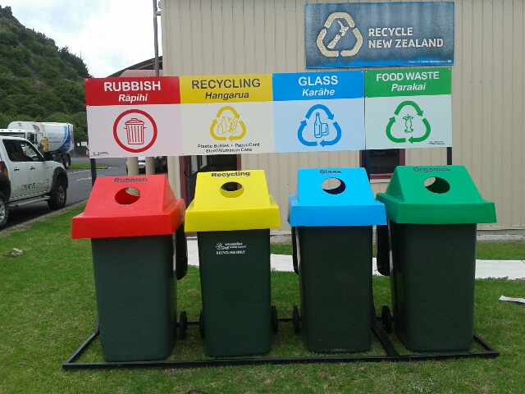
Food Packaging

Slide 10
Food Packaging Waste at Events
Events can create a lot of waste.
You may not be the organizer of the event, but you as the recipe developer needs to assure that the packaging you are using for the food is biodegradable and will not take too much space.
Remember Council bins are designed for day-to-day use and aren’t sufficient to handle the extra waste from an event.
In some countries by law, a plan must be submitted for any event where 1,000 people or more are expected to attend.
Maybe in your country it is not mandatory, but it is a good idea to create a plan for an event of any size.

Slide 11
Food Presentations
Why do Recipe Developers or Chefs Garnish their Food Creations?

Slide 12
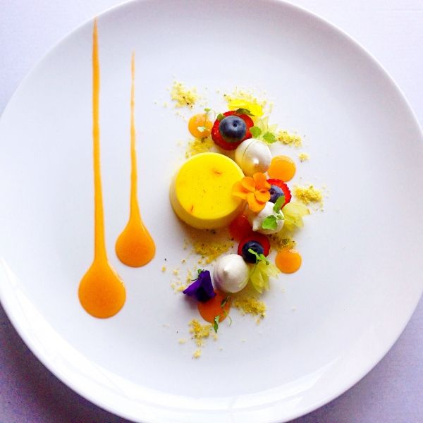
Visual Appearance
Food should look visually appealing.
Your eyes experience the food first. Garnish adds a pop of color and excitement to any platter that catches your eye and makes you want to taste the food.
Garnish does not have to be fancy.
It could be something as sprinkled
dill over steamed fish.

Slide 13
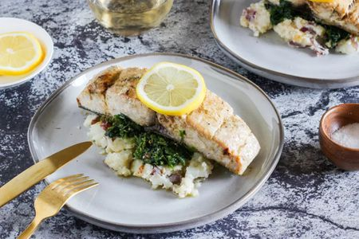
Enhancement of Flavor
Adding a slice of lemon to a seafood platter will add a tint of yellow to it.
It will not only add some color, but the lemon juice serves the purpose of enhancing the flavor.

Slide 14
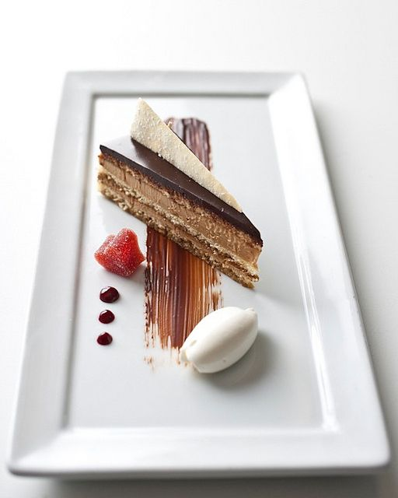
Filling the Plate
Garnish can serve as a plate filler.
If you are served a single slice of cheesecake placed on the middle of a dish, it might look a little empty and may not even seem worth the price.
By adding a sauce too, for example, a strawberry sauce, it will look more appetizing.

Slide 15
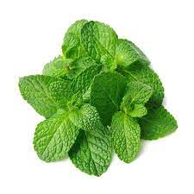

Types of Garnishes
Herbs and Leaves
Roots and Greens
Edible Flowers (Check if government regulations allows this)
Fruits and Vegetables
Puree’s
Syrups and Sauces

Slide 16
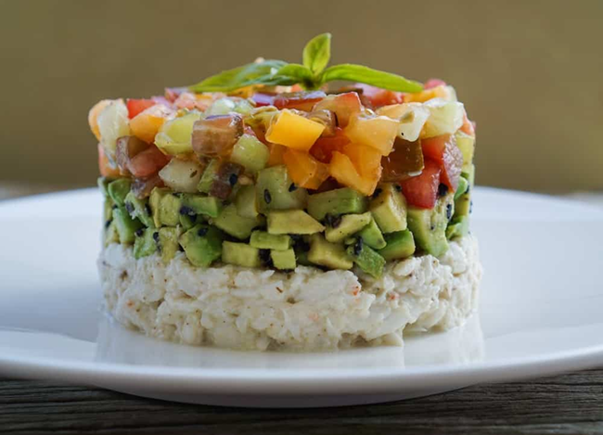
Presentation: What is your opinion?

Slide 17
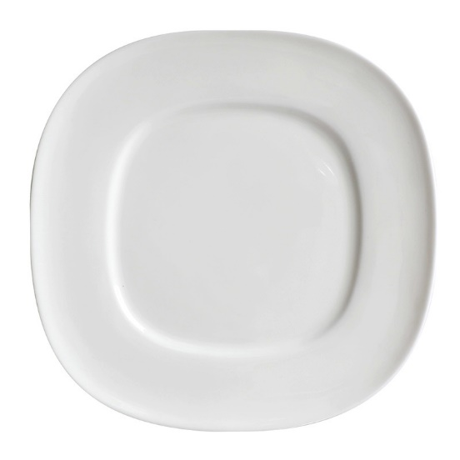
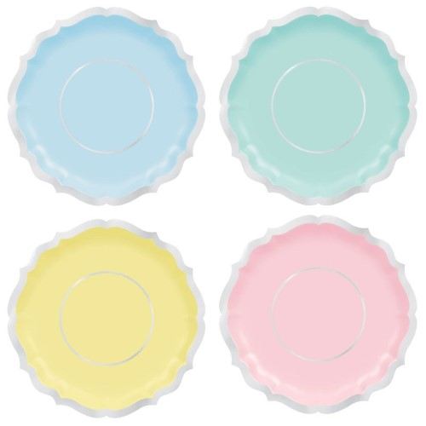
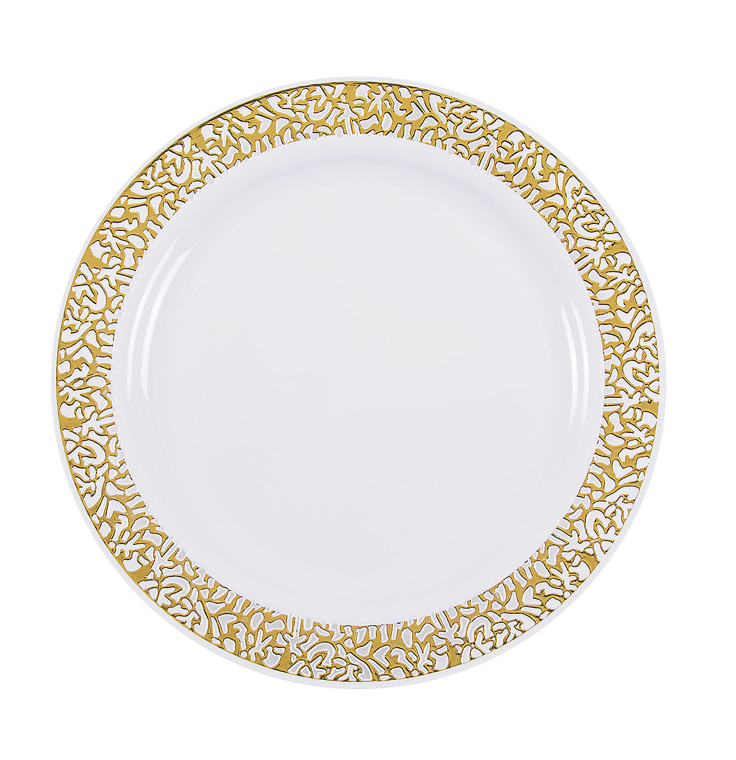
How to Plate Professionally: The Plate
Choose the right size plate. Choose your plate wisely by making sure it's big enough to allow your food to stand out, but small enough that your portions don't look too small.
Choose a complementary plate color. (Have a look at the latest trends)

Slide 18
Placing Your Ingredients
Plate with a clock in mind. As you begin plating your ingredients, picture the face of a clock. From the diner's point of view, your protein should be between 3 and 9, your starch or carbohydrate from 9 and 12, and your vegetable from 12 and 3.
Use moist ingredients as your base. One way to anchor runny ingredients is by placing other foods on top of them. A good example will be, sliced meat or vegetables against purees and mashed vegetables.
Serve odd amounts of food. Never plate equal numbers.
Place food to create flavor bites

Slide 19
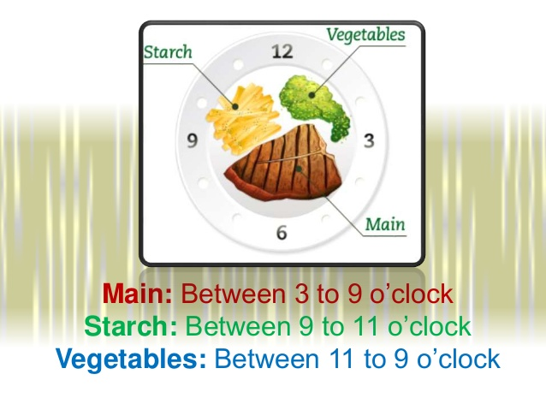
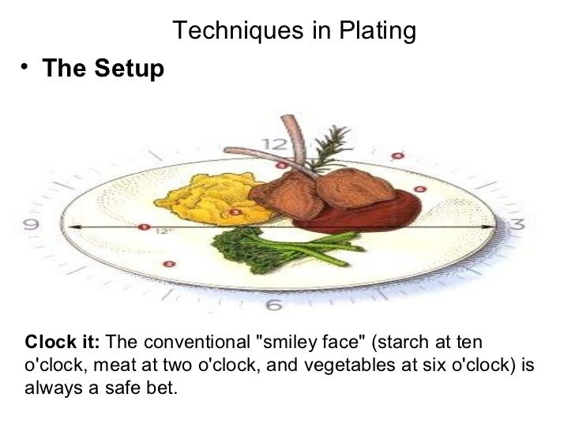
Different Techniques

Slide 20
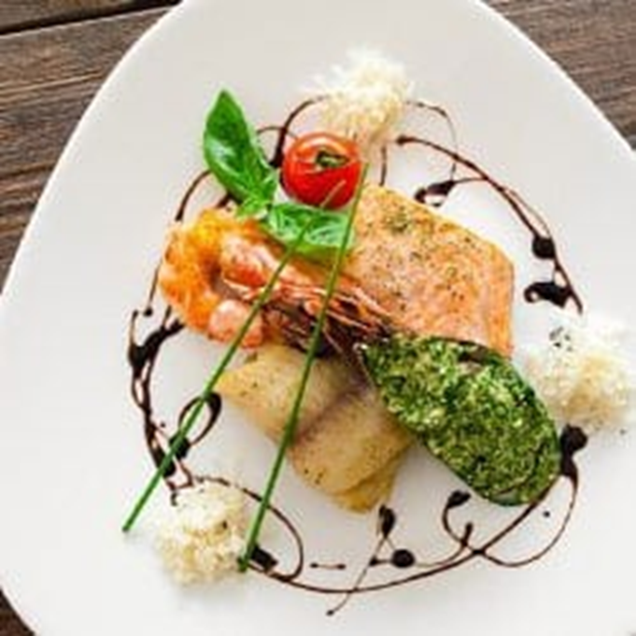
Food Presentations
Never overcrowd your plate.
Remember - very important…less is more….

Slide 21
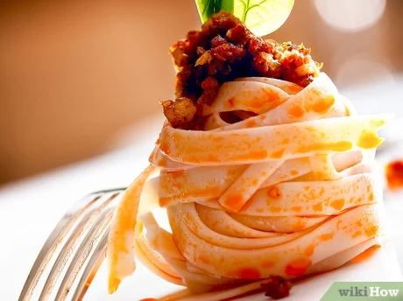
Pay Attention To Detail
Think about color and contrast.
Create height on your plate.
You can also balance out taller ingredients by leaning long, flat items against them. For example, you can plate your steak on top of polenta and lean asparagus spears against them at a 45-degree angle.
Use texture to enhance your dish.

Slide 22
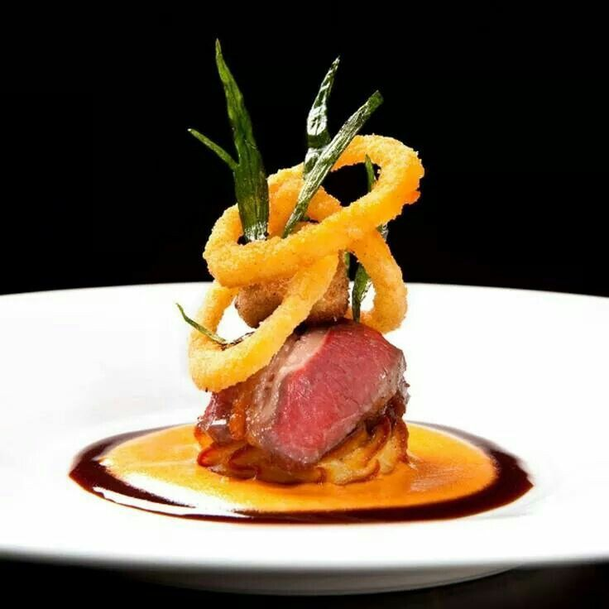
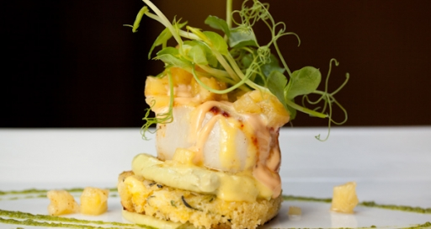
Pay Attention To Detail

Slide 23
Use Garnishes Purposefully
Do not throw anything on the plate just before it leaves the kitchen just to add something.
All garnishes must be edible.
Place garnishes purposefully.

Slide 24
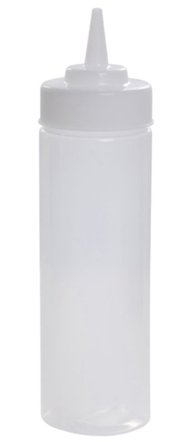
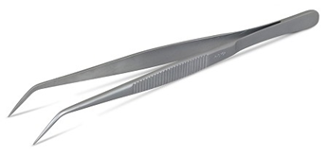
Tools for Professional Plating
Decorating Brushes
Garnishing Kits
Molds
Plating and Precision Tongs
Plating Wedges
Shavers
Spoons
Squeeze Bottles

Slide 25
Conclusion
It is important to create beautiful plates when presenting food to a restaurant owner.
Think twice before deciding on the packaging for your event food.
Think about wastage, how it will contain the food inside, including the temperature of the food. Is it easy to handle? What about wastage?
In the next session, the student will learn how to set up a tasting station and the history of Menu’s.
Thank you for attending the session!

