Slide 1
Nature Science Research and Innovation Centre
Ontario (ON), Canada
Online Education (OE) Division
Recipe Development and Menu Planning
Lesson 13
Ms Wonda Grobbelaar (MBA)
Professor of Practice – OE Division
NSRIC Inc.
London, ON, Canada
E-mail: wonda.grobbelaar@gmail.com
https://www.nsric.ca

Slide 2
Learning Outcomes
The student will understand how to choose the correct packaging for food items.
The student will know the difference between the various types of packaging.
The student will be able to design a label for a food item containing all the necessary information on it.

Slide 3
Packaging

Slide 4
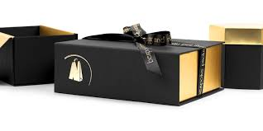
Packaging
Packaging is materials that is used to wrap or protect goods and the presentation of any item in an advantageous way.

Slide 5
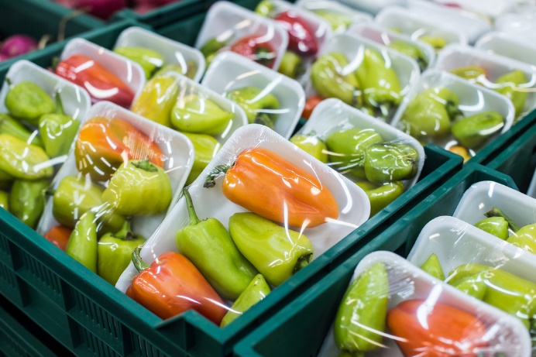
Food Packaging
Food packaging is specialised packaging for food.
A package provides protection, tamper resistance and special physical, chemical or biological needs. It must include nutritional facts, label and other information about the food being offered.

Slide 6
Food Packaging Requirements
Description or technical name of the food or drink (not the brand).
Net weight or volume – amount of food or drink without the weight of the packaging.
Production date, expiry date.
Ingredient list (All ingredients and Additives).
Nutritional information.
Allergy warning or allergen declaration.
Name and address of manufacturer, distributor or importer.
Country of origin.
Storage instructions example keep refrigerated at 4°C.
Use the link below to work out basic nutrition.
    https://recipes.sparkpeople.com/recipe-calculator.asp

Slide 7
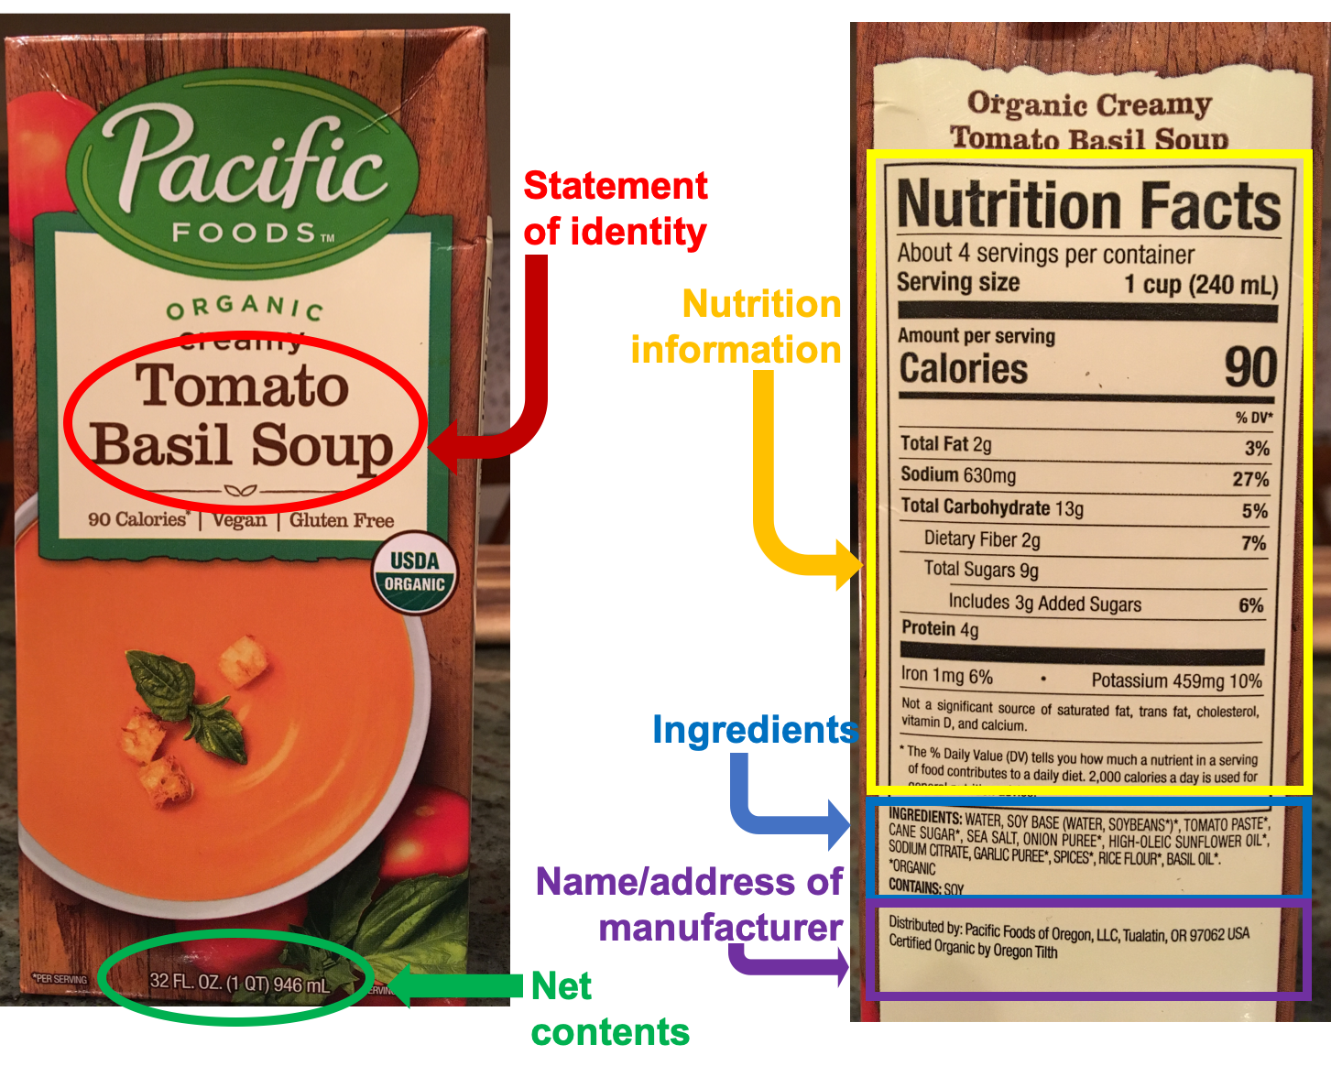
Food Packaging Requirements (Label)

Slide 8
Different Types of Packaging
In recent decades, packaging and containers have become an essential element in food purchases.
The food is packaged and packed with the aim of being transported and stored.
That is, not only is it a container, but “the container must protect what it sells and sell what it protects” (Briston-Neill, 1972).

Slide 9
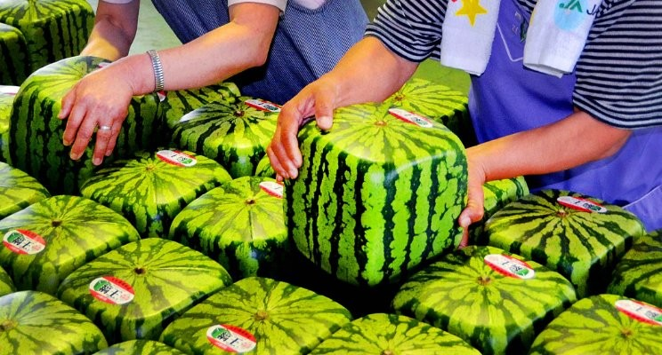

Natural Food Packaging

Slide 10
Different Types of Packaging (Cont.)
Plastic Packaging
  In the plastic manufacturing process, there are many varieties of plastic resins, with the most widely used being:
Polyvinyl chloride (PVC): very resistant to humidity, fats and gasses.
Polyethylene and its varieties (PET, HDPE, LDPE).
  The development of the PET range has revolutionized the packaging industry, allowing plastic to compete directly with glass bottles.
Polystyrene (PS) is the plastic of choice for thermoforming due to its strength, malleability and low cost.

Slide 11
Suitable Food Packaging
The most common plastic resins approved by the FDA for food contact are:
Polyethylene Terephthalate (PET)
Polypropylene (PP)
High-Density Polyethylene (HDPE)
Low-Density Polyethylene (LDPE)
Polycarbonate (PC)

Slide 12
HDPE Plastic Packaging
High-density polyethylene (HDPE) is the plastic of choice for milk and juice jugs and other such item that need to be held in a rigid container.
Not only does HDPE have superior moisture-resistant properties, but it is also resistant to chemicals and detergents used in the household environment.
In addition to milk bottles, HDPE can be found in 5-gallon food buckets and disposable shopping bags.
It is important to note that not all HDPE containers are considered food-grade.
If they are not labelled specifically as "food safe," the container should be lined with a food-grade plastic bag before storing food in it.

Slide 13
Suitable Food Packaging (Continued)
Many food grade plastic containers fall into the high-density polyethylene — or HDPE — category.
It has excellent chemical resistant properties making it suitable for a wide range of foods and other products.
For example, most juice or milk containers and five-liter food buckets are made from HDPE.

Slide 14
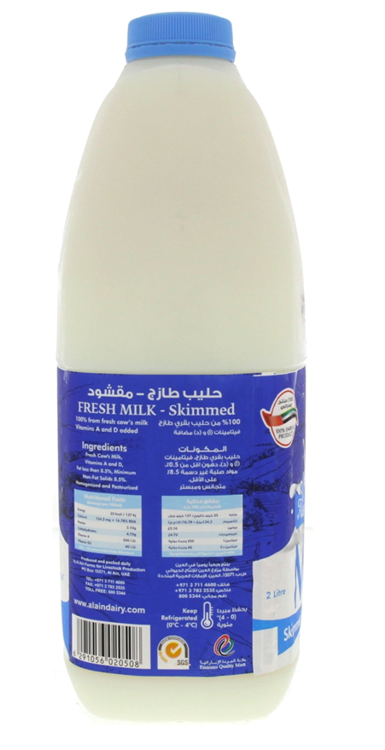
Certification for Quality
S.G.S stands for Standard Global Services. SGS S.A. (formerly Société Générale de Surveillance), a Swiss company providing inspection, verification, testing and certification services.
The Emirates Quality Mark (EQM) is both a voluntary and a mandatory mark for specified products. The EQM is a mandatory mark of conformity granted to products that can demonstrate compliance with the relevant United Arab Emirates (UAE) product safety and quality requirements.

Slide 15
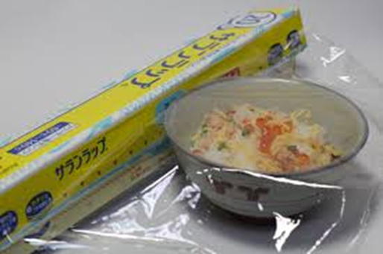
Suitable Food Packaging (Continued)
Vinyl (PVC)
Polyvinyl chloride (PVC) is used in all manner of food wraps. It is transparent and strong and clings very well to food when used as a wrap, but it also allows enough oxygen through its surface for products that need to "breathe," such as fresh meats. Garden hoses and shoe soles are also often made with PVC, as are the white plastic pipes used for household plumbing.

Slide 16
The Health Risks of Plastic Food Packaging
Although the risk is low, there's growing evidence that food can be contaminated by harmful chemicals from some types of plastic.
Many foods are packaged in these risky plastics – including fresh meat, gourmet cheese, and even some health foods and organic vegetables.

Slide 17
How to identify safe Plastic Food Packaging
Learning how to tell if a plastic container is food-grade plastic is easy.
Look for a triangle-shaped label with rounded corners made of three arrows, then check the number in the center to determine what type of plastic is in the container.
Food Grade Plastics Approved By The FDA:
  The easiest way to check is to look for the Resin Identification Code—i.e., recycling number—which identifies the type of plastic material.
  The code consists of a triangle of arrows surrounding a number between 1 and 7. Generally, numbers 1 through 7 indicate food grade plastic. (Refer next slide)

Slide 18
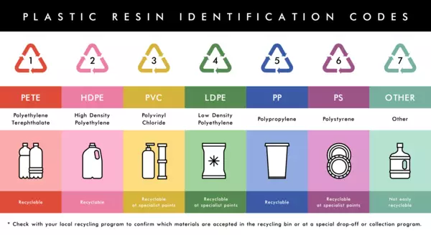
How to identify safe Plastic Food Packaging (Cont.)

Slide 19
Microwave Packaging Definition
Microwave package is a package which can be used for cooking or heating the product in a microwave oven.
Thermal conductivity of the package can affect the heat transfer between food and oven. Microwaves heat the product without interfering with these packaging materials.

Slide 20
Heating Plastics
Scientists warn of the risk of ingesting phthalates when heating food in non microwaved plastic.
When exposed to heat, these plastic additives can break down and leach into food.
“Some plastic isn’t designed for microwaves because it has polymers inside to make it soft and flexible, which melt at a lower temperature and may leach out during the microwave process if it goes beyond 100C (212F),” says Juming Tang, professor of food engineering at Washington State University.
Disrupt hormones and metabolic system, fertility issues, asthma and ADHD.
In children: Increased blood pressure, insulin resistance and increase the risk of metabolic disorders for example diabetes and hypertension.

Slide 21
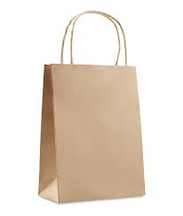
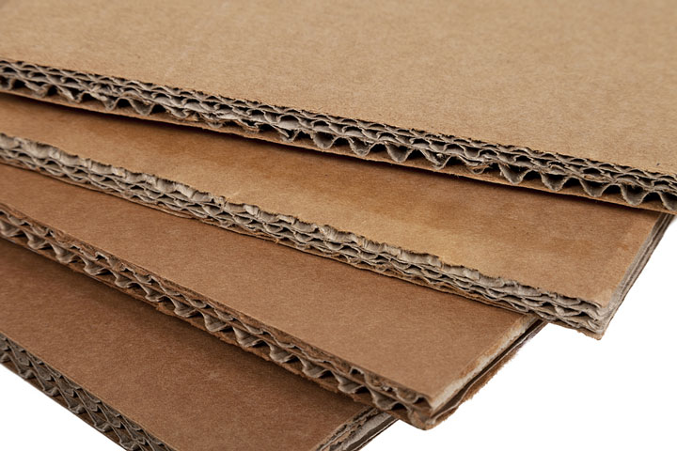
Types of Paper Packaging
There are three major types of paper packaging: corrugated boxes, boxboard or paperboard cartons, and paper bags and sacks.
Corrugated Boxes: Corrugated boxes are commonly used to carry heavier products such as appliances, electronic goods, wine, fruit and vegetables.

Slide 22
Paper Food Packaging (continued)
Products derived from wood are widely used in the packaging of food in the form of paper and cardboard.
Paper is a very cheap, lightweight product with excellent printing capacity. Although it is very sensitive to moisture, it can be corrected with a combination of paper and other materials such as plastic or paraffin.
Cardboard is a material made up of several superimposed layers of paper, making it thicker, harder and more resistant than paper. Its main use is for packaging and containers in the form of boxes.
In recent years, paper and cardboard manufacturers are paying special attention to issues related to health and the environment by working with recycled products that increase the useful life of these raw materials.

Slide 23
Glass Packaging
Glass is an inert material that is impermeable to gases and vapors. It is an excellent and completely neutral oxygen barrier when in contact with food.
However, it is a fragile, heavy material that requires a lot of energy to be manufactured.
Glass uses one of the most abundant raw materials on the planet, silica, but it is not renewable.
Despite this, it is a recyclable product, as it can be used as a container repeatedly.

Slide 24
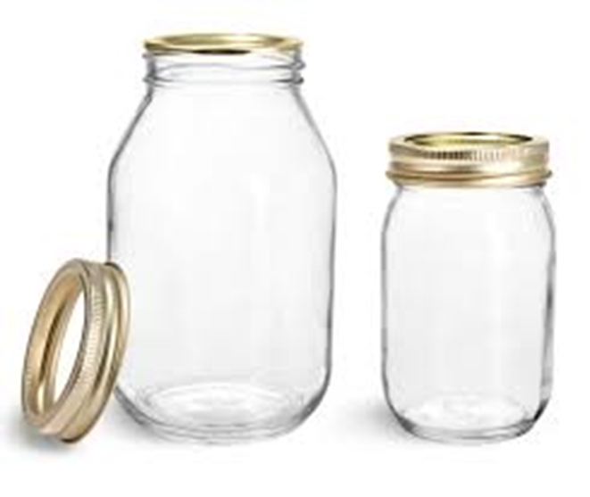
Glass Packaging (Continued)
More than 75 billion glass containers are used per year in the food industry, being its main use for wines, juices, baby food and soft drinks.
Glass containers can be bottles (the most used), jars, glasses, ampoules, etc.
However, this material is not used for frozen products due to the risk of breakage.

Slide 25
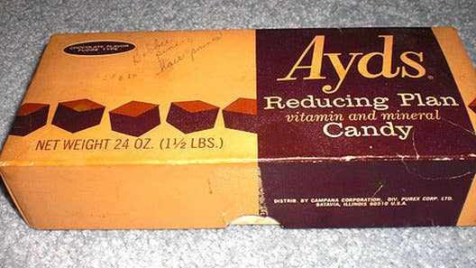
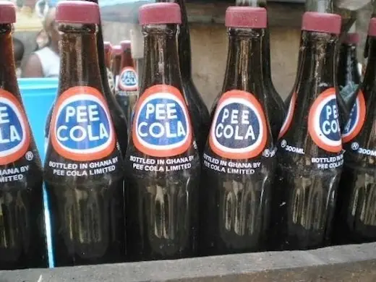
Product Names
All prepacked products must bear a name that accurately describes the product; it must be clearly presented, not misleading, and not broken up by other words or pictures.

Slide 26
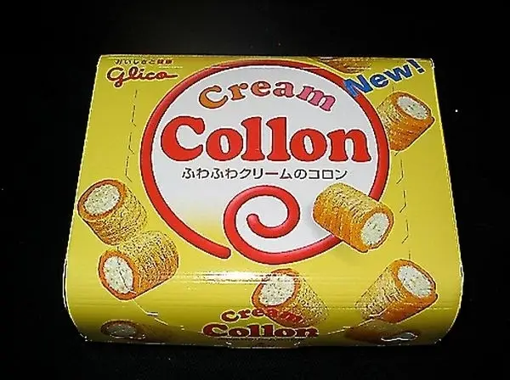
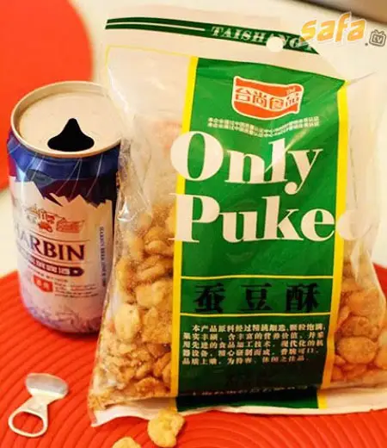
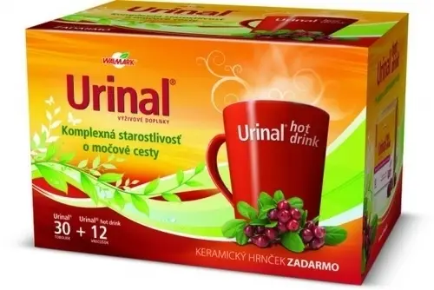
Product Names (Continued)

Slide 27
Brand Names
Fancy names and brand names are used to market products but say nothing about the product and have no legal standing; for the purpose of food legislation, they are not considered to be names.
If you use fancy names or brand names you will also need to use the most appropriate name from those below, usually on the back of the product.
For example:
Fancy name: 'Coca-Cola’
Descriptive name (back of can): 'Sparkling soft drink with vegetable extracts’.

Slide 28
Product Names (Continued)
The descriptive name must accurately describe the food that people are eating so that they can make an informed choice as to whether they want to eat it.
Ingredients, treatments, that may affect the decision to purchase should be included in the descriptive name.
Examples include:
  A bacon and egg sandwich that contains brown sauce.
  A beef and mustard baguette that contains pickled gherkins.

Slide 29
How to choose?
How do you choose the correct package?

Slide 30
Assignment
Design a label for a food item.
The food item can be a meal, a snack, a treat or salad.
Include all the basic requirements on the label.
Decide on the type of food packaging you will use to pack this item in.
Give a short explanation why you made this choice.

Slide 31
Conclusion
In the next session, the student will learn about food presentation and food packaging suitable for different occasions.
Thank you for attending the session!

