Slide 1
Nature Science Research and Innovation Centre
Ontario (ON), Canada
Online Education (OE) Division
Recipe Development and Menu Planning
Lesson 12
Ms Wonda Grobbelaar (MBA)
Professor of Practice – OE Division
NSRIC Inc.
London, ON, Canada
E-mail: wonda.grobbelaar@gmail.com
https://www.nsric.ca

Slide 2
Learning Outcomes
The student will understand how to work out the costing of a recipe.
The student will know how to upscale recipes.
The student will have knowledge about yield and why it is important when working out prices for a menu.
The student will be able to work out the trim loss of a food item.

Slide 3
How to cost a recipe

Slide 4
Standardized Recipes
With the use of standardized recipes, you can ensure the consistency that the same type and quantity of ingredients are used each time the product is prepared.
Therefore, the yield will be the same, so food cost will be predictable and foreseeable. In this way, the restaurant can meet its financial goal.
It can help to control labor costs.
Standardized recipes include the same preparation activities that will be used, it can estimate that the time to prepare the items, regardless of which employee carries out the work.
Therefore, it can control the labor cost.

Slide 5
Limitations of Standardized Recipes
Takes away all creativity from the kitchen.
There is no room for experimenting.
Developing recipes is time consuming.
Ingredient substitutions is not advisable.
Equipment and facilities might not be everywhere the same.
Financial constraints if more expensive ingredients are used.

Slide 6
Converting Total Yield in Recipes
If portion size remains constant, then the following two-step method can be used
Divide the new yield by the old yield to obtain the conversion factor:
New Yield / Old Yield = Conversion Factor

Slide 7
Converting Total Yield in Recipes (cont.)
Multiply each recipe ingredient by the conversion factor to obtain the new quantity to calculate the new yield:
Old ingredient quantity x Conversion factor = New quantity
Can all ingredients be converted in a similar way?

Slide 8
Conversion of Standardized Recipes
When you multiply quantities in a recipe, measure by weight (grams) not volume (ml). You will create measurements that create a recipe that tastes the same.
Spices, herbs and seasoning.
When doubling recipes, you should put 150% of the required amounts. Putting the twice amount can ruin a recipe. Adjust the taste afterwards.
Cooking liquid.
If the meat is cooked slowly in a broth, put 150% of the required liquid. If it’s still not enough liquid, add more. The taste will not be diluted.

Slide 9
Conversion - Bread and Pastry Recipes
If you must increase the amount of bread or pastries, make a recipe twice, not double it.
Multiplying can change the recipe’s chemistry.
Everything is accounted for in a very precise discipline, so ingredients react properly in their interaction with each other.
Changing quantities can break the balance.
Mix the ingredients very well if you want to try and double the recipe.

Slide 10
Fresh Herbs Versus Dried Herbs
1 teaspoon of dried herbs for every 1 tablespoon of fresh herbs.
Use three times as much fresh herbs when the recipe calls for dried and 1/3 of the number of dried herbs when the recipe calls for fresh.

Slide 11
How to Cost a Recipe (Step 1)
Ingredient | Measurement | Quantity
AP Flour | g | 100
White Sugar | g | 25
Egg | each | 1
Vanilla Essence | ml | 5
Milk | ml | 30
Total

Slide 12
How to Cost a Recipe (Step 2)
Determine what the cost of each ingredient is as it is sold as a unit in the store.
Ingredient | Measurement | Quantity | Kibsons
AP Flour | g | 100 | 8.75/ 2kg
White Sugar | g | 25 | 5.50/1 kg
Egg | each | 1 | 10.00/15 eggs
Vanilla Extract | ml | 5 | 53.00/100ml
Milk | ml | 30 | 10.50/2 l
Total

Slide 13
How to Cost a Recipe (Step 3)
Divide the weight/measurement of each of the ingredients used in the recipe by the weight of the unit it is sold in and multiply it by the price of the unit. This will determine the cost of each ingredient used.
Remember Yields, as it may affect your costing.
Ingredient | Measurement | Quantity | Kibsons | grams
AP Flour | g | 100 | 8.75 / 2kg | 2000
White Sugar | g | 25 | 5.50 / 1kg | 1000
Egg | each | 1 | 10.00 / 15 eggs
Vanilla Extract | ml | 5 | 53.00 / 100ml
Milk | ml | 30 | 10.50 / 2l | 2000
Total
Kg must be converted into grams
L must be converted into ml.

Slide 14
How to Cost a Recipe (Step 4)
Ingredient | Measurement | Quantity | Kibsons
AP Flour | g | 100 | 8.75/ 2kg (2000) | 8.75/2000= 0.004
White Sugar | g | 25 | 5.50/1 kg (1000) | 5.50/1000=0.0055
Egg | each | 1 | 10.00/15 eggs | 10.00/15= 0.6666 (0.67)
Vanilla Extract | ml | 5 | 53.00/100ml | 53.00/100= 0.53
Milk | ml | 30 | 10.50/2 l (2000) | 10.50/2000= 0.005
Total
Work out the price of the smallest unit: 1 g, 1 ml, 1 piece.

Slide 15
How to Cost a Recipe (Step 5)
Ingredient | Measure-ment | Quantity | Kibsons | Calculation per smallest unit
AP Flour | g | 100 | 8.75/ 2kg (2000) | 8.75/2000= 0.004 | 100x0.004=0.40
White Sugar | g | 25 | 5.50/1 kg (1000) | 5.50/1000=0.0055 | 25x0.0055=0.1375
Egg | each | 1 | 10.00/15 eggs | 10.00/15= 0.6666 (0.67) | Price of 1 =0.67
Vanilla Extract | ml | 5 | 53.00/100ml | 53.00/100= 0.53 | 5x0.53= 2.65
Milk | ml | 30 | 10.50/2 l (2000) | 10.50/2000= 0.005 | 30x0.005=0.15
Total
Work out the price of the smallest unit: 1 g, 1 ml, 1 piece.

Slide 16
How to Cost a Recipe (Step 6)
Add the costs of all the ingredients used together. This will determine the cost of the entire recipe.
Ingredient | Measurement | Quantity | Kibsons | Calculation per smallest unit
AP Flour | g | 100 | 8.75/ 2kg (2000) | 8.75/2000= 0.004 | 100x0.004=0.40
White Sugar | g | 25 | 5.50/1 kg (1000) | 5.50/1000=0.0055 | 25x0.0055=0.1375
Egg | each | 1 | 10.00/15 eggs | 10.00/15= 0.6666 (0.67) | Price of 1 =0.67
Vanilla Extract | ml | 5 | 53.00/100ml | 53.00/100= 0.53 | 5x0.53= 2.65
Milk | ml | 30 | 10.50/2 l (2000) | 10.50/2000= 0.005 | 30x0.005=0.15
Total |  |  |  |  | 4.0075

Slide 17
How to Cost a Recipe (Step 7)
Divide the cost of the entire recipe by the amount of portions that it serves.
This will determine the cost of each serving.
4.0075 (Total of the overall recipe) / 5 portions = 0.8015 Fills
The markup will be determined by your overheads!

Slide 18
Yields
Yield Percent is a vital tool for determining how much of a product to purchase or used in a recipe.
Calculating yield percentage is critical to placing an accurate food order.
Improperly calculating your food order can result in having too much or too little of a given ingredient.
Too much of an ingredient will put you in the situation of scrambling to create a new dish to entice your customers and use your excess product.

Slide 19
Yields (cont.)
On the flip-side, running short of an item or ingredient can only lead to disappointment for customers longing for your new "signature dish.“
Determining the Yield Percentage of your recipes in advance will lead to greater efficiencies and a more productive operation.
By utilizing the following formulas and tips, you and your staff will lower your food costs and create a healthier bottom-line.

Slide 20
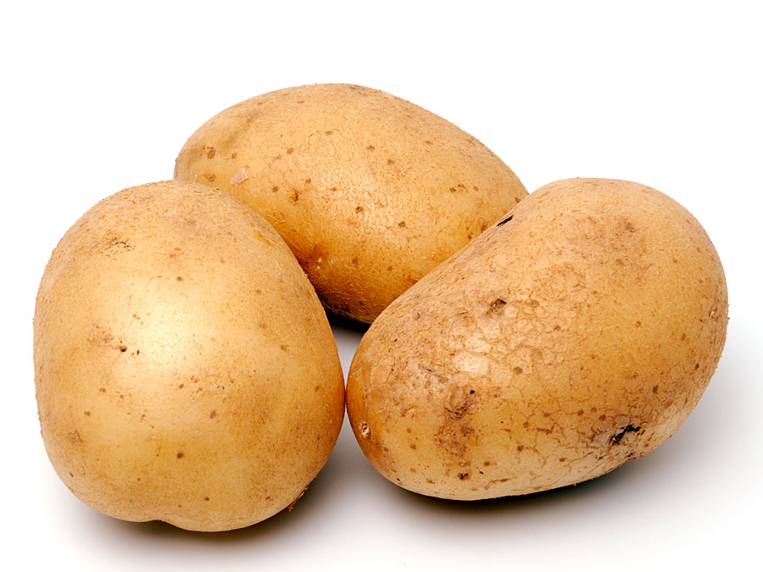
Yields (cont.)
As-Purchased Quantity (APQ):
The weight, volume, or count of the product as it is received from the vendor. The cost of a bag of potatoes, before fabrication, is the as-purchased quantity or APQ.

Slide 21
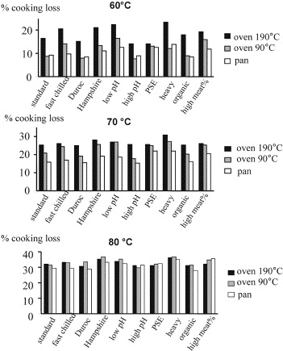
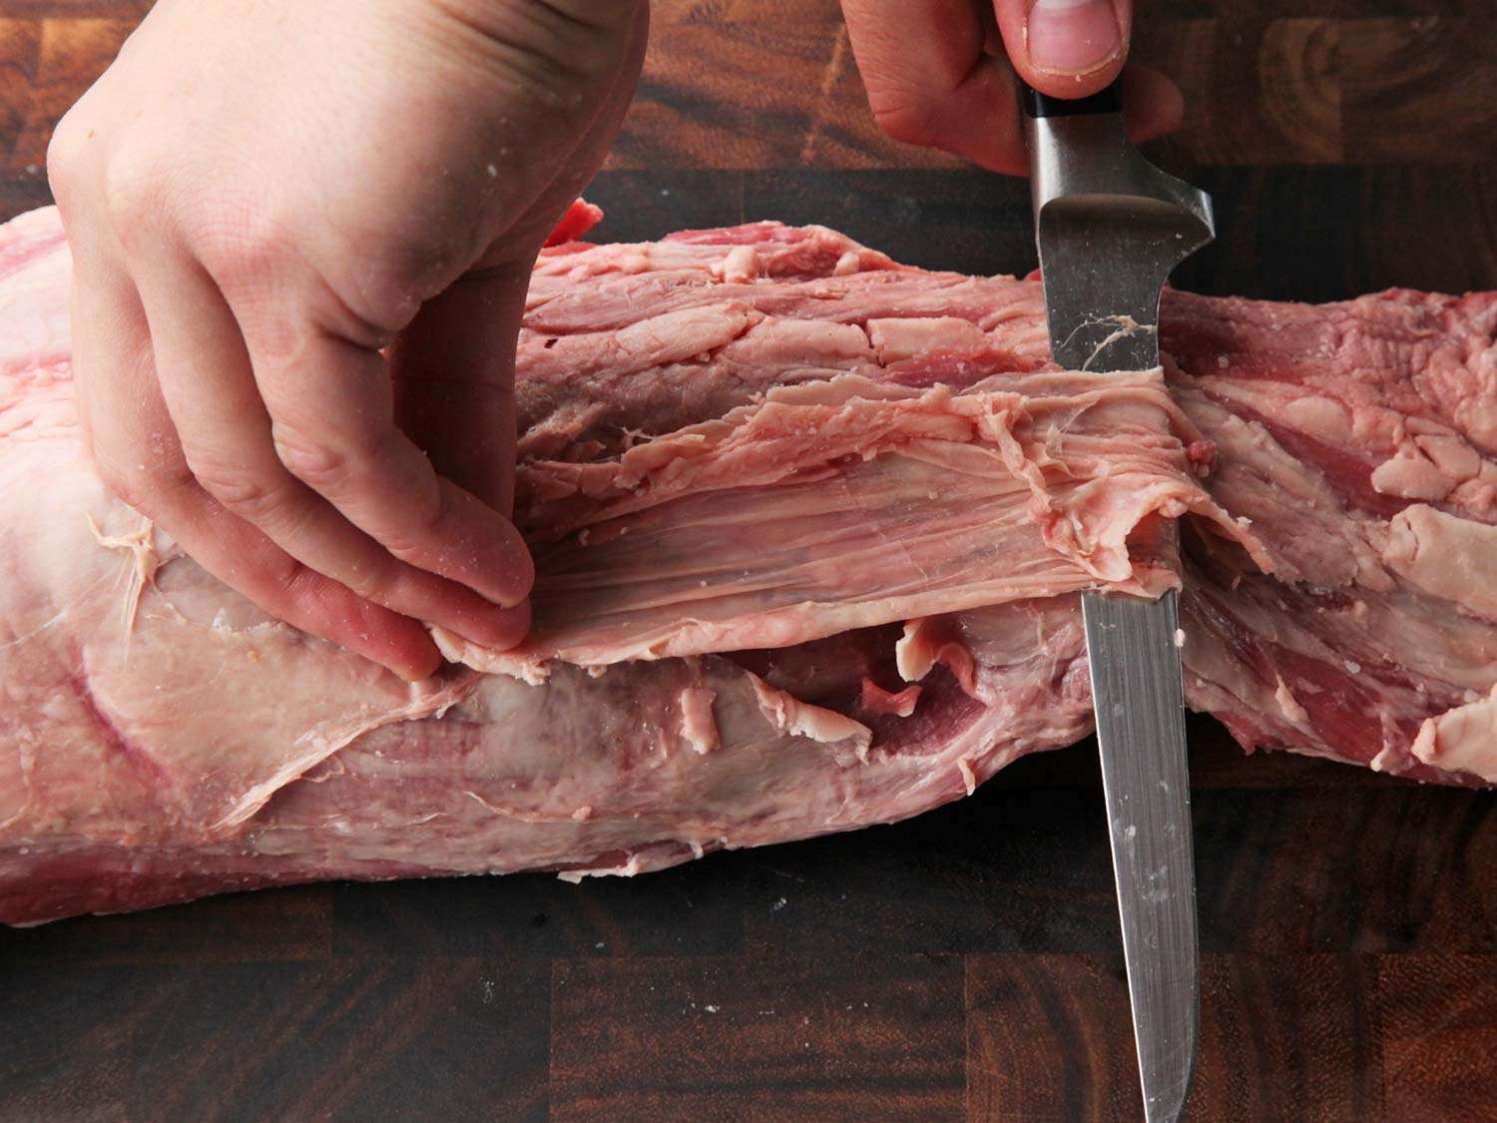
What About Other Losses?
Cooking loss and juiciness in relation to raw meat quality and cooking procedure - ScienceDirectCooking loss and juiciness of meat in ... sciencedirect.com
Trim Loss

Slide 22
Edible Portion (EPQ)
The weight, volume, or count of the product after it has been cleaned, peeled, or prepared (fabricated) and is ready for use.
The word edible signifies the condition of the product as ready for use in the dish you are going to prepare within your operation.

Slide 23
Yield Percentage
The trim is the weight or volume of the waste.
This factor can be determined mathematically as the difference between APQ and EP
APQ – EPQ = Trim
Example: The edible portion of a cleaned bag of potatoes would be the EPQ and would weigh in at approximately 42.5 kilogram. 50 kg – 42.5 kg = 7.5 kg (trim)

Slide 24
Yield Percentage (cont.)
Yield Percentage = EPQ/APQ or 42.5 kg/50 kg = .85*100 = 85%
The loss will be 15%
Not all trim is loss; if the trim is usable, then it is not loss. For example, if the potato peels can be used in a vegetable stock for soup, they would not be considered trim.
Utilizing the trim will make a kitchen run more cost-effectively; however, the value of the skins may be so small that it might not be worth allocating this cost to the ultimate recipe.

Slide 25
Factors Influencing Yield
An employee’s skill in cleaning the product will have an enormous effect on the yield percentage – skilled employees will not create as much waste.
The size of the product also influences the yield percentage – cleaning smaller carrots will create more waste and a lower yield percentage.
The condition of the product influences the yield – if your operation is not using the freshest products available, the yield percentage will be lower.

Slide 26
Assignment
The assignment of session 11 refers.
The customer has a budget of 5.00 to 8.00 AED per food item (Main meal)
Use the same recipe and work out the cost.
Remember the trim and cooking loss.
Replace some of the ingredients with a better quality and some with a cheaper product.
See if this will be possible by making the recipe with at least two different quality ingredients. (One product, two different brand names)
Produce the recipe and take note of the differences.
Difference brands, different tasting.
Color of product.
Overall look of product.
Any other notable differences?
Price difference.

Slide 27
Conclusion
Not all ingredients can be scaled up in a direct way.
When working out costing of recipes, trim and cooking loss should be taken in consideration.
Yield percentages are important especially when buy food products, as some suppliers might look cheaper on product, but the yield percentage is much lower than the more expensive product.
In the next session, the student will learn about food presentation and food packaging suitable for different occasions.
Thank you for attending the session!

