Slide 1
Nature Science Research and Innovation Centre
Ontario (ON), Canada
Online Education (OE) Division
Recipe Development and Menu Planning
Lesson 11
Ms Wonda Grobbelaar (MBA)
Professor of Practice – OE Division
NSRIC Inc.
London, ON, Canada
E-mail: wonda.grobbelaar@gmail.com
https://www.nsric.ca

Slide 2
Learning Outcomes
The student will have knowledge of writing different types of preparation methods.
The student will understand the importance of writing in a professional way including using the correct terminology.

Slide 3
How to write a standard recipe

Slide 4
The Recipe
A recipe is a list of all the ingredients required to make a certain food.
The recipe will include:
  the yield,
  method of preparation,
  the length of time required to cooking it,
  the temperature at which it should be cooked at, and
  how the food should be stored.

Slide 5
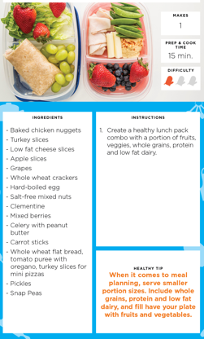
The Recipe (cont.)
The yield of the recipe shows you the number of guests and the size of the portion.
This information is important when preparing the recipe for a few guests.
List of Ingredients
How many portions?

Slide 6
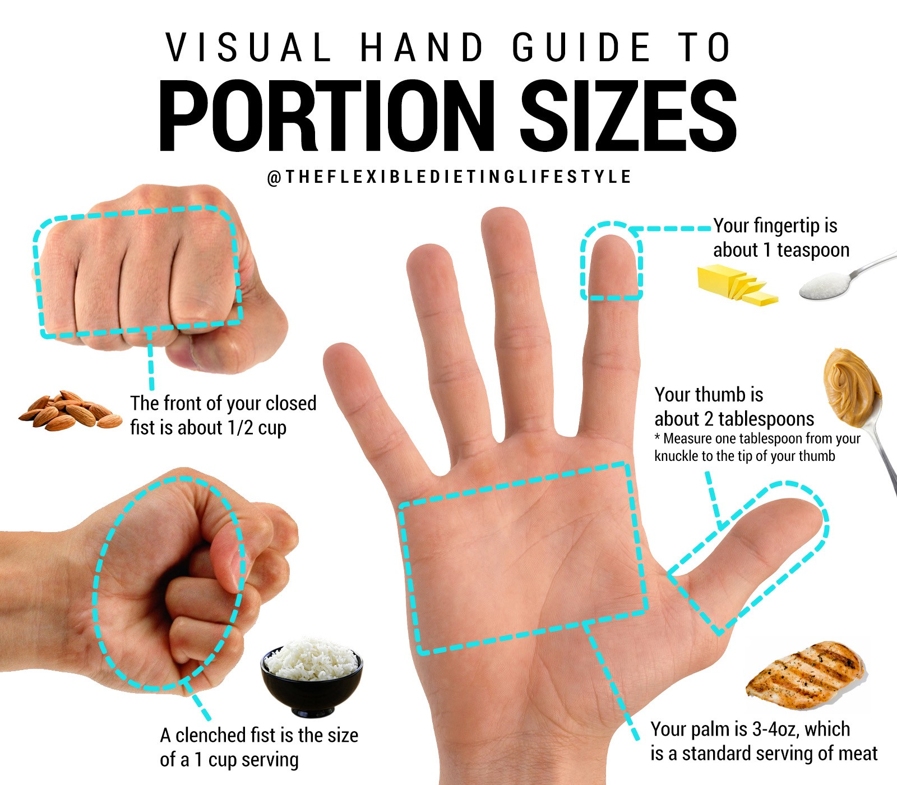
Portion Sizes

Slide 7
Portion Sizes (cont.)
Food Item | Weight or Size
Protein (Meat, Fish) Lunch | 70 – 100 g
Protein (Meat, Fish) Dinner | 150-200 g
Green or Orange Cooked Vegetables | 75 g -1/2 cup
Olives | 30 g
Cheese (Hard) | 25 g
Rice (Uncooked Rice) | 60 – 90g
Pasta (Side dish) | 55-60g
Pasta(Main Dish) | 85-115g
Dessert one portion (physical size) | 2.5x5x10cm
Salad Dressing | 15 ml
Soup (Starter) | ¾ to 1 cup (250ml)
Soup (Main Dish) | 1.5 cup (330-450ml)

Slide 8
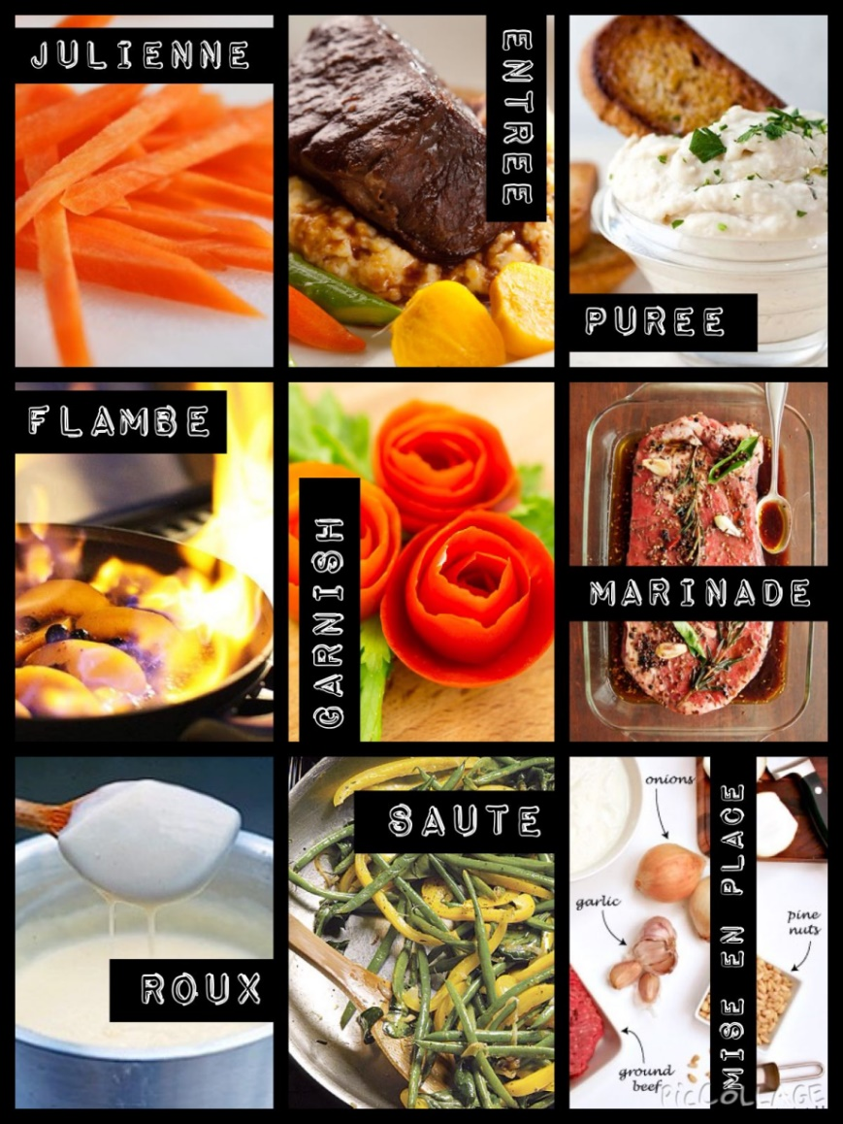
Definition of a Food Preparation Method
A food preparation method is a set of instructions of combining different ingredients together or, a procedure to follow on how to create a food product.

Slide 9
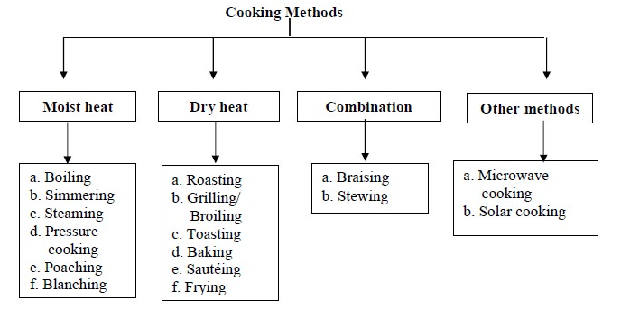
Different Food Preparation Techniques

Slide 10
What is Broiling?
Grilling and broiling refer to a similar cooking process.
In grilling, the heat source is below the food item, for example a barbecue grill.
In oven broiling, the heat is above the food item.
Both grilling and broiling involve intense heat.
Broiling temperature: + 290C or 550 F

Slide 11
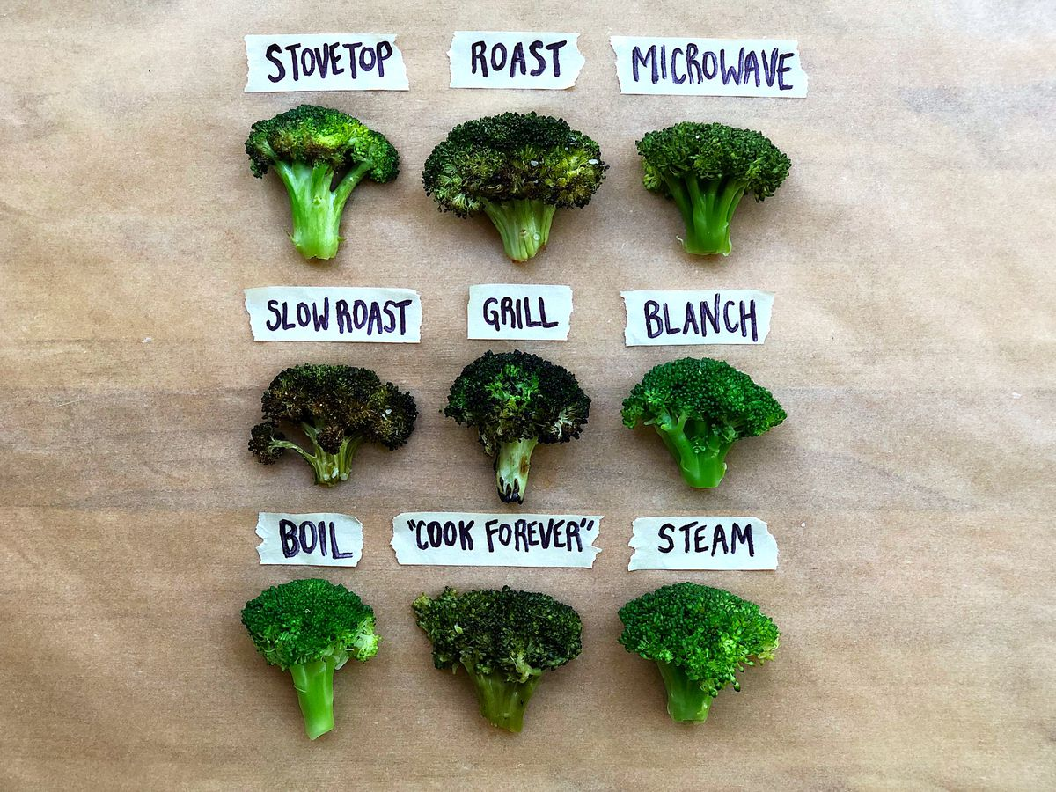
Different Food Preparation Techniques (cont.)

Slide 12
How to Write Preparation Methods in a Recipe like a Professional
There are two main parts to a recipe, the ingredient list and the preparation method.
If the preparation of an ingredient is simple, place the technique in the ingredient list, example, “2 whole eggs beaten”.
If an ingredient is used more than once in a recipe, indicate the amount used in each step.
Indicate the size of bowls and cookware, for example large bowl.
Write the preparation methods short and concise.

Slide 13
How to Write Preparation Methods in a Recipe like a Professional (cont.)
Indicate the level of heat, example simmer over low heat.
State exact or approximate cooking times, example: Sear 1 minute on each side.
If there are different elements to the recipe, separate each element in the method, example: “For the crust” followed by the method, the “For the Filling”.
Separate each step into a different paragraph.

Slide 14
How to Write Preparation Methods in a Recipe like a Professional (cont.)
Finish of with the serving instructions or plating techniques.
The last instruction should be regarding storage, if applicable.
Example: “Cookies will keep at room temperature in an airtight container for 10 days.

Slide 15
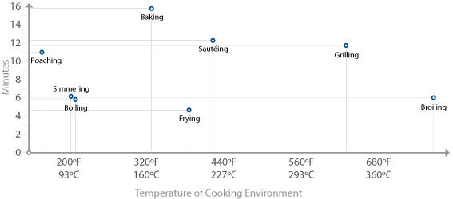
Level of Heat

Slide 16
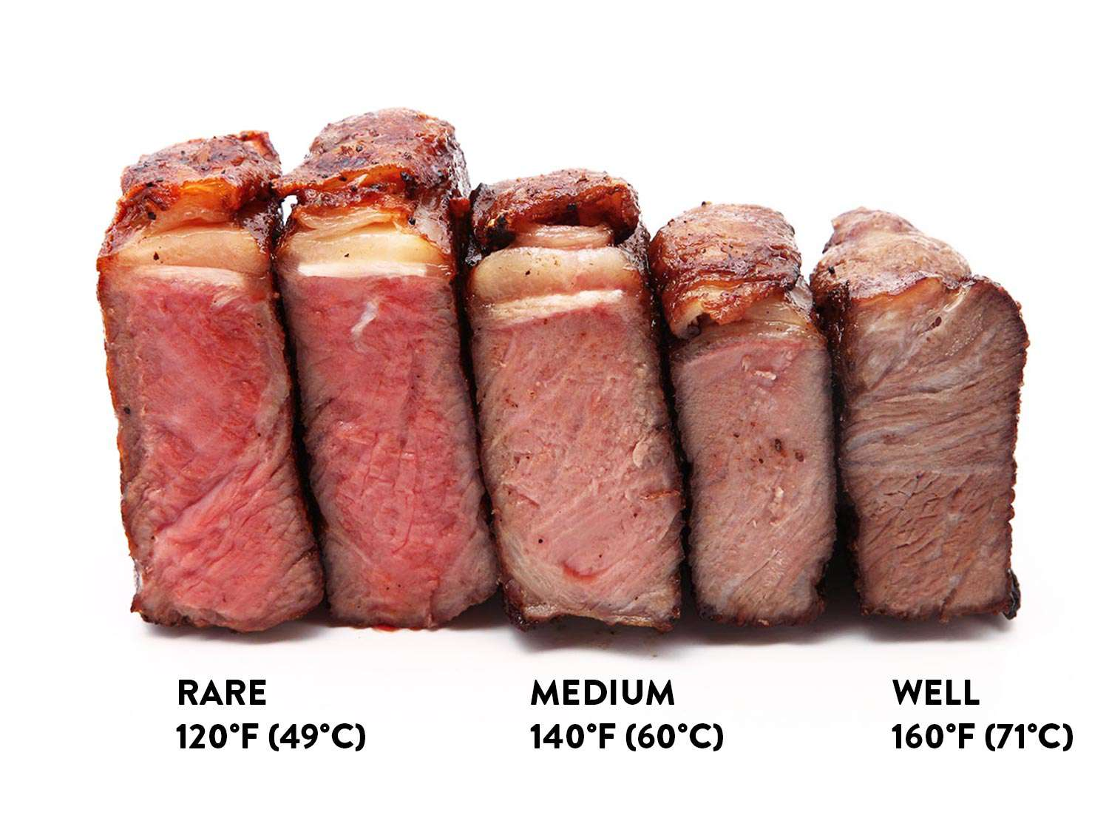
Level of Heat

Slide 17
Level of Heat
TEMPERATURE | FAHRENHEIT | CELSIUS | USED FOR
Low grilling temperature | 300 | 150 | Great for fish & Vegetables or delicate foods. Usually cakes and cookies are baked at this temperature mark.
Roasting temperature | 325 | Between 150 - 160 DEGREE C | For Meat, chicken, etc.
Medium hot grilling temperature | 400 - 500 | Between 200 - 260 DEGREE C | Common grilling temperature
Extremely hot grilling temperature - BROILING | 550 | 288 | Great for mesquite

Slide 18
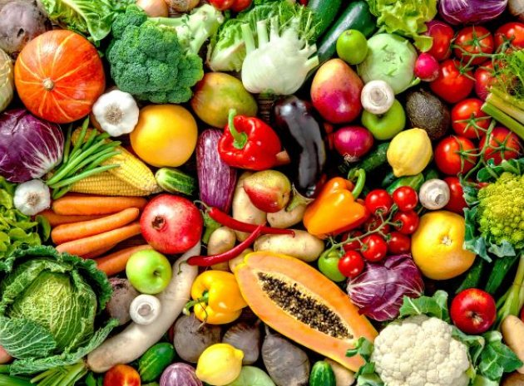
Preparing Vegetables
Steaming
Stewing
Syrup
Pies and Cakes
Tartare
Tempura
Vinaigrette
Warm Salads
Pickling
Soup
 | Bouillon Carpaccio Drying and Freeze-drying Fermenting Emulsions Deep-frying Jelly Grilling Ice cream Granita and Ice Cubes Injecting Caviar Cooking in Water or Broth Confit | Liqueurs Marmalades, Jams and Chutneys Mousse Breading Pasta Brining or salting Powders Blinis and Crêpes Piquage Purée Grating | Popping mechanism Culinary cooking torch Slow cooking Vacuum packing Freeze-drying Teppanyaki Crudités Risotto Smoking Roasting Sabayon Juice Sauces Espuma (Foam) Stoemp
Courtesy of Frank Fol, Belguim)

Slide 19
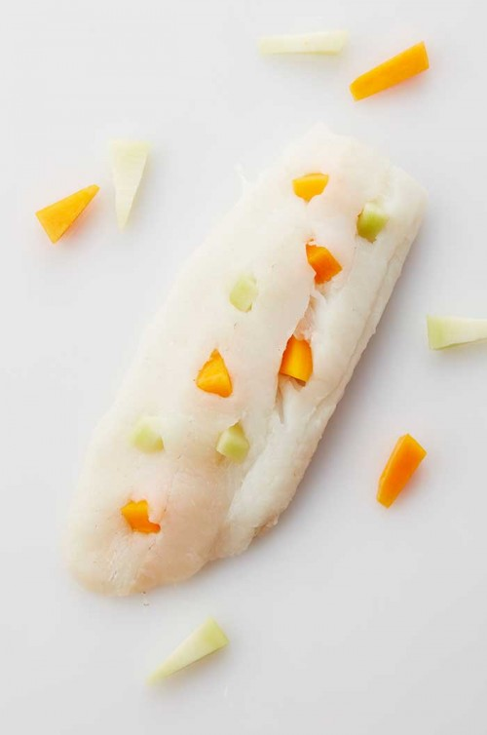
Piquage
Clean and wash the vegetables. Cut them into thin sticks or strips.
Cut small incisions into the meat or the fish and insert the vegetable strips.

Slide 20
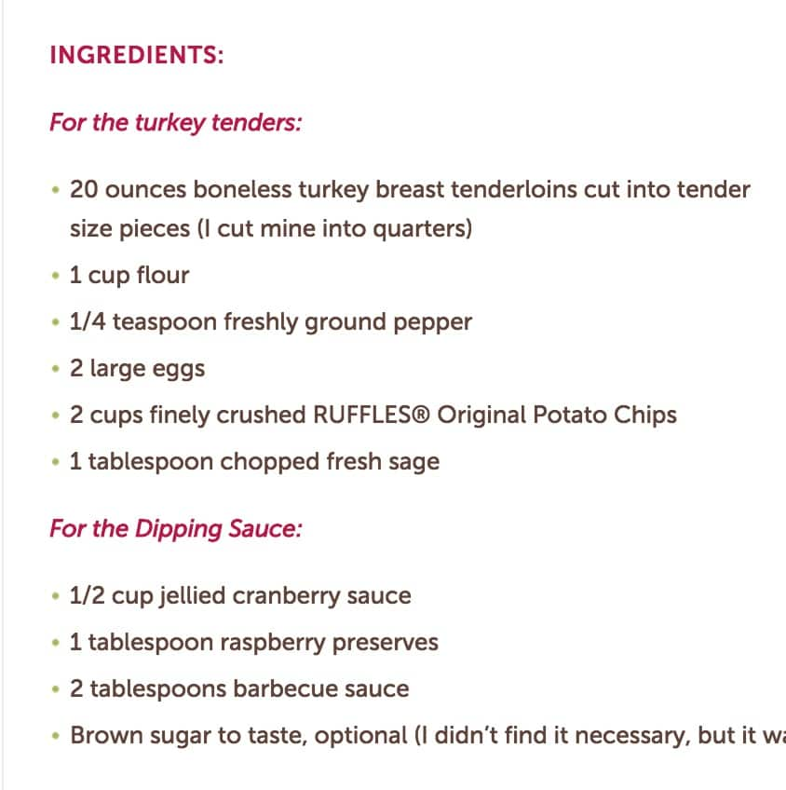
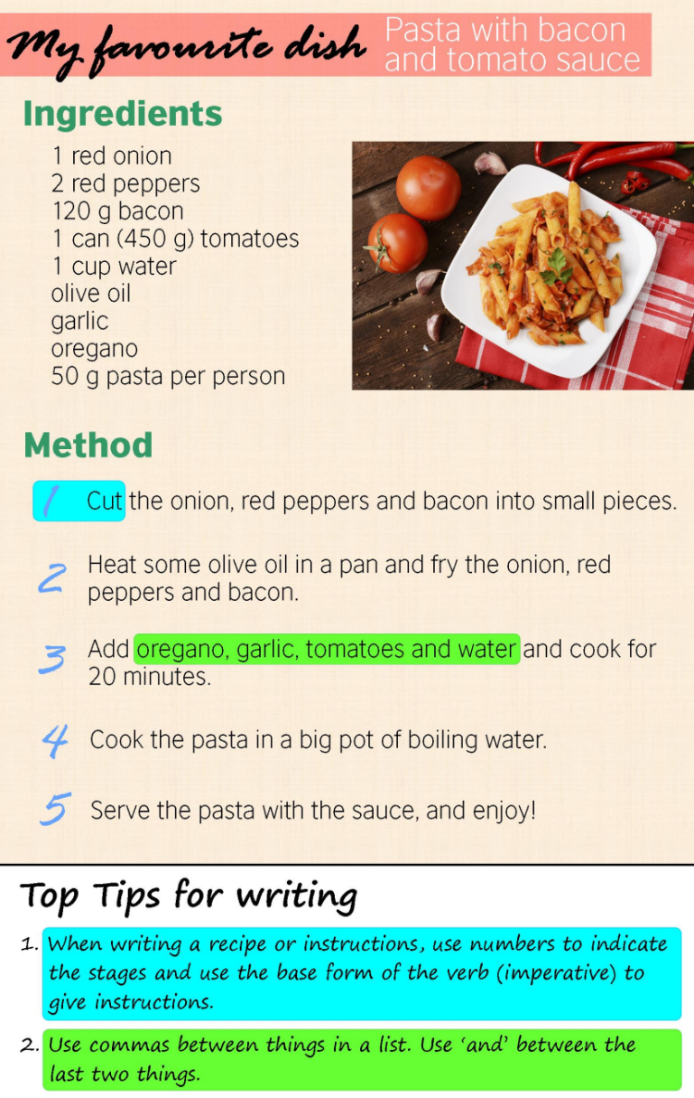
Recipe

Slide 21
How to check your Food Preparation Techniques
Check the method against the ingredients to make sure everything coincides.
Simplicity is important so that the beginner and the more experienced chef can understand.
Get someone else to read your methods to see if it is understandable.
Clearly describe how the ingredients should be prepared.

Slide 22
How to check your Food Preparation Techniques
Example: There is a fine line between finely chopped, chopped and sliced.
Every description has a different meaning. Choosing one term instead of another can make the difference between success and failure for the chef who wants to follow the recipe.
Test the recipe, especially the methods before it becomes a part of a menu for production.
Use a spell checker to make sure there is no spelling mistakes.

Slide 23
Procedures
Definition of a Procedure
It is an established or official way of doing something, for example a certain way in which a specific food item is prepared.
In the culinary world, procedures can be another word for methods.

Slide 24
Purpose of a Standard Recipe
To determine the quantity of the ingredient to be used.
To teach chefs how to prepare the food item.
Consistency which is very important in a “lean culture”.
To reflect the yield obtainable from a recipe.
To determine the cost per portion.
To determine the nutritional value.
It helps in costing of dishes, pricing menus.

Slide 25
Assignment
Choose any of your favorite recipes and write it over in a standardized form, suitable to use in a commercial kitchen.
The recipe must be suitable to stand alone, a main course for example, a pasta dish, chicken casserole or a vegetable stew. The choice is yours!
The recipe will be used in the following session for costing purposes as well as to try different quality of ingredients.
The template will be emailed to you, however if you wish, you can create your own version, but all the steps must be included.

Slide 26
Conclusion
The student learnt about the different cooking techniques which could form a part of a recipe.
The student understood why a standard recipe is important in a commercial kitchen.
The student will be able to write a standard recipe.
In the next session, the student will learn about costing and how to choose the best product for the recipe.
Thank you for attending the session!

