Slide 1
Nature Science Research and Innovation Centre
Ontario (ON), Canada
Online Education (OE) Division
Recipe Development and Menu Planning
Lesson 8
Ms Wonda Grobbelaar (MBA)
Professor of Practice – OE Division
NSRIC Inc.
London, ON, Canada
E-mail: wonda.grobbelaar@gmail.com
https://www.nsric.ca

Slide 2
Class Learning Outcomes
The student will learn about the different oils.
The student will understand how to replace different oils in food items.
The student will have knowledge about an egg substitute and an egg replacement.
The student will be able to replace eggs in recipes as well as understand the reason why some ingredients are not possible to replace.

Slide 3
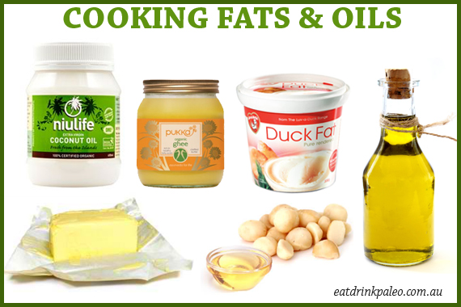
Why do we use oil in food?
Oils, butter or margarine are sometimes used directly on food.
The major use of cooking oil is in frying, where it functions as a heat transfer medium and contributes flavor and texture to foods.

Slide 4
What is Fats?
Fats in food come in several forms, including saturated, monounsaturated, and polyunsaturated.
Too much fat or too much of the wrong type of fat can be unhealthy.
Fat is a source of essential fatty acids, which the body cannot make itself.
Fat helps the body absorb vitamin A, vitamin D and vitamin E. These vitamins are fat-soluble, which means they can only be absorbed with the help of fats.

Slide 5
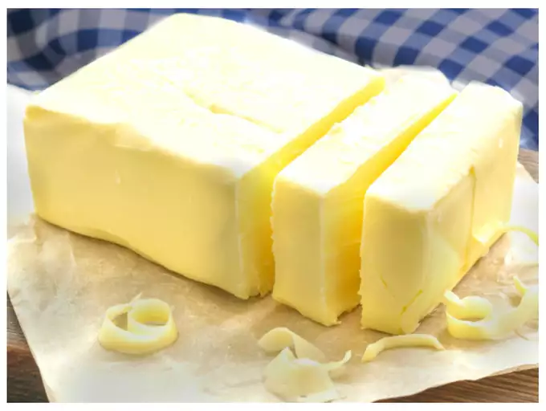
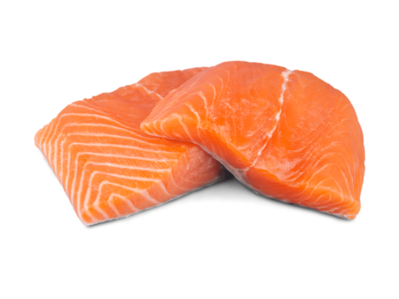

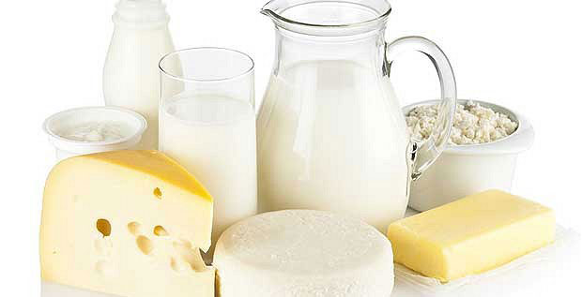
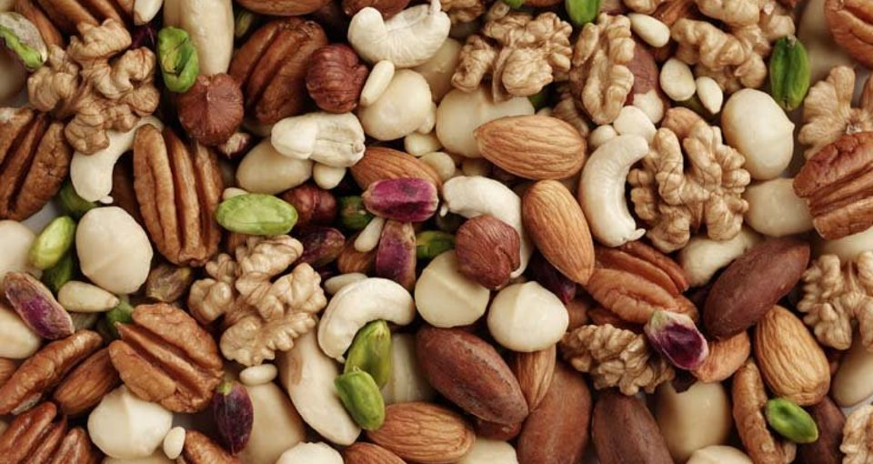
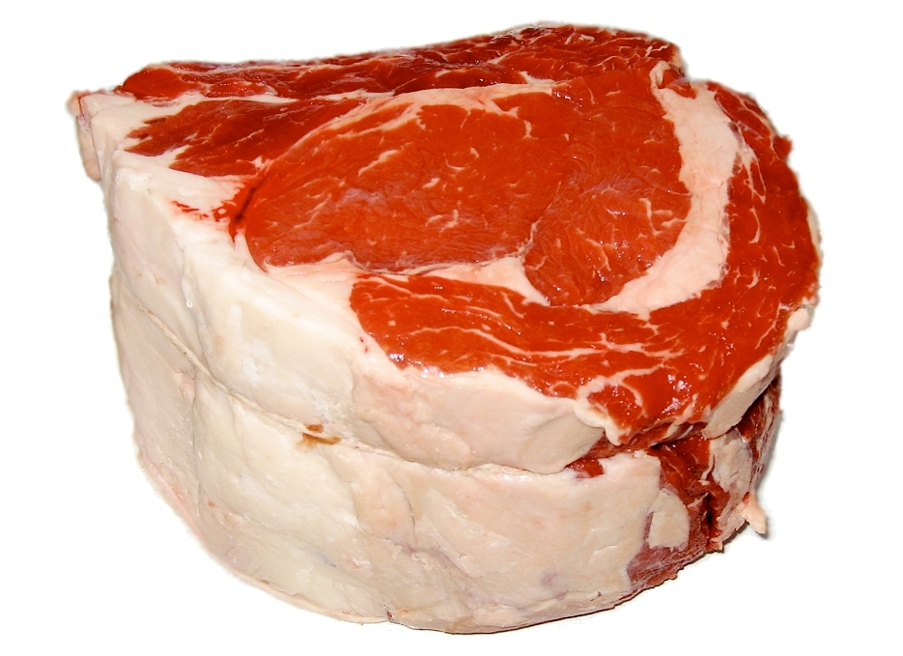
Foods that contain natural fats
Butter, oil, nuts, meat, fish, and some dairy products.

Slide 6
Fat and your health
If fat that you consume is not used by your body's cells or turned into energy is converted into body fat.
Likewise, unused carbohydrates and proteins are also converted into body fat.
All types of fat are high in energy. A gram of fat, whether it's saturated or unsaturated, provides 9kcal (37kJ) of energy compared with 4kcal (17kJ) of carbohydrate and protein.
Most fats and oils contain both saturated and unsaturated fats in different proportions.

Slide 7
Saturated Fats
As part of a healthy diet, you should try to cut down on foods and drinks that are high in saturated fats and trans fats and replace some of them with unsaturated fats.
Saturated fats are found in many foods, most of them come from animal sources, including meat and dairy products, as well as some plant foods, such as palm oil and coconut oil.
Food that contains a high level of saturated fats: fatty cuts of meat, butter, ghee, and lard, hard cheeses, cream, cheese crackers, chocolate confectionery, biscuits, cakes, and pastries, palm oil coconut oil and coconut cream.
Eating too much saturated fats in your diet can raise "bad" LDL cholesterol in your blood, which can increase the risk of heart disease and stroke.

Slide 8
How to replace oil in baking
Canola oil is one of the best types of oil for baking.
It’s preferred in many recipes since it has the most neutral flavor compared to other types of oil.
It also tends to be lighter in flavor, so it will not negatively affect the baked product’s flavor and texture.
Oil will create moist in a cake.
Using vegetable oil will also yield a tender cake that melts.
When you bite into a cake that is made with oil, it will fall apart in your mouth as you bite into it.
Since vegetable oil is pure fat without the addition of any liquid, the protein in flour (gluten) will not excessively interact with water to create a tough, dense cake.

Slide 9
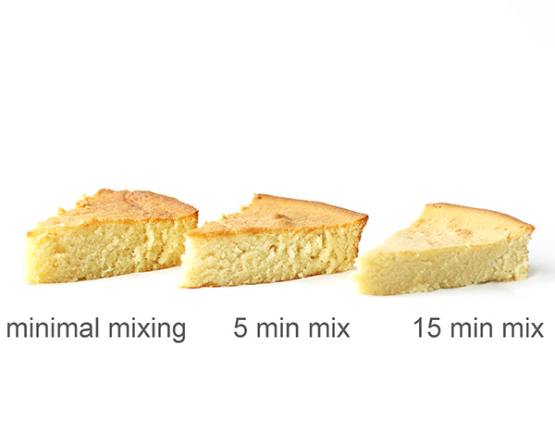
How to replace oil in baking (Continued)
It is possible to overmix a cake batter, even if it uses vegetable oil.
Keep in mind that you should never mix too much when your dry and wet ingredients are already combined!

Slide 10
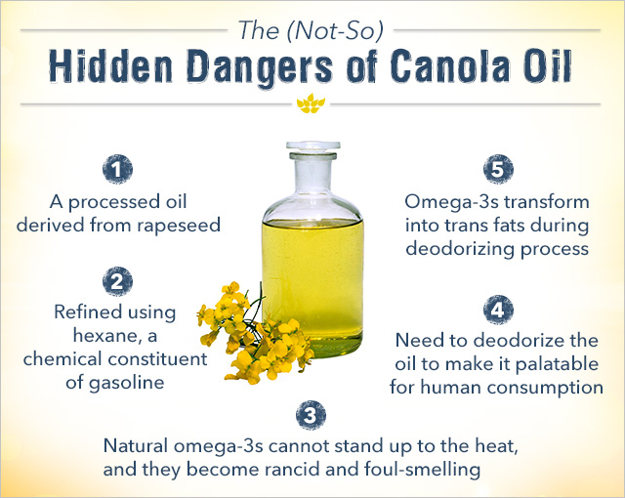
Canola oil versus vegetable oil

Slide 11
Canola oil versus vegetable oil
Canola oil only contains 7% saturated fat (bad fats) and contains the highest omega-3 content among oils, except flaxseed oil.
Canola oil doesn’t contain any cholesterol.
Using vegetable oil in baked goods will give very moist results because vegetable oil remains liquid at room temperature, while butter turns solid.
Vegetable oil will also yield a tender cake that falls apart in your mouth as you bite into it.
Since vegetable oil is pure fat without the addition of any liquid (as opposed to butter), the protein in flour (gluten) will not excessively interact with water to create a tough, dense cake.

Slide 12
Coconut oil
Coconut oil is sometimes used to replace butter in baked goods. It is especially suitable in recipes where vegan substitutes are needed.
Like vegetable and canola oils, coconut oil is made up of 100% fat.
Additionally, it is high in saturated fats, and its composition of fatty acids makes it very suitable for cooking/baking methods that require very high heat, such as frying.
Coconut oil can be swapped in your baking for an equal amount of fat that is required in the recipe. It can be used in both solid and liquid forms to replace butter/shortening and liquid oil respectively.

Slide 13
Sunflower oil
Sunflower oil contains a high proportion of unsaturated fats (good fats), which makes it a great choice if you’re health-conscious.
Sunflower oil has a high smoke point (the temperature where oils become less healthy to consume).
When oils reach the smoke point, they will start to burn and release harmful chemicals.
A high smoke point allows you to subject the oil at higher cooking/baking temperatures, and therefore sunflower oil is suitable for baking.

Slide 14

Sunflower oil (Continued)
Sunflower oil is also considered a better option of oils to use in baked goods.
Although its flavor and aroma isn’t as subtle as canola oil, it tends to complement any kind of baked goods, ranging from cookies to cakes.
When a recipe calls for mild-tasting oils such as corn, safflower, or rapeseed oil, you can replace this with sunflower oil.

Slide 15
Olive Oil
Olive oil is considered one of the healthiest oils that can be used for human consumption.
Olive oil has a high unsaturated fat content.
Depending on the type of baked goods, it might not be advisable to replace the oil used in baking recipes with olive oil since it has a considerably strong flavor which can significantly affect the result of your baked goods.
To avoid altering the aroma and flavor of your baked goods, we recommend using olive oil with buttery or fruity notes.
Olive oil is best used in savory baked goods such as focaccia and pumpkin bread; using olive oil in sweet ones might not give the best taste.

Slide 16
Peanut Oil
Peanut oil can be used in baked stuff.
Steamed peanuts are pressed to create this oil, that’s what gives it a distinct mild, nutty flavor.
Peanut oil resembles olive oil in certain ways.
Peanut oil has a considerably high unsaturated fat content, which makes it better for your health than any other types of oil.
Flavor-wise, peanut oil is also more suitable to use in baked goods that are more on the savory side.
It’s also recommended to use peanut oil in baked goods that contain nuts as the oil will enhance the nuttiness.

Slide 17
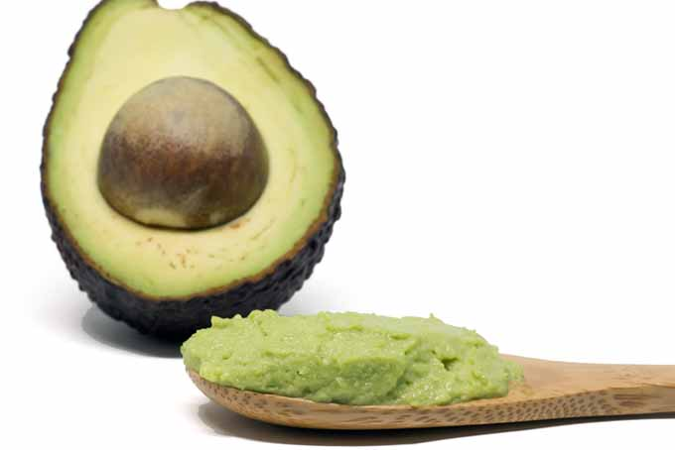
Replacements for oil
Applesauce, preferably unsweetened
Banana, ripe and mashed
Cauliflower – unseasoned, cooked, and pureed
Mayonnaise
Pumpkin, cooked and pureed
Sour cream
Vegetable shortening
Yogurt
Zucchini – unseasoned, cooked, and pureed
Beets, cooked and pureed
Overripen avocados

Slide 18
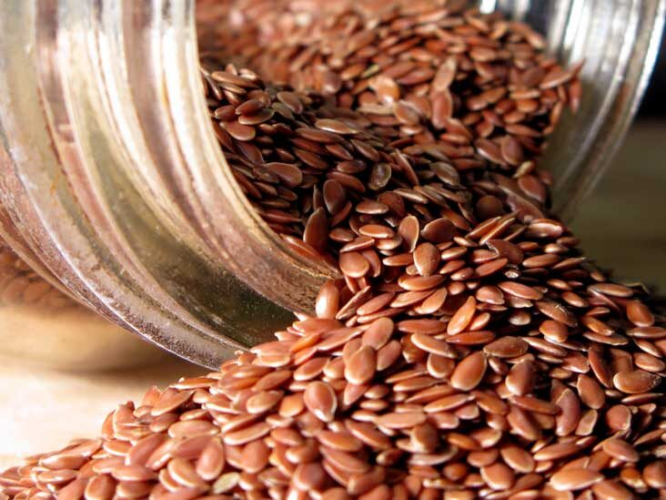
How to replace oils in sauces
Place ground flax seeds into hot water.
Start with hot water in the amount of oil the recipe calls for and add ground flax seeds to it one teaspoon at a time, stirring constantly, until the mixture is almost the consistency of oil.

Slide 19
How to replace oil with apple sauce
Applesauce is an excellent substitute used in many baking recipes.
Apple sauce does not have a flavor of its own, but it is still moist and delicious.
The moistening properties of applesauce make it the best substitute for oil.
It can be used for baking muffins, cakes, cookies, pancakes, brownies, etc.
It is also low in fat, thus making for a perfect and healthy substitute. However, it is best to use unsweetened applesauce for baking purposes. The proportion of applesauce that needs to be added to a recipe is half of the cooking oil needed. Alternatively, you can also use it as a substitute for butter or margarine.

Slide 20
The purpose of egg in a baked goods recipe
Eggs generally play one of two roles: binder (to hold the recipe together) or leavening agent (to help it rise).
Sometimes eggs play both roles at once. Determining which purpose the eggs primarily hold in the recipe you are considering will help you determine what options for replacement you might have.
Normally if a recipe for baked goods calls for three or more eggs per batch (with a typical "batch" consisting of 36 cookies, one pan of brownies, one loaf of bread, or one cake), egg substitutes generally do not work.
The consistency of the finished product comes out poorly.

Slide 21
Egg substitutes
Whole wheat flour, cornstarch, coarsely powdered oats, or even mashed potatoes will work fine as an egg substitute in such recipes.
You will have to start adding one of these ingredients in little increments like about a tablespoon or so until you can shape it into balls, patties, etc.

Slide 22
Egg replacements and substitutes
Pound cakes, sponge cakes, angel food cakes, and other popular desserts with relatively high egg content do not turn out well in egg-free cooking. In these situations, it is usually best to make something else.
However, there are commercial egg replacement products on the market.
Be sure that you are considering an egg replacement, not an egg substitute.
Egg substitutes are generally marketed in the dairy portion of the grocery store, and are designed for cholesterol-conscious people, rather than for egg-allergic people.
They contain egg and are unsafe for those with egg allergies.

Slide 23
How to replace egg in food
Applesauce
Mashed Banana
Ground Flaxseeds
Commercial Egg Replacer
Silken Tofu
Vinegar and Baking Soda
Yogurt or Buttermilk
Arrowroot Powder

Slide 24
How to replace egg in food
Use applesauce to add moisture.
  Replace one egg with 1/4 cup of applesauce in sweet desserts. If you want a lighter texture, add an extra 1/2 teaspoonful of baking powder, as fruit purées tend to make the final product denser than the original recipe.
To Replace Oil In Dressings and Sauces:
  Mix ground flax seeds into hot water. Start with hot water in the amount of oil the recipe calls for and add ground flax seeds to it one teaspoon at a time, stirring constantly, until the mixture is almost the consistency of oil.

Slide 25
Assignment
You will take a basic recipe, for example a vanilla cupcake or a sponge cake recipe.
Create 4 different batches:
The idea is to replace egg, oil and sugar, separately in a batch and then try to replace them all in one batch.
Write a report on the texture and the feeling in the mouth, flavor balance, taste, volume and color.

Slide 26
Conclusions
Different oils can be used to create moist baked goods.
There is a difference between egg replacements and egg substitutes.
Like any other food, too much of fat is unhealthy!
In the next session, we will look at how to replace flour in recipes for difference reasons
Thank you for attending the session !

