Slide 1
Nature Science Research and Innovation Centre
Ontario (ON), Canada
Online Education (OE) Division
Recipe Development and Menu Planning
Lesson 9
Ms Wonda Grobbelaar (MBA)
Professor of Practice – OE Division
NSRIC Inc.
London, ON, Canada
E-mail: wonda.grobbelaar@gmail.com
https://www.nsric.ca

Slide 2
Class Learning Outcome
The student will have knowledge about the different flours.
The student will understand the difference between gluten free baking and other types of baking.
The student will be aware of mistakes that can be made when replacing different type of flours.
The student will know how to add “gums” to flour to get the desirable effect in gluten free baking.

Slide 3
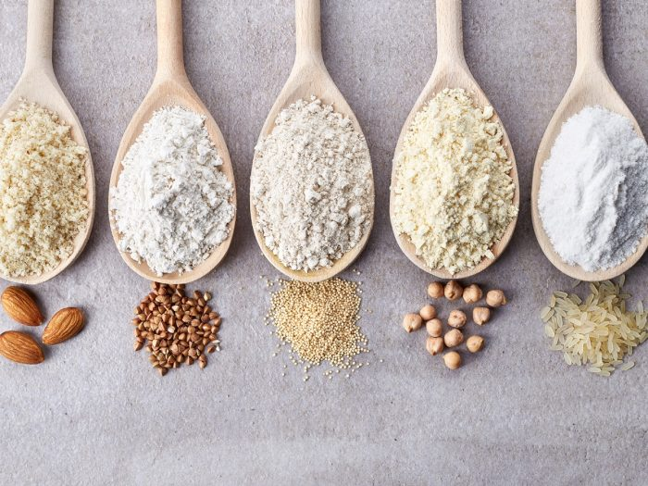
Definition of Flour
Flour is a fine or coarse powder made by grinding uncooked food for example grains, roots, beans, nuts, or seeds.
Flours are used to make many different food items, or it can be used as a thickener.
Cereal flour, particularly wheat flour, is the main ingredient of bread, which is a staple food for some cultures.

Slide 4
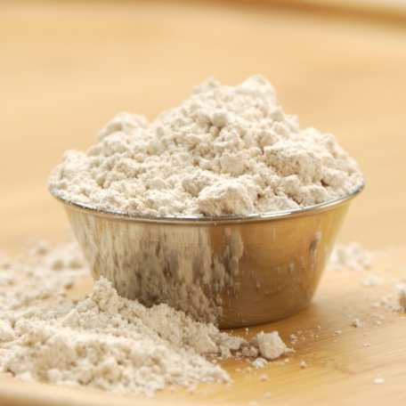
Different Types of Flours
There is a huge selection of flours available at the baking section:
All-Purpose Flour
Whole Wheat Flour
White Whole Wheat Flour
Pastry Flour
Cake Flour
Bread Flour
Self-Rising Flour
Vital Wheat Gluten Flour
Gluten Free Flour
Sprouted Flour
Did you know?
Sprouted flour is made from sprouted grains, for example spelt, amaranth, Kamut, einkorn, sorghum, rye, corn, and more. As its name implies, a sprouted grain is a grain that's been allowed to sprout and begin to germinate as it would if left to its own devices in nature.

Slide 5
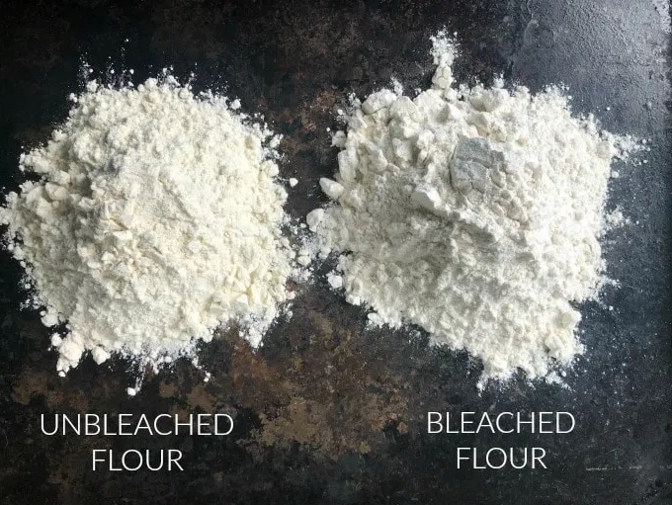
Bleached and Unbleached Flours
Bleached flour has a whiter color, finer grain, and softer texture.
Unbleached flour has a denser grain and tougher texture.
Bleached flour is treated with chemical agents to speed up the aging process.
The type of chemicals used in bleaching flour is bad for your health.
Chemicals may include chlorine, bromates, and peroxides.

Slide 6
All Purpose Flour
All-purpose flour is made from processed wheat.
It contains a moderate amount of protein (gluten) and, like other white flours, is made from only the endosperm of the wheat kernel, without the nutrient-rich germ or bran.
According to research, white flour has little to no vitamins and minerals.
All-purpose flour provides a relatively strong gluten structure that's suitable for breads, quick breads, and cookies.
Gluten content: 8-11%
34 g of flour (1/4 cup): 110 calories, 1 g fat (0 g sat), 5 mg sodium, 23 g carbs, 0 g sugar 1 g fiber, 2 g protein

Slide 7
Bread Flour
Like all-purpose flour, bread flour is one of the types of flour made with only wheat's endosperm.
However, compared to all-purpose flour, it has as very high protein (gluten) content, which is suitable in bread for strong structure and chew.
You can use all-purpose flour in place of bread flour, but all-purpose's lower protein content means it may yield a slightly wetter dough or batter.
Per 34 g (¼ cup): 110 calories, 0.5 g fat (0 g sat), 0 mg sodium, 23 g carbs, 0 g sugar, 1 g fiber, 4 g protein

Slide 8
History of Self- Raising Flour
Self rising flour is one of the more interesting types of flour.
It was invented in England in the 1800s, as a way for sailors to create better baked goods while on board.
It was a type of cheat product, as it is simply a mixture of other already-existing ingredients.
It worked for the English baker who sold a ton of it on British ships! In 1849, he patented the “invention” in the United States, which eventually led to the creation of mass-market baking mixes.

Slide 9
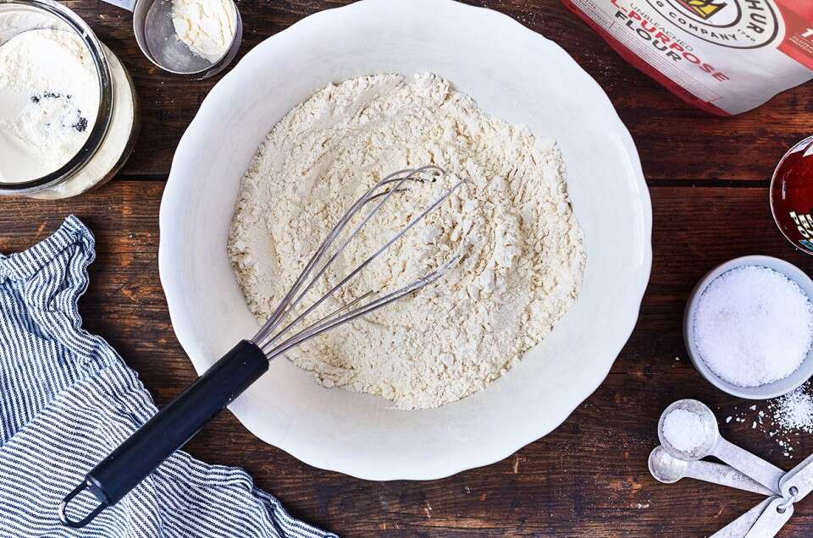
Make Your Own Self- Raising Flour
Self rising flour is a mixture made up of regular flour (All purpose flour), baking powder and salt.
You can make your own by combining 1 cup (120g) all-purpose flour, 1 ½ teaspoons(7.5 ml) baking powder and 1/4 teaspoon(1.25g) fine salt

Slide 10
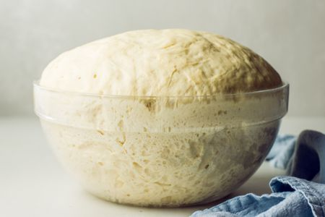
Yeast
Milk, eggs and butter interact with the rising of yeast, and therefore recipes using these ingredients tend to take longer to rise.
To counteract this, either allow for a longer rise time, place in a warmer environment or use more yeast.
To avoid that your bread go stale very quickly, add a natural preservative: fat.

Slide 11
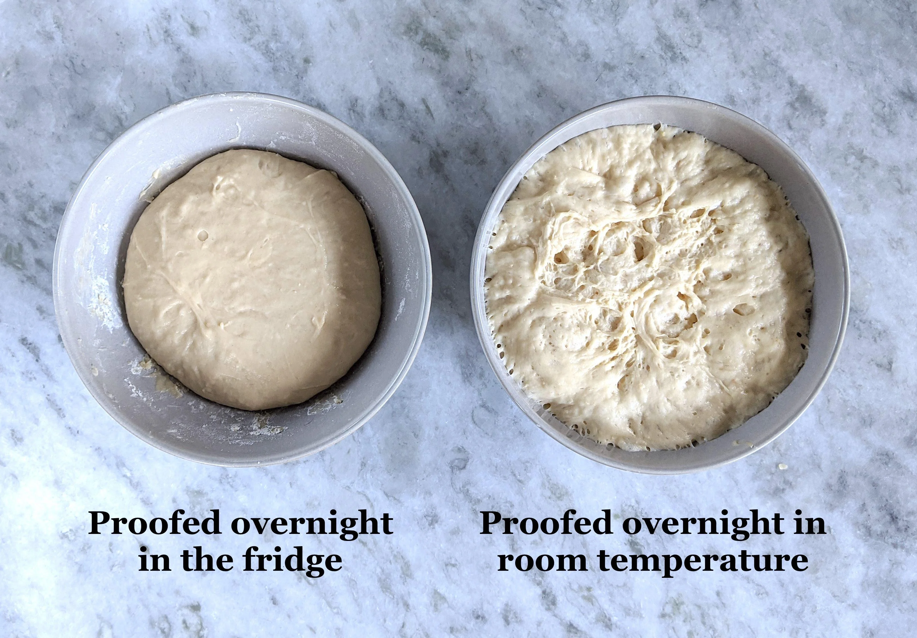
Climate and Yeast
GCC’S hot temperatures supports yeast activity and enables it to grow faster.
The high humidity might result in the dough absorbing too much moisture, resulting in a situation of over-proofing.
Over-proofing is where the air bubbles in your dough has grown too large and burst, therefore resulting in dense bread.

Slide 12
Rising in the Baking Process
Rising is a vital part of the baking process when you are working with batter or dough, and it is key to getting it right for your recipe.
There are a few different ways that you can leaven or raise your breads and pastries to get the fluffy, chewy, airy, or flaky texture depending on the recipe.
Leavening agents include yeast, baking soda and baking powder.

Slide 13
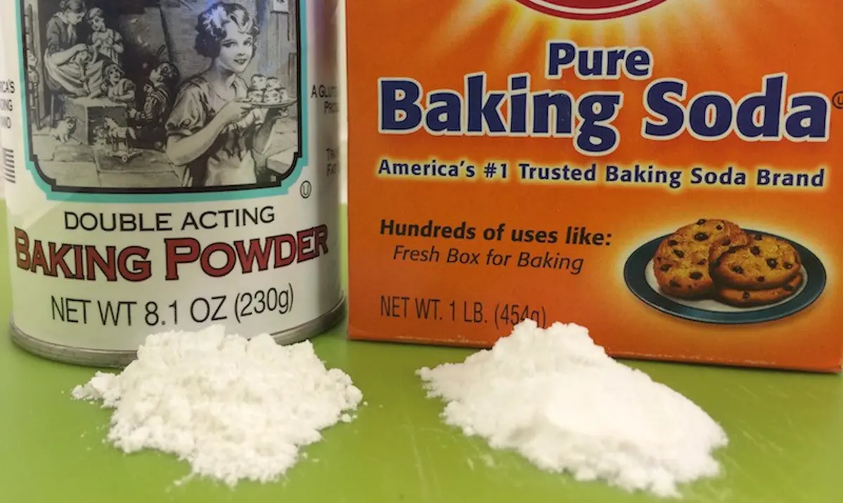
Baking Soda & Baking Powder
Baking soda is a very basic source, and it combines with the acid in other ingredients (lemon juice, buttermilk, etc.) to give off gases that create little pockets in your dough.
Once the dough is baked, the gases dissipate in the hot temperatures and leave behind the structure created by those little gas bubbles. This entire process is called leavening and is a key step in the baking process.
Baking powder is baking soda that has already been mixed with an acidic ingredient and fillers or starches.

Slide 14
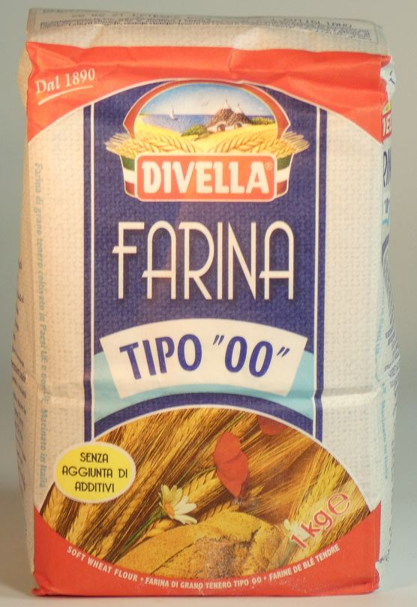
Double (“00”) flour
Double 00 flour is a finely ground Italian flour.
In Europe flours are categorized by how finely the flour has been grounded.
“00” flour is ground from durum wheat and has a mid-range protein content of about 11 to 12%, like all-purpose white flour.

Slide 15
Difference between “00” Flour & All-Purpose Flour
The biggest difference between “00” flour and all-purpose flour is how the gluten in each flour behaves.
The gluten from durum wheat flour tends to be strong but not very elastic, while the gluten in wheat flour is both strong and elastic.
This means that with durum wheat, we’ll get a nice bite on our breads and pasta, but not as much chew.
That’s why when combined with bread flour in pizza dough, “00” flour results in a chewy, crispy crust — the perfect duo!

Slide 16
Durum Wheat versus Whole Wheat Flour
Pasta made with “durum wheat semolina” is high in carbohydrates and low in dietary fiber and therefore is not a “healthy” choice.
Durum contains 27% extractable wet gluten, about 3% higher than in common wheat.
Durum wheat is harder than bread wheat.
Doughs made from durum wheat tend to have higher extensibility. (stretched).
Doughs made from bread wheat have a higher elasticity (bounce back when kneaded)

Slide 17
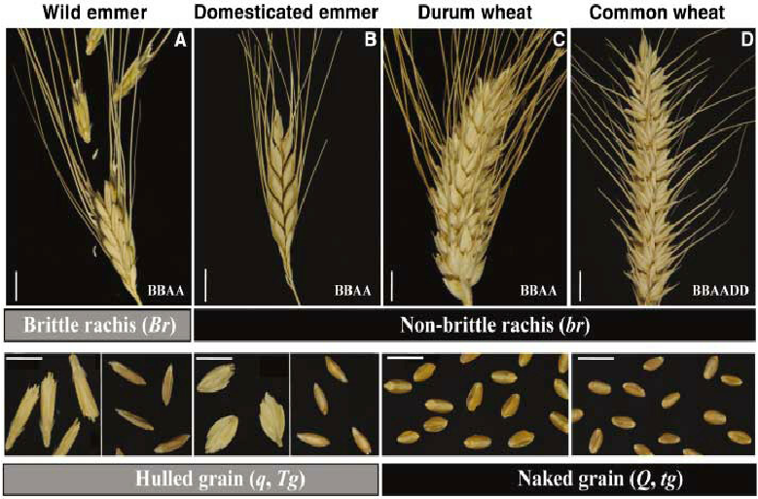
Durum Wheat versus Whole Wheat Flour

Slide 18
Durum Wheat and Semolina
Durum wheat grains can be ground into semolina — a type of coarse flour commonly used in pasta and couscous.
The difference between the two is mainly in texture: durum flour is very finely milled, whereas semolina is coarser.
Semolina and durum wheat flour are high in protein and gluten, and therefore is not suitable for people with celiac disease.
Semolina is high in protein and fiber.
Semolina is perfect for bread baking!

Slide 19
Gluten Free Flour
In stead of using flour in a recipe, make your own gluten free flour!
3 parts white or brown rice flour
2 parts potato starch
1 part tapioca flour/starch
1 teaspoon xanthan gum for every 1-1/2 cups flour mixture.

Slide 20
Replacement of Ingredients
Xanthan gum can be replaced by Arrow Root or Guar Gum.
Baking powder must be checked in every recipe. Use 2-1/2 (12.5g) teaspoons of baking powder for every cup of flour used in a recipe.
For yeast bread recipes, try adding 2 teaspoons apple cider vinegar to help activate the yeast.
Check the liquid quantity. Some flours may be a bit drier, so you may have to add additional liquid ingredients, such as water or oil, depending on what the recipe calls for.

Slide 21
Gums and Gluten Free Baking
Yeast Breads & Pizza Recipes:
7.5 g xanthan gum or 10 g guar gum per 135 g of gluten-free flour blend
Cookies:
2 g xanthan gum or 2.5 guar gum per 135 g gluten-free flour blend
Cakes:
2.5 g xanthan gum or 4 g guar gum per 135 g of gluten-free flour blend
Quick Breads & Muffins:
4 g xanthan gum or 5 g guar gum per 135 g gluten-free flour blend

Slide 22
Mistakes
Bean flour doesn’t work for gluten free flours.
When using bean flour, you will have to add more sugar to mask the funny smell.
Regular wheat flour CANNOT be replaced by just one gluten free flour like almond flour or coconut flour.
If your baked goods are too heavy or dense, re-examine which flours you are using, or it can be that you should use more starch the create a lighter product.
When measuring flour, don’t scoop from the bag with a measuring cup. This can compress the flour up to 25%! Use a spoon to scoop flour into the measuring cup and level off with a knife instead.

Slide 23
Mistakes (Continued)
Make sure that all your ingredients are at room temperature!
In gluten free bread, you don’t have to knead the dough as there is no gluten to stretch.
Gluten free bread only rises once. There is no first rise, second rise then the shaping of bread. Don’t mess with the shape after rising.
When making bread rolls, shape them in the pan. Let them rise and then bake them.
Use a metal pan.
Don’t take you bread out of the oven before fully baked.

Slide 24
Almond flour
Almond flour can be replaced 1:1 with all-purpose (white) flour but will require more egg or binding agent.
Almond flour is low in carbs yet high in healthy fats and fiber.
There is a difference between Almond Meal and Almond Flour.
Almond meal is made from raw (unpeeled) almonds and almond flour is made from blanched (peeled) almonds. Therefore, almond flour has a finer texture and lighter color then almond meal.
The only difference between almond meal and almond flour is the grind!

Slide 25
Assignment
Take any simple standard bread or cake recipe (not more than 7 ingredients) and convert it into a gluten free recipe.
Prepare the food item and observe the following:
Taste
Overall look
Color
Lightness
Similarities to standard item
Differences to standard item
Make sure that you write down the changed recipe for future reference.

Slide 26
Conclusions
There are many types of flours.
The same techniques can not be followed when making gluten free bread.
You need to add a “gum” to add stretch to flour when using it in baking.
White bleached flour is very unhealthy to eat, due to the chemicals that are used in the process.
In the next session, we will look at the importance of color when developing recipes.
Thank you for attending the session !

