Slide 1
Nature Science Research and Innovation Centre
Ontario (ON), Canada
Online Education (OE) Division
Recipe Development and Menu Planning
Lesson 7
Ms Wonda Grobbelaar (MBA)
Professor of Practice – OE Division
NSRIC Inc.
London, ON, Canada
E-mail: wonda.grobbelaar@gmail.com
https://www.nsric.ca

Slide 2
Class Learning Outcomes
The student will learn about possible replacements for sugar.
The student will be able to replace sugar with dates, honey and apple sauce, for example.
The student will know in which type of products sugar can be reduced without any change in the product.
The student will have knowledge about the health-related issues associated with sugar.

Slide 3
Sugar and Food
Avoiding too much sugar is an accepted dietary guidance throughout the world.
Sugar is linked to many illnesses and can be addictive.
Labeling added sugars is one tactic to potentially curb the obesity epidemic.
To reduce added sugar when creating recipes could be another way.

Slide 4
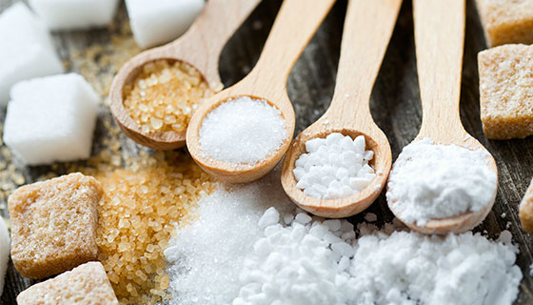
What is Sugar
Sugars are a type of simple carbohydrate.
Sugar has a sweet taste.
They can also be added to all types of food and drinks for different reasons, for example during preparation to enhance the taste of food.

Slide 5
What is Sugar? (Continued)
Types of natural sugars include glucose (different food types), fructose (fruit), sucrose (honey, dates, maple syrup) and lactose (milk, animal products).
Our bodies change 100% of the carbohydrates we eat into glucose.
Carbohydrate can be found in bread, rice, pasta, potatoes, vegetables, fruit, sugar, yogurt, and milk.
Protein: Includes fish, meat, cheese, and peanut butter, butter, salad dressing, avocado, olive oil.

Slide 6
How much sugar should we eat per day?
“First, let’s see how much sugar we are actually eating now. On average, Americans eat about 66 pounds of sugar each year. The American Heart Association says that women should consume 24 grams of sugar per day, and men should limit their sugar intake to 36 grams per day. We eat too much sugar.” (http://scottcomitermd.com)
Example:- Coffee per day: 4 cups (1 teaspoon) = 20 g
Wheat Crackers: = 1 g
Banana: = 12 g
Potato: = 1 g
Dark Chocolate 1 block (small) = 1.5 g
Jelly Sweet 25% Less Sugar = 3 g
Juice 1 Glass = 42 g 80.5 g

Slide 7
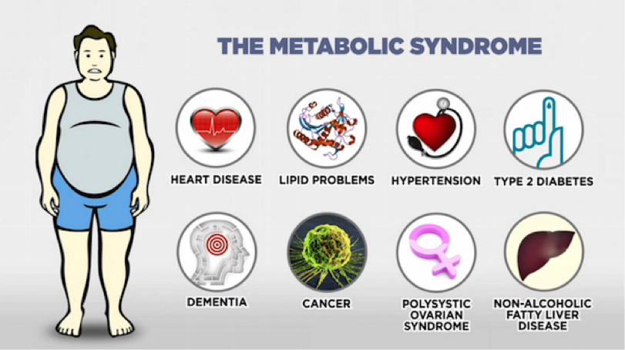
Illness and Sugar
http://scottcomitermd.com/

Slide 8
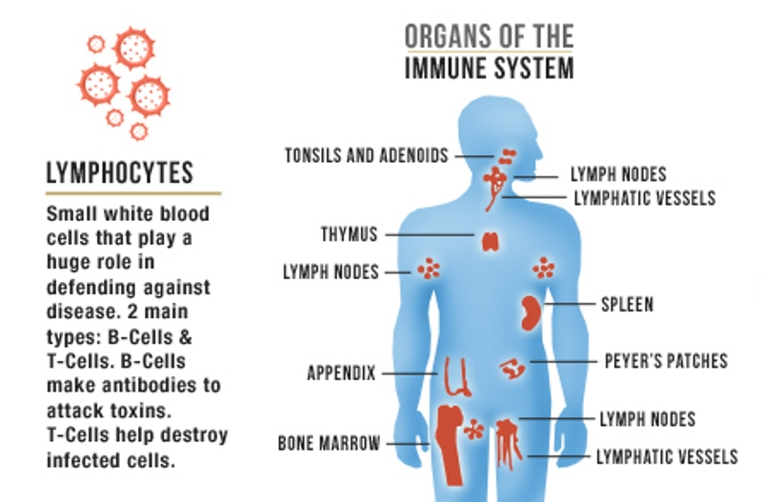
Sugar and Immune System
High levels of sugar in your blood can lower how white blood cells function and weaken your immune system.
Consuming 100 grams of sugar, in fact, can reduce the ability of your white blood cells to function by 40 percent.

Slide 9
Sugar and Immune System (Continued)
According to Dr Sujeet Jha, Principal Director - Endocrinology, Diabetes & Obesity, Max Hospital, New Delhi, "Around 10-13 per cent of people in the country suffer from diabetes.
Due to the ongoing coronavirus pandemic, we all have not been going out and staying at home. All this has reduced the level of physical activity, which has impacted our health and blood sugar levels hugely.
Any kind of acute infection in the body can lead to a rise in blood sugar levels. The not so good diet, high fever and other factors during the COVID infection led to a rise in blood sugar levels.
On top of it, it's fueled by the use of steroids, which is unavoidable in some patients.“
(Coronavirus: Here's how COVID is affecting blood sugar levels By -TIMESOFINDIA.COM Updated: May 20, 2021, 13:06 IST)

Slide 10
How to reduce or replace sugar in recipes
In a recipe, sugar can be reduced by 10%.
Reducing it more, will sometimes risk the compromising texture depending on the recipe.
Reducing sugar by more than 10% in foam cakes results in texture changes and an egg flavor.
Sugar keeps baked goods soft and moist.
The bond between sugar and water allows sugar to lock in moisture so that items such as cakes, muffins, brownies, and frostings don't dry out too quickly.
It creates tenderness, deepens color and flavor, and adds crunch.

Slide 11
How to reduce or replace sugar in recipes (Continued)
Start with a 10 to 15% sugar reduction.
If you still find it too sweet, continue reducing until up to 33% (⅓ of the total sugar amount).
Going beyond this level, might affect the texture and overall appearance of your baked goods.

Slide 12
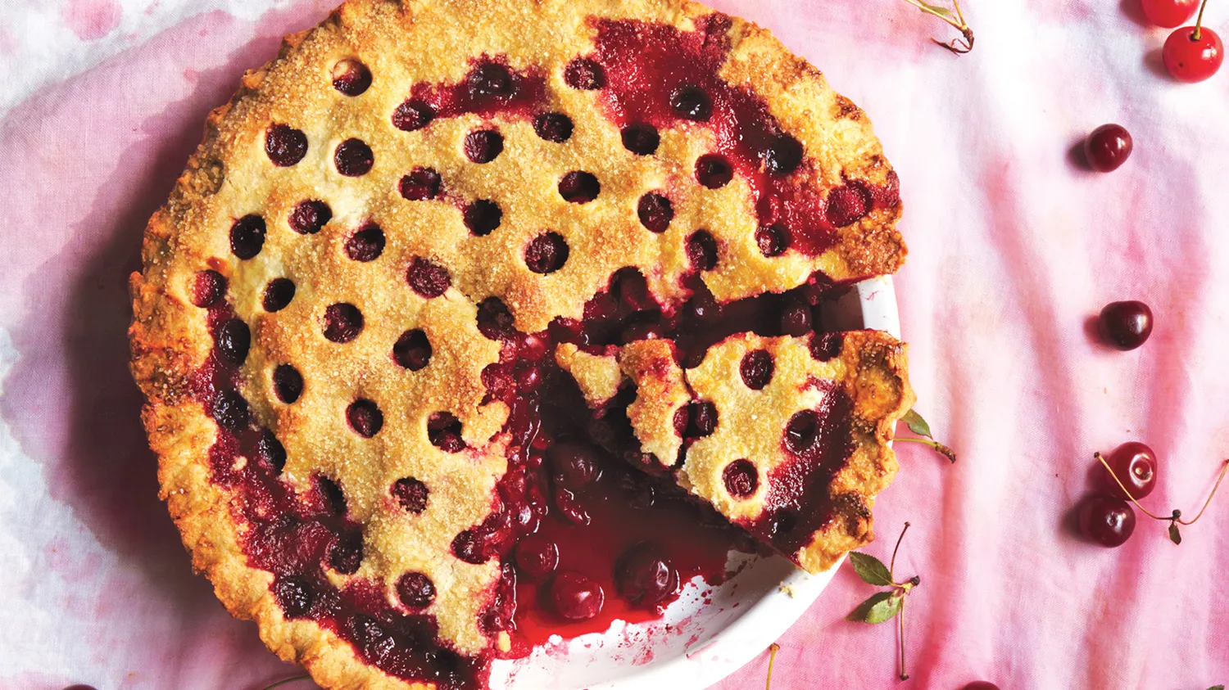
When is it possible to reduce sugar?
When the sugar inside the recipe is only acting as a sweetener you can reduce as much sugar as you like without changing any chemical reaction.
Examples: Sweet , sour pie fillings such as fresh blueberry pies.
Reducing sugar in this type of will not really matter.
Fruit compotes, galettes, or any treat where sugar is only for sweetness and not for any chemical reaction.

Slide 13
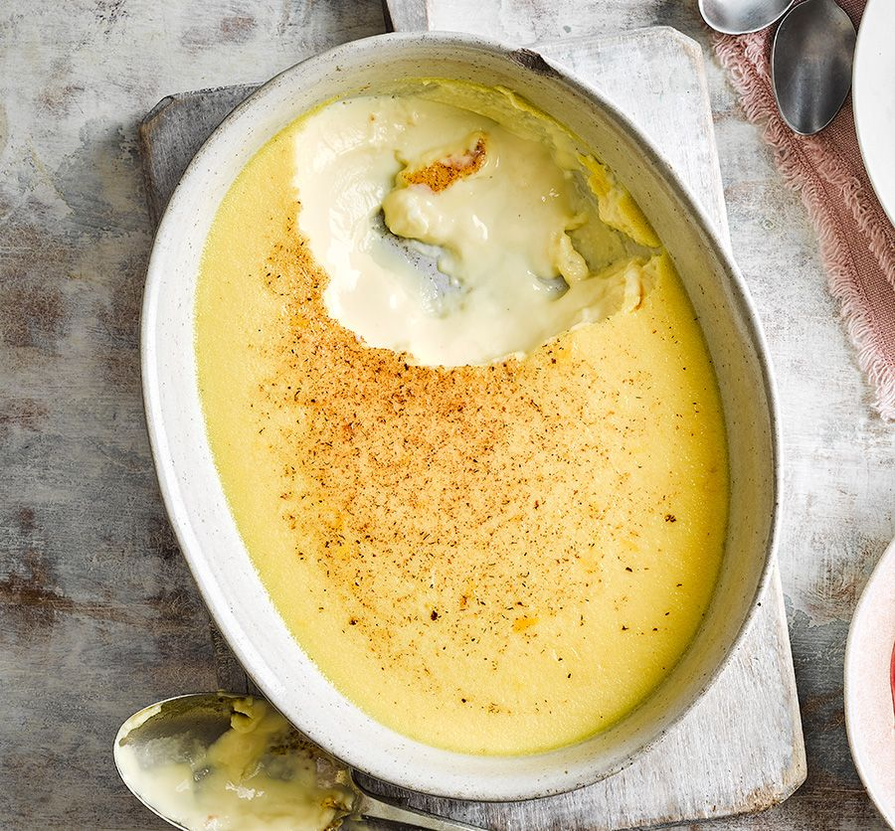
Sugar and custards
Sugar delays coagulation of egg proteins in custards and similar cooked egg dishes.
Sugar in a custard mixture breaks up the clumps of protein molecules so that they are finely dispersed in the liquid mixture, therefore getting a smooth mixture.

Slide 14
What is the functional properties of sugar in Food ?
Flavor Balance - Balances acidic and bitter flavors (Tomato sauce, vinegar-based sauces)
Preservation - Sugar stops bacteria from growing and delays spoilage.
Texture and Mouth feeling - Creates a soft structure in baked goods and the smoothness in frozen dairy products.
Volume - Sugar adds volume to different products, and that allows them to be tall, fluffy, or soft.
Color - Sugar reacts with heat (caramelization) or with heat and proteins (Maillard reaction)
Taste - High fiber food tastes better with sugar

Slide 15
The sweet truth about sugar
Sugar makes baked goods a bit more palatable.
It is recommended to use brown sugar, not because it is healthier or less refined, but because one cup of sticky sugar weigh less than one cup of white sugar.
Sugar free food may nor be sugar free at all.
Sugar is a highly concentrated sauce of carbohydrates is released into the blood stream.
It is better to use sometimes natural sugar than artificial sweeteners.
Sugar is important in bread making (Fermentation process).

Slide 16
Replacing sugar with date syrup
Case Study
Date syrup has been widely studied for its suitability and acceptability as a sweetener in food products.
The uses of date syrup can be used as potential substitute of free sugar in various food products such as fruit juices, biscuits, cakes, muffins, desserts, and confectionery as they produced comparable physicochemical and sensory attributes in these product.
Substitution of free sugar with date syrup in ice cream increased the viscosity but decreased the freezing point of ice cream.
The sensory properties of modified ice cream were not affected up to 50% of replacement but the samples prepared with 100% date syrup were rejected by panelists. Yogurt enriched with 10% date syrup had the highest rating for sweetness, taste, total phenolic contents, antioxidant value, acid soluble minerals, and folate concentrations.

Slide 17
Replacing sugar with date syrup (Continued)
Sidhu et al.[120] used date syrup from two different Kuwaiti date varieties (Birhi and Safari) to replace sugar in pan bread formulations.
Five types of pan breads were prepared in which sugar was replaced at 0 (control), 50 and 100% with Birhi date-syrup and 50 and 100% replacement with Safari date-syrup.
They observed that the use of concentrated date syrup in pan bread formulations did not adversely affect the baking loss, but rather gave a significantly higher specific loaf volume (4.32–4.35 cm3/g) for 100% replacement level compared with the control (4.09 cm3/g).
The lower compression force (358.8-368.5 g) at 100% replacement of free sugar with date syrup also indicated a softer texture of test bread samples than the control (479.6 g). Even though the crumb color of date syrup pan bread scored lower in sensory evaluation, there were no significant differences in texture, flavor, and overall acceptability of control and date-syrup pan breads.[120]

Slide 18
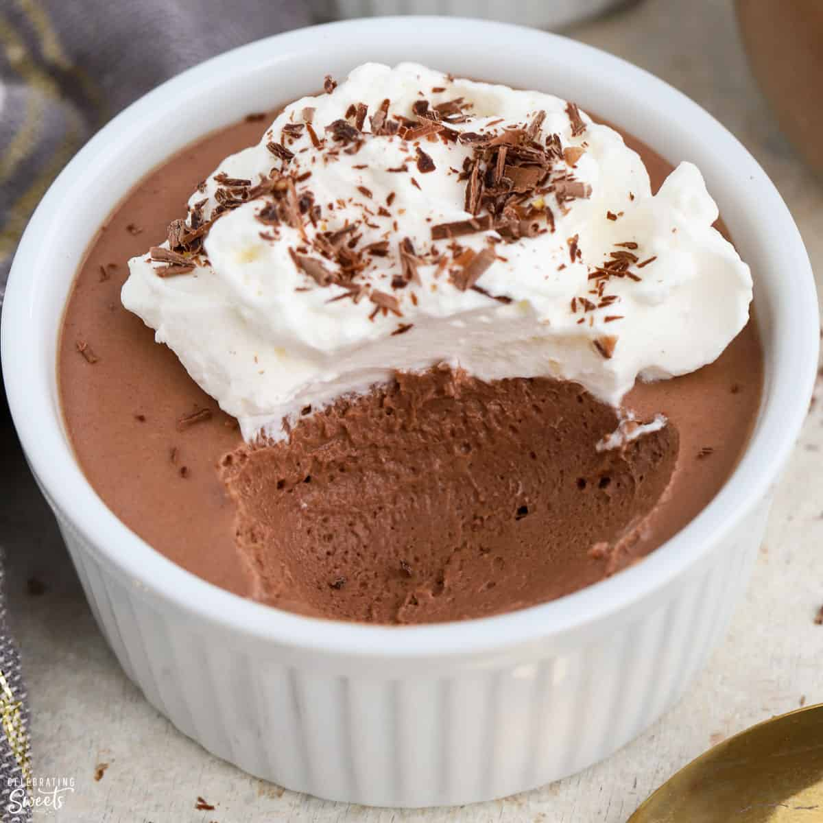
How to replace brown sugar in recipes
It is not possible to successfully sweeten a chocolate mousse with applesauce.
Sweetness, moisture, and chemical composition (fructose, glucose, and other sugars behave differently from sucrose) and sugars vary in terms of ph.
A recipe with baking soda will likely react with the slight acidity of brown sugar and using another sweetener may change the reaction.
Brown sugar replacements works very good for BBQ sauces but is not good for the replacement of brown sugar in a baking recipe.

Slide 19
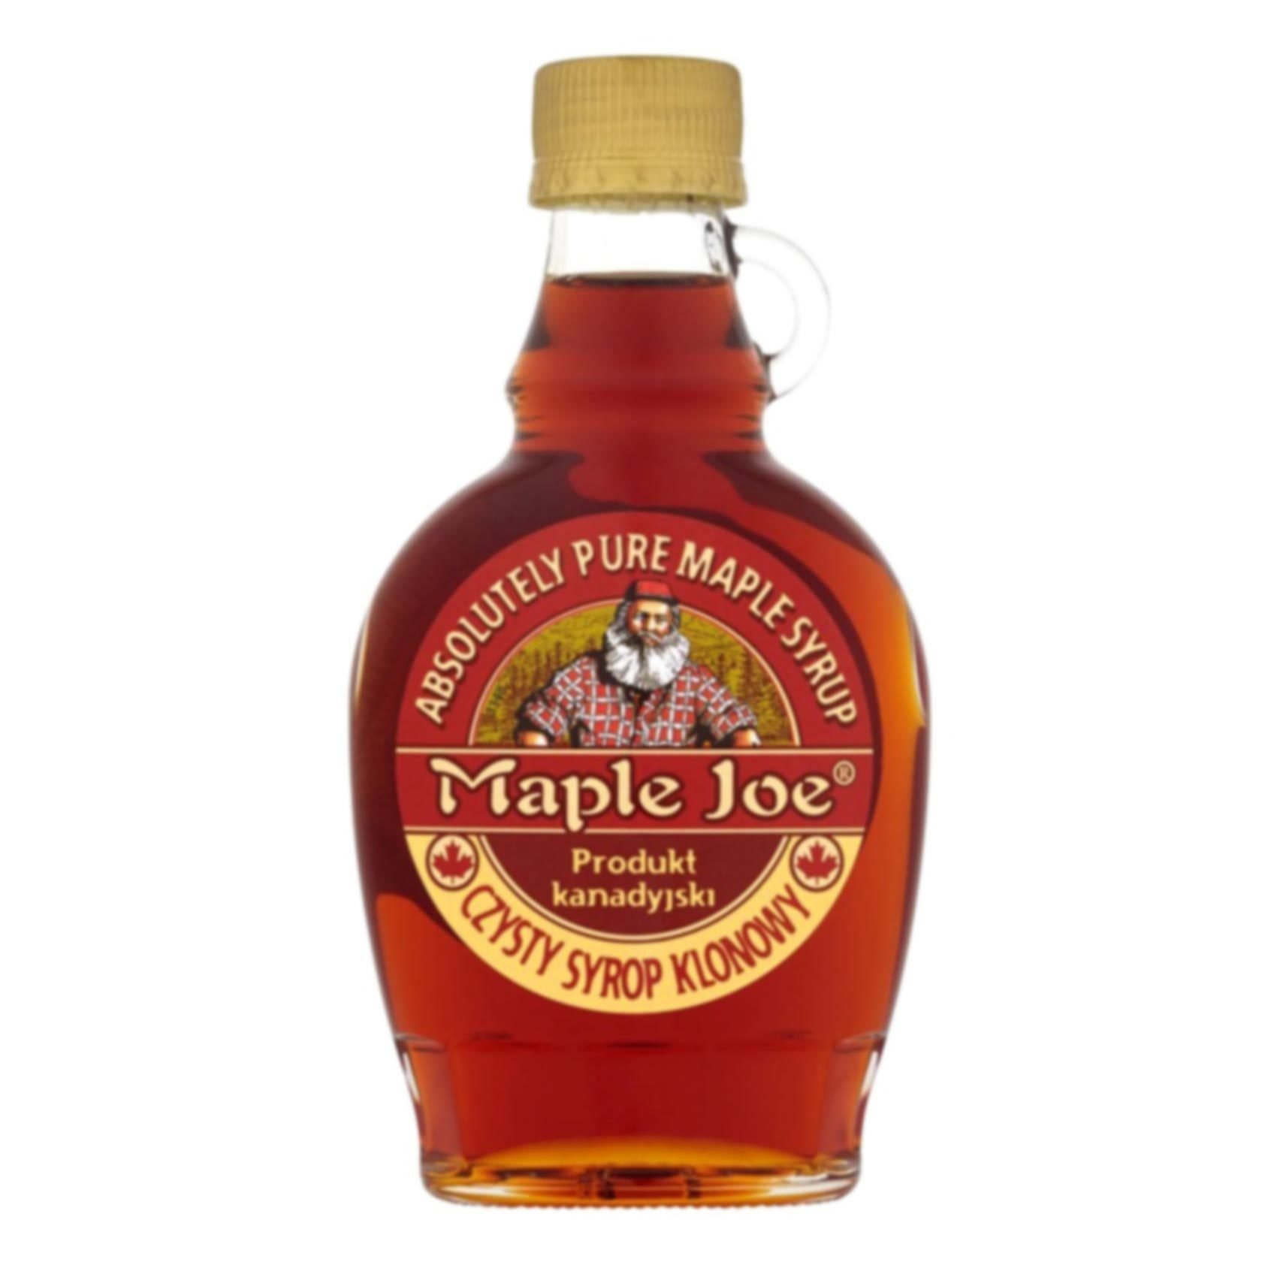
Maple sugar replacement
This granulated sugar produced from maple syrup has similar properties as brown sugar.
In practice, it’s much sweeter, and lacks brown sugar’s hygroscopic properties.
It is best to use in recipes that call for white sugar but might lack flavor.

Slide 20
Honey replacement
Honey is hygroscopic like brown sugar however unlike brown sugar, it mostly consists of fructose and glucose, instead of more complex sucrose.
It’s twice as sweet as brown sugar and it is also acidic.
When replacing recipes calling for brown sugar, add less, and reduce the amount of liquid a bit
Remember honey is 20 percent water.
Because the acidity is much higher than that of brown sugar, you may need to add a pinch of baking soda to make cakes rise properly.

Slide 21
Agave replacement
Agave is produced from the leaves of the agave cactus.
The color of this sweet amber syrup behaves similar to honey and brown sugar.
It is vegan.
Agave is not a healthful replacement for table sugar and is a higher-calorie sweetener (More calories than table sugar)
It is less harmful and more natural but people who are closely managing blood glucose should avoid agave.
The high fructose content can reduce insulin sensitivity and may worsen liver health. Agave is also a higher-calorie sweetener than table sugar.

Slide 22
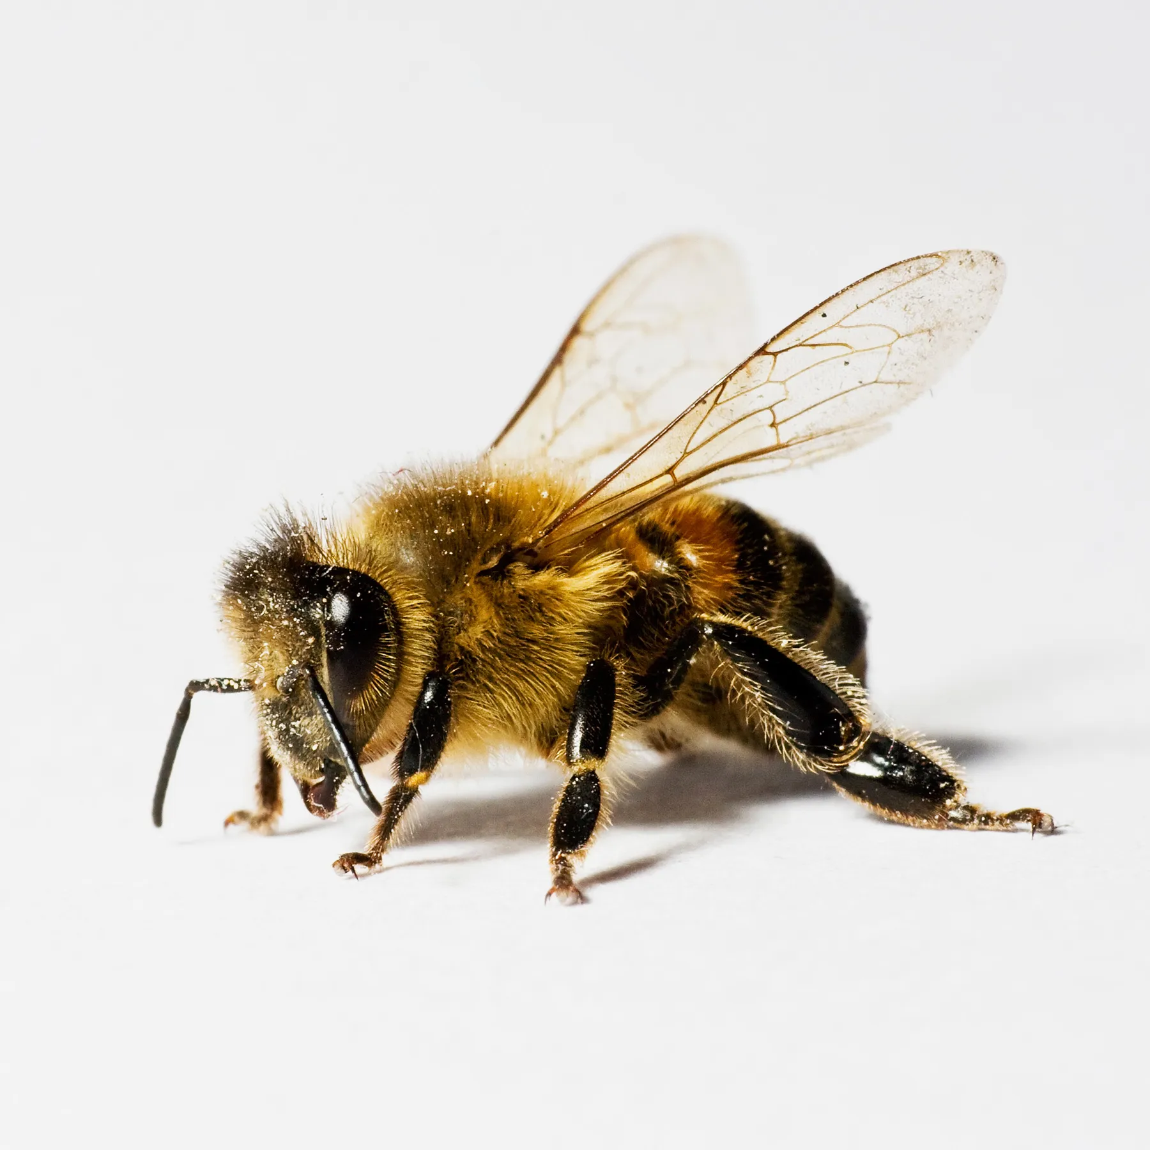

Agave or Honey replacement
If you must choose between the two, choose honey.
Honey and agave nectar are caloric sweeteners and offer none or very little nutritional value.
Honey is better than agave nectar because it is: higher in antioxidants.

Slide 23
Apple sauce replacement
Applesauce add sweetness to recipes and the calories are fewer than sugar.
Taking out all the sugar in a recipe, affects the texture and even the color.
Use applesauce in dishes that don't rely on the sugar for crispy texture.
Depending on the required sweetness, and the sweetness of your applesauce start of by using 1 part apple sauce and one part sugar.
Increase that ratio up to 1 1/2 parts applesauce for every part of sugar. Bear in mind that applesauce is a wet ingredient, and sugar is dry.
Not only is apple sauce reducing the sugar, but it can be used as a substitute for fat or oils.

Slide 24
Assignment
You will take a basic recipe, for example a vanilla cupcake or a sponge cake recipe.
Create 4 different batches:
Every time reduce the sugar with 10%. For example, if the recipe was 80 g of sugar, the first batch will have the full amount of sugar.
The second batch you will reduce the sugar with 10%
The third batch, 20 %
The fourth batch 30%.
Write a report on the texture and the feeling in the mouth, flavor balance, taste, volume and color.

Slide 25
References
Goldfein KR, Slavin JL. Why Sugar is added to foods: Food Science 101. Comprehensive Reviews in Food Science and Food Safety. 2015. Vol 14;644 – 656.
Cooper JM. Product Reformulation – Can Sugar be replaced in foods? International Sugar Journal 2012, Vol 114;1365.
Bernstein J, Christoforou AK, Weippert M, L’Abbe MR. Reformulation of sugar contents in Canadian prepackaged foods and beverages between 2013 and 2017 and resultant changes in nutritional composition of products with sugar reductions. 2020. Public Health Nutr; 23 (16): 2870-2878.

Slide 26
Conclusion
Sugar can be reduced depending if it is part of the chemical reaction or mere acting as a sweetener.
Sugar plays multiple rolls in foods, therefore, to reduce or remove sugar from a product is not a simple exchange of one ingredient with another.
Furthermore, depending on the replacement ingredients (starches, dextrin) total calories may not be lower than the original product.
In the next session, we will look at how to replace egg, and oil , fat butter in recipes.
Thank you for attending the session !

