Slide 1
Nature Science Research and Innovation Centre
Ontario (ON), Canada
Online Education (OE) Division
Recipe Development and Menu Planning
Lesson 6
Ms Wonda Grobbelaar (MBA)
Professor of Practice – OE Division
NSRIC Inc.
London, ON, Canada
E-mail: wonda.grobbelaar@gmail.com
https://www.nsric.ca

Slide 2
Class Learning Outcomes
The student will learn about food intolerances.
The student will know what the difference is between an allergy and a food intolerance.
The student will be able to identify ingredients on ready-made packaging which could be harmful for someone with an allergy or an intolerance.
The student will have knowledge about the difference between a dairy allergy and a lactose intolerance.

Slide 3
Food Intolerances
Food intolerance is a detrimental reaction, often related to a food, beverage, food additive, or compound found in foods that produces symptoms in one or more body organs and systems.
It is not the same as a food allergy.
Food intolerances appear when the body cannot properly digest certain foods.
Lactose intolerance and gluten intolerance are very well-known.

Slide 4

Food Intolerances Versus Food Allergy
Food allergies can be triggered by a very small amount of the food and occur every time the food is consumed.
People with food allergies are generally advised to avoid the offending foods completely.
Food intolerances are dose related; people with food intolerance may not have symptoms unless they eat a large portion of the food or eat the food frequently.
A person with lactose intolerance may be able to drink milk in tea or a single glass of milk but becomes sick if he or she drinks several glasses of milk.

Slide 5
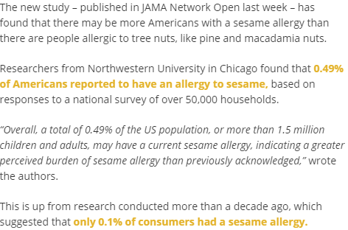
Food Intolerances Versus Food Allergy
Sesame allergies among Americans on the rise prompting calls for warning labels
https://www.bakeryandsnacks.com/Article/2019/08/06/Sesame-allergies-among-Americans-on-the-rise-prompting-calls-for-warning

Slide 6

Food Intolerances Versus Food Allergy
Food allergies and intolerances are different from food poisoning.
Food poisoning will happen when you eat spoiled or tainted food, and it normally affects more than one person eating the food.

Slide 7
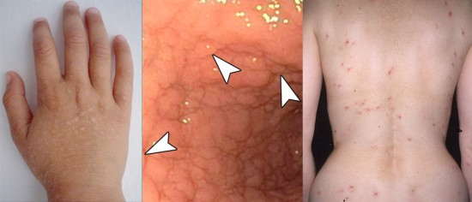
Food Intolerances Symptoms
Common symptoms include :
Diarrhea
Bloating
Rashes
Headaches
Nausea
Fatigue
Abdominal pain
Runny nose
Reflux
Flushing of the skin

Slide 8
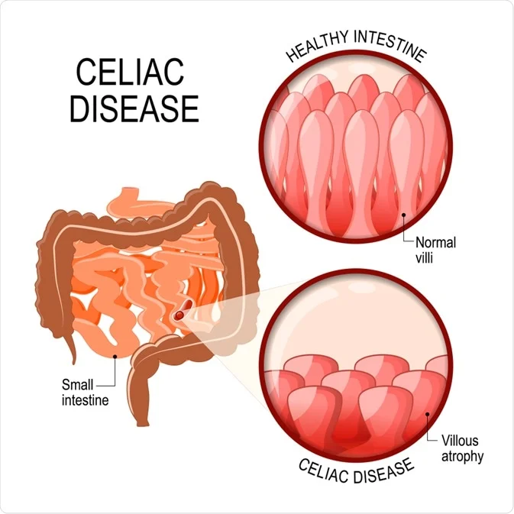
Food Intolerances – Celiac Disease
Celiac disease is a disorder in which eating gluten triggers an immune response in the body, causing inflammation and damage to the small intestine. It's estimated that celiac disease affects nearly 1% of the population in the United States

Slide 9
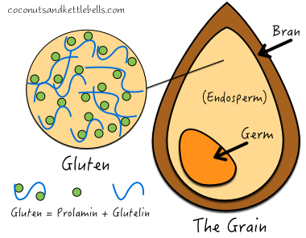
Food Intolerances – Celiac Disease
Gluten is a general name for the proteins found in wheat, wheatberries, durum, semolina, spelt, farina, faro, garam, Khorasan wheat, rye, barley and triticale which is a cross between wheat and rye.
Gluten helps foods maintain their shape, acting as a glue that holds food together.

Slide 10
Food that Might Contain Gluten
Artificial coffee creamer
Beer
Bouillon cubes
Broth/stocks
Candy
Certain ground spices
Certain veined cheeses
Chewing gum
Chips
Cold cuts
Tomato sauces
Vegetable cooking spray
Veggie burgers
Vodka
Wine coolers
Flavored teas
Flavored rice
Fish sticks
Flavored crackers
French fries
Gravies
Hot dogs
Imitation seafood
Instant coffee and other instant hot drinks
Ketchup
Matzo flavor
Mustard
Mayonnaise
Pasta side dishes
Rice mixes
Roasted nuts
Soy sauce
Salad dressing
Seitan (wheat gluten, used in meat substitutes)
Self-basting turkey
Soy and teriyaki sauces
Tinned baked beans

Slide 11
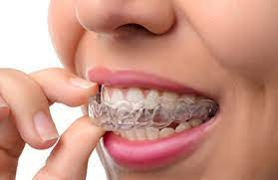
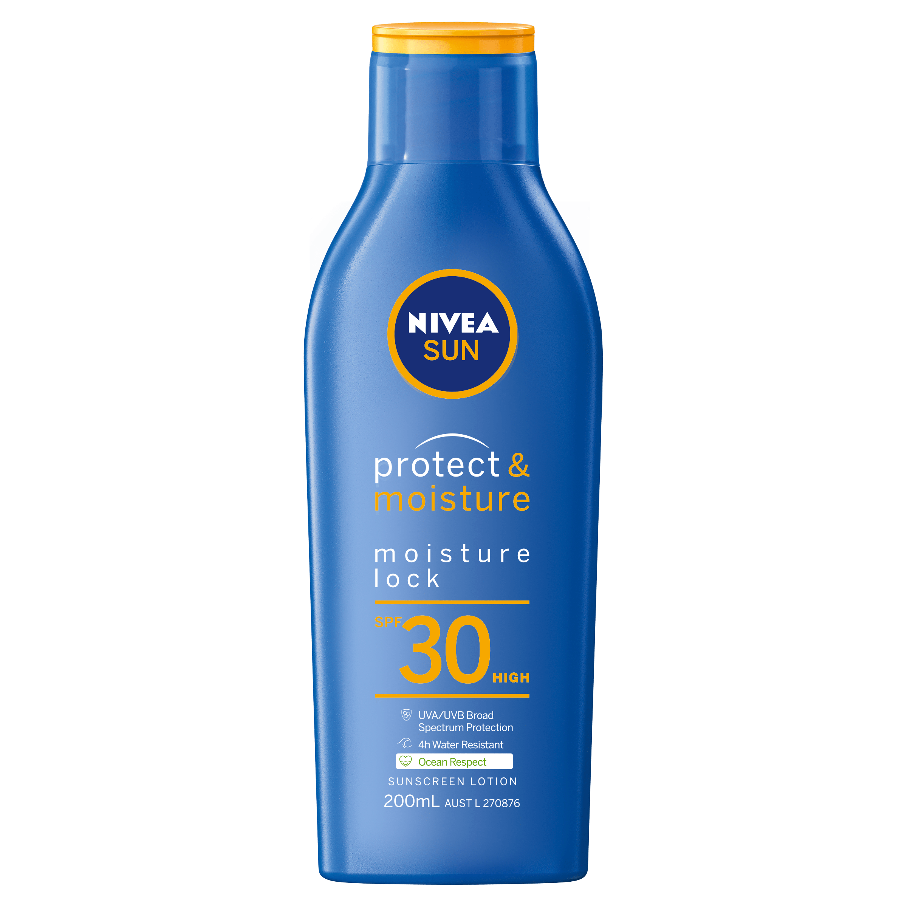
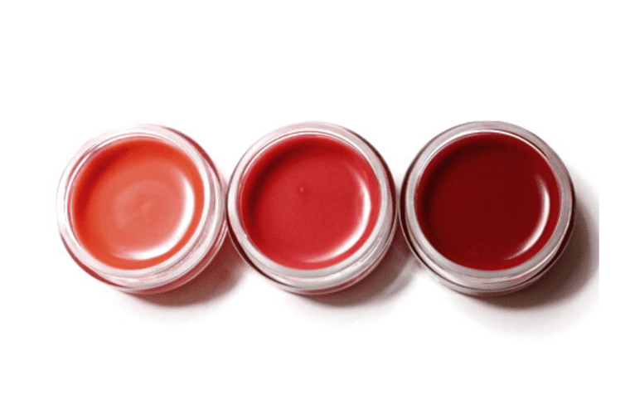
Non-Food Items that Might Contain Gluten
Dental plastics
Laundry detergent
Lip balms
Lotions
Makeup
Medications
Mouthwash
Playdough
Shampoo
Soap
Sunscreens
Toothpaste
Low quality vitamins and supplements

Slide 12
Celiac Disease & Mortality Risk
A large research project that combined data from 17 different clinical studies concluded that people with celiac disease—including those diagnosed through an endoscopy and those diagnosed simply with positive celiac blood tests were at a higher risk of early death from all causes, especially from non-Hodgkin lymphoma.
Non-Hodgkin lymphoma (NHL) is a group of blood cancers that includes different types of lymphomas except Hodgkin lymphomas. Symptoms include enlarged lymph nodes, fever, night sweats, weight loss and tiredness. Other symptoms may include bone pain, chest pain or itchiness.
Celiac disease that doesn't respond to the gluten-free diet can progress to a particularly deadly type of lymphoma, so the finding is that celiac have a much higher-than-normal death rate from lymphoma.

Slide 13
Lactose Intolerance
Lactose intolerance is a common digestive problem where the body is unable to digest lactose, a type of sugar mainly found in milk and dairy products.
If a person is lactose intolerant, it is normally due to a lack of the enzyme lactase.
Lactase is made by the cells that line the small gut.
The main duty of Lactase is to break down the sugar in milk into simpler forms so it can then be pulled into the blood stream.

Slide 14
Lactose Intolerance & Dairy Allergy
Is Lactose Intolerance and Dairy Allergy the same?

Slide 15
Lactose Intolerance & Dairy Allergy (Cont.)
Lactose intolerance is common in adults up to 20 years old.
It’s more common in people with Asian, African or Native American heritage and less common in people with a northern or western European background.
Dairy allergy means that your body reacts to the proteins in milk and other dairy products as if they’re dangerous invaders.
When the milk proteins enter your body, it releases substances that cause allergy symptoms.
Allergic reactions can be mild (rashes) to severe (trouble breathing) or even loss of consciousness.

Slide 16
Lactose and Dairy Hidden Names
Butter
Buttermilk
Casein, casein hydrolysate, and caseinates
Cheese
Cottage cheese
Cream
Curds
Diacetyl
Ghee
Lactalbumin
Lactoferrin
Lactose and lactulose
Milk (all types)
Recaldent
Rennet casein
Sour cream
Whey (in all forms)
Yogurt

Slide 17
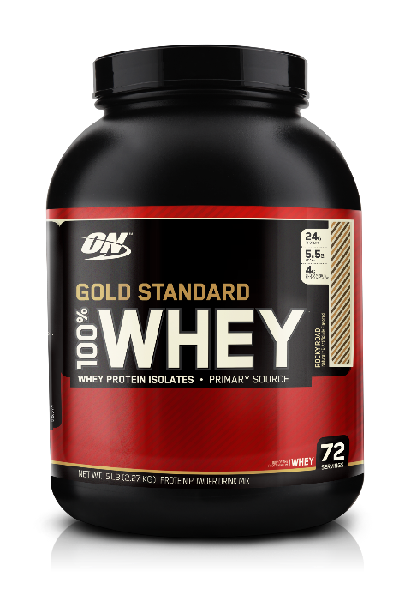
Food that Contains Lactose & Dairy
Baked goods and cake mixes
Hot dogs and deli meat
Indian food, (Ghee)
Battered and fried foods
Vegetarian cheese and soy cheese
Protein powders
Granola bars
Cereal

Slide 18
Living with Lactose Intolerance & Dairy Allergy
Living With Lactose Intolerance
Lactose intolerance is can be managed by limiting the amount of dairy food and drink a person consumes.
A person can also take lactase enzyme supplements when they eat dairy products to their body digest lactose.
Living With Dairy Allergy
If someone has an allergy, all dairy foods and other foods that contain dairy products must be avoided.

Slide 19
Salicylates
Salicylates are a group of chemicals derived from salicylic acid.
Salicin in willow bark converts to salicylic acid.
They are found naturally in certain foods and can also synthetically be produced for use in products like aspirin, toothpaste and food preservatives.
Both natural and synthetic forms can cause adverse reactions in some people.

Slide 20
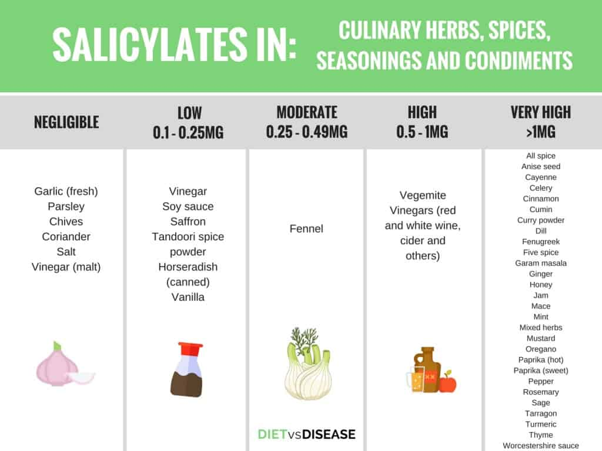
Salicylates (Continued)

Slide 21
Salicylates (Continued)
Salicylate sensitivity is caused by an overproduction of leukotrienes.
Leukotrienes are fatty immune system chemicals that come from dietary omega-3 and omega-6 fatty acids.
The body releases these chemicals after making contact with an allergen or allergy trigger.
The buildup of leukotrienes in the body leads to symptoms related to salicylate intolerance.
Leukotrienes appear to contribute to pathophysiologic features of asthma.
Although the percentage of people who have a salicylate intolerance is unknown, it is more common in adults who suffer from asthma.

Slide 22
Amines
Enzymes found in the human gut, liver and intestine are responsible for breaking down amines. Normally amines are quickly broken down and cause no problems. If the enzymes aren't functioning properly, amines can build up in the body which can cause allergic symptoms or intolerances in some people.
Amines increase in ripening fruits that go soft for example banana, avocado. Glutamate is an amino acid that is produced in the body and occurs naturally in many foods. Glutamate is found in many foods in a natural protein-bound form.
Monosodium glutamate (MSG) is the sodium salt of glutamic acid and is a common food additive. MSG is made from fermented starch or sugar and is used to enhance the flavor of savory sauces, salad dressings, and soups. MSG IS ALSO produced synthetically and added to packaged or prepared foods as a flavor enhancer. As far as foods label goes, however, MSG won't be listed as natural or artificial flavors.

Slide 23
Assignment
Caffeine and Egg Allergy
Write a report on an egg and a caffeine allergy.
The report should contain what the symptoms are of these allergens, what food you can these products normally be find in including the hidden names that is normally used for labels on ready made food.
The severity of each allergy can also be mentioned for example can an egg allergy kill someone if care is not taken to remove all egg from a food item?
If reliable data is available on the percentage of people in the world that are suffering from an allergy, this can also be included.

Slide 24
Conclusions
When a recipe developer develops a recipe to accommodate certain allergens, care must be taken to be familiar with all the hidden names that might cause an allergy.
Food intolerances symptoms can be very similar to food poisoning or a food allergy.
A lactose intolerance and a dairy allergy is not the same.
In the next session, you will learn how to change a recipe to make it suitable for someone with a certain allergy.
Thank you for attending the session of today!

