Slide 1
Nature Science Research and Innovation Centre
Ontario (ON), Canada
Online Education (OE) Division
Recipe Development and Menu Planning
Lesson 5
Ms Wonda Grobbelaar (MBA)
Professor of Practice – OE Division
NSRIC Inc.
London, ON, Canada
E-mail: wonda.grobbelaar@gmail.com
https://www.nsric.ca

Slide 2
Class Learning Outcomes
The student will understand the different basic terminology of allergens.
The student will know how to find hidden allergens in ready made products.
The student will have knowledge of the significance of allergens when developing recipes.

Slide 3
Allergens
What is an allergen?

Slide 4
Allergens
An allergen is a usually a harmless substance capable of triggering a response that starts in the immune system and results in an allergic reaction.
Food allergens are typically naturally-occurring proteins in foods or derivatives of them that cause abnormal immune responses. Prevalence of food allergies around the world is believed to be increasing, with more than 8% of children and 2% of adults in countries like Australia and New Zealand having allergy to one or more foods.

Slide 5
Allergens Statistics
40% of children is affected by allergens.
30% of adults is affected by allergens.
Asthma related allergens effects 339 million individuals in the USA.
Urban areas contribute 64% to asthma cases.
Hay fever is the main trigger, as 80% of asthmatics claim that their symptoms were triggered by this.
Peanut allergy in children - around 1.8 million in USA.
Food allergies affect 2.5% of the global population.
Around 50% of anaphylaxis reactions are caused by food allergies.
Globally, 10%–20% of people are allergic to dogs and cats. (https://comfyliving.net/allergy-statistics Hermina Drah)

Slide 6
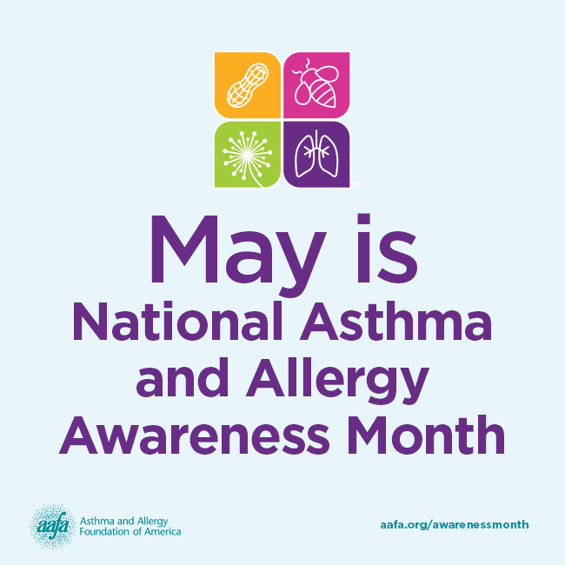
Allergy Awareness Month

Slide 7
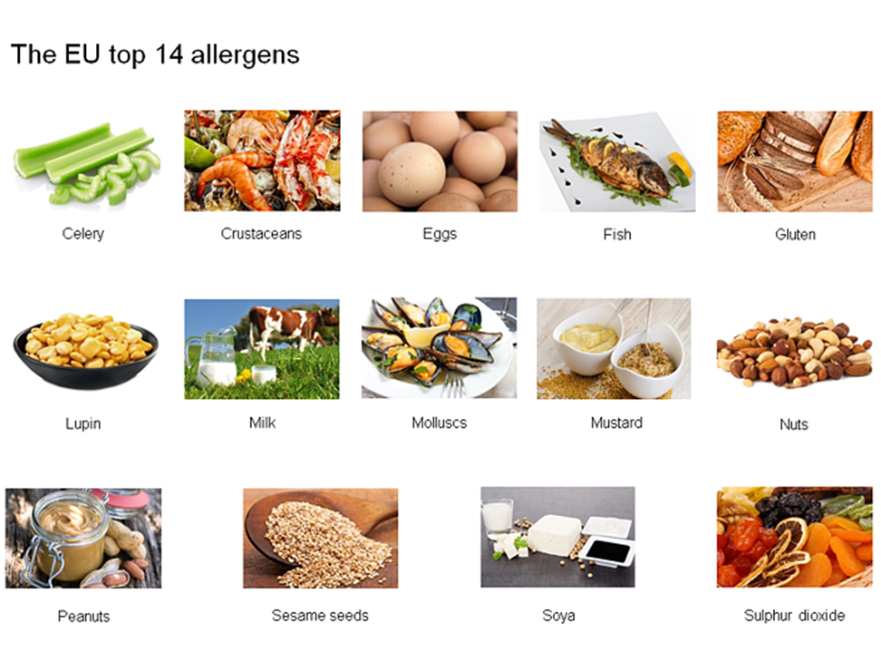
Class learning outcomes

Slide 8
Soy or Soya Allergen

Slide 9
Soy or Soya Allergen
Soy is considered one of the most common potential food allergens.
Soy is found in unexpected places such as in baked goods, cereals, crackers, infant formula and canned tuna.
Soy protein is a product of Soybeans.
Isoflavones are found in soy, and they are low plant estrogens.
Isoflavones can increase the risk of breast cancer.

Slide 10
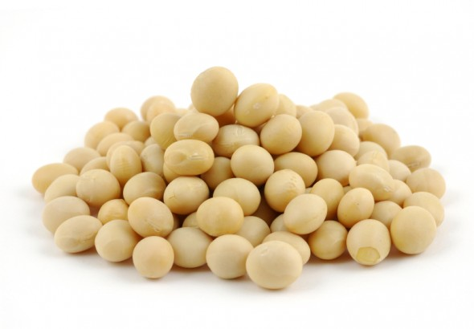
Hidden Names of Soy
Hydrolyzed vegetable protein (HVP)
Textured vegetable protein (TVP)
Lecithin
Monoglyceride
Monosodium glutamate (MSG)
Vegetable oil
Vitamin E
Natural flavoring
Vegetable broth
Vegetable gum
Vegetable starch
Soy Oil

Slide 11

Sulphur Dioxide

Slide 12
Sulfur Dioxide (Continued)
Sulfur dioxide(SO2) is a colorless gas or liquid with a strong, choking odor.
It is produced from the burning of fossil fuels (coal and oil) and the smelting of mineral ores (aluminum, copper, zinc, lead, and iron) that contain sulfur.
Sulfur dioxide dissolves easily in water to form sulfuric acid.
Sulphur dioxide is widely used in the food and drinks industries for its properties as a preservative and antioxidants.
SO2 is found in dried fruits and vegetables, soft drinks and alcoholic beverages.
Sulfites release gas, which helps keep the food free of bacteria and preserve the taste and color.

Slide 13
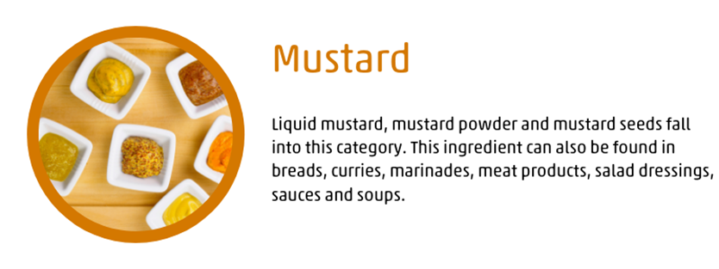
Mustard

Slide 14
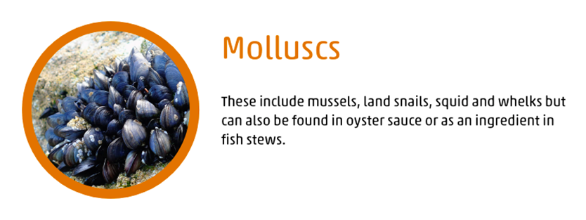
Molluscs

Slide 15
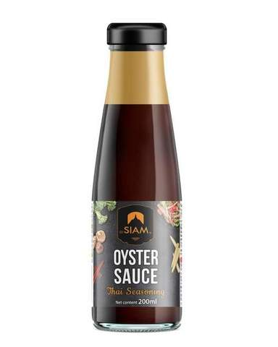
Oyster Sauce
Oyster sauce is made by boiling oysters.

Slide 16

Lupin

Slide 17
From Stock Food to Superfood
Lupin is found as a food ingredient and its flour is used as a substitute for soy or wheat in processed foods.
Lupin is closely related to peanut and some individuals with peanut allergy can react to lupin.
Lupin is higher in protein and fiber than it is in carbohydrates, lupin-enriched foods can also help assist with weight loss.
Nutritionists suggest to add Lupin slowly to your diet because the rich, fibrous legume can be a shock to the system causing bloating and gas if you eat too much of it.

Slide 18
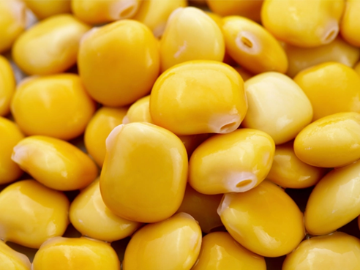
Allergy Awareness
Lupine is a legume that cross-reacts with peanut at a high rate and should be avoided by peanut allergic patients.
It does not fall under the labeling requirements of FALCPA.
Lupine is also known as Lupinus albus and can be found in seed or flour form.

Slide 19
Food that Might Contain Peanuts
Artificial flavoring
Baked goods
Candy
Chili
Chocolate
Crumb toppings
Egg rolls
Enchilada sauce
Ethnic foods: African, Asian,
Chinese, Indian, Indonesian, Thai
Nougat
Vietnamese, Mexican
Fried foods
Flavoring
Graham cracker crust
Hydrolyzed plant protein
Hydrolyzed vegetable protein
Marzipan
Mole sauce
Natural flavoring

Slide 20
Avoid the following food (Peanut Allergy)
Arachis oil (another name for peanut oil)
Artificial nuts.
Beer nuts.
Cold-pressed, expelled or extruded peanut oil*
Ground nuts.
Lupin (or lupine)—which is becoming a common flour substitute in gluten-free food. ...
Mandelonas (peanuts soaked in almond flavoring)

Slide 21
Food Allergen Reactions
Allergic reactions to foods vary from mild gastrointestinal discomfort, to skin rashes and potentially life-threatening asthma and anaphylaxis.
Commonly many adverse reactions to food are referred to collectively as food allergies.
However, true food allergies represent only a fraction of the diverse range of individualistic adverse reactions to foods, that also include food intolerances.

Slide 22
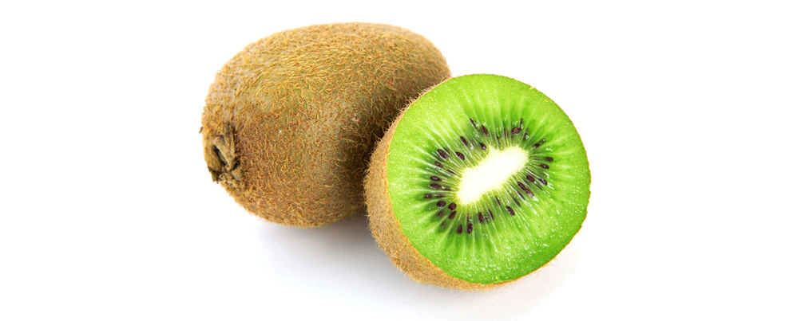
Allergic Symptoms
Some people can also experience mild allergic symptoms to fresh fruits and vegetables such as kiwi, apples, peaches, melons, pineapple and papaya.
This condition, known as oral allergy syndrome or pollen-food syndrome, is normally associated with a primary allergy to pollen (e.g., birch, ragwort or grasses) or latex.
In these individuals, the immune system reacts to the food proteins as if they were pollen and the symptoms are generally limited to the mouth and throat.

Slide 23
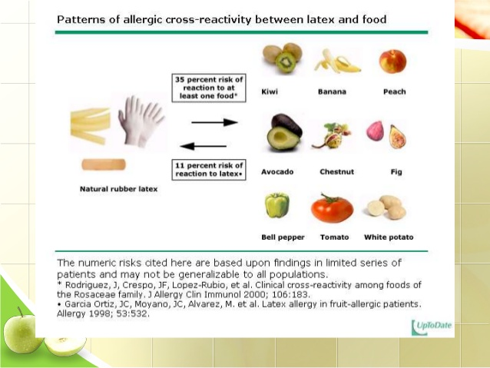
Allergic Cross-Reactivity

Slide 24
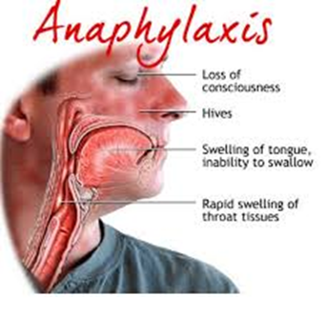
Anaphylactic Shock Definition
An extreme, often life-threatening allergic reaction to an antigen to which the body has become hypersensitive.
Skin reactions such as hives, flushed skin, or paleness
Suddenly feeling too warm
Feeling like you have a lump in your throat or difficulty swallowing
Nausea, vomiting, or diarrhea
Abdominal pain
Weak and rapid pulse
Runny nose and sneezing
Swollen tongue or lips
Wheezing or difficulty breathing
Sense that something is wrong with your body
Tingling hands, feet, mouth, or scalp

Slide 25
Conclusions
As recipe developers, we should take care to make sure that customers’ allergen requirements are met.
Never assume that you know what is in an ingredient for example a store-bought sauce.
Know your allergens!
A customer with a severe allergy can die if he eat the wrong food.
In the next session, you will learn about food intolerances.
Thank you for attending the session of today!

