Slide 1
Nature Science Research and Innovation Centre
Ontario (ON), Canada
Online Education (OE) Division
Recipe Development and Menu Planning
Lesson 3
Ms Wonda Grobbelaar (MBA)
Professor of Practice – OE Division
NSRIC Inc.
London, ON, Canada
E-mail: wonda.grobbelaar@gmail.com
https://www.nsric.ca

Slide 2
Class Learning Outcome (CLO’s)
The student will understand the latest trends.
The student will be able to analyze the changes in trends every year.
The student will have knowledge the food wastage that is happening every year.
The student will understand the term “leftovers”, and how to use this in a new dish.

Slide 3
What is a food market trend?

Slide 4
Definition of Food Market Trends
Food market trends are widespread changes in food preferences.
Food trends can differ from country to country, or it can be delayed in certain countries.
It is a tendency of a certain type or style of food to move in a particular direction over a period.
Some such trends prove to be long-lasting, some trends last only for a short duration.

Slide 5
Reduce food wastage!
Around 1.3 billion tons of edible food is thrown away each year.
Fruit & vegetables accounts for almost 44%, half of the food we waste, often due to consumer selectiveness over some being ‘imperfect’ looking.
Many countries around the world are looking at different ways to reduce food waste, for example, Australia has set a target to reduce food waste by 50% by 2030.
Scotland has aimed to reduce its food waste by one third by 2025.

Slide 6
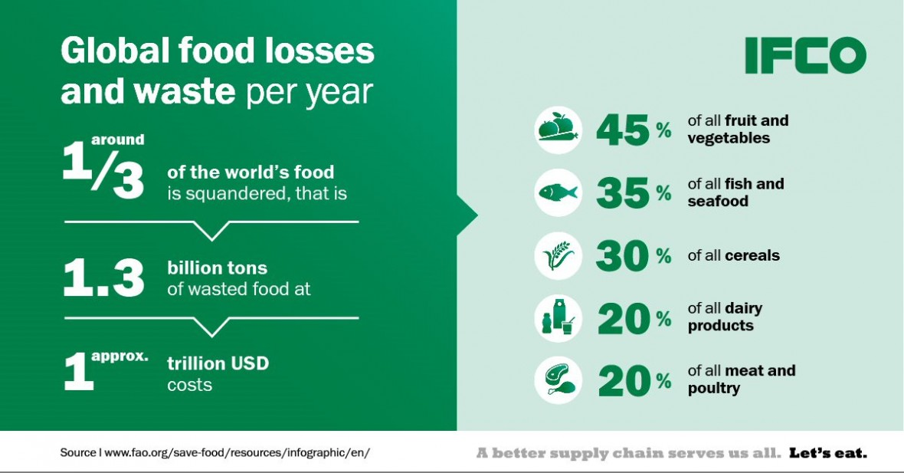

Slide 7
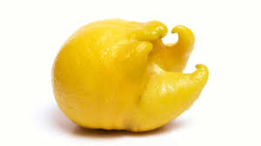
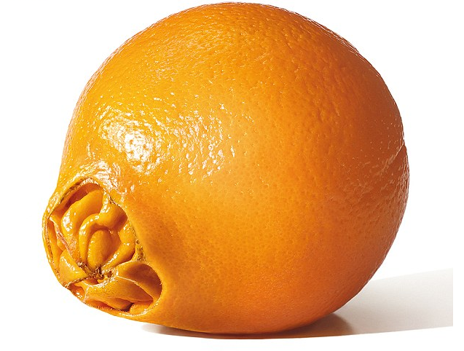
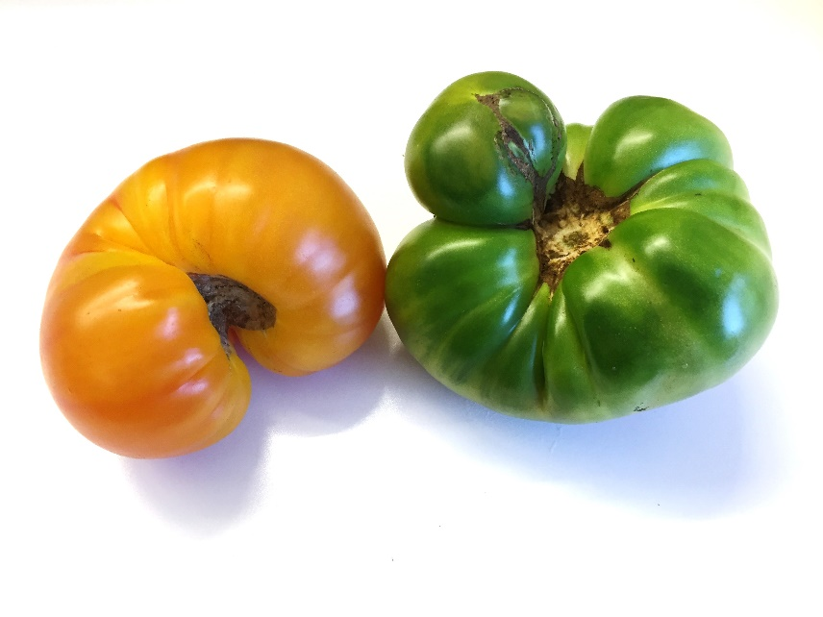
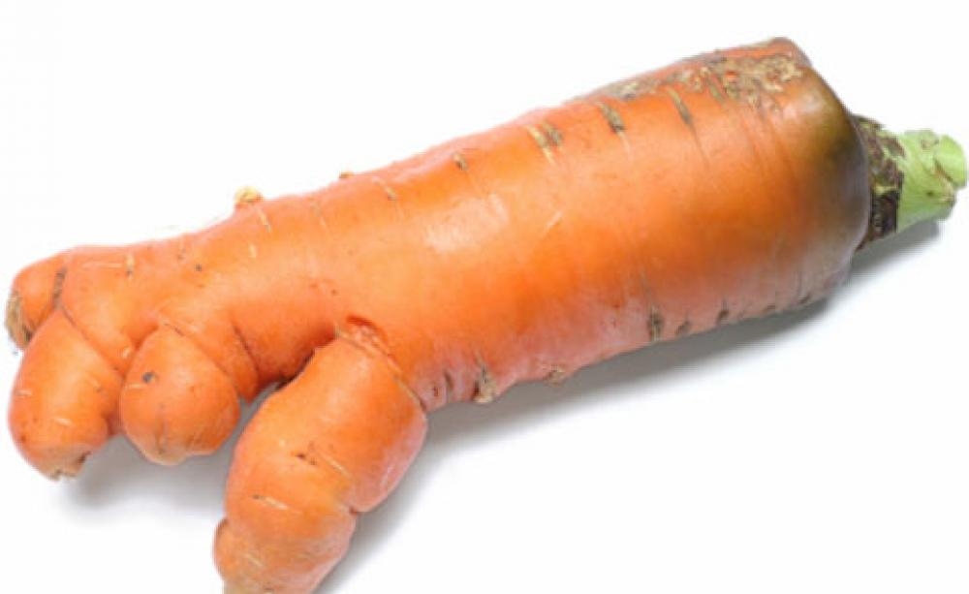
Ugly Fruit & Vegetables

Slide 8
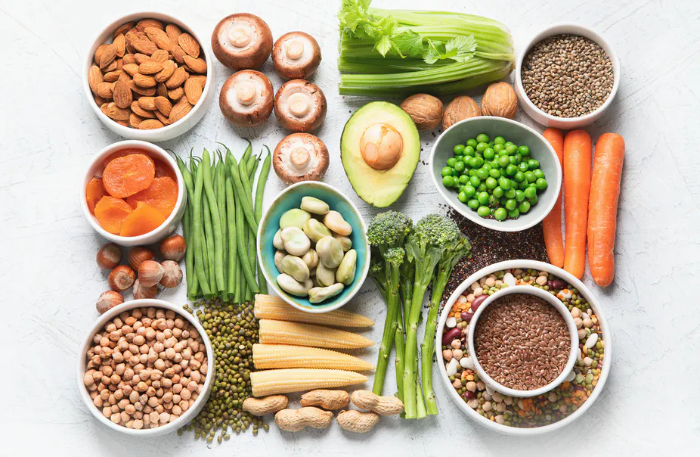
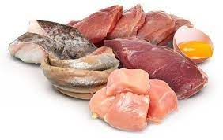
Flexitarian Blends
Some who follows primarily vegetarian diet but occasionally eats meat or fish.
+

Slide 9
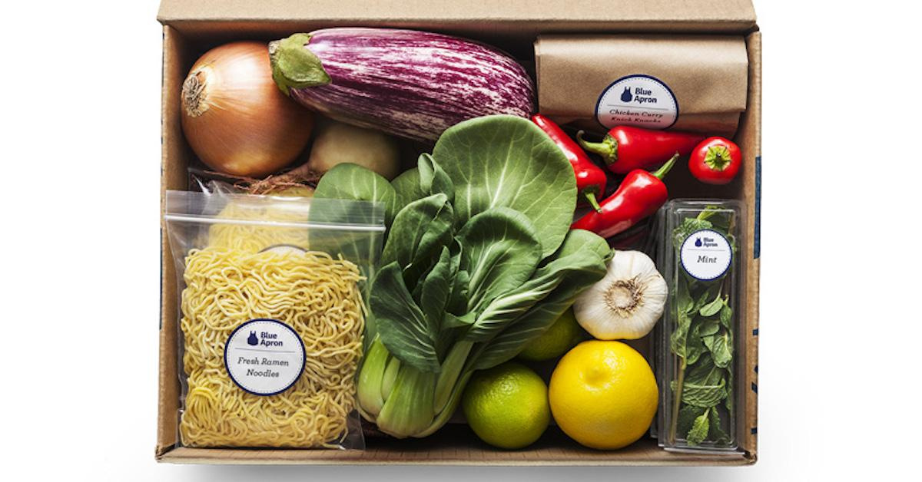
Meal Kits

Slide 10
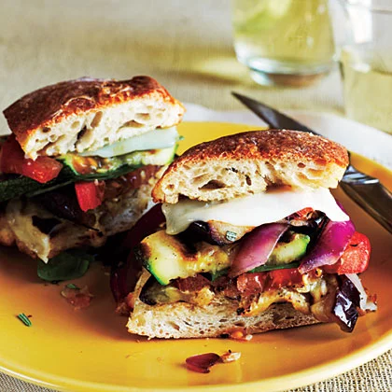
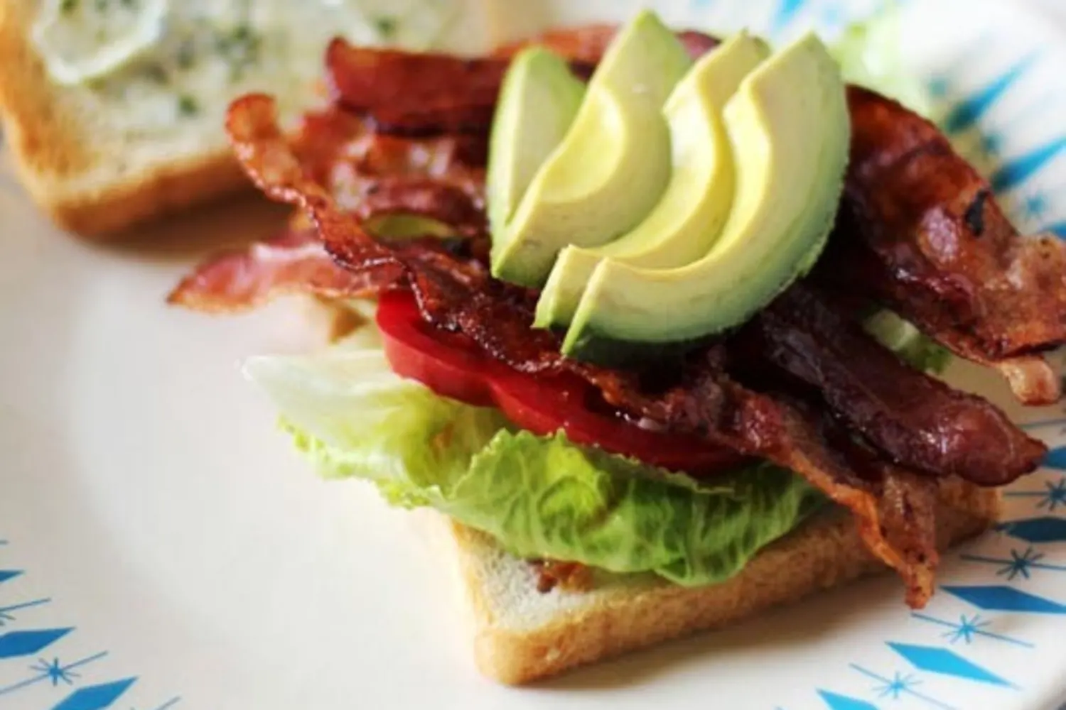
Meal-sized sandwiches

Slide 11
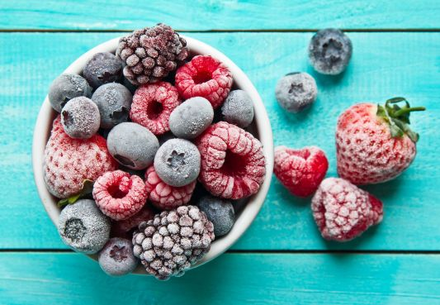
Freezer Food
The pandemic has changed the buying habits of customers.
Between office meetings and home-schooling people wanted to reduce the trips to shops.
This requirement made people starting to look at frozen.

Slide 12
Recipe Development 2019
Customer feedback are a driving force in recipe development for example an overall successful dining experience.
People do not have time to cook any longer or they don’t know how to cook.
People don’t have the talent to cook.
The need for healthy convenience products are in the increase.

Slide 13
Recipe Development 2019
People are looking for safer food.
Not any longer the long traditional meals in the evening.
Vending machines are offering more healthy options.
Limited-service restaurants or cloud kitchens are on the rise with allergen options to customers.

Slide 14
Recipe development 2021
There is an urge to establish to find a new gold standard of sweetness.
Nestlé and other companies are focused on maximizing the efficiency of sugar to provide products with the same perceived sweetness but by using up to 40% less of it.
Sugar reduction technologies is the latest trend in food preparation.

Slide 15
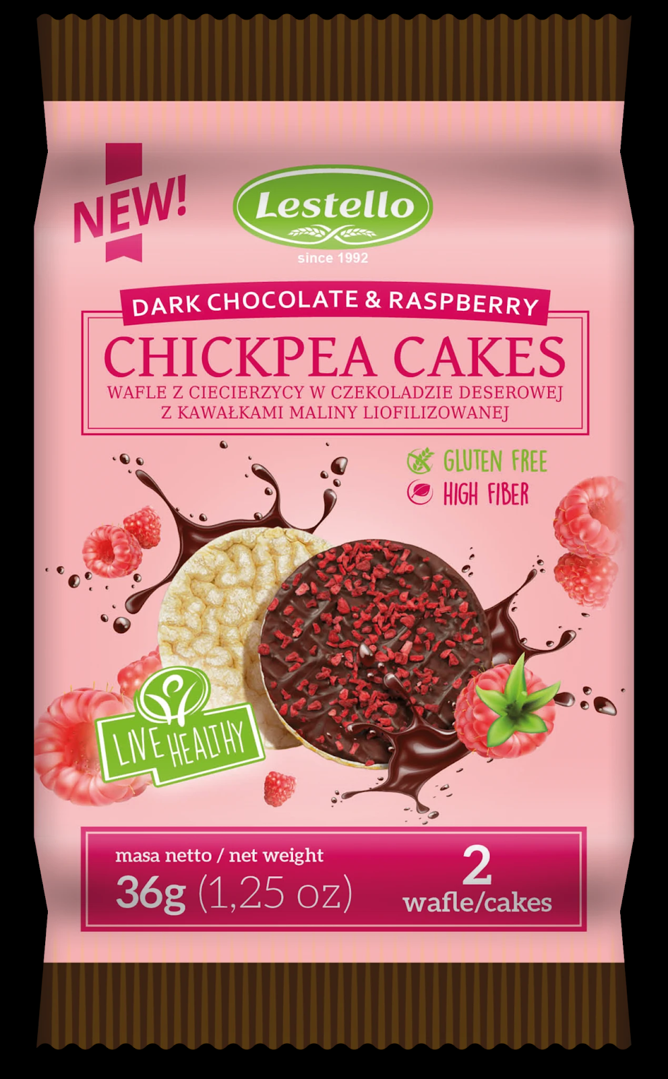
Chickpea Flour
Chickpea-based ice cream and cakes are finding growing appeal to everyone looking for better-for-you options for an indulgent treat.

Slide 16

Functional Foods
Consumers would like more functional foods for managing stress and anxiety.
Other top concerns include sleep/rest, hydration, bone/joint health, brain function, cholesterol management, eye health, skin/hair/nails, and energy.

Slide 17
Change in Food Ingredients
Carrots weren’t originally orange, they were scrawny and white; peaches once resembled cherries and tasted salty; watermelons were small, round, hard and bitter; egg plant used to look like white eggs.
The selective breeding for bulky and tasty traits, combined with intensive farming practices, has sometimes come at a nutritional cost. Protein, calcium, phosphorus, iron, riboflavin (vitamin B2) and vitamin C have all waned in fruit and vegetables over the past century, with today’s vegetables having about two-thirds of the minerals they used to have.

Slide 18
Change in Food Ingredients (Cont.)
A company recently created a meat-free burger that sizzles in the pan, tastes like meat and ‘bleeds’ the same.
Designed to be sustainable and environmentally friendly, the patties are made with wheat protein, coconut oil, potato protein, and flavorings.
The secret ingredient is heme – the oxygen-carrying molecule that makes both meat and blood red – and seems to give meat much of its flavor. The heme that Impossible Foods uses has been extracted from plants and produced using fermentation.

Slide 19
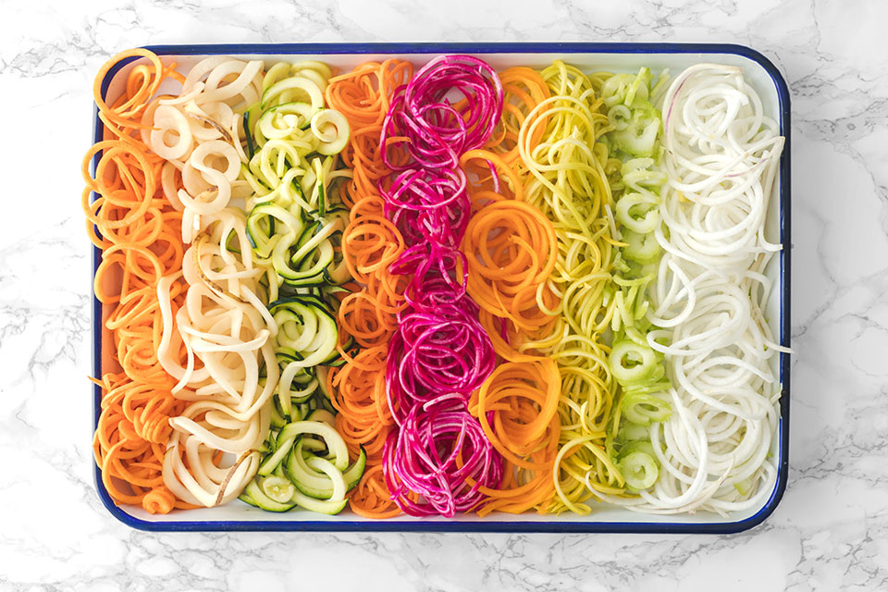
Healthier Options
Pasta made from spiralizing vegetables (Carrots, Cucumbers and Vegetables)
Pizza dough versus Cauliflower dough
Mashed Potatoes versus mashed Cauliflower
French fries versus Sweet Potato fries
Potato chips versus Kale chips

Slide 20
Left Over Food
The top reasons that food goes to waste are the following:
We are buying too much and prepare too much food.
We don’t store food properly and it changes into wastage.
We don’t do planning before grocery shopping.
Store left over food as quickly as possible at the correct temperature.
Store the food in sealable containers.

Slide 21

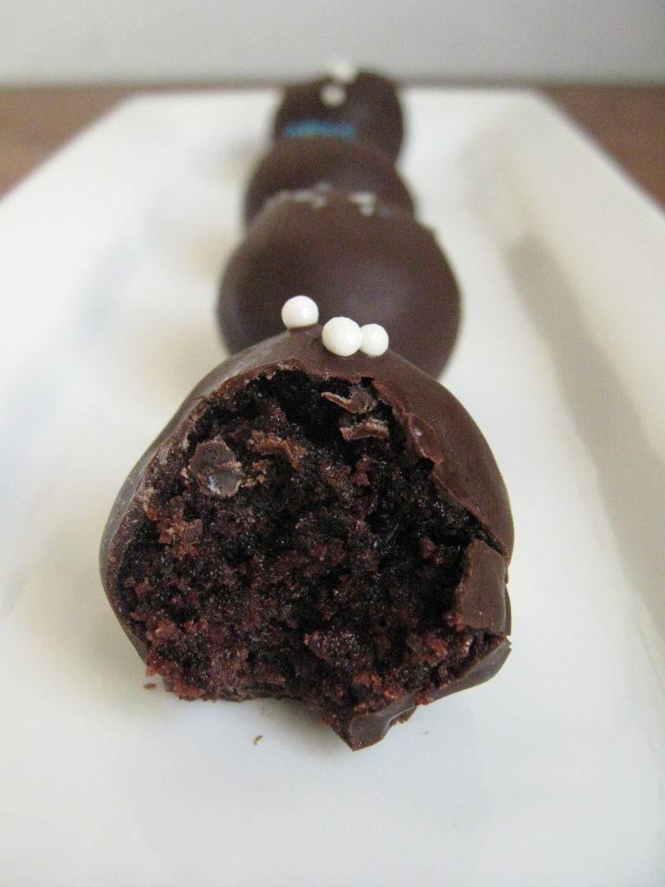
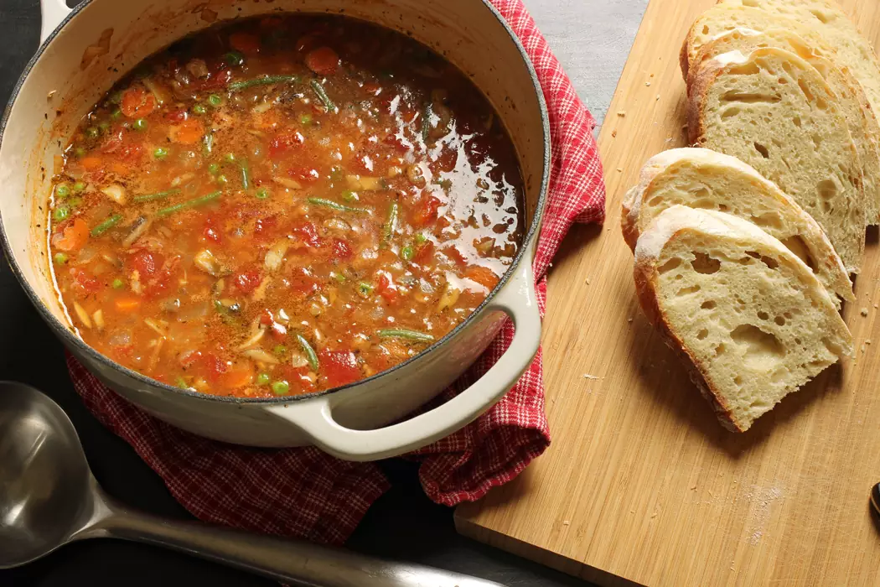
Left Over Food

Slide 22
Conclusions
Trends change every year.
Not all trends works in every country.
Do not create a menu only with trendy food on it.
Use leftover food wisely.
In the next session you will learn about food additives and how to use them wisely in recipes.
Thank you for attending this session.

