Slide 1
Nature Science Research and Innovation Centre
Ontario (ON), Canada
Online Education (OE) Division
Recipe Development and Menu Planning
Lesson 2
Ms Wonda Grobbelaar (MBA)
Professor of Practice – OE Division
NSRIC Inc.
London, ON, Canada
E-mail: wonda.grobbelaar@gmail.com
https://www.nsric.ca

Slide 2
Class Learning Outcome (CLO’s)
The student will understand the importance of a recipe.
The student will have knowledge how to start a career as a recipe developer.
The student will learn how to develop a very good palette.
The student will be familiar with the skills required to become an excellent recipe developer.

Slide 3
What is the single most important factor that can make or break your Food Establishment?

Slide 4
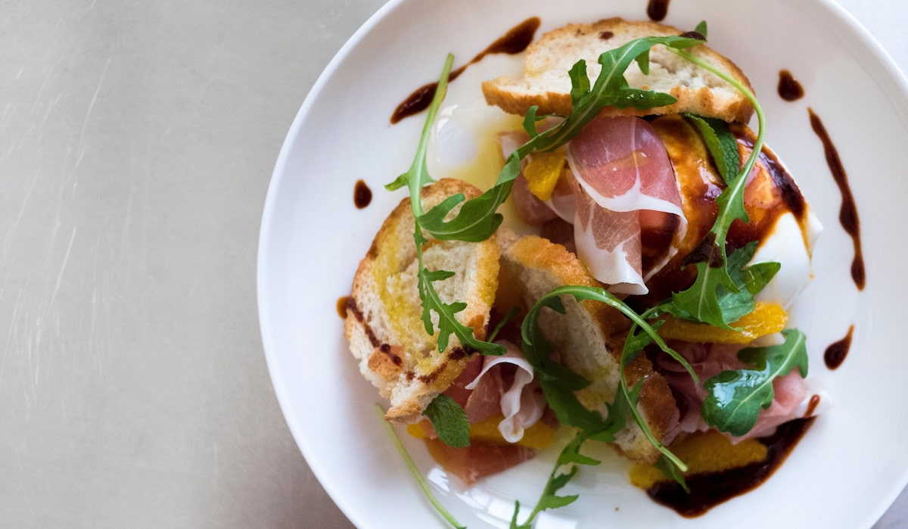
Good quality well made food

Slide 5
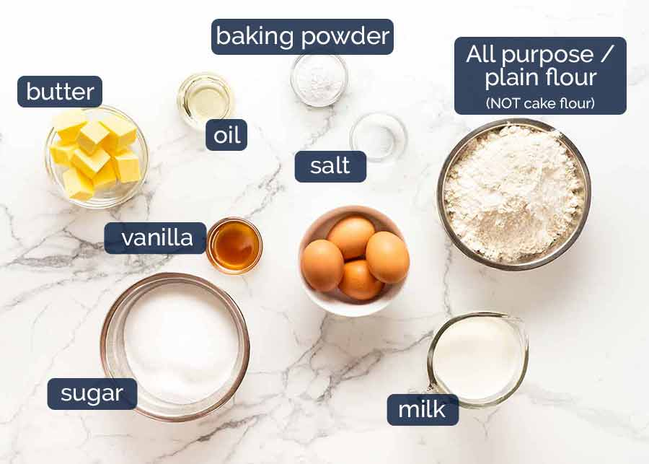
What is Recipe Development
Food recipe development is the process of turning an idea that is food related into a finished product or dish.
Recipe development is a key component in the development of cookbooks, food websites and magazines.

Slide 6
Why should we develop recipes?
Recipe development helps to ensure that the best possible ingredients are chosen, and the best food items are produced every time.
Developing your own recipes puts you in a position to showcase your creativity and educate your audience.
It shows that you or your brand are experts in certain food types and have a wide knowledge of culinary.
It also strengthens the consumer-brand relationship, as well as attracting new customers.

Slide 7
What is a recipe developer?
A recipe developer is a person who takes ingredients and creates either a new recipe out of this or taking an “old idea” and change this into something new.
A true recipe developer is an artist, the medium is food and with this you create a piece of artwork.

Slide 8
Responsibilities of a Recipe Developer
Recipe developers must know how different ingredients react with one another.
They should take the time and learn about the taste of ingredients on their own.
They should know which combinations work and which combinations just won't work.
By trying new cooking approaches, change ingredients slightly, or varying cooking times, new recipes can be created.

Slide 9
Types of Roles
Recipe developers often duplicate a food item successfully without having a recipe.
Recipe developers can develop recipes for a specific health or dietary concerns for example gluten free, egg free or health related issues.
Recipe developers can develop recipes for restaurants or food manufacturers.
Recipe developers can also develop recipes for their own websites or blogs.

Slide 10
How to Start Your Career as a Recipe Developer
Start a food blog.
Include high quality photos in your social media and/or food blog.
Practice and practice. The more you practice, the luckier you will become.
Start contacting food companies. The more companies you will contact, the more work you’ll receive. Remember Pareto’s 80/20/5 rule.*
When sending out your portfolio to companies, always follow up.

Slide 11
Additional Requirements
To be successful as a recipe developer, the following is recommended:
Take a basic food photography course to learn how to take high quality photos.
Learn how to create a food blog.
Be familiar with the basic cooking and pastry techniques.
Take a course on how to improve your creativity.

Slide 12
Purpose of a Standard Recipe
A standard recipe ensures consistency in each menu item every time the customer visits the food establishment.
It provides the same yield and results when created with consistent procedures, ingredients and equipment.
Standard recipes help maintain efficiency, contribute to financial calculations including food cost, planning of inventory and nutritional values.

Slide 13
Purpose of a Standard Recipe
A recipe communicates all the necessary steps and ingredients a chef uses to make a creation.
It is a valuable tool which allows the chef to train and replicate skills to his staff.

Slide 14
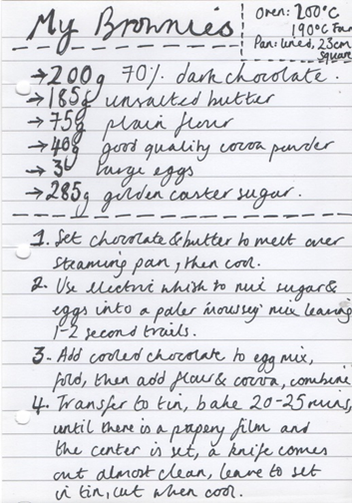
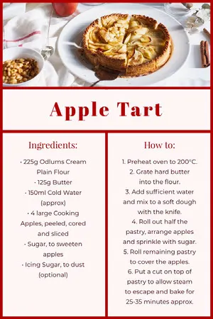
Recipes

Slide 15
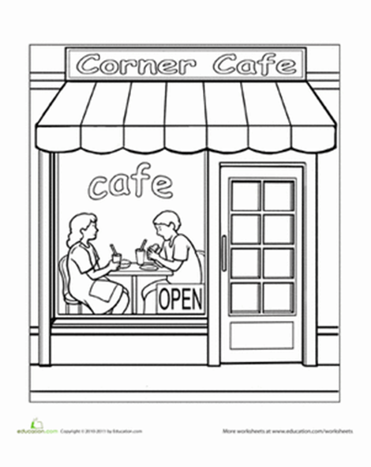
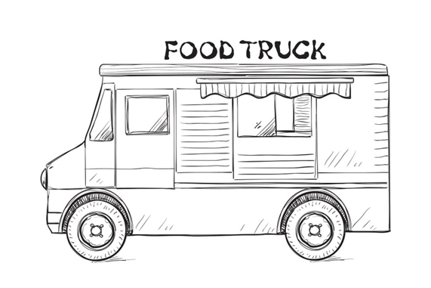
Where are Recipes Used?
Restaurants
Fast Food Establishments
Hospitals
Schools
Catering
Cafés
Food Trucks
In Food Manufacturing
Pop Up Restaurants
And many more……..

Slide 16

Tools that can be used for Recipe Development
Do an online survey to establish the flavor profile of future customers

Slide 17
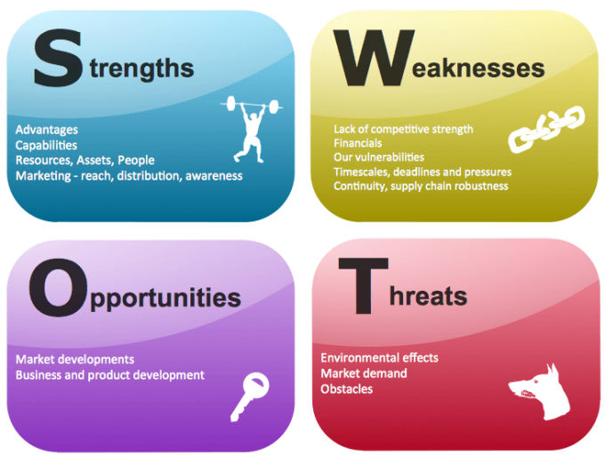
Tools that can be used for Recipe Development
Do market research before you start developing recipes for commercial use.

Slide 18
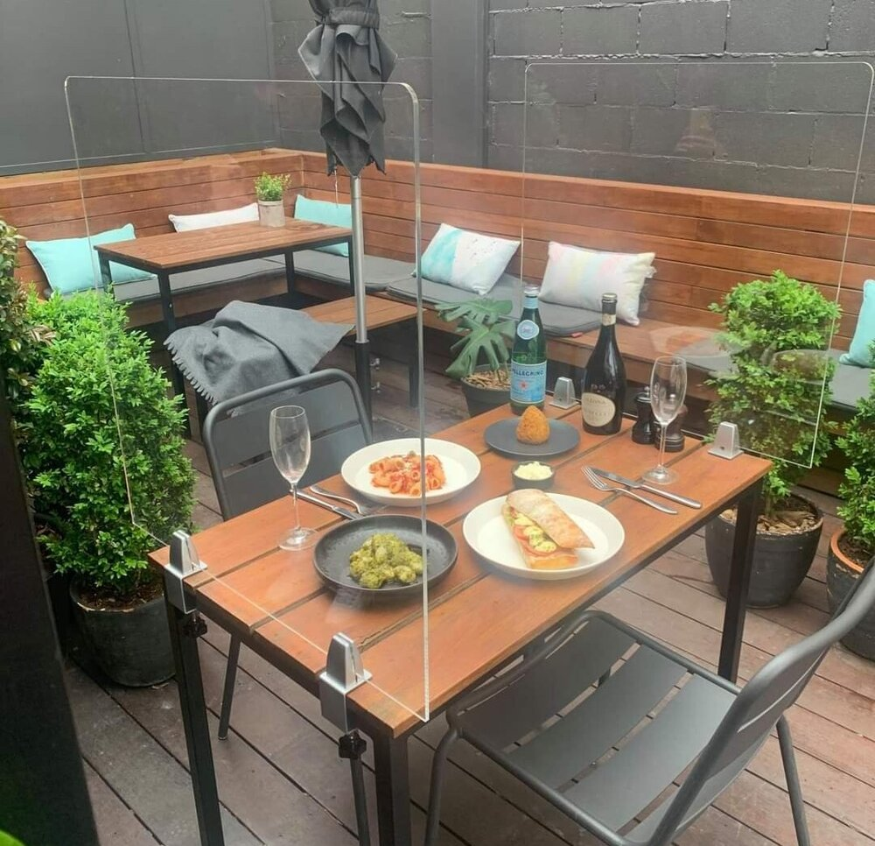
Latest Trends in Food
Stay up to date with the latest trends in the food industry.
Pantry Meals, using ingredients you already have
Mental Health Cooking
“Flexitarian” Diets
Carb Alternatives
Takeout (Cloud kitchens)
Low-Waste Foods
Elevated Desserts.

Slide 19
Improve Your Palette
Know the Basic Tastes. (basic tastes: Sweet, salty, sour, bitter, and umami.
Always try new foods.
By continuously eating the same food all the time, will not expand your taste palette.
Savor your food.
Cleanse Your Palate between different meal courses.
Use Your Senses.(touch, hear, feel, smell and see)
Watch out for sugar, strong coffee or other strong flavors that might disguise the real taste.
Don’t develop a recipe when you have a cold.

Slide 20
How to savor food
Sit at a table and eat.
Enjoy every spoonful of food before taking the next one.
Slow things down and make every meal a celebration.
Even if you only have water to drink, pour it in a beautiful glass.
Eat smaller portions and feel how digestion starts in the mouth.
Stop to eat when you start feeling full.

Slide 21
Assignment for this Week
Try ten new ingredients this week. You can complete this task by either going to a food store and try different samples, or by trying to eat something different when you go out.
You can also ask your friends from other countries if they can supply you with a sample there most popular ingredient.
Once you taste it, you need to try and establish the following:
Bitter, sour, salty, sweet or umami.
What does the taste remind you of? What type of food you already know?
Is it soft, smooth, coarse, creamy, noisy, crunchy, loud?
Draw up a table and fill it in and send it my email ID: wondag@nsric.ca

Slide 22
Assignment for this Week - Example
Ingredient | Bitter | Sour | Salty | Sweet | Umani
Lemon | No | Yes | No | No | No
Ingredient | Smell | Sound | Color | Touch
Turmeric | Powerful/Sweet | No sound | Golden | Silky

Slide 23
Conclusions
Recipe development is an art. The medium is food.
Develop recipes from the heart.
You can have all the book knowledge you require to do recipe development, but it still needs passion.
The menu is said to be the presentation of recipes and services.
In the next session you will learn about the importance of recipe development and menu planning.
Thank you for attending this session.

