Slide 1

NSRIC International School in Toronto (NIST)
Ontario (ON), Canada
Canadian Immigration Express
64314 Hotel front desk clerks
Wonda Grobbelaar
Faculty
NSRIC Inc.
London, ON, Canada
E-mail: wondag@nsric.ca
https://www.nistonline.ca

Slide 2
Module 4
(The Reservation System)

Slide 3

Hotel front desk clerks
A reminder of recommended reading material
3
3
3

Slide 4
Hotel front desk clerks
Can you remember what you have learned in the last session?
4
4
4

Slide 5
Hotel front desk clerks
The Reservation System
Property Management Systems (PMS)
3.2. Types of Reservations
3.3. Confirmation of Reservation
3.4. Cancellation of Reservation
3.5. Reservation Control
3.6. Daily Tasks of Reservation Staff
3.7. Review Websites in the Hotel Industry
5
5
5

Slide 6

Hotel front desk clerks
The Reservation System
A hotel reservation system is software used in the hotel industry to manage room inventory, rates, and bookings.
It is also called a central reservations system (CRS), it may be housed within the hotel's property management system (PMS) or may be standalone software connected to the PMS.
6
6
6

Slide 7
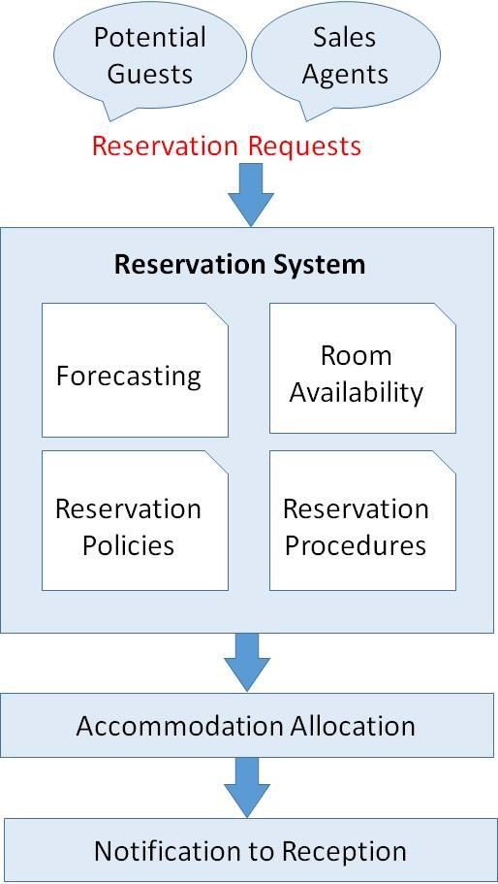
Hotel front desk clerks
The Reservation System
7
7
7

Slide 8
Hotel front desk clerks
Property Management Systems
A Hotel property management system (Hotel PMS) is a software that helps hotels efficiently organize, schedule and manage their daily operations.
It enables hotels, both small & independent and groups to handle front office workflow including booking, guest check-in & checkout, assigning rooms to guests, delegating housekeeping tasks and billing etc.
It is referred to as a Hotel Software and working as the nerve centre of hotel operations, it ensures the seamless flow of interdepartmental information.
8
8
8

Slide 9
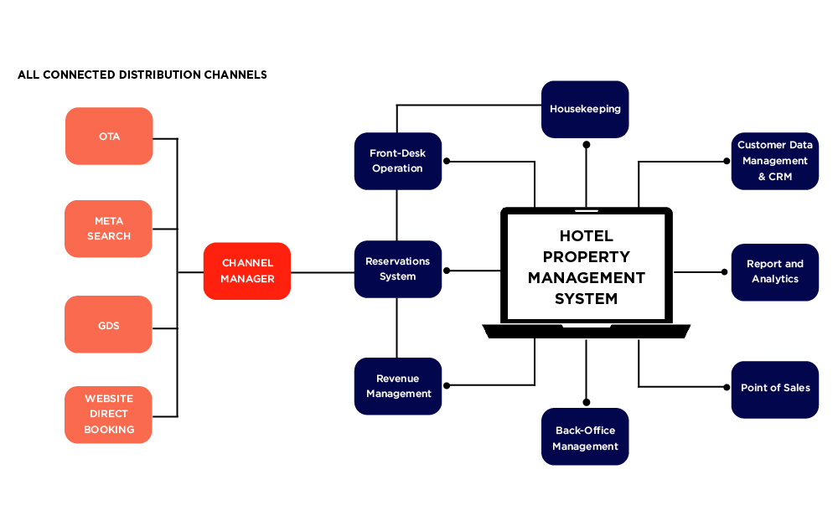
Hotel front desk clerks
Property Management Systems
9
9
9

Slide 10
Hotel front desk clerks
Property Management Systems
Let’s watch a video!
https://youtu.be/3SUI6Z4OMLA
10
10
10

Slide 11
Hotel front desk clerks
Types of Reservations
A hotel receives reservation requests from different sources like direct guests, central reservation system, travel agencies, etc.
When a hotel receives a reservation request directly from a guest without any mediator, it is termed as direct reservation.
An individual or group can contact the hotel directly.
11
11
11

Slide 12
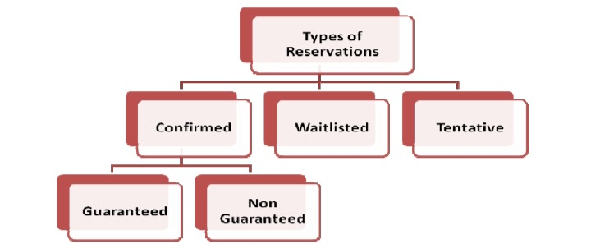
Hotel front desk clerks
Types of Reservations
12
12
12

Slide 13
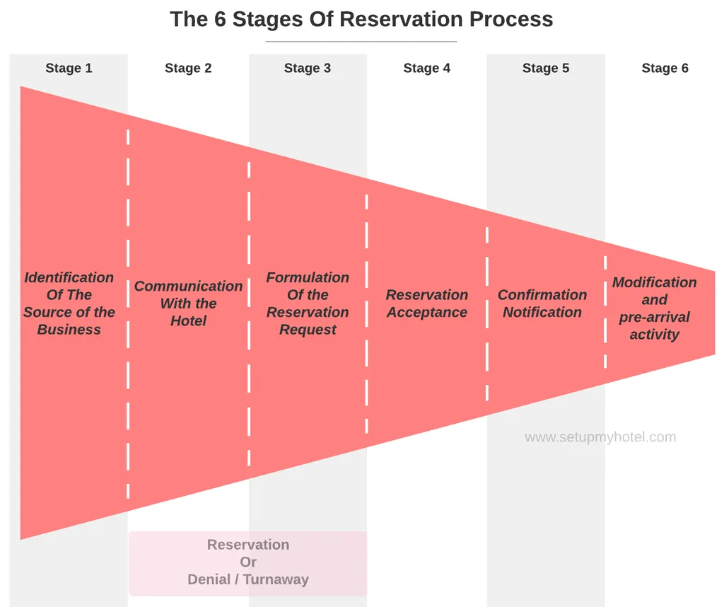
Hotel front desk clerks
The six stages of reservation
13
13
13

Slide 14
Hotel front desk clerks
Confirmation of Reservation
A reservation is a bilateral contract between a hotel and a guest, according to which the hotel must provide the specified room type to the guest and the guest must agree to pay all relevant charges.
This is also known as CONTRACT OF BOOKING.
14
14
14

Slide 15
Hotel front desk clerks
Confirmation of Reservation
Confirmed Reservation.
Confirmed guaranteed Reservation.
Confirmed Non Guaranteed Reservation.
Waitlisted Reservation.
Tentative Reservation
15
15
15

Slide 16
Hotel front desk clerks
Cancellation of Reservation
Definition of ‘Cancel a Reservation'
If a clerk cancel a reservation, it means that the reservation was removed because someone who has booked a room has informed the clerk that they no longer wish to stay at this hotel.
The cancellation of the customer's reservation could be because the travel plans of the customer had changed.
16
16
16

Slide 17
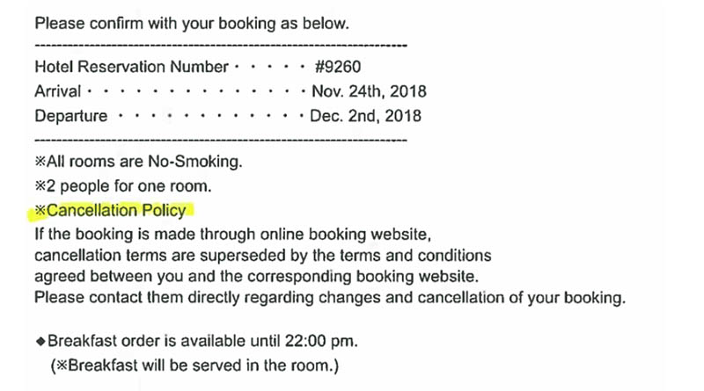
Hotel front desk clerks
Cancellation of Reservation
17
17
17

Slide 18
Hotel front desk clerks
Different types of Cancellation of Reservation Policies
1. Policy “cancel by certain date”
2. Policy “one night penalty”
The advantages of a policy
Provides Accountability
Guarantees Commitment
Shows Professionalism
18
18
18

Slide 19
Hotel front desk clerks
Reservation Management Control System
It's a computerized system that contains the hotel's availability, rates, and inventory (ARI) data and helps manage online and offline bookings.
19
19
19

Slide 20
Hotel front desk clerks
Why is a Reservation Management Control System Important?
Today, the number of walk-ins in the hotel industry is not common and the figures drop every year.
In the global digitalization era, more than 75 percent of all hotel bookings are made online.
20
20
20

Slide 21
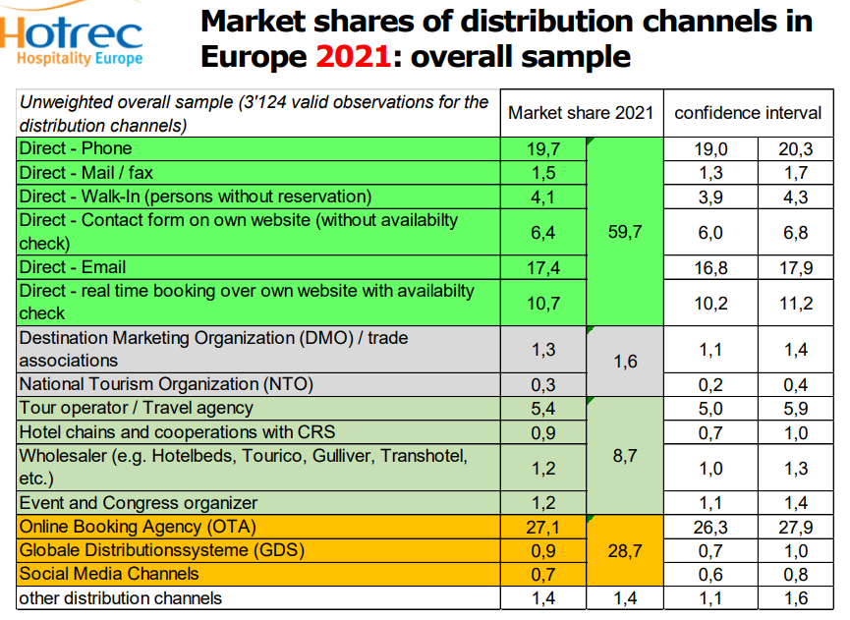
Hotel front desk clerks
Reservation Management Control System Statistics (1)
21
21
21

Slide 22
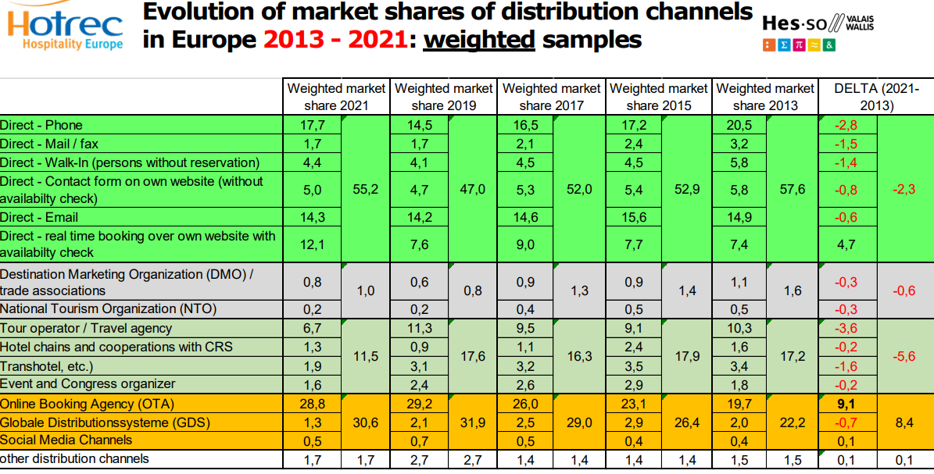
Hotel front desk clerks
Reservation Management Control System Statistics (2)
22
22
22

Slide 23
Hotel front desk clerks
Central Reservation System (CRS)
Let’s watch a video!
https://youtu.be/n-jtS5BBUb0 (Central Reservation System)
23
23
23

Slide 24
Hotel front desk clerks
Daily Tasks of Reservation Staff
The Reservation Executive or Agent handles the requests from guests, companies and travel agents via phone and other platforms.
This person needs to ensure booking information are input accurately into the reservation system, and maintain and update room availability on online booking platforms.
24
24
24

Slide 25
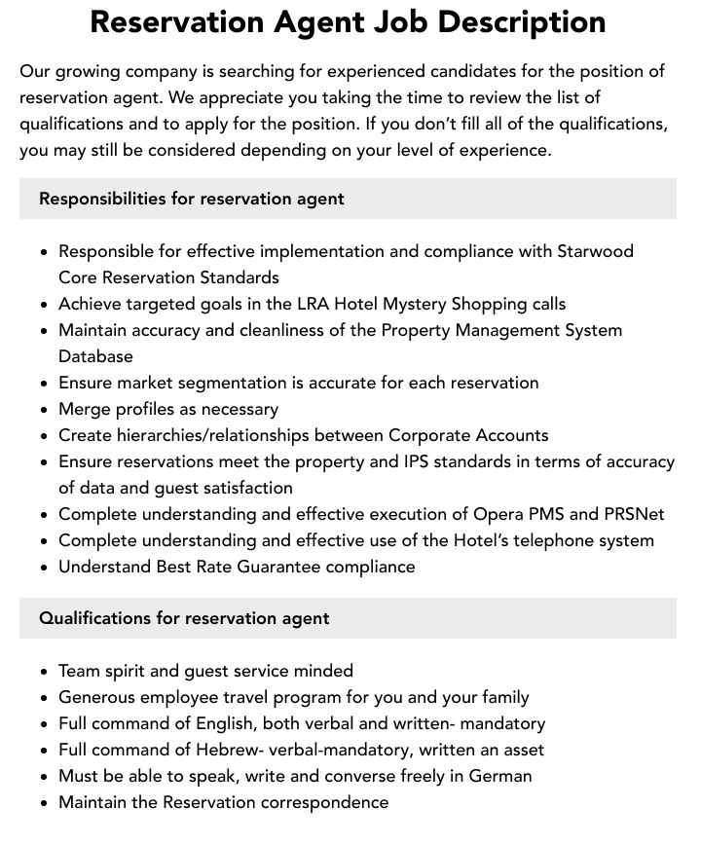
Hotel front desk clerks
Job Description of a Reservation Agent
25
25
25

Slide 26
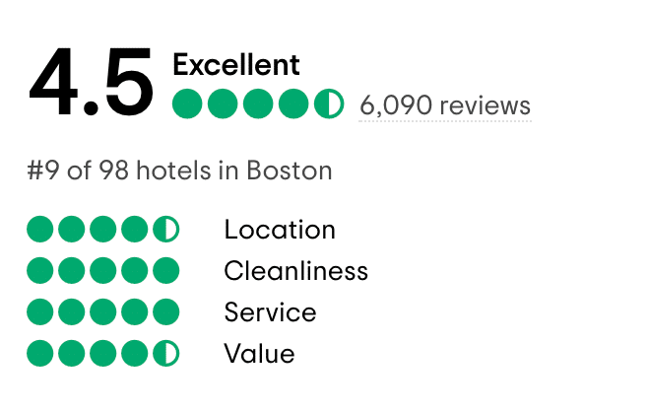
Hotel front desk clerks
Review Websites in the Hotel Industry
26
26
26

Slide 27




Hotel front desk clerks
Review Websites in the Hotel Industry
Google
TripAdvisor
Booking.com
Expedia
Hotels.com
Facebook
Orbitz
Trivago
Travelocity
Kayak
27
27
27

Slide 28

Hotel front desk clerks
Let’s Practice!
https://youtu.be/XHvJeSgwii0 Mock Reservation Call
28
28
28

Slide 29
Good Luck
and
Thanks for Attending this Course!
29
29
29

