Slide 1

NSRIC International School in Toronto (NIST)
Ontario (ON), Canada
Canadian Immigration Express
64314 Hotel front desk clerks
Wonda Grobbelaar
Faculty
NSRIC Inc.
London, ON, Canada
E-mail: wondag@nsric.ca
https://www.nistonline.ca

Slide 2
Module 3.2
(Introduction to the Hotel Industry)

Slide 3

Hotel front desk clerks
A reminder of recommended reading material
3
3
3

Slide 4
Hotel front desk clerks
Can you remember what you have learned in the last session?
4
4
4

Slide 5
Hotel front desk clerks
Design of the Lobby
Less formal/intimidating, more open/inviting.
Creates excitement/personifies hotel.
Multi-story atrium lobbies pioneered by Hyatt Hotels.
The Desk
It’s counter top is 40–42 inches across and some 45 inches high.
The work side of the desk is lower by 6 inches.
5
5
5

Slide 6
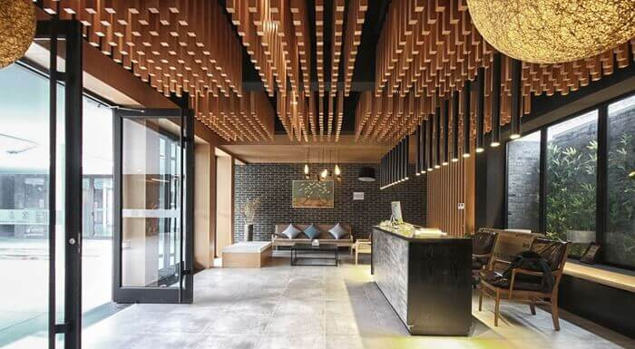
Hotel front desk clerks
Design of the Lobby
6
6
6

Slide 7
Hotel front desk clerks
Design of the Lobby
Becoming smaller now with computerization
Security of hotel and F.O. personnel are an important factor in the lobby design.
Needs unobstructed view of lobby/elevators.
Hotels with heavy group arrivals have separate desk for groups.
F.O. Clerk/Guest Service Agent/Receptionist
Duties center around:
Room Sales
Guest Relations
Record Keeping
7
7
7

Slide 8
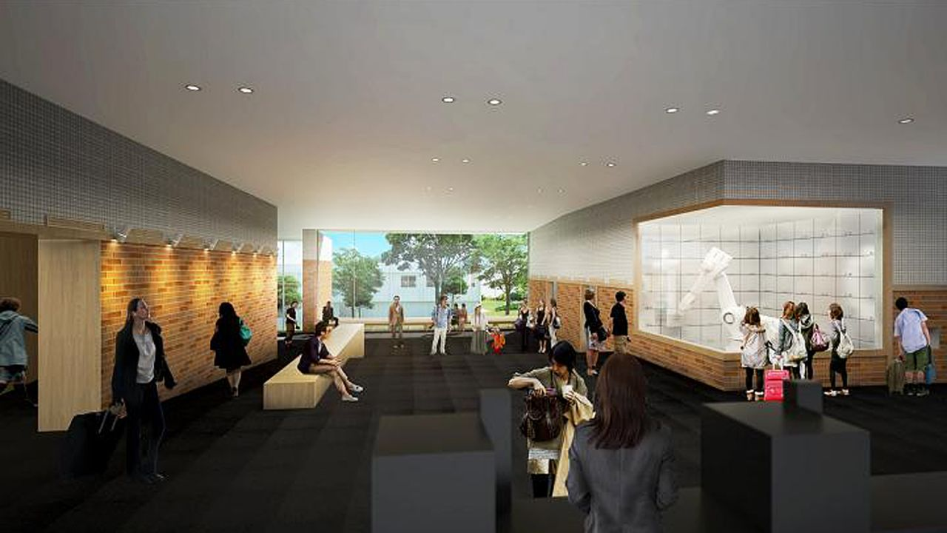
Hotel front desk clerks
A hotel lobby in Japan run by robots
8
8
8

Slide 9
Hotel front desk clerks
The Hotel Lobby
Coordination
Increasing automation is changing roles.
Hardly any mail, message handling.
Reduced key handling, info dissemination
Reduced credit issues due to use of credit cards.
Cashiers
Duties centre around:
Billing
Posting
Cash and credit transactions
9
9
9

Slide 10
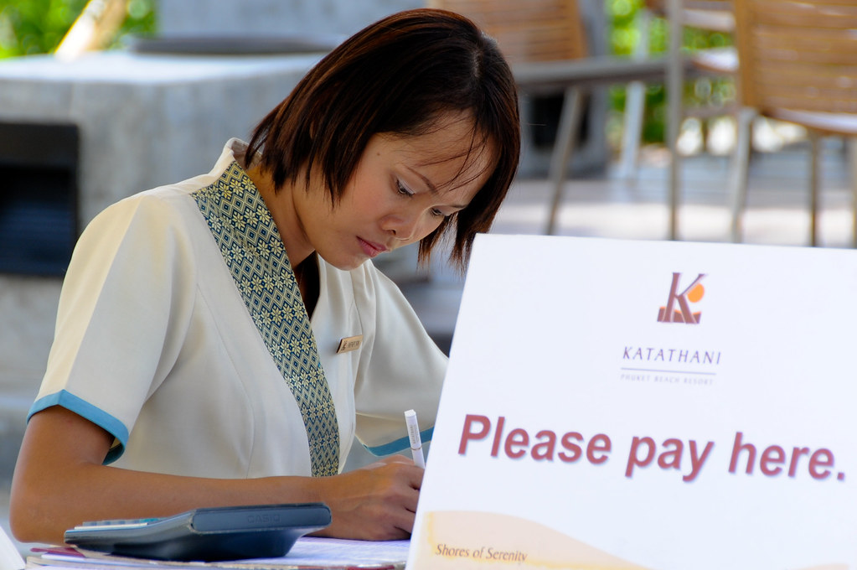
Hotel front desk clerks
Cashiers
May report to accounting or F O manager
Reduced role due to increased credit card use, reduced cash advances, check cashing etc.
10
10
10

Slide 11
Hotel front desk clerks
The Building Structure (1 of 8)
The Old versus the New
The Old: Rooms could be:
Inside, odd shaped, small, of many types, sharing bathrooms
Pricing and allotment got complicated.
The New: Rooms are:
Larger, more luxurious, more amenities, outside view, have themed suites and all-suites, less variation.
Have back-to-back utility shafts for economy in construction and maintenance
Corner Rooms are most desirable with double exposure.
.
Other amenities may be added to command premium price.
11
11
11

Slide 12
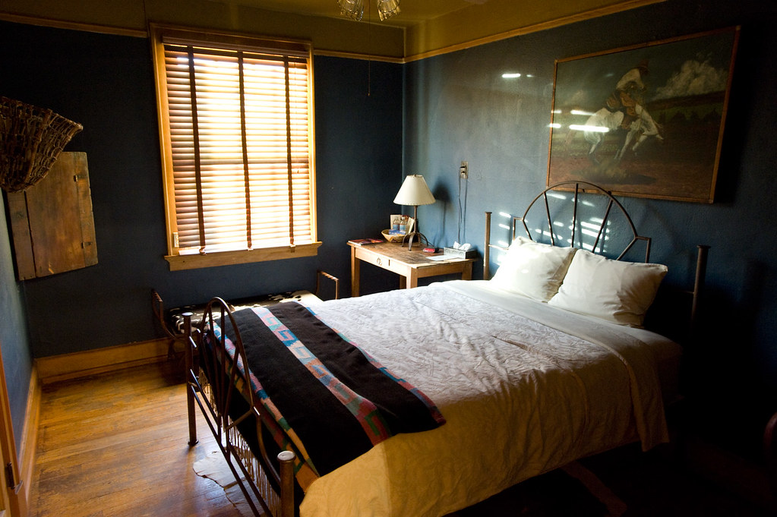
Hotel front desk clerks
Old Hotel Room
12
12
12

Slide 13
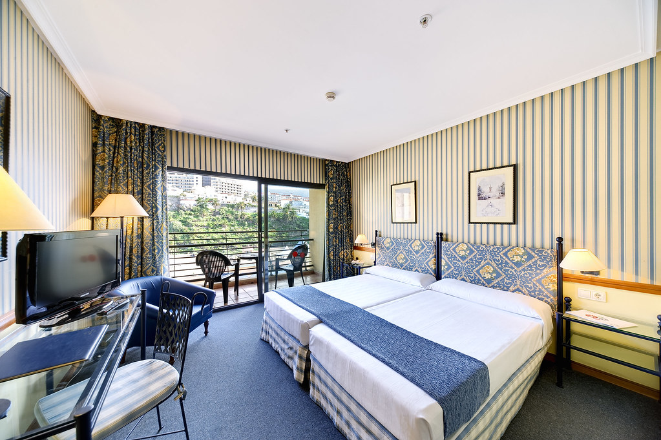
Hotel front desk clerks
New Hotel Room
13
13
13

Slide 14
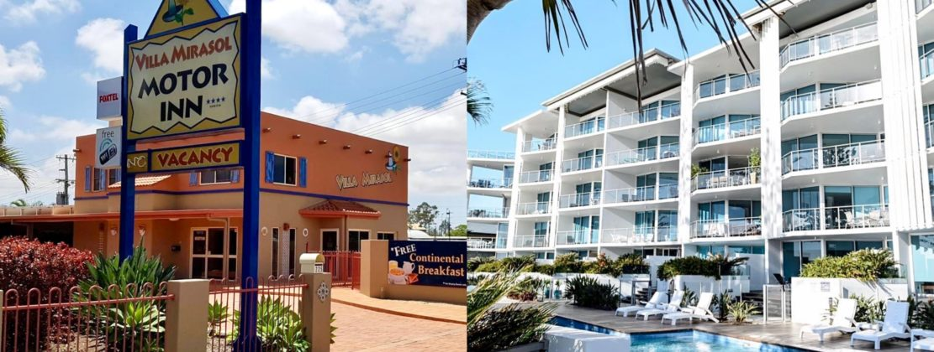
Hotel front desk clerks
The Building Structure (2 of 8)
Motor Inns tend to have low rise sprawling designs.
Emphasis on easy parking next to room.
14
14
14

Slide 15
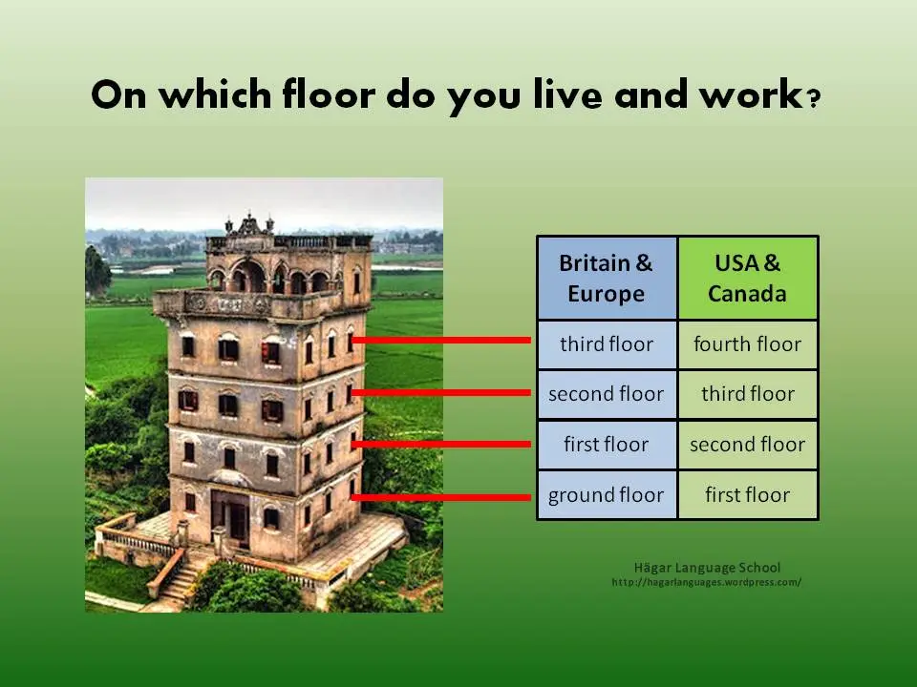
Hotel front desk clerks
The Building Structure (3 of 8)
Numbering for Identification
Floor Numbering
Tend to be numbered upward sequentially
Sometimes countries number first sleeping floor as 1
Others number starting with ground floor as 1
15
15
15

Slide 16
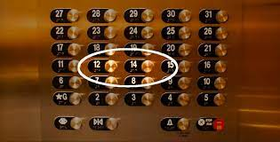
Hotel front desk clerks
The Building Structure (4 of 8)
Numbering for Identification
Did you know? No floor 13 in a hotel
16
16
16

Slide 17
Hotel front desk clerks
The Building Structure (5 of 8)
Room Numbering
With many buildings use building names and then floor numbers
Some sequentially number floors starting with a building
In all cases provide clear signage on elevators and floors
Room Numbering
Depends on the hotel design – often arbitrary
May be numbered odd and even along opposite sides of corridor
Can get very confusing if new wing is added
17
17
17

Slide 18
Hotel front desk clerks
The Building Structure (6 of 8)
Numbering
In all cases provide clear signage.
On walls, near elevators exits/entries.
Respect local custom; i.e. avoid 13, 4 etc.,
Adjoining or Connecting Rooms.
Rooms that about along a corridor.
May be connected with a door.
Ensure secure bolts, when connection is not needed.
Popular with families, small groups.
All connecting rooms adjoin; but all adjoining rooms do not connect!
18
18
18

Slide 19
Hotel front desk clerks
The Building Structure (7 of 8)
Room Shape and Size
Room Shape
Varies, but rectangular shape most practical and common.
Size is first increased by adding to depth, then width.
Balconies and French/sliding doors provide sense of spaciousness.
Room Size.
Larger rooms cost more money to build, furnish, maintain, leading to higher rates.
Square footage of hotel twice that of rooms.
Lot of effort is put into making the room look bigger.
19
19
19

Slide 20
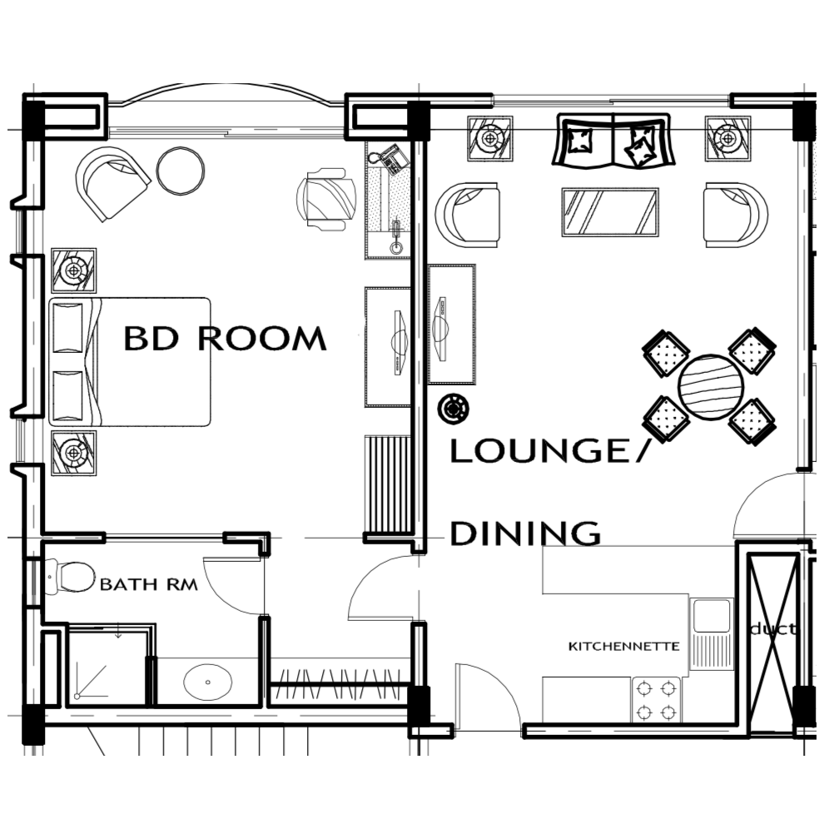
Hotel front desk clerks
Room Shape and Size
Grand Suite
20
20
20

Slide 21
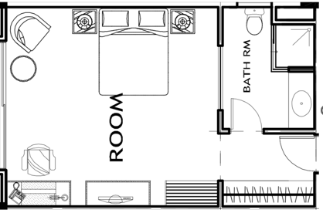
Hotel front desk clerks
Room Shape and Size
Standard Room
21
21
21

Slide 22
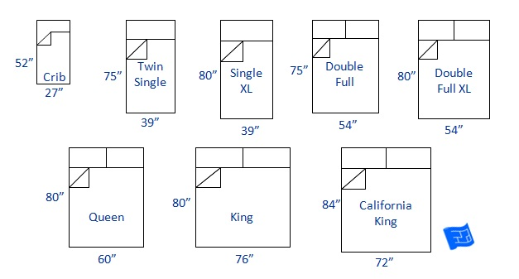
Hotel front desk clerks
Beds and Baths
Bed Sizes
22
22
22

Slide 23
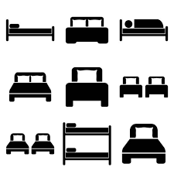
Hotel front desk clerks
Beds and Baths
Bed Symbols
23
23
23

Slide 24
Hotel front desk clerks
Bed Types
Studio Bed (Room) – Sofa by day, bed by night
Not popular, as bed is uncomfortable.
Daybed- add sleigh ends to a twin bed, and you have a daybed!
Sofa Bed – Primarily a sofa, may be in sitting area of a suite.
Rollaway Bed (Cot) – Portable bed for temporary use for 1.
24
24
24

Slide 25
Hotel front desk clerks
Bed Types
Crib- added as needed
Water Bed – not very common in hotels
Futon – cotton quilted bed, easily stores, couch use too
Wall (Murphy) Bed – folds up into wall, not popular.
Future beds- possibly air beds
25
25
25

Slide 26
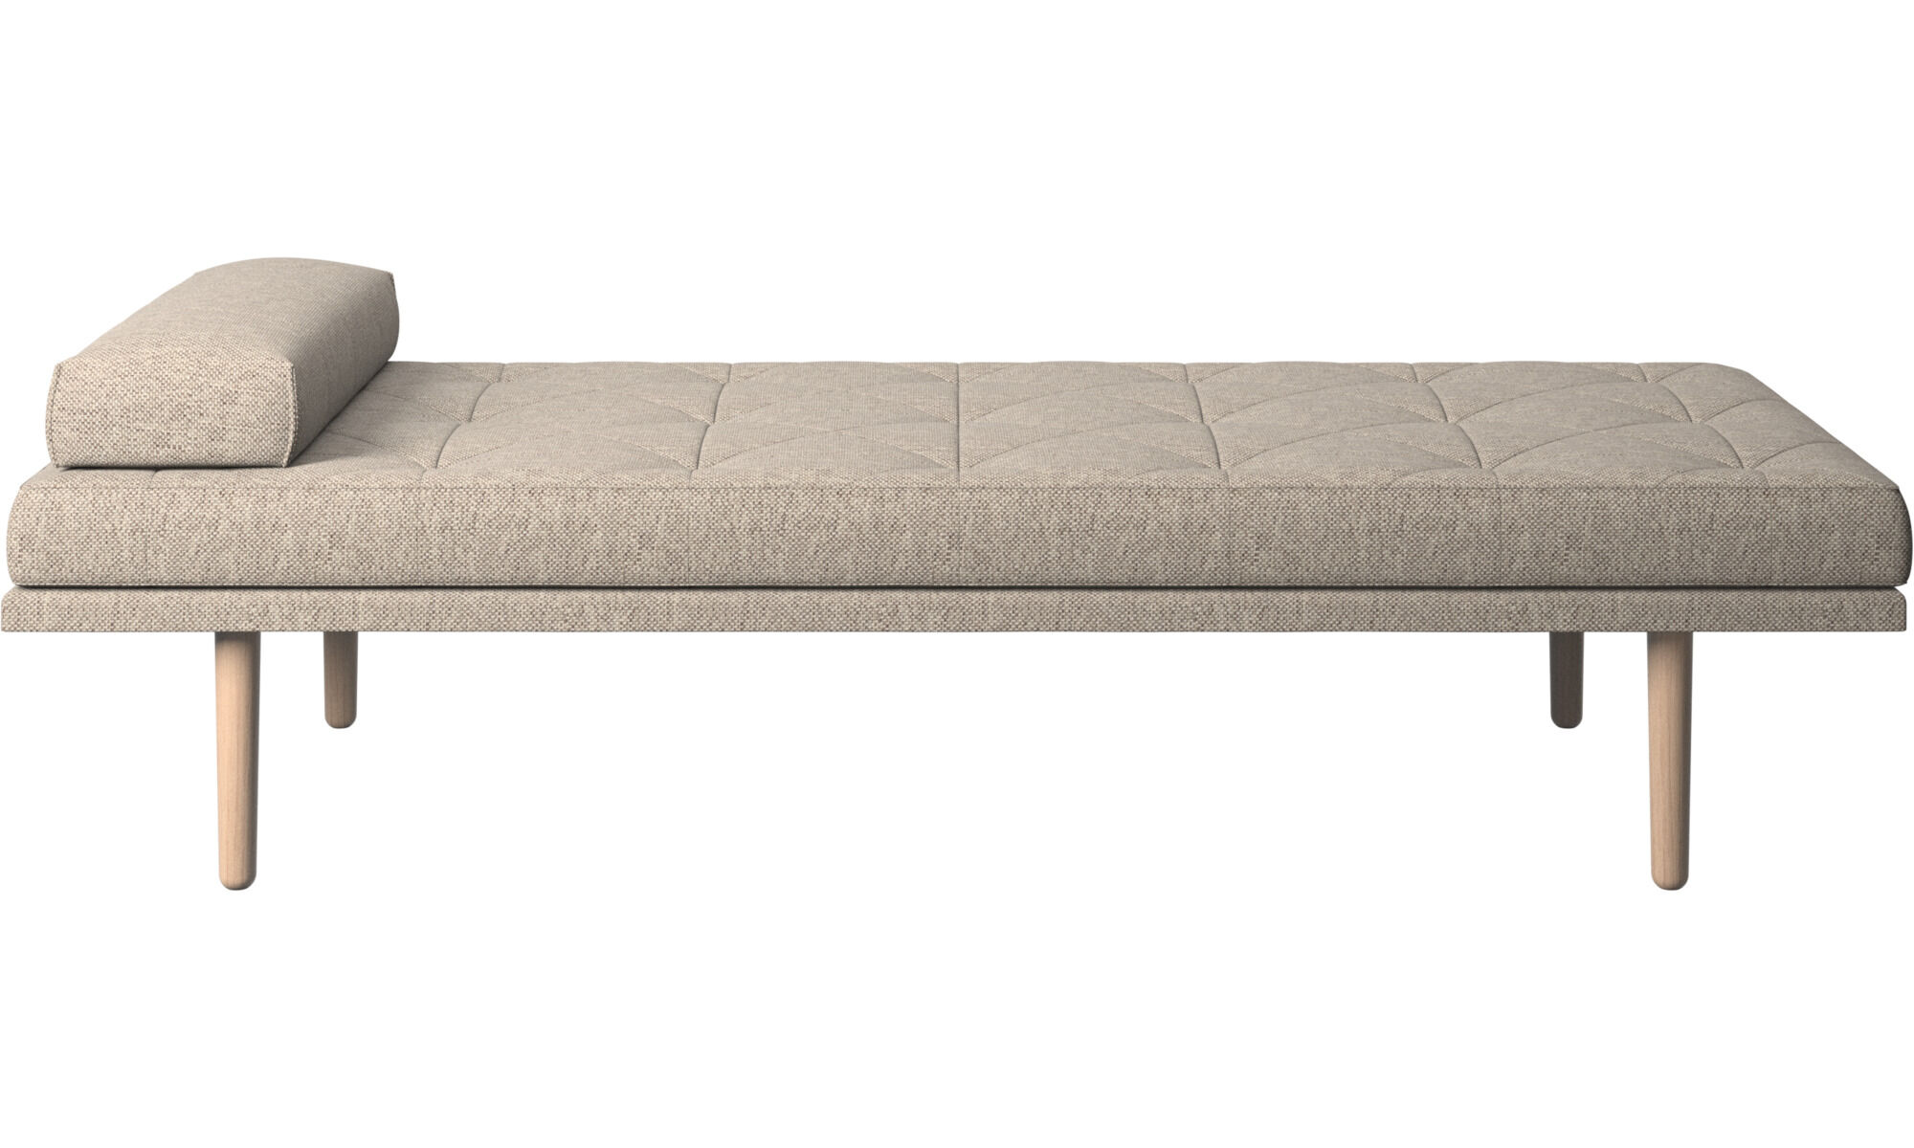
Hotel front desk clerks
The Building Structure (1 of 8)
Day Bed
26
26
26

Slide 27
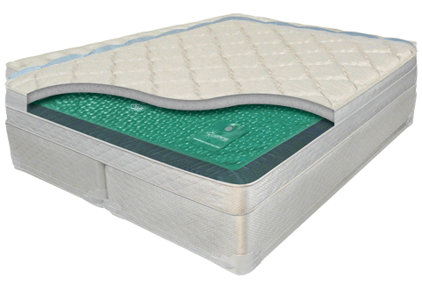
Hotel front desk clerks
The Building Structure (1 of 8)
Water Bed
27
27
27

Slide 28
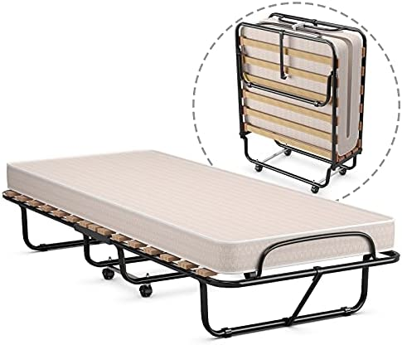
Hotel front desk clerks
The Building Structure (1 of 8)
Rollaway Bed
28
28
28

Slide 29
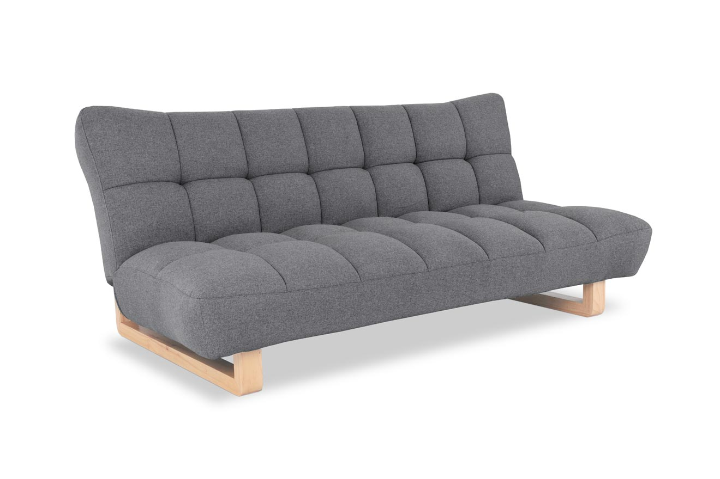
Hotel front desk clerks
The Building Structure (1 of 8)
Futon Beds
29
29
29

Slide 30
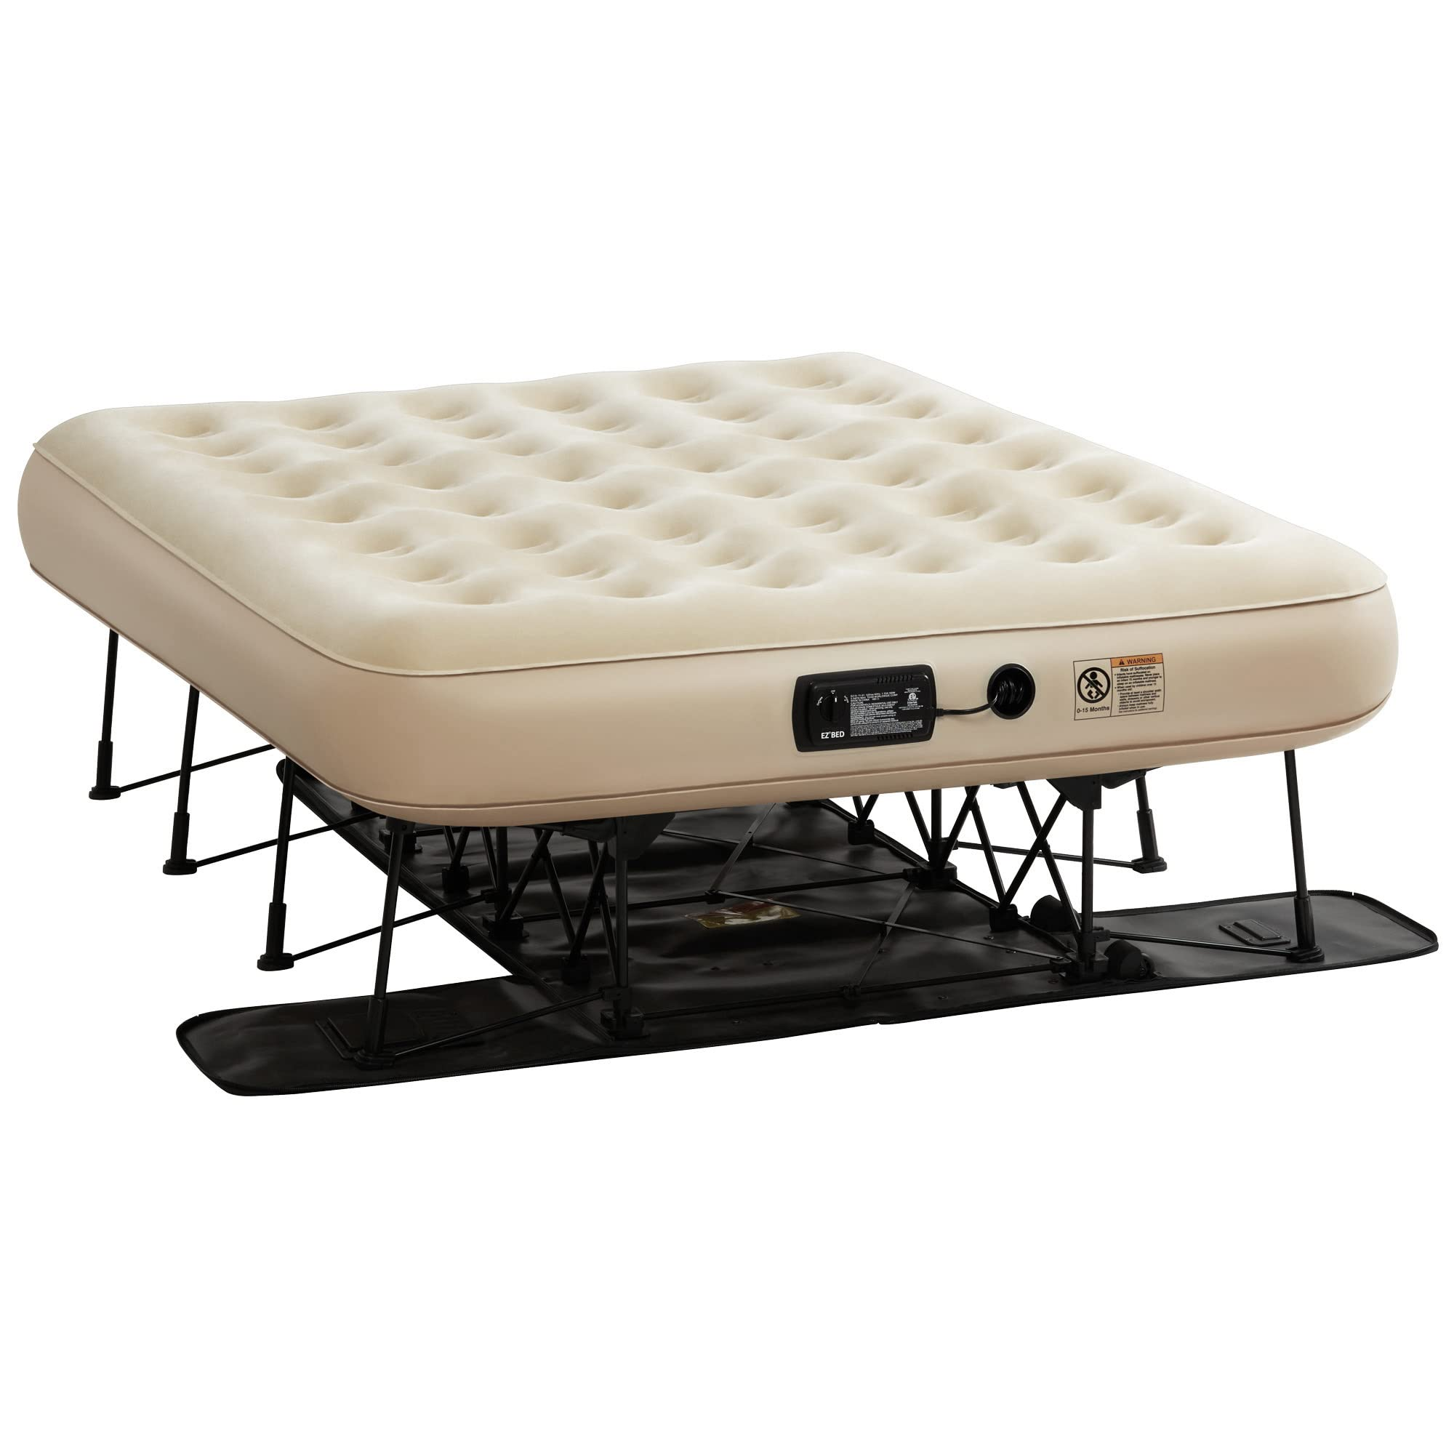
Hotel front desk clerks
The Building Structure (1 of 8)
Air Beds
30
30
30

Slide 31
Good Luck
and
Thanks for Attending this Course!
31
31
31

