Slide 1

NSRIC International School in Toronto (NIST)
Ontario (ON), Canada
Canadian Immigration Express
64314 Hotel front desk clerks
Wonda Grobbelaar
Faculty
NSRIC Inc.
London, ON, Canada
E-mail: wondag@nsric.ca
https://www.nistonline.ca

Slide 2
Module 2.1
(Introduction to the Hotel Industry)

Slide 3

Hotel front desk clerks
Recommended reading material
3
3
3

Slide 4
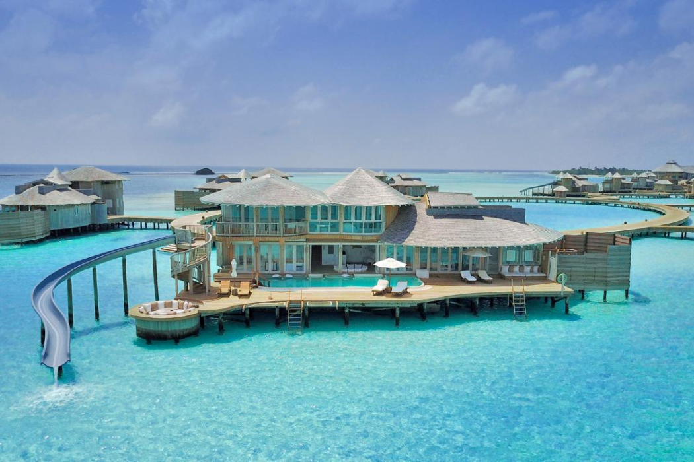
Hotel front desk clerks
Definition of a Hotel
A hotel is defined as an establishment providing accommodation, meals, and other services for travellers and tourists.
4
4
4

Slide 5
Hotel front desk clerks
In your opinion, what is a hotel? How would you described a hotel?
5
5
5

Slide 6
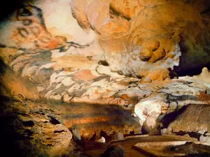
Hotel front desk clerks
History of the hotel (1 of 3)
The ancient history of the hospitality industry began in 15,000 BCE with the Lascaux caves in France which were developed to accommodate members of other tribes.
In classical antiquity we learn about Greek and Roman spas popular for those seeking rest and relaxation.
Notes:
The Lascaux caves that are part of the Unesco World Cultural Heritage are considered to be the first shelter where both an artistic cultural background as well as the accommodation of people of a different tribe can be proven. The exact dating of the caves is disputed, but they are said to be as old as 38,000 to 15,000 BCE.
It gets a little more concrete in classical Pompeii; hard evidence of a Lupanar, a bordello dating back to the year 69 BCE was found. This bordello is considered to be the first proven hospitality establishment that also charged for lodging.

Slide 7
Hotel front desk clerks
History of the hotel (2 of 3)
In the early 700s the first two hotels in history were registered in Japan which were called Ryokans.
These Ryokans were resting spots along the Silk Road.
By the 1600s more than 600 inns were registered in England and in the early
1800s the first modern hotel was built in England.

Slide 8
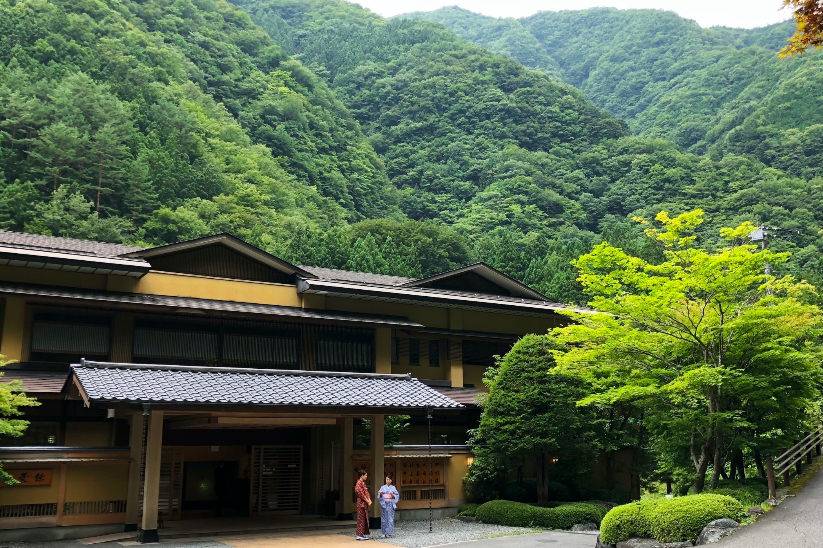
Hotel front desk clerks
Hotel Nishiyama Onsen Keiunkan
Hotel Nishiyama Onsen Keiunkan in Japan's Yamanashi is is the world’s oldest hotel which has passed on to 52 generations.

Slide 9
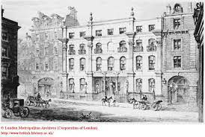
Hotel front desk clerks
History of the hotel (2 of 3)
A millennium later the first establishment that was called a hotel was opened.
The Grand Hotel opened its doors in London on 25th January 1774.

Slide 10
Hotel front desk clerks
Understanding the Hotel Business
The Service Culture
A Cyclical Industry
Housekeeping
How Hotels Count and Measure

Slide 11

Hotel front desk clerks
Understanding the Hotel Business: Service Culture

Slide 12
Hotel front desk clerks
Understanding the Hotel Business: Service Culture
What do you understand from the following statement?
A problem is only a challenge that needs an solution!

Slide 13
Hotel front desk clerks
Understanding the Hotel Business: Service Culture
“Service” could be defined as “taking action to create value for someone else” and “Service Culture” as “a shared purpose where everyone is focused on creating value for others inside and outside the organization.”

Slide 14
Hotel front desk clerks
Understanding the Hotel Business: Service Culture
Elements of a customer service culture
Find solutions for all complaints
Embrace complaints.
Don’t waste time to reply back to complaints.
Always be positive.
Understand who complains, and what the reason is for the complaint.
Communicate with clarity.
Use feedback to improve your service/company

Slide 15
Hotel front desk clerks
A Cyclical Industry: Housekeeping
A cyclical industry refers to an industry whose revenue generation capabilities are tied to the business cycle.
In other words, a cyclical industry is an industry whose performance is correlated to the business cycle.
Lodging is a cyclical industry meaning that it passes over time through four distinct phases: peak, contraction, trough and expansion.

Slide 16
Hotel front desk clerks
Activity
What is housekeeping?

Slide 17
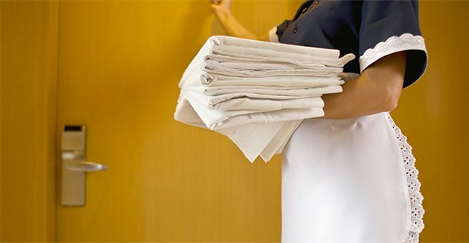
Hotel front desk clerks

Slide 18
Hotel front desk clerks
How Hotels Measure (1)
Occupancy
The relationship between demand (the number of rooms actually sold) and supply (the number of rooms available for sale)
Measures the hotel’s “share of the market”, so it measures quantity
Occupancy Rate in % = Rooms Sold / Rooms Available for sale

Slide 19
Hotel front desk clerks
How Hotels Measure (2)
Sales per Occupied Room (Average Daily Rate or ADR) in money value such as $.
The amount of money received for each room sold.
Measure the quality of the business.

Slide 20
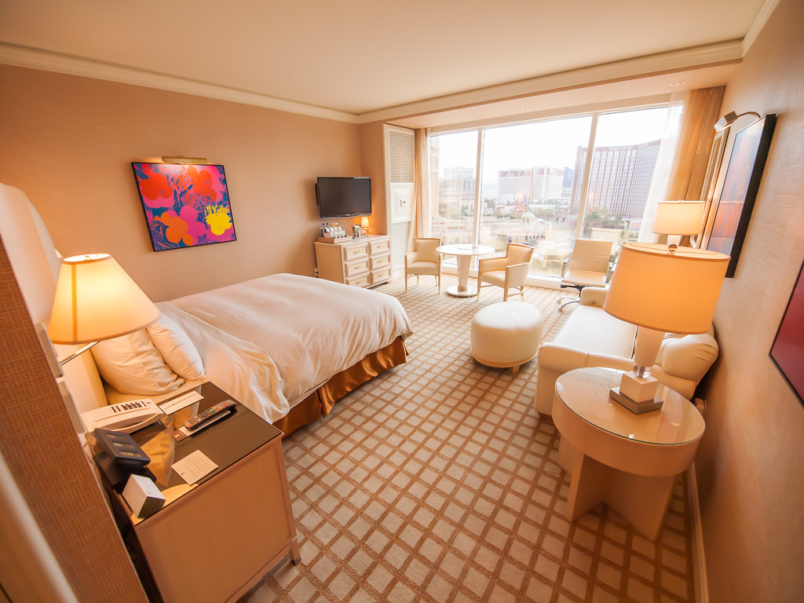
Hotel front desk clerks
Activity
Problem: What if only one room is sold, but at a high rate? Give your opinion.

Slide 21
Hotel front desk clerks
Activity
Answer: ADR can be misleading.
Why:
Average Daily Rate = Room sales (measured in dollars) / Number of rooms sold

Slide 22
Hotel front desk clerks
Double Occupancy
Refers to any room in which there is more than one person.
Double occupancy increases per-room revenue, if rates are per-person.
In full-service hotels, double occupancy leads to more additional sales
% of double occupancy = (No. of guests − No. of rooms occupied.)/No. of rooms occ.

Slide 23
Hotel front desk clerks
Breakeven Point
To break even is to have neither profit nor loss.
Break-even points are important, because there is no profit until that point is reached.
Break-even points are expressed in occupancy percentages.

Slide 24
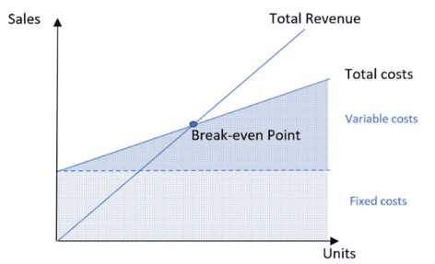
Hotel front desk clerks
Breakeven Point

Slide 25
Hotel front desk clerks
Breakeven Point
How many rooms does a hotel need to sell to cover its total costs?
The break-even point (BEP) refers to the point from which all future sales contribute to generating profit.
BEP in rooms = Fixed costs / (Selling price per room – Variable cost per room)
The BEP can be calculated in sales by simply multiplying the BEP in-room per the average daily rate, or in occupancy percentage.

Slide 26
Good Luck
and
Thanks for Attending this Course!
26
26
26

